Slide 1
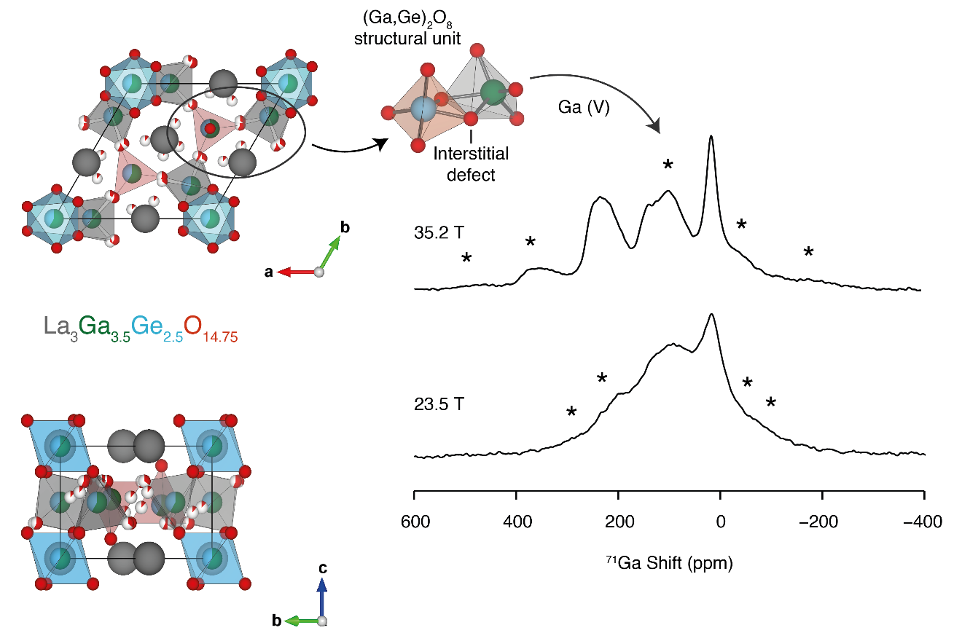
Probing the Chemistry of Fuel Cells with ⁷¹Ga NMR Spectroscopy
Lucia Corti¹, Ivan Hung², Amrit Venkatesh², Zhehong Gan², John B. Claridge¹, Matthew J. Rosseinsky¹, Frédéric Blanc¹
University of Liverpool (UK); 2. National High Magnetic Field Laboratory
Funding Grants: K.M. Amm (NSF DMR-2128556); R.W. Schurko (NIH RM1 GM148766); F.Blanc (Leverhulme Research Centre for Functional Materials Design, EPSRC EP/T015063/1, EP/R029946/1)
Fast oxide ion conductors play a critical role as electrolytes in solid oxide fuel cells that generate electrical energy from green fuels. Anionic transport in materials is facilitated by structural defects, which are challenging to observe due to their local nature, and often take the form of an atom with a vacancy or an interstitial (i.e., an atom with a range of possible coordination numbers). Nuclear magnetic resonance (NMR) is arguably one of the most powerful structural determination techniques for identifying such chemical environments. The key limiting factor of spectral resolution must be overcome – this is exacerbated for 73% of NMR-active nuclear spins in the Periodic Table, which are known as quadrupolar nuclides (nuclear spin > ½), many of which have very broad peaks or powder patterns.
In this work, we demonstrate that it is possible to detect ⁷¹Ga NMR signals from gallium-containing electrolytes, due to the resolution made possible by the 36T Series Connected Hybrid (36T-SCH) NMR platform and an ultra-high field, fast magic-angle spinning (MAS) probe, both of which are uniquely implemented and built in-house at the MagLab. The complex ⁷¹Ga powder pattern shape is very accurately reproduced by computations featuring a symmetry-adapted configurational ensemble, which comprehensively model site disorder and capture the defect chemistry of an important class of electrolyte materials. Additionally, for comparison, ⁷¹Ga NMR spectra acquired on one of the strongest commercial magnetic fields available (23.5T) are of poorer resolution and incompatible with our atomic-scale understanding of the structural defects.
Our results highlight the importance of achieving spectral resolution using ultra-high field solid-state NMR – this aids in unlocking the Periodic Table of NMR and paves the way for new opportunities to interrogate advanced materials of increasing complexity.
Figure Left: Defect chemistry of a gallium containing electrolyte (oxygens in red). Right: Resolved (35.2T) vs. unresolved (23.5T) ⁷¹Ga solid-state NMR spectra and a disorder model. Asterisks (*) indicate artefacts (spinning sidebands).
Facilities and instrumentation used: Solid-State NMR Facility – 36T/40mm Series Connected Hybrid Magnet (35.2T/1.5GHz for ¹H NMR) Citation: Corti, L.; Hung, I.; Venkatesh, A.; Gan, Z.; Claridge, J.B.; Rosseinsky, M.J.; Blanc, F., Cation Distribution and Anion Transport in the La₃Ga_{5-x}Ge_{1+x}O_{14+0.5x} Langasite Structure, Journal of the American Chemical Society, 146 (20), 14022-14035 (2024) doi.org/10.1021/jacs.4c02324
Notes:
How to compress files size:
On PowerPoint, you can save the attached image (Right click on an image -> Select “Save as picture” -> Then you save the image as PNG). PNG is the image compression without losing the image quality. You replace the original image with the PNG one on PowerPoint. This should reduce the PowerPoint file size.
One thing to be careful about is that you should enlarge your image a bit on PowerPoint before saving so is to avoid losing much resolution.

Slide 2
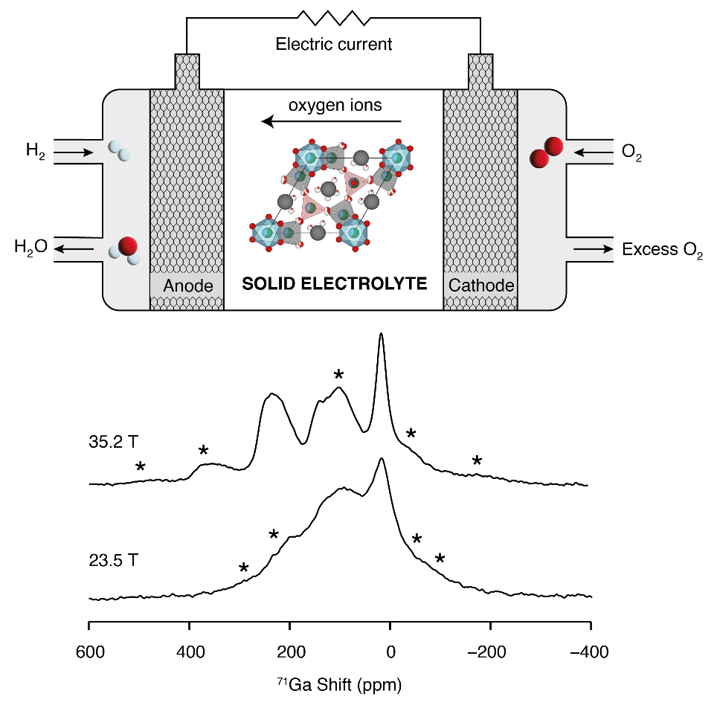
Fuel Cell Chemistry with ⁷¹Ga NMR Spectroscopy
Lucia Corti¹, Ivan Hung², Amrit Venkatesh², Zhehong Gan², John B. Claridge¹, Matthew J. Rosseinsky¹, Frédéric Blanc¹
University of Liverpool (UK); 2. National High Magnetic Field Laboratory
Funding Grants: K.M. Amm (NSF DMR-2128556); R.W. Schurko (NIH RM1 GM148766); F.Blanc (Leverhulme Research Centre for Functional Materials Design, EPSRC EP/T015063/1, EP/R029946/1)
Solid oxide fuel cells are advanced devices that generate clean energy by using hydrogen as fuel and oxygen from the air. They produce electricity without harmful emissions, addressing environmental concerns. These fuel cells don't need recharging and can continuously power things like vehicles and buildings.
All fuel cells work in a similar way: they have a negative electrode (anode) and a positive electrode (cathode) with an electrolyte in between. In solid oxide fuel cells, the electrolyte moves oxygen ions between the electrodes to convert chemical energy into electricity. This process needs special materials with defects in their atomic structures that can hold different numbers of oxygen ions. Gallium (Ga) is one such element that can do this.
What is the finding? We developed a method using ⁷¹Ga solid-state NMR spectroscopy with the world's highest-field magnet (at the MagLab) to study the number of oxygen ions around each gallium atom in electrolyte materials.
Why is this important? The function of these materials is controlled by their defect chemistry. Our results clearly show gallium atoms bound to 4, 5, or 6 oxygen ions. This information will help design better electrolyte materials for solid oxide fuel cells.
Why did this research need the MagLab? To see the different gallium sites in the 71Ga solid-state NMR spectrum, we need to use the world's highest magnetic field: the 36 Tesla Series Connected Hybrid magnet. This ultra-high field NMR platform provides a level of detail and spectral resolution that lower fields can’t, allowing us to determine the molecular structures of a wide range of advanced materials.
Ga(IV)
Ga(V)
Ga(VI)
Figure Top: The electrolyte material incorporated in a solid oxide fuel cell. (Image Credit: Lucia Corti, University of Liverpool) Bottom: ⁷¹Ga solid-state NMR spectra and computational models showing gallium with different numbers (4, 5, and 6) of proximate oxygen ions. Asterisks (*) indicate artefacts.
Facilities and instrumentation used: Solid-State NMR Facility – 36T/40mm Series Connected Hybrid Magnet
(35.2T/1.5GHz for ¹H NMR) Citation: Corti, L.; Hung, I.; Venkatesh, A.; Gan, Z.; Claridge, J.B.; Rosseinsky, M.J.; Blanc, F., Cation Distribution and Anion Transport in the La₃Ga_{5-x}Ge_{1+x}O_{14+0.5x} Langasite Structure, Journal of the American Chemical Society, 146 (20), 14022-14035 (2024) doi.org/10.1021/jacs.4c02324
Notes:
How to compress files size:
On PowerPoint, you can save the attached image (Right click on an image -> Select “Save as picture” -> Then you save the image as PNG). PNG is the image compression without losing the image quality. You replace the original image with the PNG one on PowerPoint. This should reduce the PowerPoint file size.
One thing to be careful about is that you should enlarge your image a bit on PowerPoint before saving so is to avoid losing much resolution.

