Slide 1
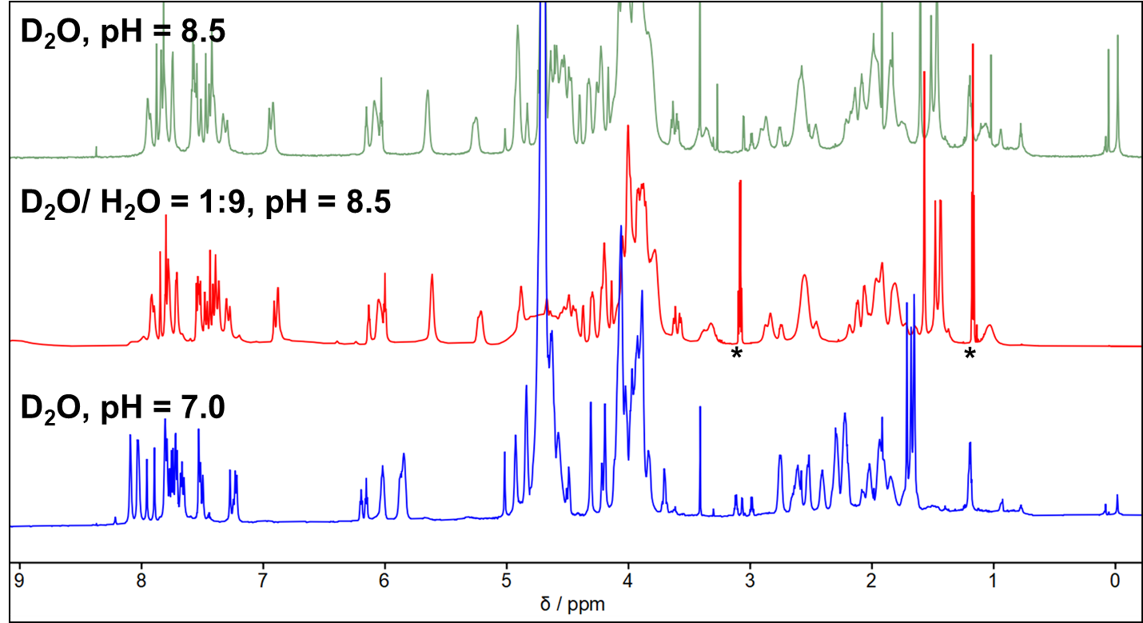
A folding motif formed with an expanded genetic alphabet
Bang Wang^{1,2}, James R. Rocca², Zunyi Yang¹, Weihong Tan^{2,3}, Steven A. Benner¹, et al.
1. Foundation for Applied Molecular Evolution; 2. University of Florida; 3. Hunan University
Funding Grants: K. M. Amm (NSF DMR-2128556); S. A. Benner (NIH GM128186 and GM141391); W. Tan (National Natural Science Foundation of China T2188102)
This study explores how adding synthetic nucleotides to DNA not only increases its information density but also diversifies its three-dimensional structures. Specifically, the research introduces an additional nucleotide (dZ) to a DNA strand, forming a stable unimolecular structure called the folded Z-motif (fZ-motif). fZ potentially expands DNA technology applications in catalysis and information storage due to its compact and unique form.
Researchers used several analytical methods, including NMR spectroscopy, to characterize the fZ-motif. DNA strands containing the dZ nucleotide exhibit a stable and unique structure over a pH range of 8-9 with six reverse, skinny dZ:dZ⁻ base pairs. Their experiments highlight how the NMR capabilities of the MagLab can determine the unique structural properties of the fZ-motif and characterize the temperature and pH conditions over which it is stable.
The discovery of the fZ-motif advances the field of synthetic biology by demonstrating a new type of DNA folding enabled by an expanded genetic alphabet. This finding opens the door to potential applications in nanotechnology and molecular biology, including the development of new DNA-based sensors and nanomachines that respond to environmental changes.
Figure 1: Characterization of the fZ-motif formed by DNA containing dZ using ¹H NMR spectroscopy. A 2 mM solution of the ZZZ oligonucleotide was examined by NMR at 18.8T using aqueous buffers with varying pH and ¹H / ²H isotope ratios to characterize hydrogen exchange, a reporter on the stability of different hydrogen bonding patterns in DNA.
Facilities and instrumentation used: AMRIS Facility NMR Spectrometers at 600 MHz and 800 MHz (14.1 and 18.8T).
Citation: Wang, B.; Rocca, J.R.; Hoshika, S.; Chen, C.; Yang, Z.; Esmaeeli, R.; Wang, J.; Pan, X.; Lu, J.; Wang, K.; Cao, Y.; Tan, W.; Benner, S.A., A folding motif formed with an expanded genetic alphabet, Nature Chemistry, 1-10 (2024) doi.org/10.1038/s41557-024-01552-7

Slide 2
A New DNA Structure Discovered
Bang Wang^{1,2}, James R. Rocca², Zunyi Yang¹, Weihong Tan^{2,3}, Steven A. Benner¹, et al.
1. Foundation for Applied Molecular Evolution; 2. University of Florida; 3. Hunan University
Funding Grants: K. M. Amm (NSF DMR-2128556); S. A. Benner (NIH GM128186 and GM141391); W. Tan (National Natural Science Foundation of China T2188102)
What is the finding? Scientists can create synthetic versions of natural polymers like DNA to better understand nature and develop new biotechnological applications. Besides the usual DNA structures (A
/U and C pairs), DNA can form other structures. Researchers discovered a new DNA structure, the folded Z-motif (fZ-motif), by adding a synthetic nucleotide (dZ) to the DNA sequence. This new, stable, and compact structure could be important for catalysis and information storage.
Why is this important? This discovery broadens our knowledge of DNA's potential by using a synthetic nucleotide. The fZ-motif could lead to new technologies like DNA-based sensors and nanomachines, helping us detect environmental changes and explore the origin of life, both on Earth and elsewhere in the cosmos.
Why did this research need the MagLab? To confirm the structure of the fZ-motif, many analysis methods were used, including nuclear magnetic resonance (NMR) spectroscopy, which needs a high magnetic field. The MagLab's facilities were crucial for these high-field NMR analyses to study the unique hydrogen bonds and the temperatures and pH ranges where the fZ-motif is stable.
Figure 2: The proposed structure of the DNA fZ-motif (left) with a negatively charged reverse dZ:dZ⁻ base pair (right) that forms over the pH range of 8.0 to 9.0
Facilities and instrumentation used: AMRIS Facility NMR Spectrometers at 600 MHz and 800 MHz (14.1 and 18.8T).
Citation: Wang, B.; Rocca, J.R.; Hoshika, S.; Chen, C.; Yang, Z.; Esmaeeli, R.; Wang, J.; Pan, X.; Lu, J.; Wang, K.; Cao, Y.; Tan, W.; Benner, S.A., A folding motif formed with an expanded genetic alphabet, Nature Chemistry, 1-10 (2024) doi.org/10.1038/s41557-024-01552-7

