Slide 1
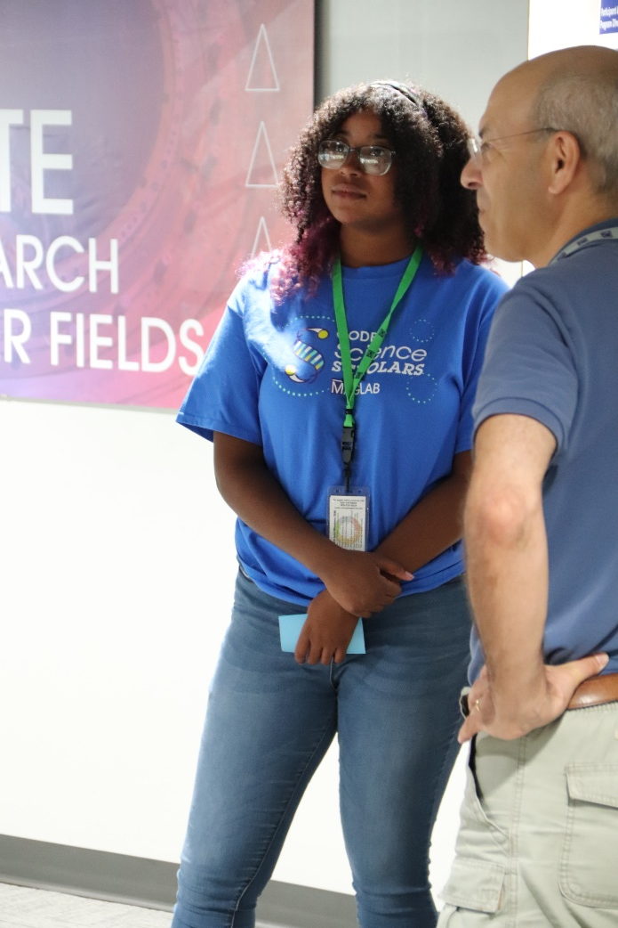
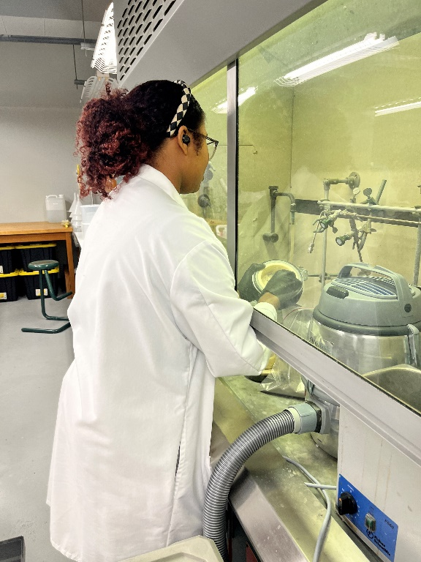
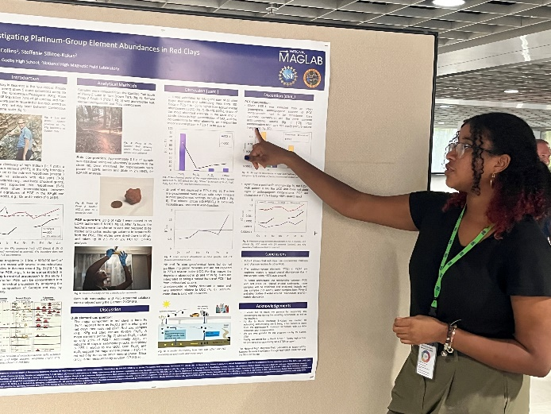
MagLab’s K-12 Education: Godby Science Scholars & the STEM Pathway
C.R. Villa¹, E.D. Gwin², C.R. Flamond², R.M. Hughes¹
Center for Integrating Research and Learning (CIRL) at the National High Magnetic Field Laboratory,
Godby Senior High School
Funding Grants: K.M.Amm (NSF DMR-2128556)
What is the finding? One of the MagLab’s core missions is to build a more diverse STEM workforce. Raoina Collins, an alumna of the Godby Science Scholars (GSS) program, is currently working in a research lab at the MagLab with Dr. Munir Humayun. The GSS is a 3-week summer program that serves Amos Godby High School students, a local Title-1 school¹ with a predominantly (72%) Black student population. The purpose of the GSS program is to introduce participating students to MagLab STEM research. Students participate in tours and conversations with scientists from multiple facilities and labs. The program culminates in a poster presentation wherein the students propose a research project that they can work on with a MagLab mentor during the academic year in the MagLab's High School Externship (HSE) program. The GSS program serves as a feeder program for the MagLab’s HSE program. Raiona participated in the 2022 GSS program, during which she connected with Dr. Humayun and his research team. In the fall of 2022, she began working with them investigating platinum group elements abundances in red clays. After completing one year as an extern, she was hired by Dr. Humayun and has been working in their lab since August 2023. The impact of the GSS program is best articulated by Raoina, “The program gave me opportunities to know what research I was interested in. I got to know a lot about myself and what I wanted to do in the future."
Why is this important? African American and Black people are underrepresented in the STEM workforce (9%) compared to their overall representation in the U.S. population (14.4%)². The GSS program has given students, like Raoina, an opportunity to engage in STEM activities and network with STEM professionals. Over its first three years, the GSS has had 17 participants, (11 Black and 3 Hispanic). Five of the first twelve found placements in the HSE.
Why did this research need the MagLab? The success of the GSS, is due in large part to the expertise of our education staff who develop programs that engage young people with information about exciting research at the MagLab. Additionally, MagLab staff commits their time to help K-12 education programs succeed in supporting the NSF mission to build a diverse STEM workforce.
Left: Raiona explains her research proposal at the Godby Science Scholars poster presentation in 2022 to her future mentor, Dr. Humayun.
Bottom left: Raiona presents her poster at the end of her 2023 High School Externship program.
Bottom right: Raiona working in the MagLab’s geochemistry lab.
Facilities and instrumentation used: The MagLab’s Center for Integrating Research & Learning
Citation: 1- A school in which at least 40% of students are from low-income families.
2- https://ncses.nsf.gov/pubs/nsf23315/report

