Slide 1
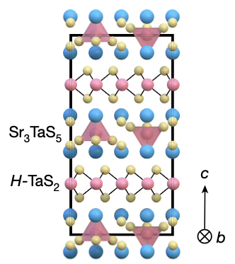
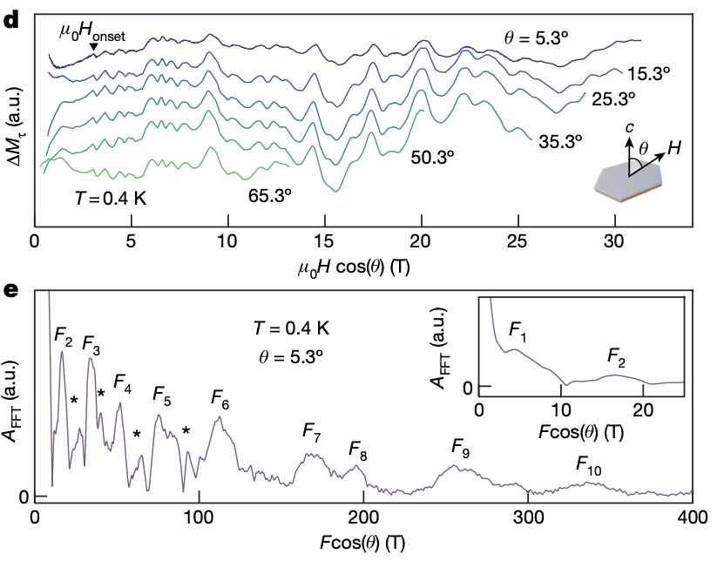
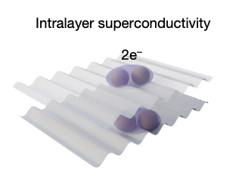
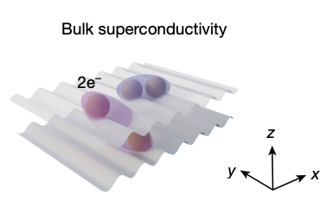
Evidence of Striped Electronic Phases in a Structurally Modulated Superlattice
A. Devarakonda ^{1,6}, A. Chen¹, D. Graf², M. Kriener³, A.J. Akey⁴, D.C. Bell⁴, T. Suzuki⁵, J.G. Checkelsky¹
1. MIT; 2. NHMFL; 3. RIKEN; 4. Harvard University; 5. Toho University; 6. Columbia University
Funding Grants: K. Amm (NSF DMR-2128556); J. Checkelsky (GBMF9070, DOE DE-SC0022028, ONR N00014-21-1-259); A. Devarakonda (Simons Foundation 855186); D.C. Bell (NSF DMR-1644779)
The electronic properties of materials (crystals) can be manipulated via the application of modulated electric & magnetic fields or via modulations engineered into the structure of the material itself. Similar to the beating sound produced by two tuning forks with slightly different frequencies, the spatial modulation produced between two crystal layers with slightly different (incommensurate) structures creates the conditions (stripes) for intriguing new electronic properties.
In layered SrTa₂S₅ such conditions are realized due to the difference in periodic structures of Sr₃TaS₅ and H-TaS₂ (Fig. 1a). These layers are formed as the material crystalizes from the molten base materials as the mixture is cooled in a furnace. The resulting modulation is ~4.4nm in length which is quite long compared to the interatomic spacing in the crystal. Investigating the properties of SrTa₂S₅ revealed intriguing superconducting behavior which suggests that the first superconducting state forms at T*~2.3K and is confined within the layers (Fig. 1b) due to the intralayer pairing of the electrons. Further cooling reveals a bulk superconducting state at T_{c}=1.49K with interlayer electron pairing (Fig. 1c).
To better understand why superconductivity behaves this way in SrTa₂S₅ measurements of the Fermi surface via quantum oscillations (QO) in resistance and magnetization were performed at the MagLab (Fig. 1d). The QO measurements revealed a complex superposition of frequencies from both the Fermi surface and oscillations resulting from the spatial modulation of the incommensurate interface between layers (Fig. 1e). The data paints a remarkable picture of electron mobility and coherent electron states in SrTa₂S₅ considering the low mobility and lack of QO in Sr₃TaS₅ & H-TaS₂ when measured individually.
a
d
e
b
c
Fig.1: a) Crystal structure of SrTa₂S₅, b) Illustration of intralayer electronic pairing, c) Illustration of interlayer electronic pairing, d) M vs. H traces to 31T showing quantum oscillations, e) Fast Fourier transform of the 5.3 deg. trace in d) showing component frequencies as well as the frequencies due to the modulated structure.
Facilities and instrumentation used: DC Field Facility, Cell 9 magnet (31T).
Citation: Devarakonda, A., Chen, A., Graf, D., Kriener, M., Akey, A.J., Bell, D.C., Suzuki, T., Checkelsky, J.G. Evidence of striped electronic phases in a structurally modulated superlattice, Nature (2024), doi.org/10.1038/s41586-024-07589-5

Slide 2
Striped Electronic Phases in a Structurally Modulated Superlattice
A. Devarakonda ^{1,6}, A. Chen¹, D. Graf², M. Kriener³, A.J. Akey⁴, D.C. Bell⁴, T. Suzuki⁵, J.G. Checkelsky¹
1. MIT; 2. NHMFL; 3. RIKEN; 4. Harvard University; 5. Toho University; 6. Columbia University
Funding Grants: K. Amm (NSF DMR-2128556); J. Checkelsky (GBMF9070, DOE DE-SC0022028, ONR N00014-21-1-259); A. Devarakonda (Simons Foundation 855186); D.C. Bell (NSF DMR-1644779)
What is the finding? Scientists measured the Fermi surface of bulk crystalline SrTa₂S₅ to understand unique superconducting behaviors inside and between the material’s layers. Measurements showed that a unique mismatch between its layers affects the material's electronic states. This leads to surprising behaviors in electron mobility, quantum oscillations, and superconductivity.
Why is this important? The properties of everyday materials (like metals, glass, and plastics) depend on how their electrons interact, either as free-moving valence electrons or bound in orbits around atoms. Understanding these interactions is crucial for developing new technologies and improving existing ones.
Why did this research need the MagLab? The Fermi surface is a mathematical model that shows the energy level dividing occupied (bound) electron states from empty (unbound) ones, determining many properties of conducting materials. To measure the Fermi surface's size and shape, one of the best methods is to place the material in a changing magnetic field and measure the resulting quantum oscillations in magnetization, susceptibility, or resistance. Using a 31T magnet and a low-temperature cryostat, researchers gathered data to map the Fermi surface of SrTa2S5 and compare it to calculations. Achieving this requires very high magnetic fields in a low-temperature, low-noise environment like those available at the MagLab.
a
d
e
b
c
Fig.1: a) Crystal structure of SrTa₂S₅, b) Illustration of intralayer electronic pairing, c) Illustration of interlayer electronic pairing, d) M vs. H traces to 31T showing quantum oscillations, e) Fast Fourier transform of the 5.3 deg. trace in d) showing component frequencies as well as the frequencies due to the modulated structure.
Facilities and instrumentation used: DC Field Facility, Cell 9 magnet (31T).
Citation: Devarakonda, A., Chen, A., Graf, D., Kriener, M., Akey, A.J., Bell, D.C., Suzuki, T., Checkelsky, J.G. Evidence of striped electronic phases in a structurally modulated superlattice, Nature (2024), doi.org/10.1038/s41586-024-07589-5

