Slide 1
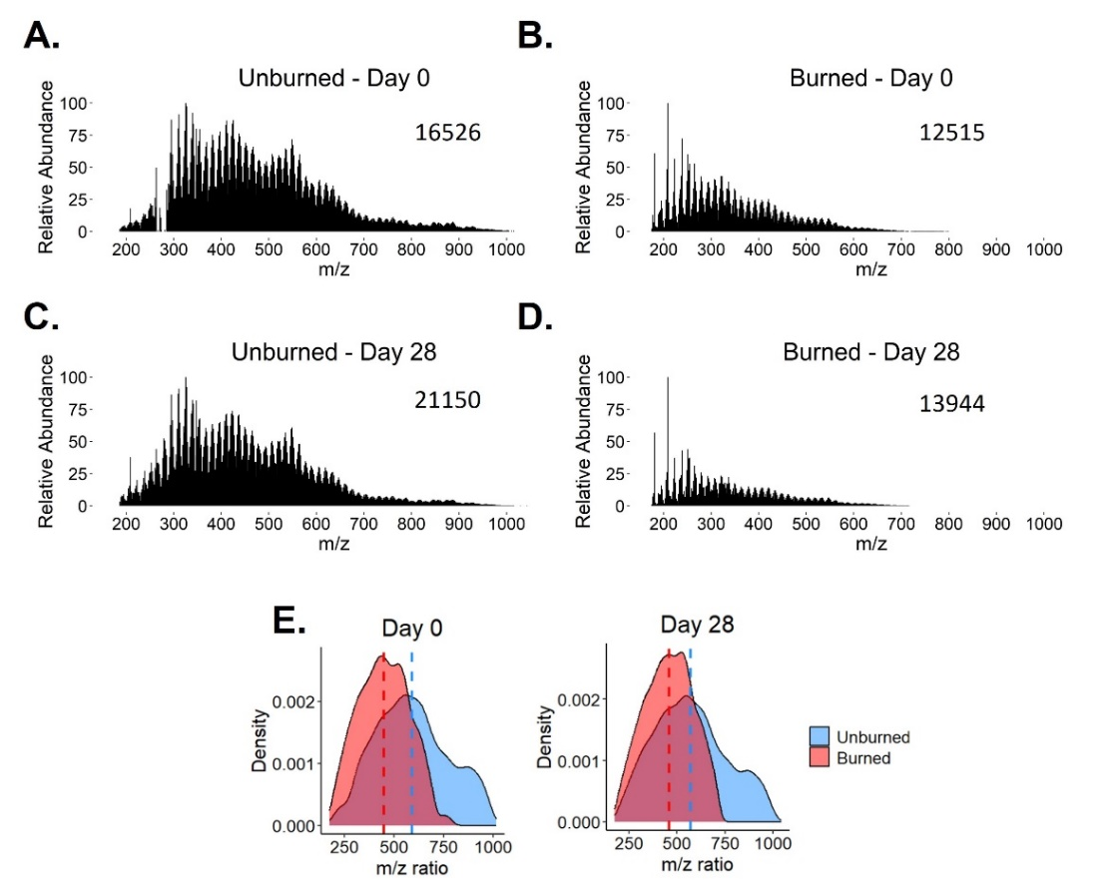
Wildfire Impacts on the Biodegradability of Soil Organic Matter
Jacob P. VanderRoest¹, Julie A. Fowlers¹, Charles C. Rhoades², Holly K. Roth¹, Corey D. Broeckling¹, Timothy S. Fegel², Amy M. McKenna^{1,3}, Emily K. Bechtold¹, Claudia M. Boot¹, Michael J. Wilkins¹, Thomas Borch^{1,2},
Colorado State U.; 2. Rocky Mountain Research Station; 3. National High Magnetic Field Laboratory
Funding Grants: K. M. Amm (NSF DMR-2128556); T. Borch, MJ. Wilkins (NSF DEB-2114868); USDA (AFRI 2021-67019-34608).
Global wildfire activity is increasing, causing ecosystems to be burned more frequently and at hotter temperatures. Wildfires can alter the presence and abundance of soil organic molecules such as amino acids, organic acids, and sugars. These molecules are important nutrient sources for microbes and vegetation; thus, changes in molecular abundance can influence the post-fire recovery of forested ecosystems. However, the specific organic molecules present in burned soil are often unknown owing to a lack of soil metabolomic analyses. Additionally, burned areas are often inaccessible, making it difficult to collect soil samples from burned ecosystems. Wildfires change the composition and biodegradability of soil organic matter (SOM) which contains nutrients that fuel microbial metabolism. Though persistent forms of SOM often increase postfire, the response of more biodegradable SOM remains unclear. Here, we simulated severe wildfires through a controlled “pyrocosm” approach to identify biodegradable sources of SOM and characterize the soil metabolome immediately postfire. Pyrocosms (steel containers filled with soil on which vegetation is ignited and burned to mimic wildfires) can be used to determine and compare the molecular content of burned soil across different locations. By burning soil and vegetation collected from different environments, pyrocosms can simulate various wildfire conditions across a diverse range of ecosystems.
Figure 1 shows negative-ion electrospray ionization 21 T Fourier transform ion cyclotron resonance mass spectrometry for burned and unburned pyrocosms after 28 days. Elemental compositions derived from mass spectral peaks showed that SOM in burned soil was lower in molecular weight and contained ~20-43% more nitrogen-containing compared to unburned soil. Nitrogen is often the limiting nutrient in soil systems; therefore, SOM enriched in nitrogen could serve as a nitrogen source for microbes in postfire environments, especially since nitrogen-containing species in burned soil likely contain amino sugars and peptides. We also measured higher water extractable organic carbon concentrations and higher CO₂ efflux in burned soils. The observed enrichment of biodegradable SOM and microbial heterotrophs demonstrates the resilience of these soils to severe burning, providing important implications for postfire soil microbial and plant recolonization and ecosystem recovery.
Figure 1. (A–D) FT ICR-MS mass spectra of unburned and burned soil from negative-mode electrospray ionization. The number in the upper-right corner of each spectrum is the total number of observed peaks that were assigned molecular formulas (including heavy isotopes).
(E) Density vs. m/z ratio plots for observed mass spectral peaks. The y-axis represents the relative probability of an ion featuring a given m/z ratio, i.e., higher density values for a given m/z ratio indicates that more ions were observed with that m/z ratio. Dashed lines are mean values.
Facilities and Instrumentation: Ion Cyclotron Resonance facility, 21T FT-ICR MS magnet
Citation: VanderRoest, J.P.; Fowler, J.A.; Rhoades, C.C.; Roth, H.K.; Broeckling, C.D.; Fegel, T.S.; McKenna, A.M.; Bechtold, E.K.; Boot, C.M.; Wilkins, M.J.; Borch, T., Fire Impacts on the Soil Metabolome and Organic Matter Biodegradability, Environmental Science and Technology, 58 (9), 4167-4180 (2024) doi.org/10.1021/acs.est.3c09797 - Data Set

Slide 2
Wildfires Reshape Soil: Impact on Nutrients and Microbes
Jacob P. VanderRoest¹, Julie A. Fowlers¹, Charles C. Rhoades², Holly K. Roth¹, Corey D. Broeckling¹, Timothy S. Fegel², Amy M. McKenna^{1,3}, Emily K. Bechtold¹, Claudia M. Boot¹, Michael J. Wilkins¹, Thomas Borch^{1,2},
Colorado State U.; 2. Rocky Mountain Research Station; 3. National High Magnetic Field Laboratory
Funding Grants: K. M. Amm (NSF DMR-2128556); T. Borch, MJ. Wilkins (NSF DEB-2114868); USDA (AFRI 2021-67019-34608).
What is the finding? Wildfires change the makeup of soil molecules that provide nutrients for microbes. While wildfires are known to kill many soil microbes and create more stable soil molecules, this study shows that biodegradable molecules and some microbes still survive after intense burning. The surviving microbes remain active and can process the diverse organic matter in the burned soil, meaning that these environments are not completely sterile or dominated by fire-resistant materials.
Why is this important? Wildfires, which burn millions of hectares annually, are a natural part of fire-adapted ecosystems. However, in the past 50 years, they have become more frequent, severe (burning more vegetation and organic matter), and intense (producing higher temperatures and energy). With wildfires expected to grow in size, it's crucial to understand how they affect soil chemistry and properties to better grasp their impact on ecosystems.
Why did this research need the MagLab? Soil is made up of thousands of different molecules containing elements like carbon, hydrogen, oxygen, and more. Identifying each of these molecules requires advanced technology. The 21T FT-ICR mass spectrometer is the only tool that can routinely separate molecules with extreme precision, even down to tiny differences in mass, which is crucial for studying soil and how its chemical makeup changes after a wildfire.
Figure 1. (A–D) FT ICR-MS mass spectra of unburned and burned soil from negative-mode electrospray ionization. The number in the upper-right corner of each spectrum is the total number of observed peaks that were assigned molecular formulas (including heavy isotopes). (E) These m/z ratios were compiled into density plots. The y-axis indicates the relative probability of an ion featuring a given m/z ratio.
The greater the density value for a given m/z ratio, the more ions that feature that m/z ratio. Dashed lines are mean values.
Facilities and Instrumentation: Ion Cyclotron Resonance facility, 21T FT-ICR MS
Citation: VanderRoest, J.P.; Fowler, J.A.; Rhoades, C.C.; Roth, H.K.; Broeckling, C.D.; Fegel, T.S.; McKenna, A.M.; Bechtold, E.K.; Boot, C.M.; Wilkins, M.J.; Borch, T., Fire Impacts on the Soil Metabolome and Organic Matter Biodegradability, Environmental Science and Technology, 58 (9), 4167-4180 (2024) doi.org/10.1021/acs.est.3c09797 - Data Set

