Slide 1
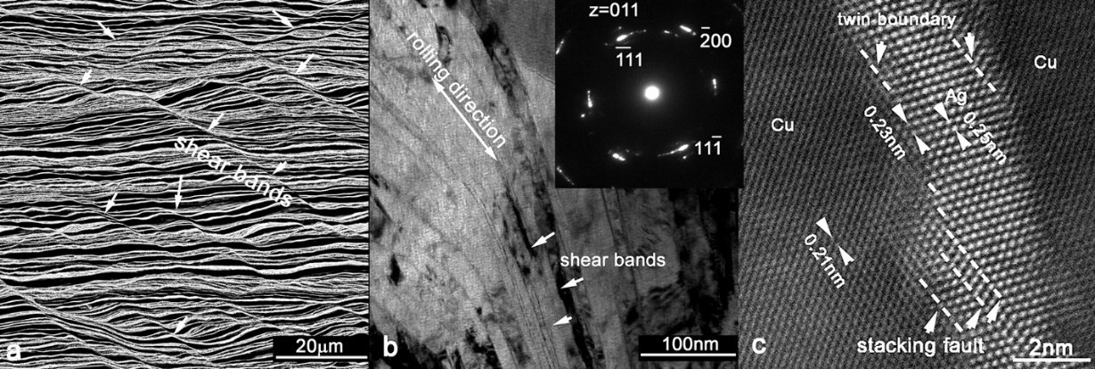
High Strength Copper-Silver Conductors for Magnets
R. Niu ¹, V. Toplosky ¹, H.L.S. Matos Pimentel ¹, Y. Xin ¹, J. Toth ¹, and K. Han¹
1. Florida State University, NHMFL
Funding Grants: K. M. Amm (NSF DMR-2128556)
Because of such desirable properties as high mechanical strength and electrical conductivity, Cu–Ag nano-structured sheets are used, not only in high-field DC magnets in general but also in the insert for our 45T hybrid magnet. In these applications, the property anisotropy of these sheets (which researchers in the MagLab have previously identified) must be taken into account. We have now further studied this anisotropic behavior, evaluated the strain-hardening or strain-softening capacity of these sheets and correlated this capacity with their microstructure.
We found overall softening in both longitudinal and transversal samples. In regions with highly strained slip bands, we discovered strain-hardening in transversal tensile samples but strain-softening in longitudinal ones. This anisotropy of plasticity occurred only in very local necking regions (~ 1.4mm in width). We observed many shear bands in the longitudinal, but not transversal, cross-sections. Microscale examination revealed shear bands running 8°-15° off the {111} crystal orientation. In longitudinal cross-section samples, we observed stacking faults and twins within the shear bands, indicating severe plastic deformation resulting mainly from the propagation of partial dislocations (see Figure). We found that measurable strain-hardening and strain-softening were both dependent on rolling direction, which introduced complex interrelationships among shear band orientations, crystallographic orientations, and interface orientations. Strain-softening in longitudinal tensile samples resulted from the presence of “favorable” angles (i.e., angles at which materials are especially easy to deform) within shear bands between the maximum shear stress direction and the existing slip system on {111}. Conversely, strain-hardening in transversal tensile samples was the result of the absence of such angles.
These findings helped us to better understand the mechanical properties of the conductor sheets that are used in our magnets.
Figure 1: Microscopy images on longitudinal x-section. a. Scanning electron microscopy image of shear bands, indicated by white arrows. b. Transmission electron microscopy image of the lamellar structure and shear bands (some of which are indicated by white arrows) on the longitudinal x-section. The average lamellar spacing is ~ 35nm. Lamellae in shear band areas are finer than in other areas: the width of Ag lamellae is <2nm, and Cu lamellae < 6nm. The inset shows a selected area diffraction pattern in the shear band. The short, curved diffraction spots in {111} or {200} indicate the presence of textured nano lamellae. Of the two opposing pairs of {111} diffraction spots, the maximum of one pair is about 8◦-15◦ off the rolling direction and of the other is about 55^{◦ -}67◦ off the rolling direction. c. Atomic resolution, High Angle Annular Dark Field (HAADF) image within the shear band showing stack faults and twinning in one Ag lamella surrounded by Cu lamellae. The <111> interplanar spacing of the Ag lamella (0.25nm) is 1.12 times that of the Cu lamellae (0.21nm).
Facilities and instrumentation used: The work was undertaken by researchers in MST using the mechanical test machines and microscopies hosted by the MagLab.
Citation: 1. Niu, R.; Han, K., Pockets of strain-softening and strain-hardening in high-strength Cu-24wt%Ag sheets, Journal of Materials Science, 58 (21), 8981 (2023) doi.org/10.1007/s10853-023-08519-y 2. Han, K.; Toplosky, V.J.; Niu, R.; Lu, J., Internal Stress in High-Strength CuAg Conductor, IEEE Transactions on Applied Superconductivity, 34, 7000105 (2024) doi.org/10.1109/TASC.2024.3368396

Slide 2
High Strength Copper-Silver Conductors for Magnets
R. Niu ¹, V. Toplosky ¹, H.L.S. Matos Pimentel ¹, Y. Xin ¹, J. Toth ¹, and K. Han¹
1. Florida State University, NHMFL
Funding Grants: K. M. Amm (NSF DMR-2128556)
What is the finding? MagLab researchers conducted a study on the strain-hardening behavior of high-strength Cu–Ag sheets by comparing overall stress–strain curves with local stress–strain curves. These stress–strain curves indicated both overall softening in both longitudinal and transverse samples. However, a distinct strain-hardening trend emerged in regions with highly strained slip bands. In the vicinity of these bands, true stress–strain curves exhibited pronounced local strain-hardening in transverse tensile samples but only a moderate degree of strain-softening in longitudinal samples. This localized plasticity anisotropy resulted in macro-anisotropy in conductors.
Why is this important? To ensure the upkeep of our high-field magnets, a steady supply of the requisite conductors is imperative. All of these conductors must be subjected to stringent quality-control characterization. This work also has impact beyond high field magnets (see Figure). The work of Cu-Ag conductors by Pimentel, Wu, Xin, et al was recognized in Microscopy and Microanalyses 2024, which was attended by 2,341 researchers. Ours was one of only 15 awarded the title of “Student & Postdoctoral Scholar Awards/2024 M&M Scholar Awards.” (Figure 2)
Why did this research need the MagLab? The MagLab boasts a rare capability for conducting characterizations, from atomic scale to full conductor dimensions. Not only does the Lab have superior mechanical testing facilities (Figure 1), which enable the characterization of strain distribution in two dimensions, but it also houses unique high-resolution microscopes, which play a pivotal role in studying material deformation. Added to that is the recognized expertise of MagLab metallurgists and materials scientists.
Figure 1 (left): A photo showing researchers working on Materials Test Systems (MTS). To assure a constant supply of the necessary high-quality conductors for our magnets, we use MTS machines to test samples from all the conductors that will be used in magnets. In 2023, for example, Vince Toplosky (on the right) tested more than 220 samples for DC resistive magnets. A high school student, Tryphon Mazu (on the left), is learning how to conduct mechanical testing on various materials. Figure 2 (right): A photo showing that Hannah Pimentel is accepting her award with others in Microscopy and Microanalyses 2024.
Facilities and instrumentation used: The work was undertaken by researchers in MST using the mechanical test machines and microscopies hosted by the MagLab.
Citation: 1. Niu, R.; Han, K., Pockets of strain-softening and strain-hardening in high-strength Cu-24wt%Ag sheets, Journal of Materials Science, 58 (21), 8981 (2023) doi.org/10.1007/s10853-023-08519-y 2. Han, K.; Toplosky, V.J.; Niu, R.; Lu, J., Internal Stress in High-Strength CuAg Conductor, IEEE Transactions on Applied Superconductivity, 34, 7000105 (2024) doi.org/10.1109/TASC.2024.3368396

Slide 3
High Strength Copper-Silver Conductors for Magnets
R. Niu ¹, V. Toplosky ¹, H.L.S. Matos Pimentel ¹, Y. Xin ¹, J. Toth ¹, and K. Han¹
1. Florida State University, NHMFL
Funding Grants: K. M. Amm (NSF DMR-2128556)
What is the finding? MagLab researchers studied the strain-hardening behavior of high-strength copper silver sheets by comparing overall and local stress-strain curves. They found that while both longitudinal and transverse samples showed overall softening, regions with highly strained slip bands displayed significant local strain-hardening in transverse samples and moderate strain-softening in longitudinal ones. This difference in localized plasticity caused the conductors to show overall anisotropic behavior.
Why is this important? To maintain our high-field magnets, we need a constant supply of conductors that must pass strict quality checks. This work also has impact beyond high field magnets since Cu-Ag conductors can be used in advanced electronics, electrical and power grid industries, and aerospace and defence . Research on Cu-Ag conductors by Pimentel, Wu, Xin, and others was recognized at the 2024 Microscopy and Microanalyses conference, attended by 2,341 researchers. This work was one of only 15 to receive the "2024 M&M Student & Postdoctoral Scholar Award."
Why did this research need the MagLab? The MagLab has unique facilities for characterizing materials, from the atomic level to full conductor size. It offers advanced mechanical testing to analyze strain in two dimensions and high-resolution microscopes to study material deformation. The lab also benefits from the expertise of its metallurgists and materials scientists.
Figure 1 (left): Researchers working on Materials Test Systems (MTS). To assure a constant supply of the necessary high-quality conductors for our magnets, we use MTS machines to test samples from all the conductors that will be used in magnets. In 2023, Vince Toplosky (on the right) tested more than 220 samples for DC resistive magnets. A high school student, Tryphon Mazu (on the left), is learning how to conduct mechanical testing on various materials. Figure 2 (right): Hannah Pimentel accepting her award in Microscopy and Microanalyses 2024.
Facilities and instrumentation used: The work was undertaken by researchers in MST using the mechanical test machines and microscopies hosted by the MagLab.
Citation: 1. Niu, R.; Han, K., Pockets of strain-softening and strain-hardening in high-strength Cu-24wt%Ag sheets, Journal of Materials Science, 58 (21), 8981 (2023) doi.org/10.1007/s10853-023-08519-y 2. Han, K.; Toplosky, V.J.; Niu, R.; Lu, J., Internal Stress in High-Strength CuAg Conductor, IEEE Transactions on Applied Superconductivity, 34, 7000105 (2024) doi.org/10.1109/TASC.2024.3368396

