Slide 1


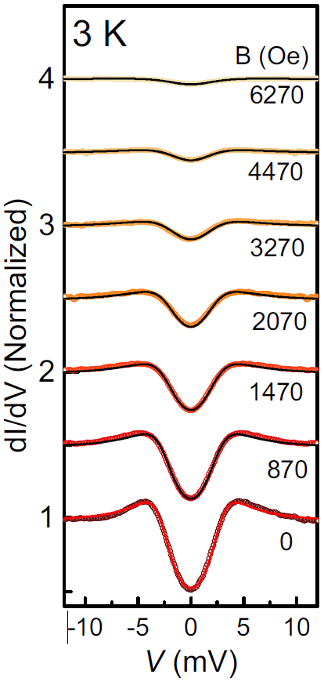



Bringing Tunneling Spectroscopy to new Extremes: Revealing Superconducting Symmetries in Sulfur at Ultra High Pressures
F. Du¹, F. F. Balakirev², V. S. Minkov¹, G. A. Smith², B. Maiorov², P. P. Kong¹, A. P. Drozdov¹, and M. I. Eremets¹
1 Max Planck Institute for Chemistry, Mainz; 2. National High Magnetic Field Laboratory, Los Alamos National Laboratory, Los Alamos
Funding Grants: K.M. Amm (NSF DMR-2128556); F.F. Balakirev (LANL 20220299ER)
The application of high pressures enables precise tuning of a system´s free energy, leading to novel behaviors that are otherwise unattainable. Elemental sulfur is one such system: under 0.9 Mbar it undergoes an insulator-to-metal transition and becomes a superconductor upon cooling. However, the high-pressure conditions generated within small diamond anvil cells significantly restrict the range of techniques available to characterize many superconducting properties of these materials.
Researchers at the Max-Planck Institute for Chemistry, in collaboration with the National High Magnetic Facility at the Los Alamos National Laboratory, have pioneered tunneling spectroscopy measurements at high pressures up to 1.6 Mbar in diamond anvil cells. This significantly extends the pressure range from the previously reported 0.03 Mbar. For the first time, the researchers directly observed a superconducting gap tunneling spectra under extreme pressures and applied magnetic fields by measuring differential conductance (Fig. 1).
This is a critical advancement, as many superconductors, both conventional and unconventional, exhibit enhanced performance under applied pressure. Additionally, the highest known critical transition temperature of superconductivity belong to hydrogen-rich compounds – a family that only exists under similarly high-pressure conditions. These techniques will enable further characterization of their superconducting properties, paving the way for the design and understanding of future superconductors.
Figure 1. a, The change of differential conductance in response to applied voltage. The drop that forms near 0 mV is due to the opening of the superconducting gap. Vertical spectra are offset by increasing magnetic fields values shown on the right. b, An image of the tunneling circuit formed on the tip of the diamond anvil press.
Facilities and instrumentation used: NHFML-PFF DynaCool PPMS.
Citation: Du, F.; Balakirev, F.F.; Minkov, V.S.; Smith, G.A.; Maiorov, B.A.; Kong, P.P.; Drozdov, A.P.; Eremets, M.I.; Du, F.; Balakirev, F.F.; Minkov, V.S.; Smith, G.A.; Maiorov, B.A.; Kong, P.P.; Drozdov, A.P.; Eremets, M.I., Tunneling Spectroscopy at Megabar Pressures: Determination of the Superconducting Gap in Sulfur, Physical Review Letters, 133, 036002 (2024) doi.org/10.1103/PhysRevLett.133.036002

Slide 2
Taking Tunneling Spectroscopy to new Extremes: Revealing Superconducting Symmetries in Sulfur at Ultra High Pressures
F. Du¹, F. F. Balakirev², V. S. Minkov¹, G. A. Smith², B. Maiorov², P. P. Kong¹, A. P. Drozdov¹, and M. I. Eremets¹
1 Max Planck Institute for Chemistry, Mainz; 2. National High Magnetic Field Laboratory, Los Alamos National Laboratory, Los Alamos
Funding Grants: K.M. Amm (NSF DMR-2128556); F.F. Balakirev (LANL 20220299ER)
What is the finding?
Scientists from the Max-Planck Institute and the National High Magnetic Field Laboratory made an exciting discovery by using a technique called tunneling spectroscopy under extremely high pressures for the very first time. They measured how certain materials – in this case Elemental sulfur - become superconductors, meaning they allow electricity to flow without resistance. By cooling the materials under pressure, they observed the exact energy levels at which electrical resistance disappeared, showing the transition to a superconducting state. (Fig. 1).
Why is this important?
This discovery is important because many materials show improved superconducting properties, like working at higher temperatures and in stronger magnetic fields, when exposed to high pressure. Some materials, like hydrides, which hold the record for the highest superconducting temperatures, only become superconductors under extremely high pressure (over 1 million times atmospheric pressure). This study gives scientists a way to explore these materials´ properties in detail for the first time, helping to design better superconductors in the future.
Why did this research need the MagLab?
Scientists at the MagLab created new tools and methods to study superconductors under much higher pressures than ever before—up to 1.6 million atmospheres, compared to the previous limit of 3,000 atmospheres. This breakthrough brings research closer to pressures found near the Earth's core, pushing the boundaries of superconducting research in extreme conditions.
Figure 1. a, A change of differential conductance occurs in response to applied voltage. The drop that forms near 0 mV is due to the opening of the superconducting gap. Vertical spectra are offset by increasing magnetic fields values shown on the right. b, The tunneling circuit formed on the tip of the diamond anvil press.
Facilities and instrumentation used: NHFML-PFF DynaCool PPMS.
Citation: Du, F.; Balakirev, F.F.; Minkov, V.S.; Smith, G.A.; Maiorov, B.A.; Kong, P.P.; Drozdov, A.P.; Eremets, M.I.; Du, F.; Balakirev, F.F.; Minkov, V.S.; Smith, G.A.; Maiorov, B.A.; Kong, P.P.; Drozdov, A.P.; Eremets, M.I., Tunneling Spectroscopy at Megabar Pressures: Determination of the Superconducting Gap in Sulfur, Physical Review Letters, 133, 036002 (2024) doi.org/10.1103/PhysRevLett.133.036002

