Slide 1
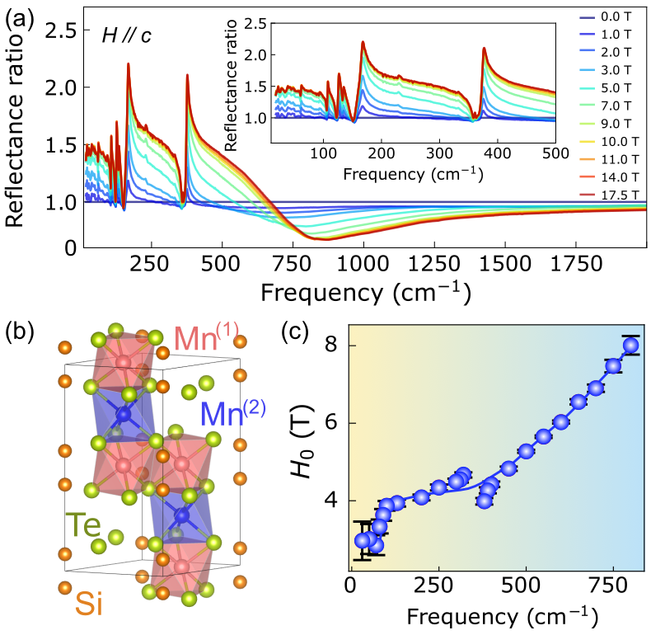
Unconventional insulator-to-metal phase transition in Mn₃Si₂Te₆
Yanhong Gu¹, Kevin A. Smith¹, Amartyajyoti Saha², Chandan De³, Choong-jae Won³, Yang Zhang¹, Ling-Fang Lin¹, Sang-Wook Cheong^{3,4}, Kristjan Haule⁴, Mykhaylo Ozerov⁵, Turan Birol², Christopher Homes⁶, Elbio Dagotto¹, Janice L. Musfeldt¹
University of Tennessee; 2. University of Minnesota; 3. Pohang University of Science and Technology; 4. Rutgers University; 5. National High Magnetic Field Laboratory; 6. Brookhaven National Laboratory
Funding Grants: DoE, BES, PBM (DE-SC00023144); K. Amm (NSF DMR-2128556)
The nodal-line semiconductor Mn₃Si₂Te₆ is generating excitement in the materials science/condensed matter physics communities due to the recent discovery of a field-driven insulator-to-metal transition with accompanying colossal magnetoresistance as well as evidence for a new type of quantum state involving chiral orbital currents. Strikingly, these qualities persist even in the absence of traditional Jahn-Teller distortions and double-exchange mechanisms, raising questions about exactly how and why magnetoresistance occurs along with conjecture as to the likely signatures of loop currents.
In this work, MagLab users measured the infrared response of Mn₃Si₂Te₆ across the magnetic ordering and field-induced insulator-to-metal transitions in order to explore colossal magnetoresistance in the absence of Jahn-Teller and double-exchange interactions. Rather than becoming a traditional metal with screened phonons, the field-driven insulator-to-metal transition leads to a weakly metallic state with localized carriers. The spectral data were fit using a percolation model which envisions ”droplets” of metallicity embedded in an insulating matrix and the results provide evidence for electronic inhomogeneity and phase separation (droplets) in the material. Modeling also reveals a frequency-dependent threshold field for carriers contributing to colossal magnetoresistance which we discuss in terms of polaron formation, chiral orbital currents, and short-range spin fluctuations. These findings enhance the understanding of insulator-to-metal transitions in new settings and open the door to the design of unconventional colossal magnetoresistive materials.
(a) Reflectance ratios of Mn₃Si₂Te₆ as a function of magnetic field at 5.5 K. The appearance of new features at high fields is entirely due to changes in the electronic background and is almost totally decoupled from the lattice. (b) Crystal structure showing two distinct Mn sites. (c) Percolation threshold as a function of frequency, obtained from percolation model fits.
Facilities and instrumentation used: This research was conducted in the 17.5 Tesla, 52 mm Bore Magnet (SCM 3) at the DC Field Facility.
Citation: Gu, Y.; Smith, K.; Saha, A.; De, C.; Won, C.; Zhang, Y.; Lin, L.; Cheong, S.; Haule, K.; Ozerov, M.; Birol, T.; Homes, C.; Dagotto, E.; Musfeldt, J., Unconventional insulator-to-metal phase transition in Mn3Si2Te6, Nature Communications, 15, 8104 (2024) doi.org/10.1038/s41467-024-52350-1

Slide 2
Unconventional insulator-to-metal phase transition in Mn₃Si₂Te₆
Yanhong Gu¹, Kevin A. Smith¹, Amartyajyoti Saha², Chandan De³, Choong-jae Won³, Yang Zhang¹, Ling-Fang Lin¹, Sang-Wook Cheong^{3,4}, Kristjan Haule⁴, Mykhaylo Ozerov⁵, Turan Birol², Christopher Homes⁶, Elbio Dagotto¹, Janice L. Musfeldt¹
University of Tennessee; 2. University of Minnesota; 3. Pohang University of Science and Technology; 4. Rutgers University; 5. National High Magnetic Field Laboratory; 6. Brookhaven National Laboratory
Funding Grants: DoE, BES, PBM (DE-SC00023144); K. Amm (NSF DMR-2128556)
What is the finding? Scientists used high-field infrared spectroscopy to study how a Manganese, Silicon, Tellurium compound (Mn₃Si₂Te₆) changes from an insulator to a metal under a magnetic field. Instead of becoming a regular metal, it forms a weak metallic state with trapped charges, revealing unique magnetic and electronic behavior.
Why is this important This research reveals how materials switch from insulators to metals at a microscopic level, uncovering new quantum states and paving the way for designing materials with exceptional magnetoresistance. These materials have potential uses in technologies like data storage and sensors.
Why did this research need the MagLab? Magnetoresistance happens when a material’s resistance changes due to a magnetic field, but understanding why it happens takes a deeper look and specialized instruments and techniques. Using specialized high-field infrared measurements available at the MagLab, scientists were able to probe the behavior of both the crystal structure and charge carriers simultaneously. This was made possible by advanced optical tools developed specifically for this research.
(a) Reflectance ratios of Mn₃Si₂Te₆ as a function of magnetic field at 5.5 K. The appearance of new features at high fields is entirely due to changes in the electronic background and is almost totally decoupled from the lattice. (b) Crystal structure showing two distinct Mn sites. (c) Percolation threshold as a function of frequency, obtained from percolation model fits.
Facilities and instrumentation used: This research was conducted in the 17.5 Tesla, 52 mm Bore Magnet (SCM 3) at the DC Field Facility.
Citation: Gu, Y.; Smith, K.; Saha, A.; De, C.; Won, C.; Zhang, Y.; Lin, L.; Cheong, S.; Haule, K.; Ozerov, M.; Birol, T.; Homes, C.; Dagotto, E.; Musfeldt, J., Unconventional insulator-to-metal phase transition in Mn3Si2Te6, Nature Communications, 15, 8104 (2024) doi.org/10.1038/s41467-024-52350-1

