Slide 1
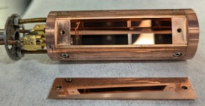
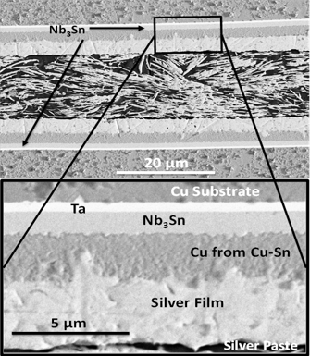
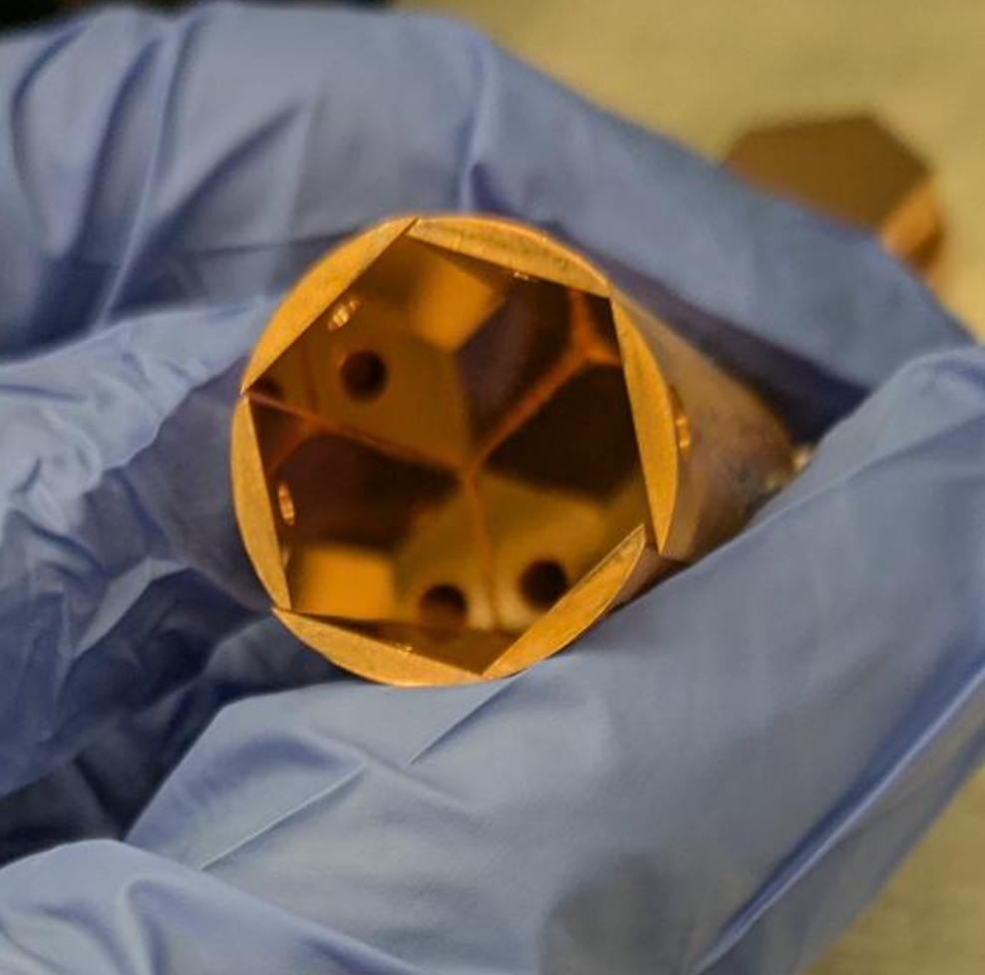
Radio Frequency Cavity for Tight Loop Optimization of Nb₃Sn Thin Films
Andre Juliao^{1,2}, Nikolya Cadavid^{1,2}, and Lance Cooley^{1,2}
1. Applied Superconductivity Center - NHMFL; 2. Florida State University
Funding Grants: L.D. Cooley (DE-SC 0018379), K. M. Amm (NSF DMR-2128556)
Traditionally, measuring the AC properties of conducting surfaces requires a complicated testing device incompatible with high magnetic fields. Here, we describe our compact 26mm diameter cavity that integrates AC testing with a modular set of removable samples in one device. The cavity resonator has six Cu walls that can be coated with a high-field superconducting material such as Nb₃Sn. Our present effort aims to test the quality factor (a measure of energy efficiency) of Nb₃Sn made by different recipes to optimize the material for quantum detectors. Even without a superconductor, our cavity attained a very good quality factor of 17,000 at 10GHz when operated at 77K. This research is part of a larger collaboration at Lawrence Livermore National Laboratory to detect dark matter in our universe.
Investing in testing devices and developing superior superconducting coatings has far-reaching implications beyond the physics of dark matter, with these optimized coatings, enhanced particle accelerators can be built with higher power and greater efficiency, significantly reducing the costs of operating major science facilities. These advancements also enable lower-cost, high-power electron, and ion beams for applications such as breaking down PFAs and microplastics, sterilizing medical equipment, detecting threatening materials, medical isotope production, and other industrial projects. Furthermore, this research advances our understanding of the material science and physics of superconductors, particularly their behavior under AC conditions and in high magnetic fields.
a)
a)
Figure 1(a). A view of the bare Cu cavity with one wall removed. In (b) the cap is lifted showing the internal resonator. The mirror finish is visible in both images.
b)
Figure 2. Nb₃Sn film deposited on copper with uniform microstructure for the detector cavity.
Facilities and instrumentation used: Applied Superconductivity Center – NHMFL, Vector Network analyzer at NHMFL and 9T PPMS at ASC
Citation: Andre Juliao 2024 Thin Film Superconducting Radio Frequency Workshop

Slide 2
Compact Radio Frequency Cavity Resonator Developed
Andre Juliao^{1,2}, Nikolya Cadavid^{1,2}, and Lance Cooley^{1,2}
1. Applied Superconductivity Center - NHMFL; 2. Florida State University
Funding Grants: L.D. Cooley (DE-SC 0018379), K. M. Amm (NSF DMR-2128556)
What is the finding? Researchers built a compact 26mm-diameter cavity resonator that integrates AC testing with a modular set of removable samples in one device that fits into an existing magnetometer. The cavity resonator has six Copper walls that can be coated with a high-field superconducting material to test the quality factor (a measure of energy efficiency).
Why is this important?
This device is a new kind of quantum detector intended to investigate dark matter in the universe, which has far-reaching consequences for our fundamental understanding. More broadly, developing devices, test capabilities, and superconducting cavity coatings has implications for enhanced particle accelerators and related major science facilities, high-power electron and ion beams for environmental and medical applications, security applications such as detecting threatening materials, and other industrial projects.
Why did this research need the MagLab? At the MagLab’s Applied Superconductivity Center, superconducting films can be grown with a state-of-the-art ultra-high vacuum sputtering machine and tested in high magnetic fields. Collaboration with the NMR probes group and the quantum device group provided expertise in AC characterizations and considerations for cavity connections. Characterization facilities in NHMFL allow us to see the film microstructure and connect electrical properties to process improvements.
Other Remarks:
Expertise and equipment from William Brey, Malathy Elumalai, and Thierry Dubroca at the NHMFL NMR lab were essential for this project.
a)
a)
Figure 1(a). A view of the bare Cu cavity with one wall removed. In (b) the cap is lifted showing the internal resonator. The mirror finish is visible in both images.
b)
Figure 2. Nb₃Sn film deposited on copper with uniform microstructure for the detector cavity.
Facilities and instrumentation used: Applied Superconductivity Center – NHMFL, Vector Network analyzer at NHMFL and 9T PPMS at ASC
Citation: Andre Juliao 2024 Thin Film Superconducting Radio Frequency Workshop

