Slide 1
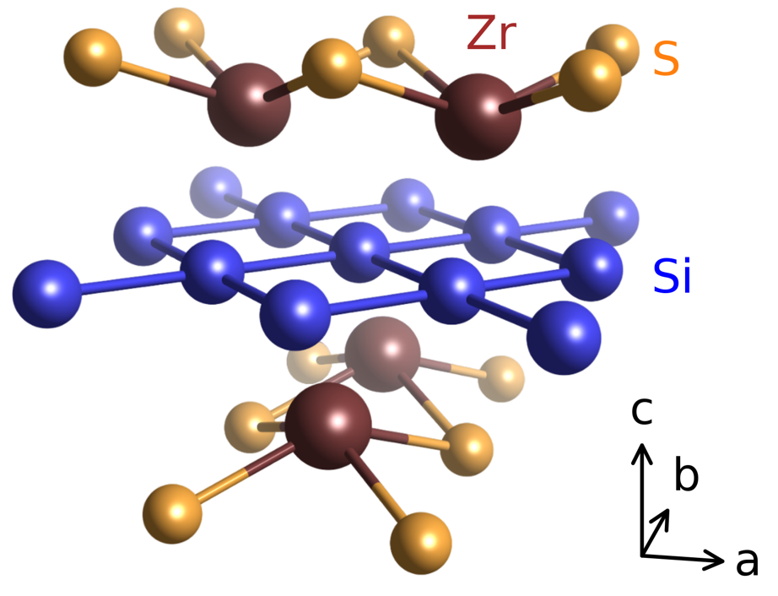
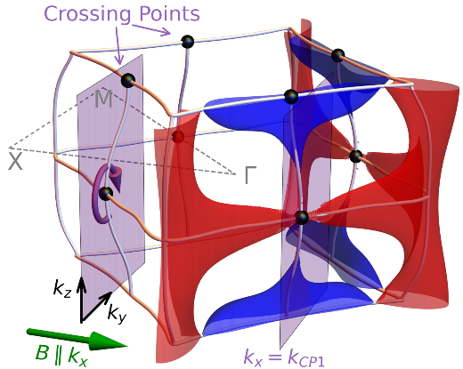
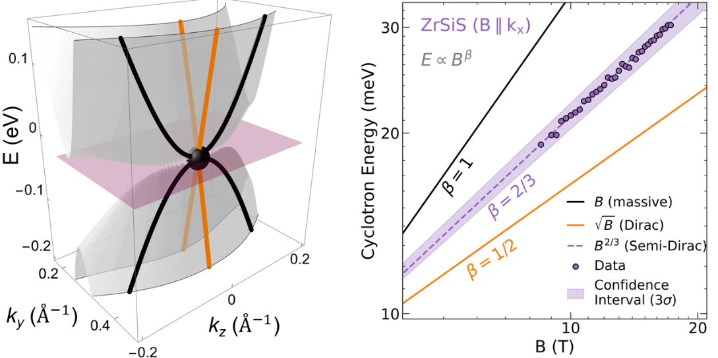
Semi-Dirac Fermions in a Topological Metal
Yinming Shao^{1,2}, Seongphill Moon^{3,4}, A. N. Rudenko⁵, Jie Wang^{6,7,8}, Jonah Herzog-Arbeitman⁹, Mykhaylo Ozerov⁴, David Graf⁴, Zhiyuan Sun⁷, Raquel Queiroz¹, Seng Huat Lee², Yanglin Zhu², Zhiqiang Mao², M. I. Katsnelson⁵, B. Andrei Bernevig^{9,10,11}, Dmitry Smirnov⁴, Andrew J. Millis^{1,12}, and D. N. Basov¹
1. Columbia; 2. PSU; 3. FSU; 4. NHMFL; 5. Radboud; 6. CMSA, Harvard; 7. Harvard; 8. Temple; 9. Princeton; 10. DIPS; 11. IKERBASQUE; 12. Flatiron
Funding Grants: K. M. Amm (NSF DMR-2128556); D. N. Basov (NSF DMR-2210186); Z. Q. Mao (2DCC-MIP NSF-DMR 2039351)
Topological semimetals with massless Dirac and Weyl fermions represent the forefront of quantum materials research. In two dimensions (2D), a peculiar class of fermions that are massless in one direction and massive in the perpendicular direction was predicted 16 years ago. These highly exotic quasiparticles—the semi-Dirac fermions—ignited intense theoretical and experimental interest but remain undetected.
Using the magneto-infrared spectroscopy facilities (SCM3) at the MagLab, we identified the smoking-gun signature of semi-Dirac fermions in an unexpected system: a three-dimensional (3D) topological semimetal known as ZrSiS (Fig. 1a). The Fermi surface of ZrSiS (Fig. 1b) consists of coexisting electron (blue) and hole (red) pockets, originating from the underlying Dirac nodal-lines. Under strong in-plane magnetic fields (green arrow), the electrons are quantized in the 2D planes perpendicular to the field, which host the semi-Dirac fermions at the nodal-line crossing-points (Fig. 1c). Above a critical field of around B = 8T, we observed Landau level transitions following a unique $B^{2/3}$power-law behavior (Fig. 1d), distinct from conventional massive fermions and massless Dirac fermions. Remarkably, this $B^{2/3}$power-law of the Landau levels is precisely the signature of semi-Dirac fermion in the original predictions.
ZrSiS also exhibits strong electron mass enhancement in high fields and low temperatures, which is attributed to electronic correlations. The observed 2D semi-Dirac fermions in ZrSiS offers a unique platform to study novel 2D quasiparticles and their interaction effects in natural bulk 3D crystals.
a
b
Figure. 1: a) Lattice structure of ZrSiS.
b) Calculated Fermi surface and nodal-line structure of ZrSiS. Black spheres indicate the crossing points (CPs) of multiple nodal lines. The circular purple arrow illustrates the cyclotron motion around one of the CPs for magnetic field (green arrow) applied along $k_{x}$ (a axis of the crystal) c) Calculated band structure of ZrSiS near the semi-Dirac point (black sphere).
d) Comparison of the power-law behavior for the cyclotron energy versus magnetic field in various fermions in a
log-log plot.
c
d
Facilities and instrumentation used: DC Field Facility: SCM3 (17 T) and SCM2 (18T).
Citation: Shao, Y.; Moon, S.; Rudenko, A.N.; Wang, J.; Herzog-Arbeitman, J.; Ozerov, M.; Graf, D.E.; Sun, Z.; Queiroz, R.; Lee, S.; Zhu, Y.; Mao, Z.; Katsnelson, M.I.; Bernevig, B.A.; Smirnov, D.; Millis, A.J.; Basov, D.N., Semi-Dirac Fermions in a Topological Metal, Physical Review X, 14, 041057 (2024) doi.org/10.1103/PhysRevX.14.041057

Slide 2
Semi-Dirac Fermions in a Topological Metal
Yinming Shao^{1,2}, Seongphill Moon^{3,4}, A. N. Rudenko⁵, Jie Wang^{6,7,8}, Jonah Herzog-Arbeitman⁹, Mykhaylo Ozerov⁴, David Graf⁴, Zhiyuan Sun⁷, Raquel Queiroz¹, Seng Huat Lee², Yanglin Zhu², Zhiqiang Mao², M. I. Katsnelson⁵, B. Andrei Bernevig^{9,10,11}, Dmitry Smirnov⁴, Andrew J. Millis^{1,12}, and D. N. Basov¹
1. Columbia; 2. PSU; 3. FSU; 4. NHMFL; 5. Radboud; 6. CMSA, Harvard; 7. Harvard; 8. Temple; 9. Princeton; 10. DIPS; 11. IKERBASQUE; 12. Flatiron
Funding Grants: K. M. Amm (NSF DMR-2128556); D. N. Basov (NSF DMR-2210186); Z. Q. Mao (2DCC-MIP NSF-DMR 2039351)
What is the finding? Scientists at the MagLab detected semi-Dirac fermions, a unique type of particle predicted 16 years ago, but never observed. These particles are massless in one direction and have mass in the perpendicular direction. Using high-field magneto-infrared spectroscopy, they found clear evidence of the fermions in zirconium silicon sulfide (ZrSiS) when exposed to strong magnetic fields and observed a distinct energy pattern that matches the predicted signature of semi-Dirac fermions (cyclotron energy scales with the two-thirds power of the magnetic field).
Why is this important? These findings confirm the existence of novel quasiparticles hosted in bulk crystals and pave the way for exploring quantum geometry and electronic correlation effect in semi-Dirac fermions. Better understanding of semi-Dirac fermions could contribute to advances in quantum materials research, potentially enabling new technologies in electronics, sensors, and quantum computing.
Why did this research need the MagLab? The spectroscopic signature of the semi-Dirac fermions studied here reside in the far-infrared and requires high-field (> 8T) reflectance measurements in the Voigt geometry. The combination of FTIR and a 17.5T magnet were crucial for this discovery and only available at the MagLab.
Left: Calculated band structure of ZrSiS near the semi-Dirac point (black sphere).
Right: Comparison of the power-law behavior for the cyclotron energy versus magnetic field in various types of fermions in a log-log plot including this measurement.
Facilities and instrumentation used: DC Field Facility: SCM3 (17 T) and SCM2 (18T).
Citation: Shao, Y.; Moon, S.; Rudenko, A.N.; Wang, J.; Herzog-Arbeitman, J.; Ozerov, M.; Graf, D.E.; Sun, Z.; Queiroz, R.; Lee, S.; Zhu, Y.; Mao, Z.; Katsnelson, M.I.; Bernevig, B.A.; Smirnov, D.; Millis, A.J.; Basov, D.N., Semi-Dirac Fermions in a Topological Metal, Physical Review X, 14, 041057 (2024) doi.org/10.1103/PhysRevX.14.041057

