Slide 1
High-Field Electron Paramagnetic Resonance Studies of Titanium-Containing Catalysts
M. Bhunia¹, J. S. Mohar¹, C. Sandoval-Pauker², D. Fehn³, L. N. Grant¹, M. R. Gau¹, S. Senthil¹, J. Goicoechea⁴, E. S. Yang⁵, A. Ozarowski⁶, J. Krzystek⁶, J. Telser⁷, B. Pinter², K. Meyer³, D. J. Mindiola¹
1. U. Pennsylvania; 2. U. Texas El Paso; 3. U. Erlangen-Nuremberg, Germany; 4. Indiana U.; 5. U. Oxford, UK; 6. NHMFL; 7. Roosevelt U.
Funding Grants: K. M. Amm (NSF DMR-2128556); D. J. Mindiola (DOE DEFG02-07ER15893); E. S. Yang (UK EPSRC)
Titanium is an “Earth abundant” transition metal, unlike precious metals such as palladium (Pd) and platinum (Pt). Partly for this reason, titanium containing-molecules are widely used as catalysts for the production of polymers such as polyethylene, polycarbonates and other “plastics”. There is, however, always a need for improvement in these catalysts to make them more efficient, cheaper and safer. Oftentimes, the differences between a better functioning (i.e., higher activity) catalyst and a poorer (i.e., lower activity) one are related to very slight differences in the geometrical and electronic structure of the catalyst molecule.
Techniques such as X-ray crystallography can provide geometrical structures, while spectroscopic information is essential for gaining insights into the electronic structure and functionality of catalysts. One such technique is electron paramagnetic resonance (EPR), which can provide precise details about the role of unpaired electrons in chemical activity. However, the EPR spectra of many transition metals, e.g., titanium, often span a very wide magnetic field range (see Figure). This necessitates high-field measurements that can only be performed at the MagLab.
In this extensive investigation, a series of titanium-containing molecules was prepared by the group of Daniel Mindiola at U. Penn, a leading expert in this area. High-field EPR results from the MagLab show small but distinct differences among them which, when combined with electronic structure calculations, will guide further synthetic efforts aimed at making more catalytically useful molecules.
*
EPR Intensity (arb. units)
Magnetic Field (tesla)
Figure. 1. Example high-field EPR spectrum (Exp) spanning a wide magnetic field range (up to 15T) compared to commercial instruments, which are typically limited to below 1.2T. The corresponding simulation (Sim) is also shown, and the feature marked by an asterisk is due to a minor species.
Facilities and instrumentation used: Electron Magnetic Resonance (EMR) Facility: 15/17 Tesla Superconducting Magnet System
Citation: [1] Bhunia, M.; Mohar, J.S.; Sandoval-Pauker, C.; Fehn, D.; Yang, E.S.; Gau, M.; Goicoechea, J.; Ozarowski, A.; Krzystek, J.; Telser, J.; Meyer, K.; Mindiola, D.J., Softer Is Better for Titanium: Molecular Titanium Arsenido Anions Featuring Ti≡As Bonding and a Terminal Parent Arsinidene, Journal of the American Chemical Society, 146 (6), 3609-3614 (2024) doi.org/10.1021/jacs.3c12939. Also: [2] Bhunia, M.; Pauker, C.S.; Fehn, D.; Grant, L.N.; Gau, M.R.; Ozarowski, A.; Krzystek, J.; Telser, J.; Pinter, B.; Meyer, K.; Mindiola, D.J., Divalent Titanium via Reductive N-C Coupling of a TiIV Nitrido with Pi-Acids, Angewandte Chemie International Edition, 63, e20240461 (2024) doi.org/10.1002/anie.202404601
Notes:
How to compress files size:
On PowerPoint, you can save the attached image (Right click on an image -> Select “Save as picture” -> Then you save the image as PNG). PNG is the image compression without losing the image quality. You replace the original image with the PNG one on PowerPoint. This should reduce the PowerPoint file size.
One thing to be careful about is that you should enlarge your image a bit on PowerPoint before saving so is to avoid losing much resolution.

Slide 2
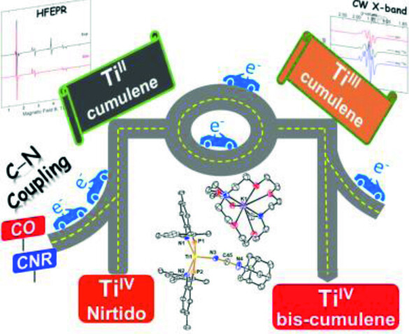
High-Field EPR Reveals Differences in Titanium-Based Catalysts' Electronic Structure
M. Bhunia¹, J. S. Mohar¹, C. Sandoval-Pauker², D. Fehn³, L. N. Grant¹, M. R. Gau¹, S. Senthil¹, J. Goicoechea⁴, E. S. Yang⁵, A. Ozarowski⁶, J. Krzystek⁶, J. Telser⁷, B. Pinter², K. Meyer³, D. J. Mindiola¹
1. U. Pennsylvania; 2. U. Texas El Paso; 3. U. Erlangen-Nuremberg, Germany; 4. Indiana U.; 5. U. Oxford, UK; 6. NHMFL; 7. Roosevelt U.
Funding Grants: K. M. Amm (NSF DMR-2128556); D. J. Mindiola (DOE DEFG02-07ER15893); E. S. Yang (UK EPSRC)
What is the finding? Researchers performed high-field electron paramagnetic resonance measurements on titanium-based catalyst molecules at the MagLab EMR facility and found small, but distinct differences indicating subtle variations in electronic structure. Changes in electronic structure can relate to effectiveness in producing polymers like plastics.
Why is this important? Titanium is a more abundant transition metal that is less costly than precious metals like palladium (Pd) and platinum (Pt). Titanium-containing molecules are widely used as catalysts for polymers like polyethylene, polycarbonates and other “plastics” and is seen as a promising material for greener, cheaper, and safer catalysts. Understanding how small changes in the molecular structure may affect catalytic performance will help scientists design better catalysts, boosting efficiency and sustainability.
Why did this research need the MagLab? Spectroscopic information is essential to understand the electronic structure and functionality of catalysts. Electron paramagnetic resonance (EPR) can provide precise details about the role of unpaired electrons in chemical activity. However, to study transition metals like titanium, very strong magnetic fields like those available at the MagLab are needed because their EPR signals cover a wide range. The MagLab's powerful instruments make these measurements possible.
Figure 2. The image illustrates the ability of the transition metal, titanium, to switch between oxidation states (Ti^{II}, Ti^{III} and Ti^{IV}), in the process accepting and donating electrons (e⁻). It is this ability to shuttle electrons to/from other chemical systems (represented by the intersections in the image) that gives rise to catalytic activity. Electron paramagnetic resonance is a technique that can directly monitor these chemically active electrons.
Facilities and instrumentation used: Electron Magnetic Resonance (EMR) Facility: 15/17 Tesla Superconducting Magnet System
Citation: [1] Bhunia, M.; Mohar, J.S.; Sandoval-Pauker, C.; Fehn, D.; Yang, E.S.; Gau, M.; Goicoechea, J.; Ozarowski, A.; Krzystek, J.; Telser, J.; Meyer, K.; Mindiola, D.J., Softer Is Better for Titanium: Molecular Titanium Arsenido Anions Featuring Ti≡As Bonding and a Terminal Parent Arsinidene, Journal of the American Chemical Society, 146 (6), 3609-3614 (2024) doi.org/10.1021/jacs.3c12939. Also: [2] Bhunia, M.; Pauker, C.S.; Fehn, D.; Grant, L.N.; Gau, M.R.; Ozarowski, A.; Krzystek, J.; Telser, J.; Pinter, B.; Meyer, K.; Mindiola, D.J., Divalent Titanium via Reductive N-C Coupling of a TiIV Nitrido with Pi-Acids, Angewandte Chemie International Edition, 63, e20240461 (2024) doi.org/10.1002/anie.202404601
Notes:
How to compress files size:
On PowerPoint, you can save the attached image (Right click on an image -> Select “Save as picture” -> Then you save the image as PNG). PNG is the image compression without losing the image quality. You replace the original image with the PNG one on PowerPoint. This should reduce the PowerPoint file size.
One thing to be careful about is that you should enlarge your image a bit on PowerPoint before saving so is to avoid losing much resolution.

