Slide 1
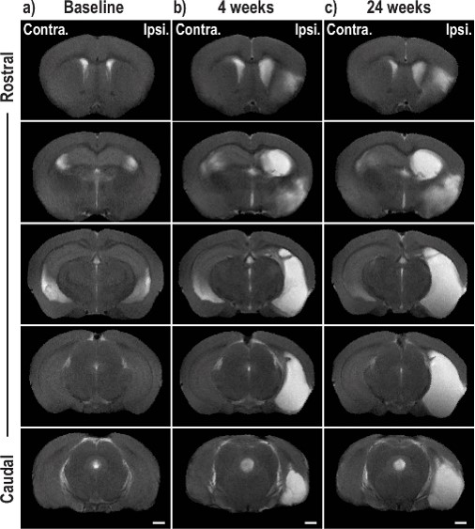
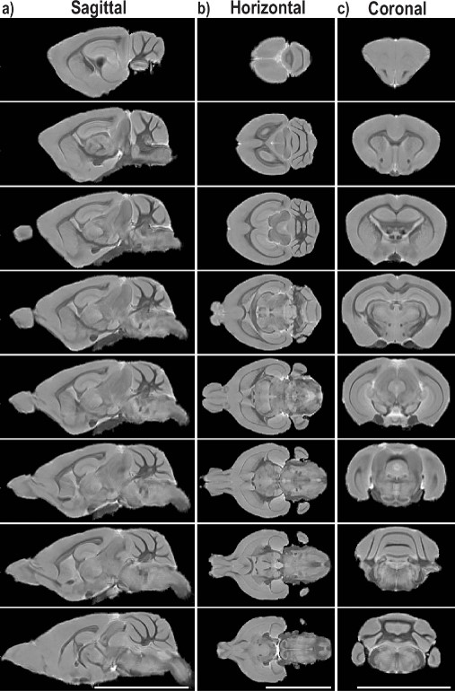
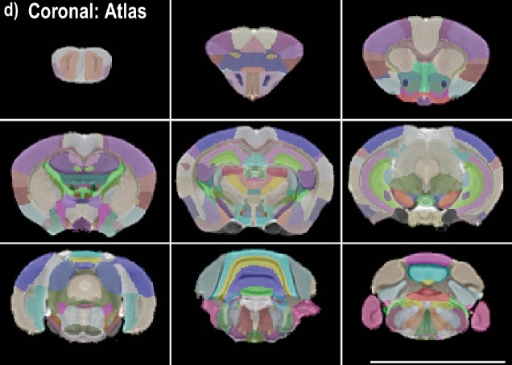
Stroke-induced neuroplasticity in spiny mice in the absence of tissue regeneration
Benjamin M. Kidd, Justin A. Varholick, Dana M. Tuyn, Pradip K. Kamat, Zachary D. Simon, Lei Liu, Mackenzie P. Mekler, Marjory Pompilus, Jodi L. Bubenik, Mackenzie L. Davenport, Helmut A. Carter, Matteo M. Grudny, W. Brad Barbazuk, Sylvain Doré, Marcelo Febo,Eduardo Candelario-Jalil, Malcolm Maden, & Maurice S. Swanson
University of Florida); G. Boebinger
Funding Grants: M. S. Swanson (NIH P50 NS048843), K. M. Amm (NSF DMR-2128556; NSF DMR-1644779); A. S. Edison (NIH S10 RR025671)
African spiny mice (Acomys cahirinus) have the unique ability among mammals to regenerate skin, muscle, and even spinal cord tissue with little to no scarring. Here, researchers investigated the effects of transient ischemia in Acomys, finding that the rodents failed to regenerate impacted brain regions yet showed rapid behavioral recovery post-stroke. Their recovery can be attributed to undamaged regions of the brain dramatically increasing their interconnectivity to compensate for damaged tissue.
After obtaining baseline behavioral and fMRI data, ischemic stroke was induced in adult male Acomys. The rodents’ behavior was monitored for 24 weeks post injury (wpi), and magnetic resonance imaging (MRI) was periodically conducted to assess the changing structure and function of the brain post-injury. MRI visualization and quantification showed that, like in humans, the damaged area increased in size over time post-injury. However, Acomys demonstrated an unusually rapid behavioral recovery (i.e. minimal neurological deficit scores and behavior similar to baseline). To explain this recovery in the absence of tissue regeneration, resting-state functional MRI (rsfMRI) was used to analyze the rodents’ connectome, or the map of functional connections in the brain. Unlike humans or traditional rodent subjects, Acomys demonstrated no significant changes in the whole brain connectome from baseline to 4 wpi. Increased connection and activity in intact brain regions, especially contralaterally to the injury, evidently allows Acomys to compensate for the damaged tissue.
The fact that no global changes to connectome were observed after stroke (unlike in human, rat, and mouse subjects) suggests an improved method of compensation in Acomys. Further studies into this neuroplasticity response in both the Acomys brain and possibly in the spinal cord could ultimately lead to a better understanding of how the mammalian brain develops and can be remodeled and ultimately impact treatment regimens for severe CNS injuries. .
Figure: Anatomical MRI of representative Acomys brains (top left) at baseline (a), 4 wpi (b), and 24 wpi (c). White areas indicate an absence of brain tissue. Like in humans and other rodents, the damaged area increases in size over time.
After the other phases of the study were completed, high-resolution ex vivo (post-mortem) MRI was
conducted on eight of the rodents. This raw data (right) was used to construct
a detailed, three-dimensional structural “atlas” of the Acomys brain (bottom left). This anatomical reference allowed the study team to more accurately interpret the previously collected functional MRI data and will continue to be useful in future research on Acomys subjects.
Facilities and instrumentation used: AMRIS Facility; 11.1T/40cm Magnex magnet with
Bruker Avance III HD MRI system. Citation: Kidd, B.M.; Varholick, J.A.; Tuyn, D.M.; Kamat, P.K.; Simon, Z.D.; Liu, L.; Mekler, M.P.; Pompilus, M.; Bubenik, J.L.; Davenport, M.L.; Carter, H.A.; Grudny, M.M.; Barbazuk, W.B.; Doré, S.; Febo, M.; Candelario-Jalil, E.; Maden, M.; Swanson, M.S., Stroke-induced neuroplasticity in spiny mice in the absence of tissue regeneration, Nature Partner Journals (npj) Regenerative Medicine, - 9 (- 1) (2024) doi.org/10.1038/s41536-024-00386-8

Slide 2
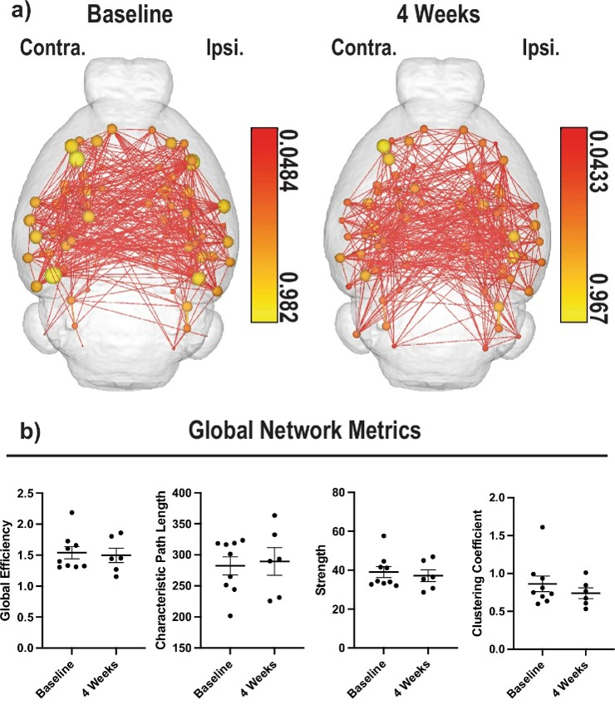
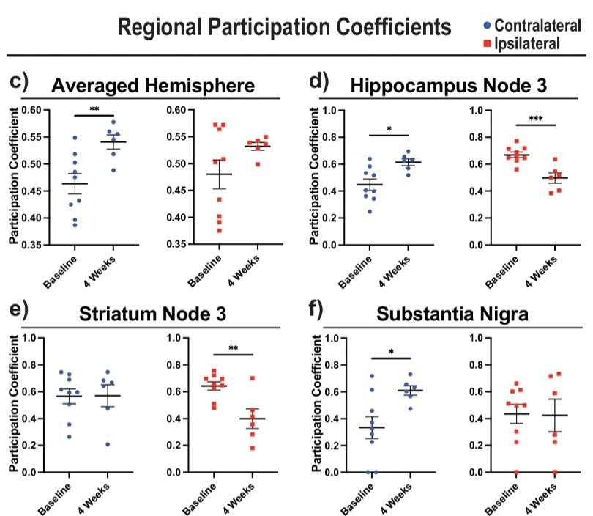
How Spiny Mice Bounce Back from Strokes Without Regrowing Brain Tissue
Benjamin M. Kidd, Justin A. Varholick, Dana M. Tuyn, Pradip K. Kamat, Zachary D. Simon, Lei Liu, Mackenzie P. Mekler, Marjory Pompilus, Jodi L. Bubenik, Mackenzie L. Davenport, Helmut A. Carter, Matteo M. Grudny, W. Brad Barbazuk, Sylvain Doré, Marcelo Febo,Eduardo Candelario-Jalil, Malcolm Maden, & Maurice S. Swanson
University of Florida); G. Boebinger
Funding Grants: M. S. Swanson (NIH P50 NS048843), K. M. Amm (NSF DMR-2128556; NSF DMR-1644779); A. S. Edison (NIH S10 RR025671)
What is the finding? This study explores how the African spiny mouse (Acomys cahirinus), a rodent known for its ability to heal damaged tissue, recovers from a stroke. Unlike previous findings in spinal cord repair, MRI scans showed the mice didn’t regrow brain tissue. Instead, they recovered quickly by using other parts of their brain to compensate for the damage.
Why is this important? Ischemic stroke happens when a blocked blood vessel cuts off oxygen from the brain. It is a major cause of disability and death in adults over 40. This study used MRI to map the African spiny mouse’s brain and see how it adapted after injury from stoke, finding that it recovers unusually well from strokes. Understanding how this mouse rewires its brain could provide valuable insights into broader brain development and healing in mammals.
Why did this research need the MagLab? This study used advanced MRI in three ways: First, to track how the brain’s structure changed after a stroke. Second, resting-state functional MRI (rsfMRI) showed how different brain areas connect and adapt to compensate for damage. Third, detailed post-mortem MRI created a high-resolution map of the spiny mouse brain, helping researchers interpret earlier results and support future studies. These techniques required powerful high-field MRI technology, only possible with the MagLab’s specialized equipment.
Figure: The spiny mice showed extraordinary recovery of neural connections only four weeks after stroke (a, b) despite not regenerating any
damaged tissue. In c - f, we can see one reason why: as the damaged side (or hemisphere) of the brain (marked in red) lost functionality, the undamaged hemisphere (blue) became more interconnected to compensate. Panels d - f show that this effect is present in three specific regions of the brain, and c confirms that this is also true of the undamaged hemisphere as a whole.
Facilities and instrumentation used: AMRIS Facility; 11.1T/40cm Magnex
magnet with Bruker Avance III HD MRI system. Citation: Kidd, B.M.; Varholick, J.A.; Tuyn, D.M.; Kamat, P.K.; Simon, Z.D.; Liu, L.; Mekler, M.P.; Pompilus, M.; Bubenik, J.L.; Davenport, M.L.; Carter, H.A.; Grudny, M.M.; Barbazuk, W.B.; Doré, S.; Febo, M.; Candelario-Jalil, E.; Maden, M.; Swanson, M.S., Stroke-induced neuroplasticity in spiny mice in the absence of tissue regeneration, Nature Partner Journals (npj) Regenerative Medicine, - 9 (- 1) (2024) doi.org/10.1038/s41536-024-00386-8

