Slide 1
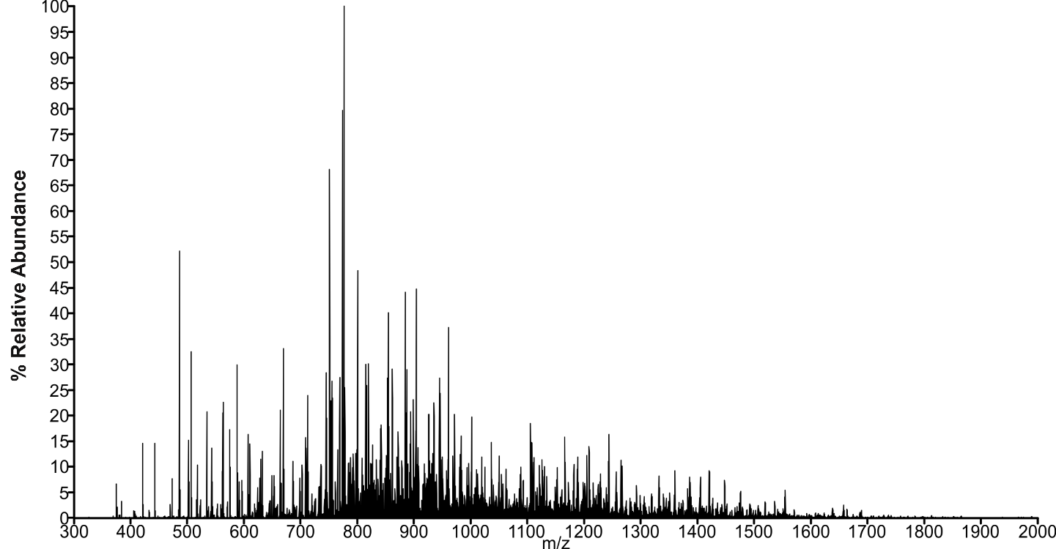
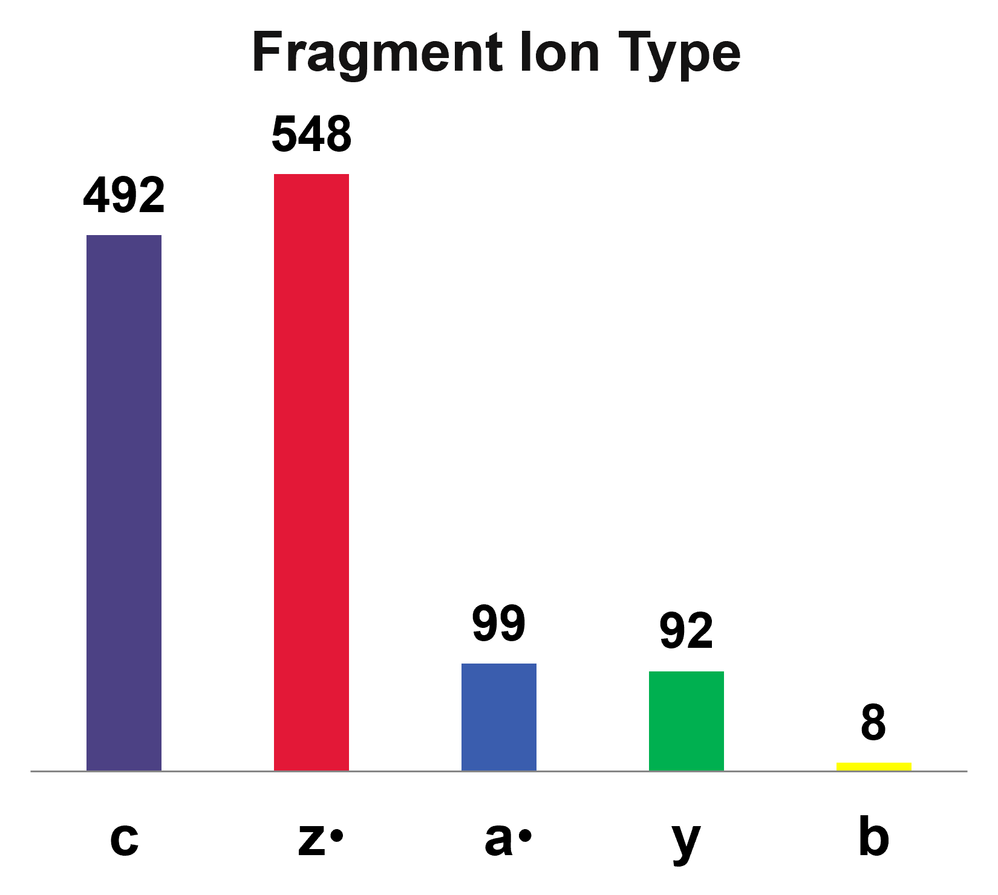
Are Internal Fragments Observable in Electron Based Top-Down Mass Spectrometry?
Neven N. Mikawy¹, Carolina Rojas Ramírez^{1,2},…Alexey I. Nesvizhskii,² Joseph A. Loo³, Brandon T. Ruotolo¹, Jeffrey Shabanowitz⁴, Lissa C. Anderson⁵, Kristina Håkansson¹
Departments of ¹Chemistry and ²Pathology, U. Michigan; ³Department of Chemistry and Biochemistry, UCLA; ⁴Department of Chemistry, U. Virginia; ⁵NHMFL (and others)
Funding Grants: K. M. Amm (NSF DMR-1644779 and DMR-2128556); K. Håkansson (NSF CHE-2004043, NIH S10OD021619); A. I. Nesvizhskii (NIH T32CA140044, R01GM094231, and U24CA271037); J. A. Loo (NIH R35GM145286 and DOE DE-FC02-02ER63421); B. T. Ruotolo (Agilent Technologies); D. F. Hunt (NIH GM037537)
Tandem mass spectrometry of intact proteins, or “top-down” proteomics, provides a molecular understanding of phenotype that is otherwise unobtainable. Successful experiments provide the highest amino acid sequence coverage possible to pinpoint sites of mutation and protein modifications. Internal fragment ions, which are produced when the protein backbone undergoes multiple cleavage events, can provide valuable information by increasing the sequence coverage of a protein. However, with electron-based dissociation techniques, there are tens of thousands of possible internal fragments, many of which are isomers or isobars, and their signal-to-noise ratios are too low to be reliably detected.
In 2017, MagLab researchers published an ultrahigh quality spectrum of a 29 kDa protein fragmented by electron transfer dissociation (Figure 1) to demonstrate the maximum sequence coverage achievable by 21 tesla Fourier transform ion cyclotron resonance tandem mass spectrometry. More recently, this spectrum was exhaustively annotated, and terminal fragments accounted for virtually all of the signals in the spectrum, resulting in 91% sequence coverage of the protein. None of the signals could be reliably assigned to internal fragments.
These findings, along with extensive additional data from multiple laboratories, demonstrate that internal fragments are not formed at a detectable level from electron-based fragmentation techniques. We urge great caution when assigning such fragments due to their innate potential for false discovery. Elimination of false assignments will enhance the integrity of top-down proteomics data and prevent misidentification of proteoforms involved in phenotypes of interest.
Terminal
Figure 1: 21 T Fourier transform ion cyclotron resonance tandem mass spectrum of carbonic anhydrase II (34+, 29 kDa) following 6 milliseconds of electron transfer dissociation. The signal was summed over 1600 acquisitions (600,000 resolving power at m/z 400). The inset shows the terminal fragment ion types identified in the spectrum. No internal fragments were found.
Facilities and instrumentation used: Ion Cyclotron Resonance (21 T FT-ICR); FAIR data
Citation: Mikawy, N.N.; Ramírez, C.R.; DeFiglia, S.A.; Szot, C.W.; Le, J.; Lantz, C.; Wei, B.; Zenaidee, M.A.; Blakney, G.T.; Nesvizhskii, A.I.; Loo, J.A.; Ruotolo, B.T.; Shabanowitz, J.; Anderson, L.C.; Hakansson, K., Are Internal Fragments Observable in Electron Based Top-Down Mass Spectrometry?, Molecular and Cellular Proteomics, 17 (23), 100814 (2024) doi.org/10.1016/j.mcpro.2024.100814 Data Set – DOI: 10.1007/s13361-017-1702-3 (Weisbrod et al. J. Am. Soc. Mass Spectrom. 2017; 28:1787-1795)

Slide 2
Internal Fragments are Elusive in Electron-Based Fragmentation of Proteins
Neven N. Mikawy¹, Carolina Rojas Ramírez^{1,2},…Alexey I. Nesvizhskii,² Joseph A. Loo³, Brandon T. Ruotolo¹, Jeffrey Shabanowitz⁴, Lissa C. Anderson⁵, Kristina Håkansson¹
Departments of ¹Chemistry and ²Pathology, U. Michigan; ³Department of Chemistry and Biochemistry, UCLA; ⁴Department of Chemistry, U. Virginia; ⁵NHMFL (and others)
Funding Grants: K. M. Amm (NSF DMR-1644779 and DMR-2128556); K. Håkansson (NSF CHE-2004043, NIH S10OD021619); A. I. Nesvizhskii (NIH T32CA140044, R01GM094231, and U24CA271037); J. A. Loo (NIH R35GM145286 and DOE DE-FC02-02ER63421); B. T. Ruotolo (Agilent Technologies); D. F. Hunt (NIH GM037537)
What is the finding? In mass spectrometry of intact proteins, electron-based fragmentation does not reveal internal fragment ions (Figure 1). Researchers used data from the MagLab’s 21 tesla FT-ICR mass spectrometer and other lower-resolution data from other labs. Automated software incorrectly identified internal fragments, but careful manual analysis proved these assignments were wrong.
Why is this important? Electron-based fragmentation in mass spectrometry provides better protein sequence information than traditional methods by creating more observable terminal fragments. Adding internal fragments, formed by breaking multiple bonds, could improve coverage of the protein's interior, making it easier to identify important modifications that affect protein function in health and disease. However, misidentifying these fragments can lead to errors in the analysis.
Why did this research need the MagLab? The 21 T FT-ICR mass spectrometer offers exceptional mass resolving power, mass accuracy, and sensitivity. These performance characteristics significantly enhance the confidence in assigning both terminal and internal fragments in complex mass spectra (Figure 1). In particular, low-abundance and high-mass fragments, which may not be observed or may be impossible to annotate in lower resolution data, can be confidently assigned, highlighting the risk associated with internal fragment annotation in mass spectra.
a•, b, c
y, z•
Terminal
Figure 1: Fragments observed after transferring electrons to the protein carbonic anhydrase II. This activation process cleaves chemical bonds between the amino acids making up the protein sequence in a random manner, resulting in fragments with different lengths and mass-to-charge (m/z) ratios measured by a 21 T FT-ICR mass spectrometer. The bar graph shows fragment types identified from a single bond cleavage event. Internal fragments, which form through two cleavage events, were not observed. FT-ICR, Fourier transform ion cyclotron resonance.
Facilities and instrumentation used: Ion Cyclotron Resonance (21 T FT-ICR); FAIR data
Citation: Mikawy, N.N.; Ramírez, C.R.; DeFiglia, S.A.; Szot, C.W.; Le, J.; Lantz, C.; Wei, B.; Zenaidee, M.A.; Blakney, G.T.; Nesvizhskii, A.I.; Loo, J.A.; Ruotolo, B.T.; Shabanowitz, J.; Anderson, L.C.; Hakansson, K., Are Internal Fragments Observable in Electron Based Top-Down Mass Spectrometry?, Molecular and Cellular Proteomics, 17 (23), 100814 (2024) doi.org/10.1016/j.mcpro.2024.100814 Data Set – DOI: 10.1007/s13361-017-1702-3 (Weisbrod et al. J. Am. Soc. Mass Spectrom. 2017; 28:1787-1795)

