Slide 1
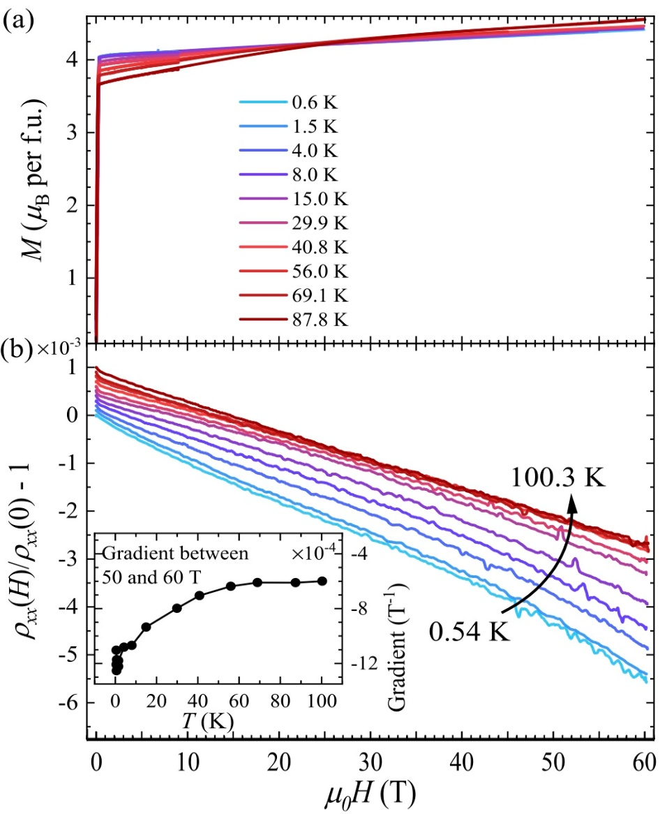
Pulsed fields detect a dramatic change of electronic character in the ferromagnet Fe3−xGeTe2
S. Vaidya1, M. J. Coak 1,2, D. A. Mayoh1, M. R. Lees1, G. Balakrishnan1, J. Singleton3 and P. A. Goddard1
¹Department of Physics, University of Warwick, ²School of Physics & Astronomy, University of Birmingham, ³National High Magnetic Field Laboratory - LANL
Funding Grants: K. M. Amm (NSF DMR-2128556); J. Singleton (NSF DMR-2128556; DOE Science of 100 T); Goddard/Balakrishnan (ERC 681260, EPSRC EP/T005963/1, EP/N032128/1)
Magnetic van der Waals materials provide an exciting testing ground for fundamental theories of magnetism in the extreme two-dimensional limit. Moreover, the ease with which they are exfoliated and reassembled has led to proposals for a wide range of novel magnetic devices. Within this family, Fe_{3-x}GeTe₂ (FGT) is very promising, as it has both a high Curie temperature and good electrical conductivity, leading to heterostructures with potential for low-power, room-temperature spintronic technologies. Interestingly, FGT also shows coexistence of itinerant and localized magnetism; as a result, it has been suggested that Kondo-lattice behavior develops at low temperatures. Whilst Kondo-lattice behavior is accepted in f-electron systems, its presence in 3d compounds is controversial. An understanding of this issue is essential for designing future FGT devices.
In order to demonstrate Kondo-lattice behavior in FGT, magnetization [M(H) - [Figure (a)] and resistivity [𝝆_{xx} - Figure (b) and 𝝆_{xy}] data were recorded at many temperatures in pulsed magnetic fields of up to 60 T. These experiments reveal three distinct contributions to the magnetoresistance (MR; i.e., the variation of the resistivity in magnetic field): a linear negative component, a contribution from closed Fermi-surface orbits, and an enhancement proportional to the square of the applied magnetic field, linked to a noncoplanar spin arrangement. The availability of magnetization and resistivity data over a wide range of conditions enabled the ordinary Hall coefficient of FGT to be extracted reliably for the first time, demonstrating a significant change in character of the electrons and holes on the Fermi-surface at at about 80 K; eventually, the Hall coefficient reverses sign at 35 K. This change in character supports the development of Kondo-lattice behavior in this d-electron material below 80 K. Additional evidence comes from the negative linear component of the MR, which arises from electron-magnon scattering with an atypical temperature dependence [inset in Figure (b)] attributable to the onset of Kondo screening.
Facilities and instrumentation used: PFF - 65 T magnet, magnetometer and 3D printed rotator
Citation: Vaidya, S.; Coak, M.J.; Mayoh, D.A.; Lees, M.R.; Balakrishnan, G.; Singleton, J.; Goddard, P.A., Direct evidence from high-field magnetotransport for a dramatic change of quasiparticle character in van der Waals
ferromagnet Fe_{3-x}GeTe₂, Physical Review Research, 6, L032008 (2024) doi.org/10.1103/PhysRevResearch.6.L032008

Slide 2
Pulsed Fields Unlock Hidden Electron Behavior in the Magnetic Material Fe₃₋ₓGeTe₂
S. Vaidya1, M. J. Coak 1,2, D. A. Mayoh1, M. R. Lees1, G. Balakrishnan1, J. Singleton3 and P. A. Goddard1
¹Department of Physics, University of Warwick, ²School of Physics & Astronomy, University of Birmingham, ³National High Magnetic Field Laboratory - LANL
Funding Grants: K. M. Amm (NSF DMR-2128556); J. Singleton (NSF DMR-2128556; DOE Science of 100 T); Goddard/Balakrishnan (ERC 681260, EPSRC EP/T005963/1, EP/N032128/1)
What is the finding? Scientists studied a magnetic material called Fe₃₋ₓGeTe₂ (FGT) under very strong magnetic fields up to 60 T at different temperatures. They observed a small but important change in its behavior at 80 K (about -193°C), seen as a shift in how its magnetization and electrical resistivity responded to the magnetic field. This subtle change signals a significant rearrangement in how the material’s electrons behave, caused by a phenomenon known as the Kondo effect, which affects how electrons interact with magnetic impurities.
Why is this important? FGT is a special material that grows in thin layers, making it ideal for building devices. It has excellent electrical conductivity, unusual magnetic properties that work at high temperatures, and a strong connection between its magnetism and conductivity. These features make FGT a promising candidate for low-power spintronic devices, which use the spin of electrons, not just their charge, for more efficient data storage and transfer. This study highlights the need to consider the Kondo effect—a rare electron behavior—when designing FGT-based devices. What’s exciting is that the Kondo effect, usually seen in rare elements like Uranium or Cerium, appears in FGT, a material made from common iron, opening up new possibilities for advanced technologies.
Why did this research need the MagLab? To detect the Kondo effect, researchers needed to measure resistivity and magnetization of FGT at magnetic fields above 50 T. During some measurements, FGT crystals were rotated to precise angles in the field at temperatures down to 0.5 K. This combination of extreme conditions is not accessible in ordinary laboratories, and can be found and used at the MagLab’s Pulsed-Field Facility.
Facilities and instrumentation used: PFF - 65 T magnet, magnetometer and 3D printed rotator
Citation: Vaidya, S.; Coak, M.J.; Mayoh, D.A.; Lees, M.R.; Balakrishnan, G.; Singleton, J.; Goddard, P.A., Direct evidence from high-field magnetotransport for a dramatic change of quasiparticle character in van der Waals
ferromagnet Fe_{3-x}GeTe₂, Physical Review Research, 6, L032008 (2024) doi.org/10.1103/PhysRevResearch.6.L032008

