Slide 1
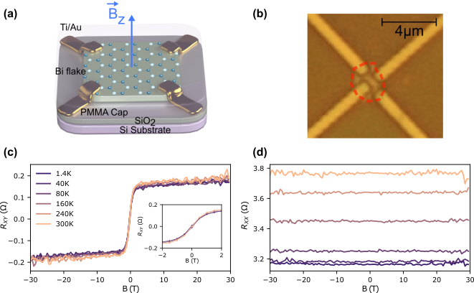
Observation of Temperature-Independent Anomalous Hall Effect in Thin Bismuth from Near Absolute Zero to 300 K Temperature
Oulin Yu¹, F. Boivin¹, A. Silberztein¹, and G. Gervais¹
Department of Physics, McGill University, Montréal, H3A 2T8, Canada
Funding Grants: NSERC (Canada), FRQNT (Québec), CXC (Montréal), K. M. Amm (NSF DMR-2128556);
Bismuth has been an archetypal material for discovering new physical phenomena. Notably, it has led to the observation of diamagnetism by Faraday and later on the Nernst-Ettingshausen effect and Shubnikov-de Haas oscillations.
Propelled by its potential for new discoveries and the renewed interest for bismuthene (i.e., the 2D limit of bismuth), we developed an innovative mechanical exfoliation technique to fabricate thin bismuth Van der Pauw devices of thicknesses ranging from 29 to 69nm (see Figs. 1(a) and 1(b)). Preliminary results in a 9T system at 15mK unravelled the presence of a bona fide anomalous Hall effect (AHE) in our thin bismuth device. The MagLab 31T resistive magnet equipped with a variable temperature insert allowed us to widely extend the measurement range. As a result, we surprisingly observed that the AHE is independent of temperature from 1.4 to 300K (see Fig. 1(c)) and that the magnetoresistance is featureless from -30 to 30T (see Fig. 1(d)).
Both results are puzzling, especially since bismuth is known to be diamagnetic and the AHE requires time reversal symmetry to be broken which typically occurs in ferromagnetic materials. Furthermore, the absence of temperature dependence supports an interpretation of the AHE as being of an intrinsic nature, known to be a precursor of the quantum anomalous Hall effect. Given its buckled honeycomb crystal structure and high degree of spin-orbit coupling, bismuth could be a promising platform to explore the parity anomaly predicted by Haldane and leads us to speculate whether the quantum anomalous Hall effect could be observed at higher temperature than it has been so far.
Fig. 1: (a) Schematic and (b) optical image of the thin bismuth device. (c) Hall and longitudinal responses for temperatures ranging from 1.4 to 300K.
Facilities and instrumentation used: DC field, 31 Tesla, 50 mm bore resistive magnet, cell 9
Citation: Yu, O.; Boivin, F.; Silberztein, A.; Gervais, G., Observation of Temperature-Independent Anomalous Hall Effect in Thin Bismuth from Near Absolute Zero to 300K Temperature, Physical Review Letters, 134, 066603 (2025) doi.org/10.1103/PhysRevLett.134.066603
Notes:
How to compress files size:
On PowerPoint, you can save the attached image (Right click on an image -> Select “Save as picture” -> Then you save the image as PNG). PNG is the image compression without losing the image quality. You replace the original image with the PNG one on PowerPoint. This should reduce the PowerPoint file size.
One thing to be careful about is that you should enlarge your image a bit on PowerPoint before saving so is to avoid losing much resolution.

Slide 2
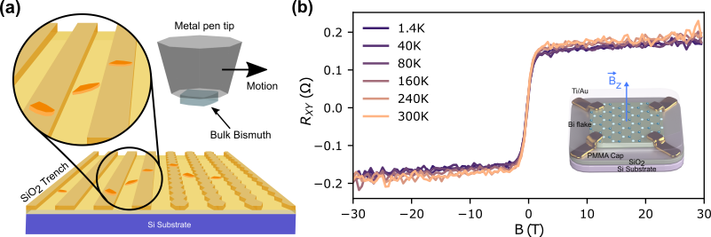
Bismuth Breaks the Rules: Mysterious Magnetic Effect Stays Unchanged Across Extreme Temperatures
Oulin Yu¹, F. Boivin¹, A. Silberztein¹, and G. Gervais¹
Department of Physics, McGill University, Montréal, H3A 2T8, Canada
Funding Grants: NSERC (Canada), FRQNT (Québec), CXC (Montréal), K. M. Amm (NSF DMR-2128556);
What is the finding?
Researchers created ultra-thin bismuth films, about 68 nanometers thick — thinner than a thousandth of a human hair — using a unique method similar to a cheese grater to shave off thin flakes. When exposed to a magnetic field, the electrical resistance in the bismuth showed an unusual behavior (called the anomalous Hall effect), which remained the same from near absolute zero to room temperature. (see Fig. 1(b)).
Why is this important?
The anomalous Hall effect shouldn’t happen in bismuth because of its magnetic properties, making this discovery unexpected. Even more puzzling is that the effect stays the same across a huge temperature range, from near absolute zero to room temperature—something never seen before. This suggests that the effect is intrinsic to bismuth and not caused by magnetic impurities. Looking ahead, bismuth could be a valuable material for exploring quantum versions of this effect and for developing biocompatible electronics, thanks to its low toxicity.
Fig. 1: (a) Micro-trench exfoliation technique. (b) Hall response and schematic of the bismuth device.
Why did this research need the MagLab?
This discovery was made on a resistive 31 Tesla magnet equipped with a variable temperature insert at the MagLab’s DC Field Facility. The specialized magnet system was of fundamental importance to the discovery of temperature independence since no magnet with this field and temperature range is available at the researchers’ home laboratory.
Facilities and instrumentation used: DC field, 31 Tesla, 50 mm bore resistive magnet, cell 9
Citation: Yu, O.; Boivin, F.; Silberztein, A.; Gervais, G., Observation of Temperature-Independent Anomalous Hall Effect in Thin Bismuth from Near Absolute Zero to 300K Temperature, Physical Review Letters, 134, 066603 (2025) doi.org/10.1103/PhysRevLett.134.066603
Notes:
How to compress files size:
On PowerPoint, you can save the attached image (Right click on an image -> Select “Save as picture” -> Then you save the image as PNG). PNG is the image compression without losing the image quality. You replace the original image with the PNG one on PowerPoint. This should reduce the PowerPoint file size.
One thing to be careful about is that you should enlarge your image a bit on PowerPoint before saving so is to avoid losing much resolution.

