Slide 1
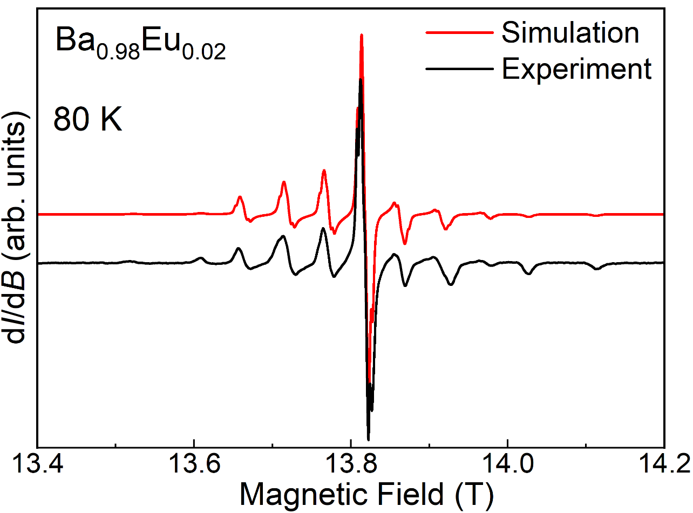
A Triangular Frustrated Eu^{II} Magnetic Framework for Sub-Kelvin Refrigeration
A.S. Manvell,¹ M.A. Dunstan,¹ D. Gracia,² J. Hrubý,³ M. Kubus,¹ J.N. McPherson,¹ E. Palacios,² H. Weihe,⁴ S. Hill,³ J. Schnack,⁵ M. Evangelisti,² K.S. Pedersen¹
1. TU Denmark, Denmark; 2. CSIC & Universidad de Zaragoza, Spain; 3. NHMFL, FSU; 4. University of Copenhagen, Denmark; 5. Universität Bielefeld, Germany
Funding Grants: K. M. Amm (NSF DMR-2128556); K. S. Pedersen (Villum Fonden, Sapere Aude, Carlsberg Foundation); M. Evangelisti (European Union, Gobierno de Aragón)
Attaining sub-kelvin temperatures is technologically challenging and often relies on the scarce resource ³He, unless employing adiabatic demagnetization refrigeration. Herein, the coolant typically consists of weakly coupled paramagnetic ions, whose magnetic interaction strengths are comparable in energy to the relevant temperature regime of cooling. Such interactions depend strongly on inter-ion distances, fundamentally hindering the realization of dense coolants for sub-kelvin refrigeration.
In this investigation, a magnetically concentrated triangular coordination network, Eu_{0.9}Ba_{0.1}I₂(pyrazine)₃, is reported featuring the large s = ⁷/₂ spin moment of Eu^{II}. High-field electron paramagnetic resonance (EPR), magnetization, and heat capacity measurements indicate weak antiferromagnetic correlations between the Eu^{II} spins and a dominant easy-plane magnetic anisotropy. In particular, EPR measurements at high magnetic fields and relatively high temperatures (80K – see Figure) are essential to quantifying the magnetic anisotropy independently from the inter-ion antiferromagnetic exchange interaction energy.
This interdisciplinary collaboration has demonstrated a perfect combination of weak magnetic interactions and geometric frustration in the low-dimensional organic Eu_{0.9}Ba_{0.1}I₂(pyrazine)₃ framework, which prevents entropy-annihilating magnetic ordering down to at least 0.17K; large magnetic entropy is a critical requirement for adiabatic demagnetization refrigeration. These factors, combined with the large spin moment and high Eu^{II} concentration, open up exciting possibilities for efficient on-chip cryogenic refrigeration down to remarkably low (sub-kelvin) temperatures, especially in scenarios where established inorganic refrigerants cannot be utilized.
Figure 1. High-field EPR spectrum (Experiment) recorded at a frequency of 385GHz along with the corresponding simulation, from which quantitative information about the Eu^{II} magnetic anisotropy can be deduced.
Facilities and instrumentation used: Electron Magnetic Resonance (EMR) Facility – 15/17 Tesla Superconducting Magnet System.
Citation: Manvell, A.S.; Dunstan, M.A.; Gracia, D.; Hrubý, J.; Kubus, M.; McPherson, J.N.; Palacios, E.; Weihe, H.; Hill, S.; Schnack, J.; Evangelisti, M.; Pedersen, K.S., A Triangular Frustrated Eu(II)–Organic Framework for Sub-Kelvin Magnetic Refrigeration, Journal of the American Chemical Society, 147 (9), 7597-7603 (2025) doi.org/10.1021/jacs.4c17003 - Data Set

Slide 2
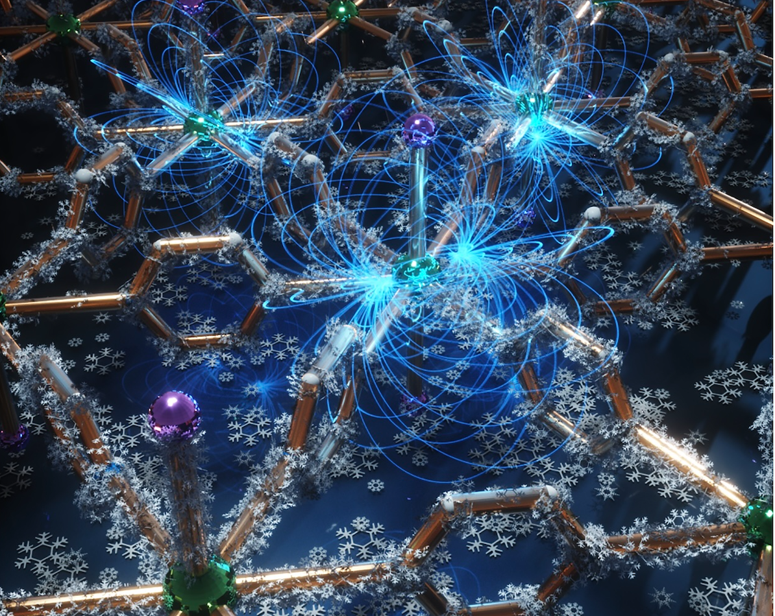
Unlocking Ultra-Cold Cooling: A Unique Magnetic Material for Next-Generation
Refrigeration
A.S. Manvell,¹ M.A. Dunstan,¹ D. Gracia,² J. Hrubý,³ M. Kubus,¹ J.N. McPherson,¹ E. Palacios,² H. Weihe,⁴ S. Hill,³ J. Schnack,⁵ M. Evangelisti,² K.S. Pedersen¹
1. TU Denmark, Denmark; 2. CSIC & Universidad de Zaragoza, Spain; 3. NHMFL, FSU; 4. University of Copenhagen, Denmark; 5. Universität Bielefeld, Germany
Funding Grants: K. M. Amm (NSF DMR-2128556); K. S. Pedersen (Villum Fonden, Sapere Aude, Carlsberg Foundation); M. Evangelisti (European Union, Gobierno de Aragón)
What is the finding? Scientists discovered that a special arrangement of europium ions connected by organic molecules could be ideal for efficient magnetic cooling at extremely low temperatures. The triangular pattern prevents the europium ions from settling into an ordered magnetic state, keeping them disordered even at near absolute zero. This unique property makes the material promising for advanced cooling technologies.
Why is this important? Scientists found that by briefly applying and then removing a magnetic field, a special material with europium ions can cool itself down. This could lead to efficient mini refrigerators for ultra-low temperatures, reducing the need for rare and costly helium-3, which is currently used for cooling below 1K.
Why did this research need the MagLab? Scientists studied how europium ions interact in this special material, which is key to understanding its cooling ability. Electron paramagnetic resonance measurements at magnetic fields far greater than those of commercial instruments were essential for measuring these interactions and discovering how europium’s magnetic poles align. This knowledge helps explain how the material achieves ultra-low-temperature cooling.
Figure 1. Illustration of the triangular Eu_{0.9}Ba_{0.1}I₂(pyrazine)₃ network and the magnetic fields (blue lines) produced by the Eu^{II} ions (green spheres) that are essential to the refrigeration process.
Facilities and instrumentation used: Electron Magnetic Resonance (EMR) Facility – 15/17 Tesla Superconducting Magnet System.
Citation: Manvell, A.S.; Dunstan, M.A.; Gracia, D.; Hrubý, J.; Kubus, M.; McPherson, J.N.; Palacios, E.; Weihe, H.; Hill, S.; Schnack, J.; Evangelisti, M.; Pedersen, K.S., A Triangular Frustrated Eu(II)–Organic Framework for Sub-Kelvin Magnetic Refrigeration, Journal of the American Chemical Society, 147 (9), 7597-7603 (2025) doi.org/10.1021/jacs.4c17003 - Data Set
Notes:
How to compress files size:
On PowerPoint, you can save the attached image (Right click on an image -> Select “Save as picture” -> Then you save the image as PNG). PNG is the image compression without losing the image quality. You replace the original image with the PNG one on PowerPoint. This should reduce the PowerPoint file size.
One thing to be careful about is that you should enlarge your image a bit on PowerPoint before saving so is to avoid losing much resolution.

