Slide 1
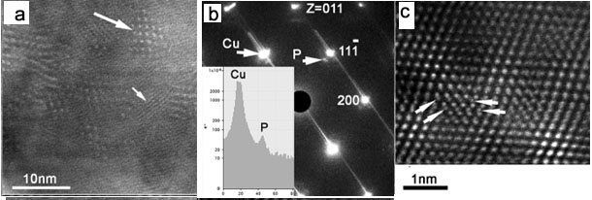
Development of long length, high strength conductors
R. Niu ¹, V. Toplosky ¹, W. Starch ¹, T. Adkins ¹, I. Dixon, J.W. Levitan ¹, J. Lu ¹, D. N. Nguyen ², and K. Han ¹
1. Florida State University; 2. Los Alamos National Laboratory
Funding Grants: K. M. Amm (NSF DMR-2128556)
The high-magnetic fields that the MagLab has created for our users are not available in any other institute in this country. Because our users must have reliable, uninterrupted access to these fields at all times, the maintenance of our magnets is an absolute priority. This is especially true for the short-pulsed magnets that are our users’ workhorses. In addition to these short-pulsed magnets, the MagLab has several other types, including the 100T pulsed and the 60T Controlled Waveform (CW) magnets. Because the generator in Los Alamos is now under repair, these 100T and 60T CW magnets are not currently available. This has led to even greater demand being placed on the short-pulsed magnets that do not need the generator. To address the strong demand and to keep the required conductors from running out, we rapidly developed CuCrZr conductors with improved qualities and increased yields.
In this study, we enhanced both hardness and electrical conductivity in solution-treated Cu-Cr-Zr conductors. After cold deformation, hardness increased by ~100%, and electrical conductivity increased by 24%. We further demonstrated that post-deformation aging increased hardness by another 27%~38% while bringing electrical conductivity up an additional 80%. We attributed our simultaneous enhancement of hardness and conductivity to the generation of deformation-induced, disc-shaped, and semi-coherent precipitates with thicknesses less than a nanometer. Aging-induced precipitates remained only a couple of nanometers thick, but their Cr content was relatively greater than that of deformation-induced precipitates (see figure).
In collaboration with our vendors, we used the above fabrication conditions to manufacture conductors for the 65T short-pulsed magnets. The first 65T pulsed magnet using these conductors, with their improved design, delivered 1577 shots, of which 972 were 60T or higher. (By comparison, 65T magnets made from older conductors and following the older design delivered only 500 shots on average at >60 T).
Figure: Longitudinal cross-section of the microstructure in a Cu-Cr-Zr conductor. This unique microstructure allows the conductors to be drawn to a large strain (up to 2.9). The conductors were drawn to various cross-sectional areas in long lengths for use in short pulsed magnets, the 60T CW magnet, and the 100T magnet. a. An image showing Moiré fringes (MFs) resulting from Cr nanosized strengthening particles. Some MFs appear as dot arrays (indicated by a long arrow), while others appear as parallel lines (indicated by a short arrow). b. Selected area diffraction pattern, showing particles in a cube-on-cube orientation relationship with the Cu matrix [(100) Cr // (100) Cu and [011] Cr // [011] Cu]. The inset shows an intensity profile of the diffraction spots from either the Cu matrix or Cr nanoparticles (indicated by P). c. Atomic resolution HAADF image showing atomic columns (indicated by white arrows) of a strengthening particle forming a semi-coherent interface with the matrix (see citation).
Facilities and instrumentation used: Facilities for wire drawing, winding, inspection, and microstructure examination
Citation: Niu, R.; Han, K.; Lu, J.; Levitan, J.W.; Toplosky, V.J., Deformation induced precipitation in CuCrZr composites, Materials Science and Engineering A, 875 (6), 145092 (2023) doi.org/10.1016/j.msea.2023.145092

Slide 2
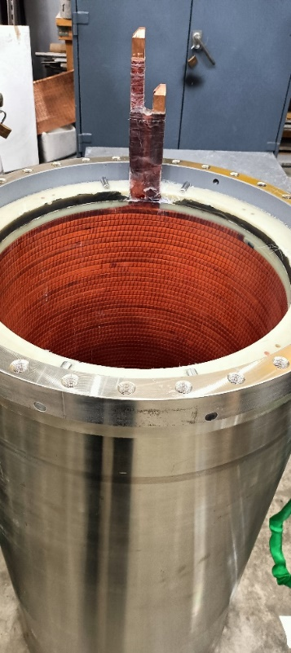
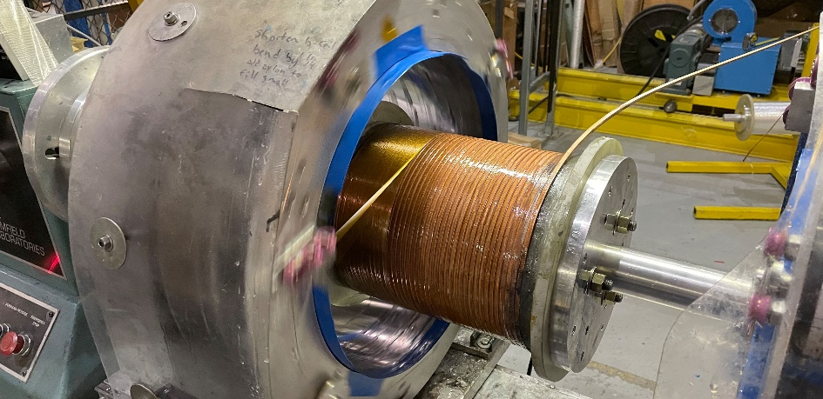
Long length, high strength conductors
R. Niu ¹, V. Toplosky ¹, W. Starch ¹, T. Adkins ¹, I. Dixon, J.W. Levitan ¹, J. Lu ¹, D. N. Nguyen ², and K. Han ¹
1. Florida State University; 2. Los Alamos National Laboratory
Funding Grants: K. M. Amm (NSF DMR-2128556)
What is the finding? Creating strong, high-quality materials in long lengths without defects is difficult, but critically important for use in pulsed magnets at the MagLab. MagLab researchers found a way to improve the process by selecting the right chemistry and improving fabrication procedures. They successfully made Copper Chromium Zirconium (Cu-Cr-Zr) conductors up to 600 meters long with no defects, maintaining their strength at both room and extremely cold temperatures.
Why is this important? Long-length conductors developed at the lab have led to major advancements, including increasing the number of pulses available in short-pulsed magnets, winding coils for a duplex magnet that generates over 75T, completing a key coil for the 60T continuous-wave magnet, and starting production of a 100T magnet coil without layer-to-layer joints. These longer conductors lower costs, reduce weak points, and improve overall performance.
Why did this research need the MagLab? The MagLab has special tools to study conductor materials at every scale, from tiny atoms to full-sized wires. It has powerful microscopes, unique cold-temperature testing machines, and custom equipment for making and inspecting strong conductors. A team of experts, including metallurgists, engineers, and materials scientists, use these tools to develop and improve advanced materials.
The winding of coil 3 for the 100T magnet, which requires four layers of conductors. The newly developed long-length conductor, exceeding 600 meters, makes it possible to avoid joints between layers.
The completed coil 7 for the 60T CW magnet, which used two layers of the newly developed conductors.
The winding of outer coil for a duplex pulsed magnet. The newly developed conductor makes this magnet to target to 85T without generator.
Facilities and instrumentation used: Facilities for wire drawing, winding, inspection, and microstructure examination
Citation: Niu, R.; Han, K.; Lu, J.; Levitan, J.W.; Toplosky, V.J., Deformation induced precipitation in CuCrZr composites, Materials Science and Engineering A, 875 (6), 145092 (2023) doi.org/10.1016/j.msea.2023.145092

