Slide 1
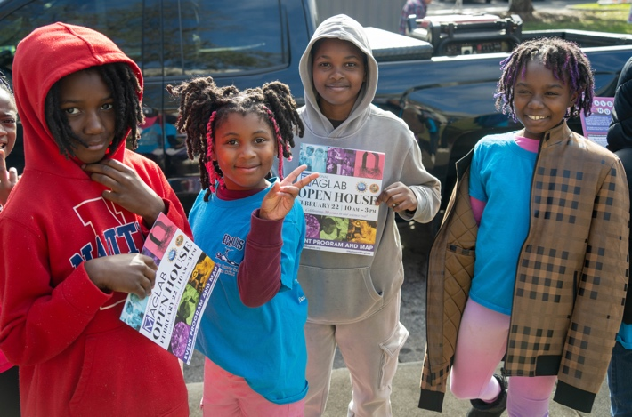
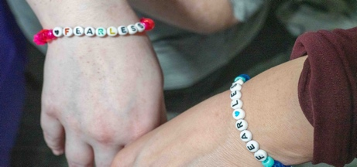
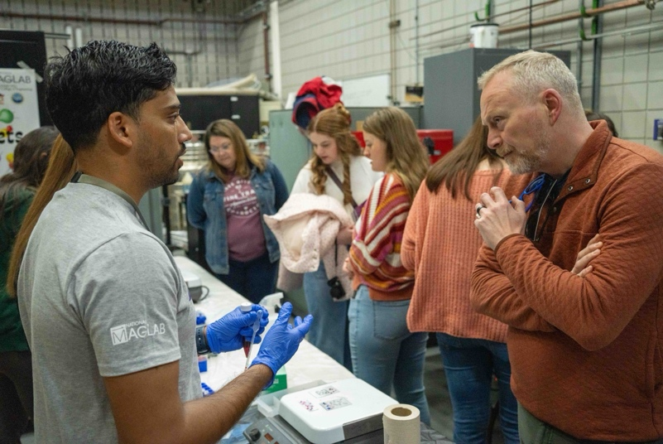
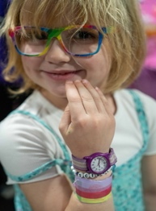
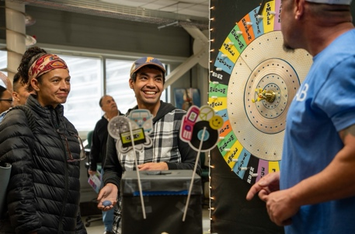
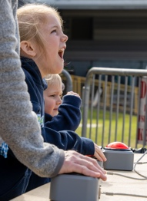
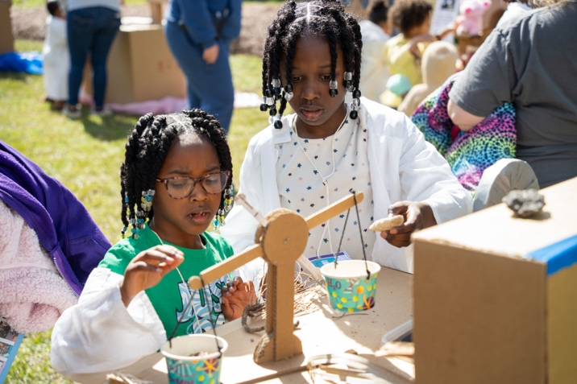
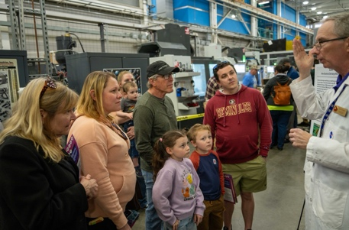
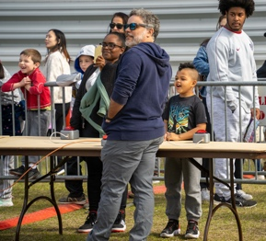
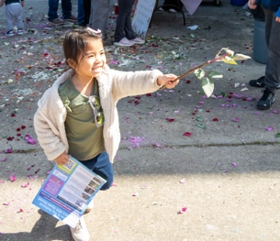
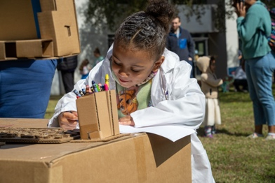
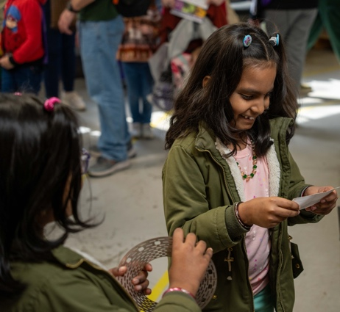
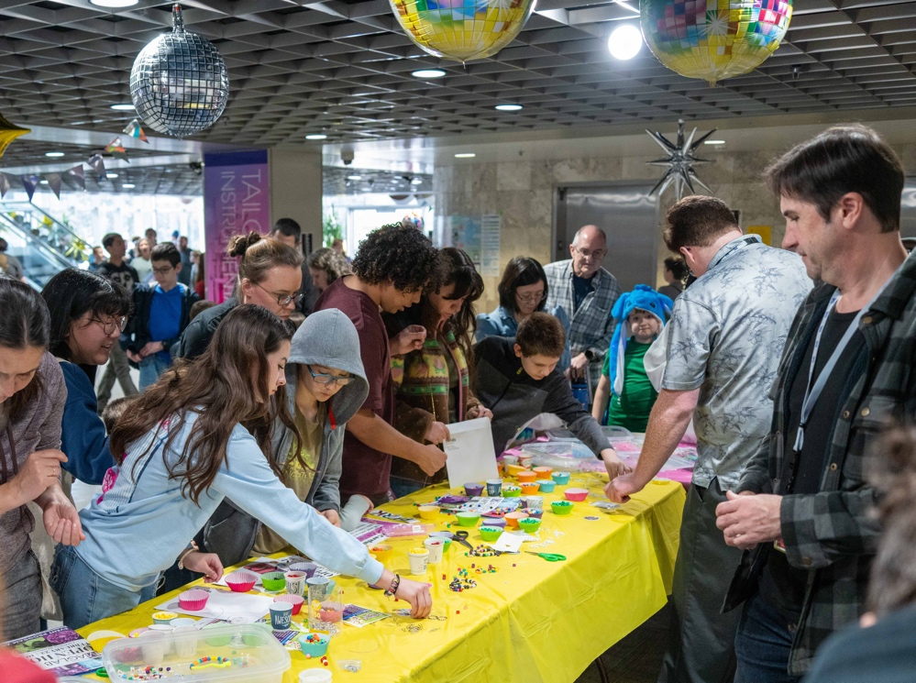
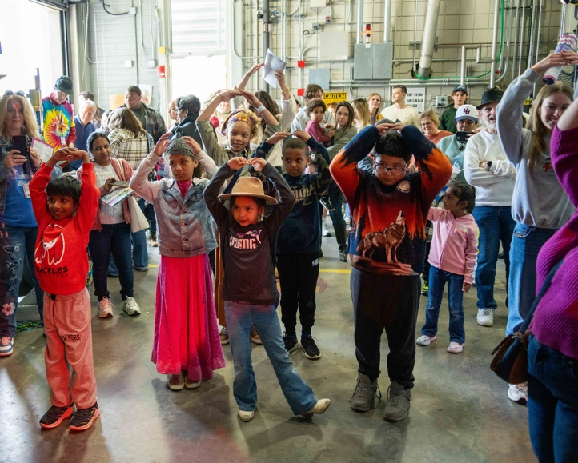
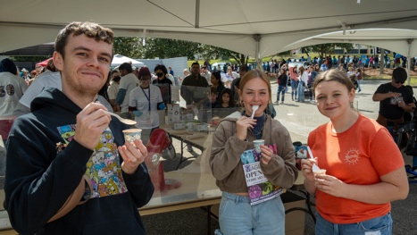
In our MagLab Era: The MagLab’s 30th Open House Event
Funding Grants: K. M. Amm (NSF DMR-2128556)
More than 10,000 visitors of all ages came from across the region to be in their MagLab Era at our 30th Open House on February 22, 2025.
This year’s ERAS theme celebrated the past, present and future of the MagLab with hands-on activities and demonstrations and featured some special anniversary and Eras-themed activities including a Quantum Dance Party at the world’s strongest 45 T Magnet where participants compared binary computing with simple 1 and 0 dance moves to quantum computing with freestyle dances, an exploration of Capacitors through Time, a Bitter Disk of Fortune activity to learn about magnet-making, a Magnetic Personalities Game where visitors created custom Wooly Willy-style magnetic games or go on a scavenger hunt around the lab, collecting beads to make a MagLab Friendship Bracelet.
Events like Open House are an important way for visitors of all ages to connect with the MagLab by meeting our researchers, exploring our unique lab spaces, and experiencing the fun of hands-on science. Events are particularly good at exciting and inspiring visitors. Preliminary 2025 Open House survey data shows that about half of Open House visitors had never been to the lab before the event and that 88% agreed or strongly agreed that the event helped them better understand the science at the MagLab and how it benefits our community.
Open House is a one-of-a-kind event that brings together the energy and fun of a science festival inside of a world-unique research laboratory. This special combination and the participation from about 200 MagLab scientists, students and staff is what makes Open House possible.
Photos from the 2025 Open House.
Facilities and instrumentation used: Open House features every FSU-based MagLab Facility and is run by the lab’s Public Affairs Team with immense support from Facilities & Safety

Slide 2
In our MagLab Era: The MagLab’s 30th Open House Event
Funding Grants: K. M. Amm (NSF DMR-2128556)
What is the finding? More than 10,000 visitors of all ages came from across the region to be in their MagLab Era at our 30th Open House on February 22, 2025.
This year’s ERAS theme celebrated the past, present and future of the MagLab with hands-on activities and demonstrations including some special anniversary and Eras-themed activities including a Quantum Dance Party at the world’s strongest 45 T Magnet where participants compared binary computing with simple 1 and 0 dance moves to quantum computing with freestyle dances, an exploration of Capacitors through Time, a Bitter Disk of Fortune activity to learn about magnet-making, a Magnetic Personalities Game where visitors created custom Wooly Willy-style magnetic games or go on a scavenger hunt around the lab, collecting beads to make a MagLab Friendship Bracelet.
Why is this important? Events like Open House are an important way for visitors of all ages to connect with the MagLab by meeting our researchers, exploring our unique lab spaces, and experiencing the fun of hands-on science. Events are particularly good at exciting and inspiring visitors. Preliminary 2025 Open House survey data shows that about half of Open House visitors had never been to the lab before the event and that 88% agreed or strongly agreed that the event helped them better understand the science at the MagLab and how it benefits our community.
Why did this research need the MagLab? Open House is a one-of-a-kind event that brings together the energy and fun of a science festival inside of a world-unique research laboratory. This special combination and the participation from about 200 MagLab scientists, students and staff is what makes Open House possible.
Photos from the 2025 Open House.
Facilities and instrumentation used: Open House features every FSU-based MagLab Facility and is run by the lab’s Public Affairs Team with immense support from Facilities & Safety

