Slide 1
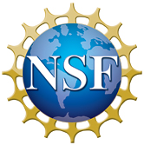
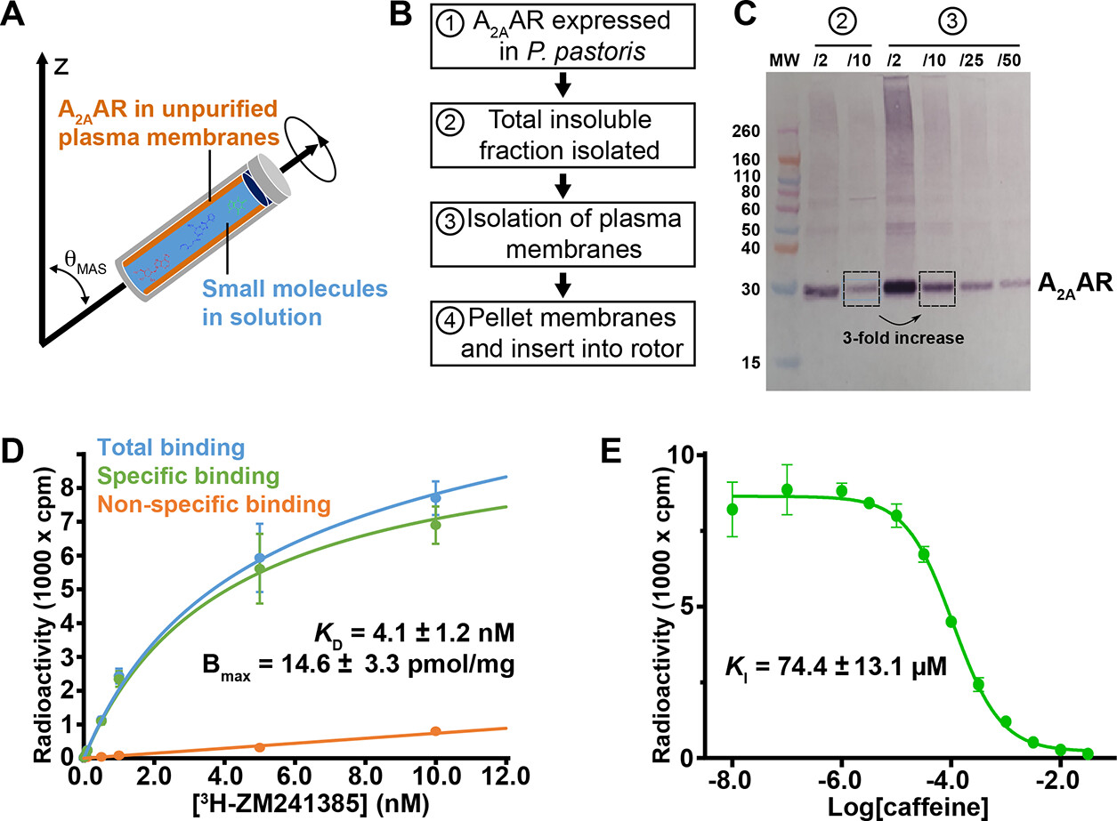
Development of an In Situ G Protein-Coupled Receptor Fragment Molecule Screening Approach with High-Resolution Magic Angle Spinning Nuclear Magnetic Resonance
Enzo Petracco¹, Guillaume Ferré¹, Ivo Kabelka², Flavio Ballante², Jens Carlsson², Emma Mulry¹, Arka P. Ray¹, James Collins¹, Florent Allais¹, and Matthew T. Eddy¹
University of Florida; 2. Uppsala University
Funding Grants: K. M. Amm (NSF DMR-2128556); M.T.E. (NIH R35 GM138291); J.C. (Swedish Research Council 2021-04186 and 2021-03464; Olle Engvists 2910154)
Over 4,000 proteins not targeted by current drugs have been identified as potential therapeutic targets, many of which are G protein-coupled receptors (GPCRs). Conventional drug screening methods rely on labeled ligands that are expensive or not commercially available, limiting which proteins can be studied. Additionally, these methods overlook lower affinity molecules that provide leads for ultimately developing drug-like compounds.
This study demonstrated a proof-of-concept application of high-resolution magic angle spinning nuclear magnetic resonance (HRMAS NMR) spectroscopy for screening for small molecules that bind the human A_{2A} adenosine receptor (A_{2A}AR), a GCPR target for Parkinson’s disease and several cancers. Researchers developed a novel workflow to prepare plasma membranes enriched with A_{2A}AR without the need for detergent purification, which is often required in conventional experiments. This improved the sensitivity of NMR experiments while maintaining a native-like cellular environment of the plasma membrane. Researchers then used known investigational molecules such as caffeine to validate their approach before applying their method to identify novel chemical scaffolds that interact with the receptor and serve as starting points for new drug discovery.
Beyond GCPRs, HRMAS NMR could be applied to lipid-based nanoparticles, biodegradable polymeric nanoparticles, protein-excipient interactions, and antigen-adjuvant binding in drug formulations. Additionally, the method applied in this study should be readily adapted for GPCRs and other membrane proteins expressed in mammalian cells and other cell systems, underscoring its broad applicability.
Figure:
(A) A diagram of the HRMAS rotor, showing membranes with A2AAR and small molecules in solution.
(B) Optimized sample preparation workflow
(C) Western blot quantification of A_{2A}AR that validates the workflow described in (B).
(D and E) Ligand binding data demonstrating that the workflow results in active protein samples.
Facilities and instrumentation used: AMRIS Facility; 800 MHz/63 mm Bruker Avance III NMR spectrometer, 4mm HRMAS HCND probe.
Citation: Petracco, E.; Ferré, G.; Kabelka, I.; Ballante, F.; Carlsson, J.; Mulry, E.; Ray, A.P.; Collins, J.H.; Allais, F.; Eddy, M.T., Development of an In Situ G Protein-Coupled Receptor Fragment Molecule Screening Approach with High-Resolution Magic Angle Spinning Nuclear Magnetic Resonance, ACS Chemical Biology, 20 (2), 401-411 (2025) doi.org/10.1021/acschembio.4c00686

Slide 2
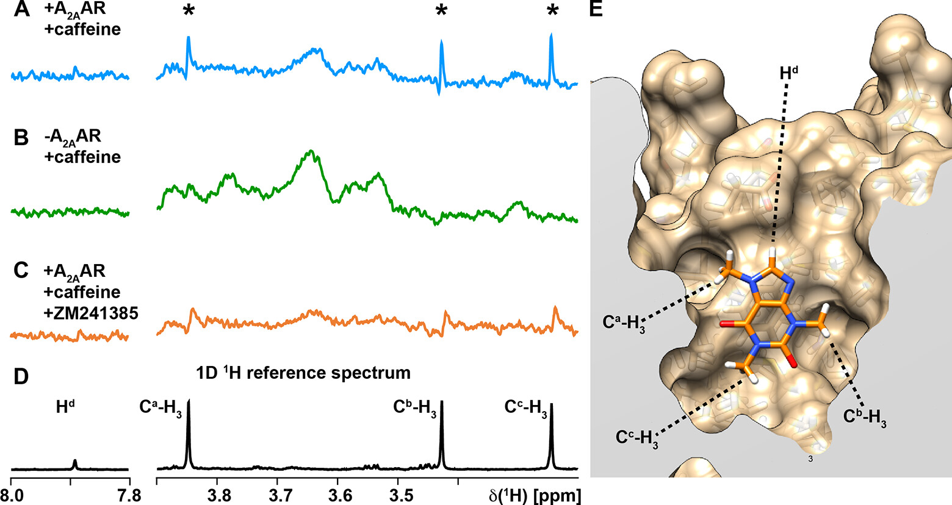
New Screening Method Uses Advanced NMR to Discover Potential Drug Molecules
Enzo Petracco¹, Guillaume Ferré¹, Ivo Kabelka², Flavio Ballante², Jens Carlsson², Emma Mulry¹, Arka P. Ray¹, James Collins¹, Florent Allais¹, and Matthew T. Eddy¹
University of Florida; 2. Uppsala University
Funding Grants: K. M. Amm (NSF DMR-2128556); M.T.E. (NIH R35 GM138291); J.C. (Swedish Research Council 2021-04186 and 2021-03464; Olle Engvists 2910154)
What is the finding? Researchers developed a new way to test if a molecule binds to a protein, which helps in studying biology and developing new medicines. They first proved their method works using known molecules like caffeine and then applied their method to discovering new kinds of molecules that can potentially be further developed into better drugs.
Why is this important? Most medicines work by attaching to proteins in the body. However, over 4,000 therapeutically-important proteins have no existing drug treatments. Finding molecules that bind to these proteins is crucial for developing new medicines, but traditional methods only work for certain types of molecules. Finding molecules that bind to these proteins is a key part of developing new medications, but conventional methods are limited to molecules that can easily be “labeled” with radioisotopes or fluorescent compounds. This new “label-free” technique allows scientists to study a much wider range of molecules, opening the door to discovering new drugs that were previously impossible to explore.
Why did this research need the MagLab? NMR spectroscopy needs powerful magnets, like those at the MagLab, to work. This study also used a new, special technique called High Resolution Magic Angle Spinning (HRMAS), a technique that yields much higher resolution spectra by spinning the sample inside the magnetic field at a specific angle and frequency using specially-designed equipment that is not commonly available at NMR facilities outside of the MagLab.
*
Figure: NMR data for caffeine interacting with cell membranes: (A) caffeine (* signals) binds to membranes containing A_{A2}AR; (B) when A_{A2}AR is absent from the membranes, no bound caffeine is detected; and (C) addition of ZM231385, which targets A_{2A}AR, prevents caffeine from binding. (D) is a reference spectrum for caffeine in solution. Because we see these peaks in spectrum A, where we would expect caffeine to bind to A_{2A}AR, but not spectra B or C, where binding should not occur, this validates that the technique is correctly screening for molecules binding to the protein. (E) is an illustration of where caffeine binds to A_{2A}AR. The labeled hydrogens (H^{d}, Cª-H₃, C^{b}-H₃, and C^{c}-H₃) correspond to the signals seen in the NMR data.
Facilities and instrumentation used: AMRIS Facility; 800 MHz/63 mm Bruker Avance III NMR spectrometer, 4mm HRMAS HCND probe.
Citation: Petracco, E.; Ferré, G.; Kabelka, I.; Ballante, F.; Carlsson, J.; Mulry, E.; Ray, A.P.; Collins, J.H.; Allais, F.; Eddy, M.T., Development of an In Situ G Protein-Coupled Receptor Fragment Molecule Screening Approach with High-Resolution Magic Angle Spinning Nuclear Magnetic Resonance, ACS Chemical Biology, 20 (2), 401-411 (2025) doi.org/10.1021/acschembio.4c00686
Notes:
How to compress files size:
On PowerPoint, you can save the attached image (Right click on an image -> Select “Save as picture” -> Then you save the image as PNG). PNG is the image compression without losing the image quality. You replace the original image with the PNG one on PowerPoint. This should reduce the PowerPoint file size.
One thing to be careful about is that you should enlarge your image a bit on PowerPoint before saving so is to avoid losing much resolution.

