Slide 1
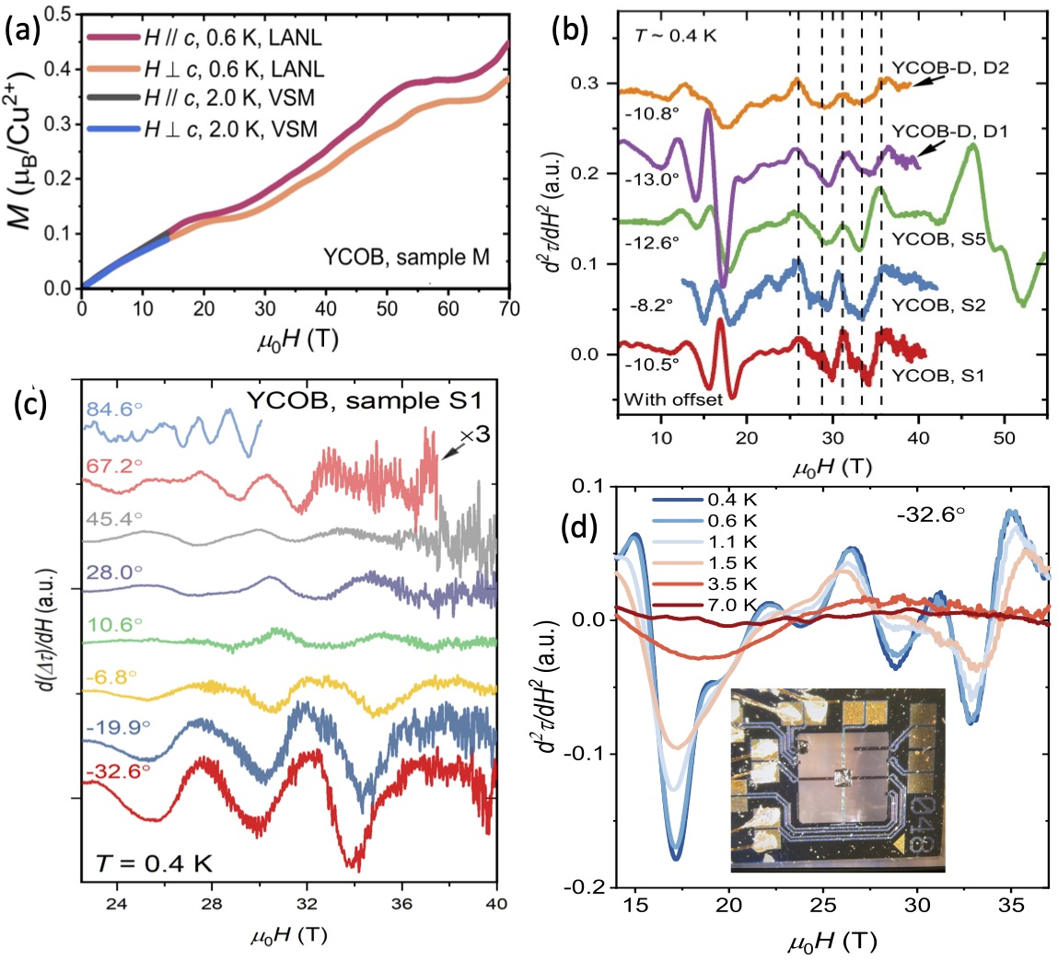
Magnetic oscillations due to spinons in a quantum spin liquid hosted by a Kagome lattice
G. Zheng¹, Y. Zhu¹, K. Chen¹, B. Kang², D. Zhang¹, K. Jenkins¹, A. Chan¹, Z. Zeng^{3,4}, A. Xu^{3,4}, O. Valenzuela⁵, J. Blawat⁵, J. Singleton⁵, S. Li^{3,4,6}, P. Lee² & Lu Li¹ ¹Department of Physics, University of Michigan, Ann Arbor; ²Department of Physics, MIT, Cambridge, MA 02139; ³Beijing National Laboratory for Condensed Matter Physics, Beijing 100190, China; ⁴Physical Sciences, University of CAS, Beijing 100190, China; ⁵National High Magnetic Field Laboratory, Los Alamos, NM 87545; ⁶Songshan Lake Materials Laboratory, Guangdong 523808, China
Funding Grants: USA: NSF DMR-2128556; DOE BES; Gordon & Betty Moore Fdn; China: 2022YFA1403400, 2021YFA1400401, GJTD-2020-01, XDB33000000.
Magnetization measurements strongly suggest that the Kagome lattice Mott insulator YCu₃(OH)₆Br₂[Br_{1−y}(OH)_{y}] (YCOB) is a quantum spin liquid. In such a system, antiferromagnetic order is suppressed by geometrical frustration and quantum fluctuations. Under these conditions, spin–charge separation of electrons can produce charge-neutral spinons, fermions that possess spin but no charge. Using ultrasensitive torque magnetometry, de Haas-van Alphen oscillations are observed, giving strong evidence for both the spinons and an effective gauge field which allows the coupling of the applied magnetic field to these charge-neutral particles. A theoretical model of spinon band structure that includes Dirac nodes near the 1/9 magnetization plateau produces quantitative predictions consistent with the observed oscillations.
The Figure shows several aspects of the experiments. The observation of a 1/9 plateau in the magnetization of YCOB at around 20 T (a), is a strong indication that the material is a quantum spin liquid; the data were recorded in the 75 T Duplex magnet. At fields above the 1/9 plateau, de Haas-van Alphen oscillations are seen in the second derivative of the magnetic torque with respect to field [(b), dotted lines]; their presence in several samples of YCOB and in data from both the 60 T Midpulse magnet, and the 41.5 T quasistatic magnet (b), show they are an intrinsic property of YCOB. The oscillations show a complicated dependence on the orientation of the YCOB crystals (c) caused by the gauge field; angles shown are between the crystal c axis and the field. The temperature dependence of the oscillations (d) is consistent with the spinons being fermions; it agrees with the Lifshitz-Kosevich formula, originally derived for electrons in metals. The inset to (d) shows the bespoke torque magnetometer (designed in a collaboration between the MagLab and industry) employed for measurements in both pulsed and quasistatic fields.
Zheng, G.; Zhu, Y.; Chen, K.; Kang, B.; Zhang, D.; Jenkins, K.; Chan, A.; Zeng, Z.; Xu, A.; Ayala Valenzuela, O.E.; Blawat, J.; Singleton, J.; Li, S.; Lee, P.A.; Li, L., Unconventional magnetic oscillations in a kagome Mott insulator, Proc. National Academy of Sciences (PNAS), 122 (5), e2421390122 (2025) doi.org/10.1073/pnas.2421390122
Figure. (a) Magnetization (M) versus field (μ₀H) of a YCOB crystal at two different orientations. (b) d²τ/dH², where τ = torque, for several YCOB samples. (c) Torque oscillations for different angles between H and the crystal c axis. (d) Oscillations in d²τ/dH² versus field for several different temperatures. Inset: torque magnetometer chip.

Slide 2
Magnetic Signals Reveal Exotic 'Spin Liquid' State in Unusual Crystal Pattern
G. Zheng¹, Y. Zhu¹, K. Chen¹, B. Kang², D. Zhang¹, K. Jenkins¹, A. Chan¹, Z. Zeng^{3,4}, A. Xu^{3,4}, O. Valenzuela⁵, J. Blawat⁵, J. Singleton⁵, S. Li^{3,4,6}, P. Lee² & Lu Li¹ ¹Department of Physics, University of Michigan, Ann Arbor; ²Department of Physics, MIT, Cambridge, MA 02139; ³Beijing National Laboratory for Condensed Matter Physics, Beijing 100190, China; ⁴Physical Sciences, University of CAS, Beijing 100190, China; ⁵National High Magnetic Field Laboratory, Los Alamos, NM 87545; ⁶Songshan Lake Materials Laboratory, Guangdong 523808, China
Funding Grants: USA: NSF DMR-2128556; DOE BES; Gordon & Betty Moore Fdn; China: 2022YFA1403400, 2021YFA1400401, GJTD-2020-01, XDB33000000.
What is the finding? Magnetization measurements show that a special material called YCOB may be a quantum spin liquid—a rare and fascinating state of matter. In YCOB, copper atoms are arranged in a pattern similar to traditional Japanese basket weaving (called "kagome"). Normally, the magnetic parts of these atoms (spins) would align opposite each other, but the triangle pattern makes that impossible. Instead, the spins constantly shift around, similar to how water molecules move in liquid. In this state, the electron seems to split into two parts: one carrying its magnetism (called a spinon) and the other carrying its electric charge (a holon). These experiments show clear signs that spinons are present.
Why is this important? Scientists have been searching for quantum spin liquids for decades; YCOB appears to be the first strong candidate. The splitting of electrons into holons and spinons (spin-charge separation) is also a rare and sought-after phenomenon, with possible applications in future quantum devices.
Why did this research need the MagLab? These discoveries were only possible using the extremely powerful magnets available at the MagLab. To prove that YCOB is a quantum spin liquid, scientists looked at how its magnetization behaved in strong magnetic fields—up to 75 tesla, the highest in the U.S. They saw flat areas in the data, a sign of the quantum spin liquid state. They also used a technique called torque magnetometry, which measures how the crystals twist in the magnetic field. Small “wiggles” in this twisting showed up at specific field strengths, angles, and temperatures—clear evidence of spinons. These measurements required a special tool built through a partnership between the MagLab and industry.
Figure. (a) Magnetization (M) versus field (μ₀H) of a YCOB crystal at two different orientations. (b) d²τ/dH², where τ = torque, for several YCOB samples. (c) Torque oscillations for different angles between H and the crystal c axis. (d) Oscillations in d²τ/dH² versus field for several different temperatures. Inset: torque magnetometer chip.
Zheng, G.; Zhu, Y.; Chen, K.; Kang, B.; Zhang, D.; Jenkins, K.; Chan, A.; Zeng, Z.; Xu, A.; Ayala Valenzuela, O.E.; Blawat, J.; Singleton, J.; Li, S.; Lee, P.A.; Li, L., Unconventional magnetic oscillations in a kagome Mott insulator, Proc. National Academy of Sciences (PNAS), 122 (5), e2421390122 (2025) doi.org/10.1073/pnas.2421390122

