Slide 1
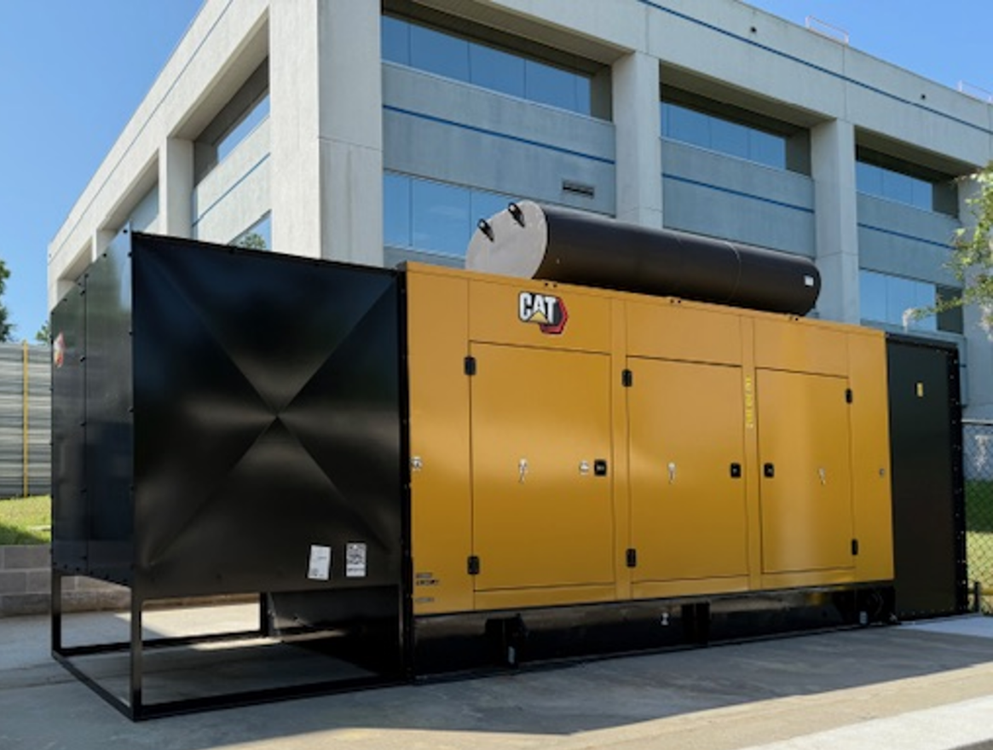
Enhancing Research Resiliency: Emergency Power Infrastructure Upgrades
John G. Kynoch, Marshall Wood, Jason Hosey
Florida State University; National High Magnetic Field Laboratory
Funding Grants: K.M. Amm (NSF DMR-2128556)
What is the improvement? We successfully replaced a 30-year-old diesel generator at the FSU branch with a new natural gas unit, significantly improving the resiliency and reliability of our critical equipment.
Why is this important? This upgrade ensures that our safety systems and research operations can continue with minimal disruption during and after power outages. Many of the life safety functions such as egress lighting, fume hoods, fire alarms, and safety sensors rely on reliable back up power. In addition, research infrastructure such as magnet protection, critical vacuum, cryogenics, cold storage, building networking, and the building access systems are connected to the generator to protect our research assets and reduce the recovery time after the power is restored.
Natural gas was chosen as the fuel because of the limited availability of diesel fuel deliveries during and after major storm events.
Why did this happen at the MagLab? The MagLab supports complex, unique science instrumentation that serve users and facilitate important research discoveries. When hurricanes, tornados or power grid problems occur, the infrastructure needs to keep staff and visitors safe and ensure that research availability is restored soon quickly. Reliable backup systems are essential to protect people, experiments, and equipment and to ensure science stays safe and operational—even in extreme conditions.
This project, funded by FSU’s Vice President for Research and executed through a partnership between MagLab Facilities and FSU Project Design and Construction,
Department: MagLab’s Facilities

