Slide 1
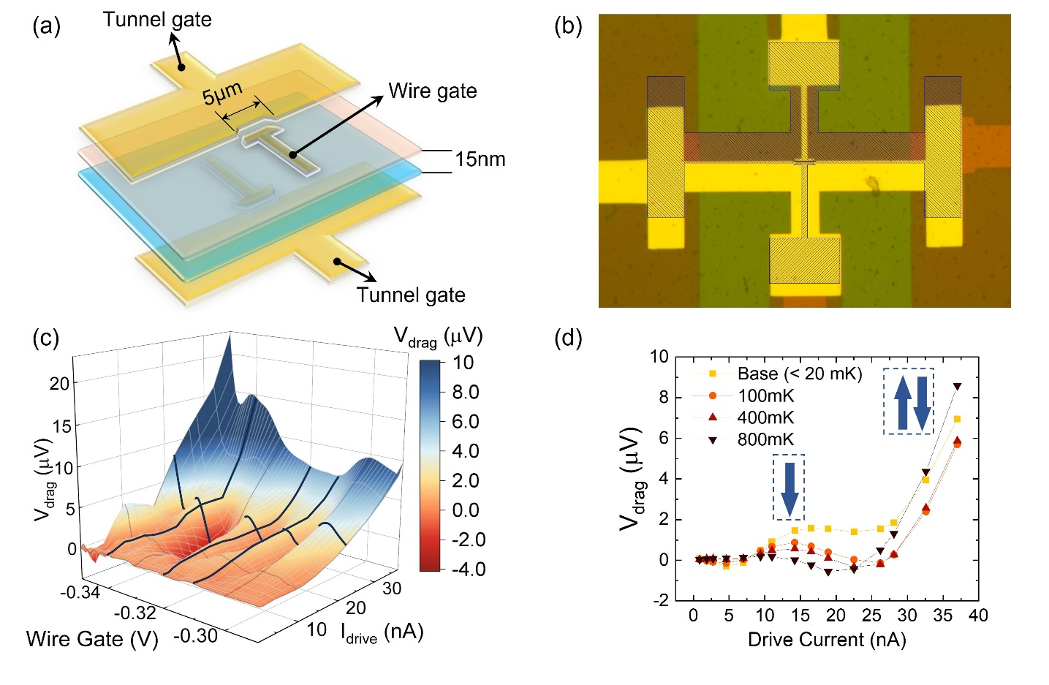
Coulomb-induced drag between 1D wires in the nonlinear regime
Mingyang Zheng¹, Rebika Makaju¹, Rasul Gazizulin^{1,2}, Alex Levchenko³ S. J. Addamane⁴ and Dominique Laroche¹
1. University of Florida; 2. National High Magnetic Field Laboratory; 3. University of Wisconsin–Madison 4. Center for Integrated Nanotechnologies, Sandia National Laboratories,
Funding Grants: D. Laroche (NSF/DMR-1644779); K. M. Amm (NSF DMR-2128556); A. Levchenko (DMR-2203411)
Owing to their strong interactions arising from reduced screening and dimensionality, one-dimensional (1D) systems are predicted to exhibit exotic quantum properties, such as spin-charge separation and topological superconductivity. However, little is experimentally known about how
Coulomb-coupled one-dimensional systems behave.
Utilizing the ultra-quiet electromagnetic interference environment and immersion cooling available in the MagLab High B/T facility, the electron currents in 1D quantum wires only 15nm apart from one another (Figures 1a and b) were studied as the current in one wire drags along electrons in a nearby wire through Coulomb scattering. By extending the study of the Coulomb drag signal to the non-linear regime, our observation of a non-monotonic drive-current/drag-voltage dependence (Figure 1c) confirms theoretical predictions. In addition, telltale signs of Luttinger liquid physics in the form of a non-monotonic temperature dependence (Figure 1d) have also been observed. Crucially, the non-linear signal offers a novel self-consistent way to extract the electron-electron interaction strength in these
1D systems with low electron temperatures. This study also underscores the
co-existence of both reciprocal and rectified signals in 1D wires, providing essential insight needed to understand the quantum origin of both contributions.
Characterizing coupled 1D systems is critical for the future development of quantum devices employing strong electron-electron interactions, such as heat harvesters and novel platforms with induced topological superconductivity.
Figure 1. (a) Schematic and (b) Optical pictures of the coupled quantum wires device. (c) Nonlinear drag response with drive current at different biasing voltages. (d) Non-monotonic temperature dependence of 1D Coulomb drag at low electron temperatures to below 20mK.
Facilities and instrumentation used: High B/T facility, Bay 1 (dry dilution refrigerator during cryogenic testing phase prior to 14T magnet delivery and installation). Citation: Mingyang Zheng, Rebika Makaju, Rasul Gazizulin, Alex Levchenko, Sadhvikas J. Addamane, Dominique Laroche, Quasi-1D Coulomb drag in the nonlinear regime,
accepted in Physical Review Letters, 15 May 2025, https://doi.org/10.1103/v3dn-bnrp; UCGP funded.

Slide 2
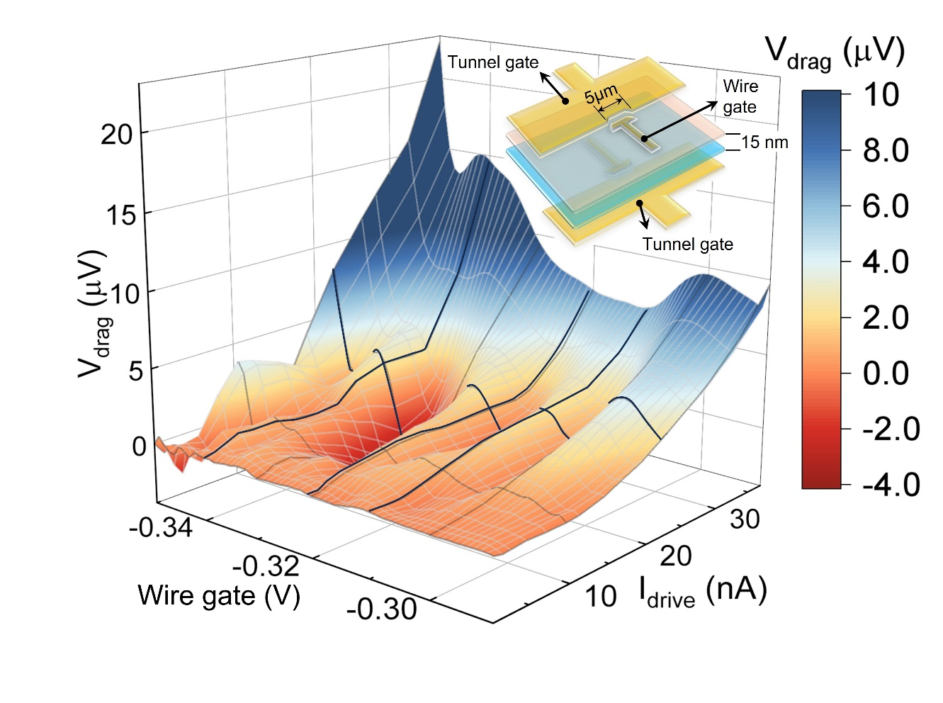
Coulomb-induced drag between 1D wires in the nonlinear regime
Mingyang Zheng¹, Rebika Makaju¹, Rasul Gazizulin^{1,2}, Alex Levchenko³ S. J. Addamane⁴ and Dominique Laroche¹
1. University of Florida; 2. National High Magnetic Field Laboratory; 3. University of Wisconsin–Madison 4. Center for Integrated Nanotechnologies, Sandia National Laboratories,
Funding Grants: D. Laroche (NSF/DMR-1644779); K. M. Amm (NSF DMR-2128556); A. Levchenko (DMR-2203411)
What is the finding? Researchers created a tiny, custom-built device to study how electricity flows in wires placed just 15 nanometers apart—about 5,000 times thinner than a human hair. At extremely low temperatures, running current through one wire caused a voltage to appear in the nearby wire, a phenomenon known as Coulomb drag. At large currents, the effect didn’t increase linearly —instead, it rose and fell in a surprising pattern, providing possible constraints for future theoretical descriptions about how electrons behave in one-dimensional systems.
Why is this important? Measuring how ultra-thin, one-dimensional systems behave is extremely challenging, especially at very low temperatures. This study reveals a new way to measure how strongly electrons interact in these tiny systems which can enable breakthroughs in quantum technology like devices that harvest waste heat, enable new forms of superconductivity, or support more accurate quantum computing.
Why did this research need the MagLab? This experiment used a special experimental setup available only at the MagLab’s High B/T Facility that combines extremely low electrical noise with ultra-cold temperatures—colder than -459°F (20 millikelvin). These special conditions were essential to detect the delicate quantum signals and interactions that would be impossible to observe elsewhere and sets the stage for future experiments that will use powerful 14-tesla magnetic fields to explore even more quantum effects.
Figure 1. Non-monotonic oscillations of the Coulomb drag response to a variable strength current. Inset: Double quantum wire device schematic.
Facilities and instrumentation used: High B/T facility, Bay 1 (dry dilution refrigerator during cryogenic testing phase prior to 14T magnet delivery and installation). Citation: Mingyang Zheng, Rebika Makaju, Rasul Gazizulin, Alex Levchenko, Sadhvikas J. Addamane, Dominique Laroche, Quasi-1D Coulomb drag in the nonlinear regime,
accepted in Physical Review Letters, 15 May 2025, https://doi.org/10.1103/v3dn-bnrp; UCGP funded.

