Slide 1
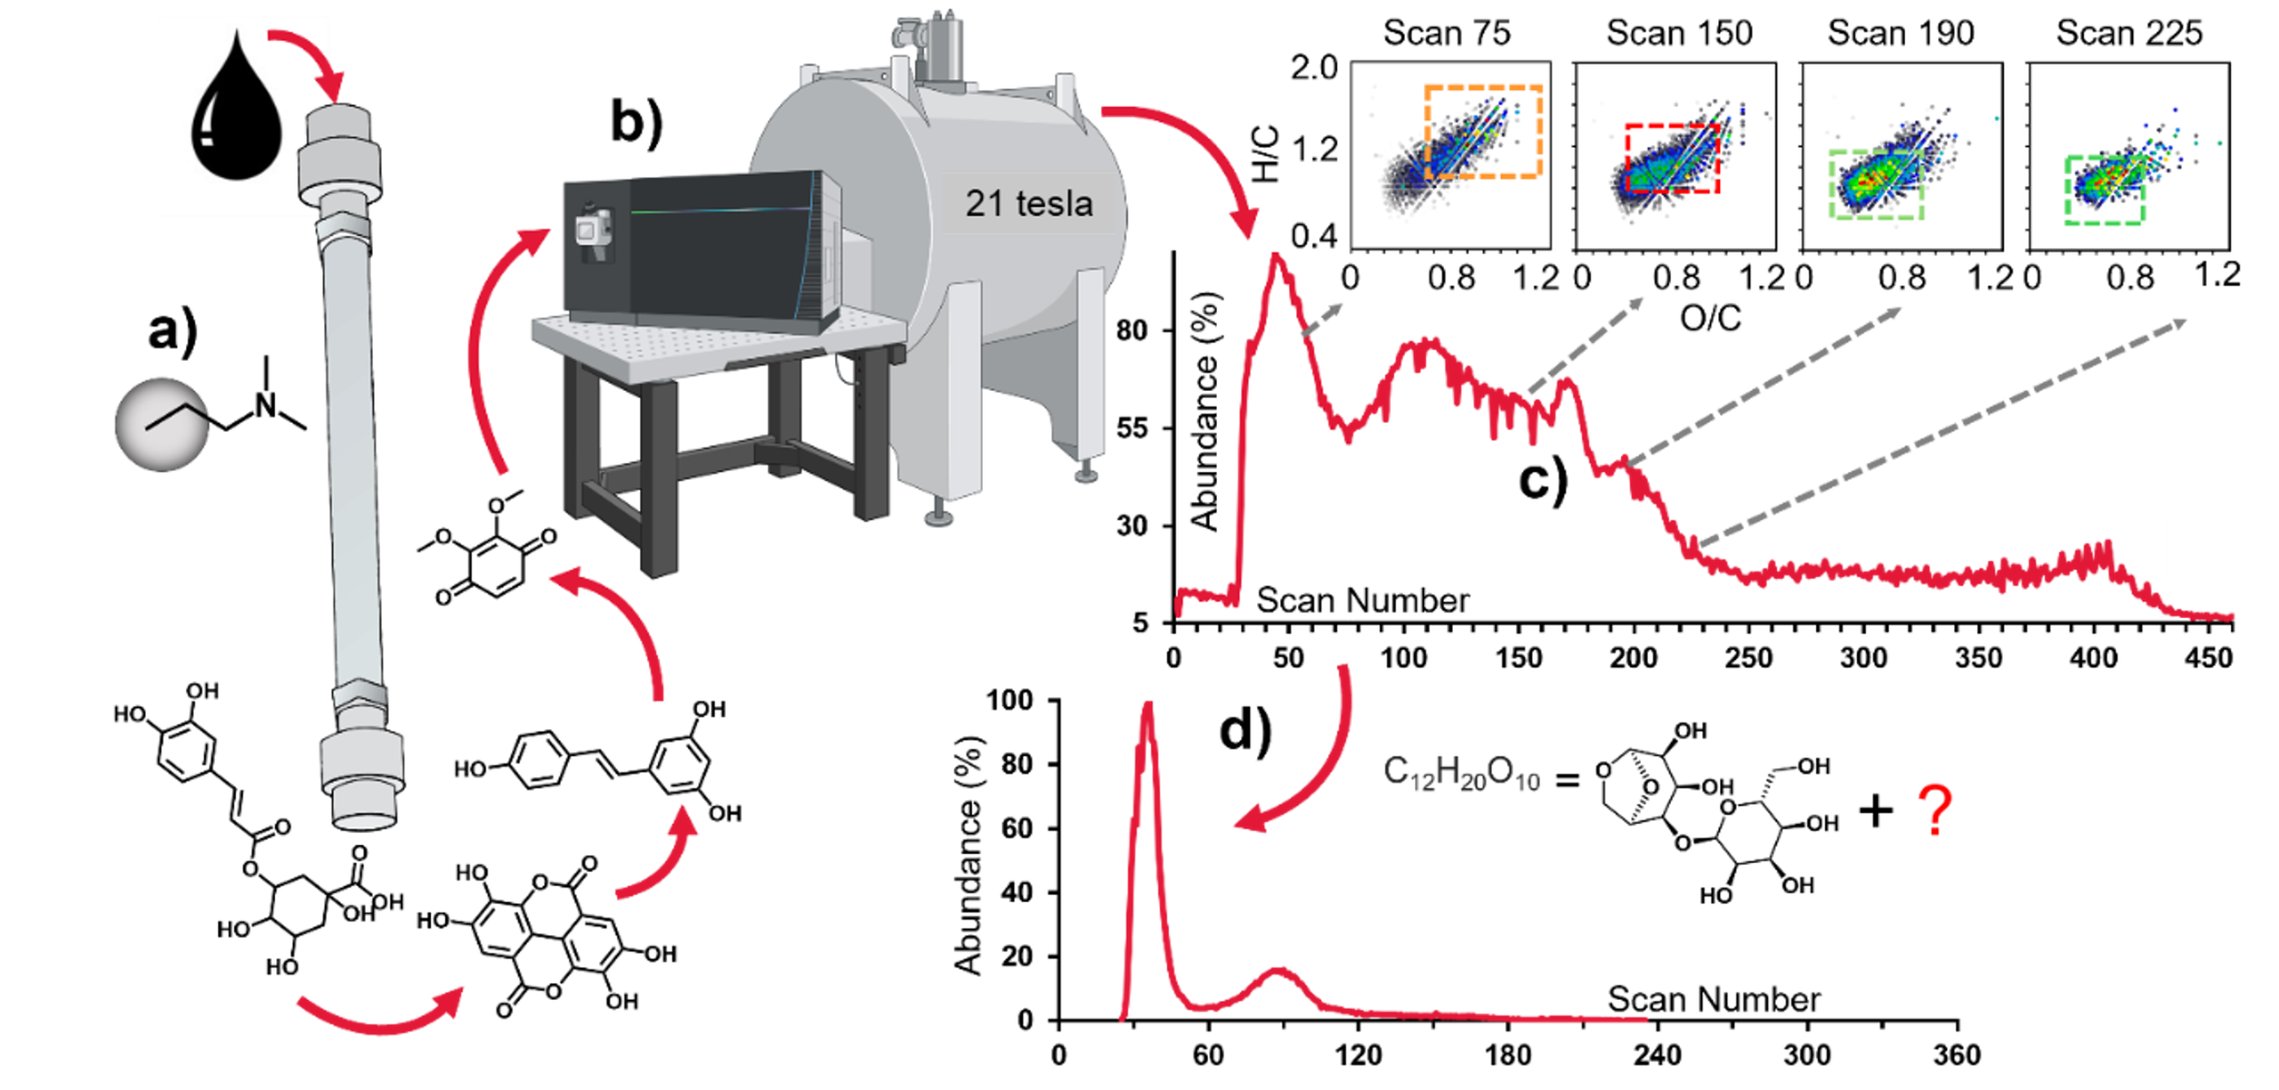
New Separation Method Reveals Thousands of Hidden Compounds in Renewable Bio-Oils
Chacón-Patiño, M. L.¹; Frye-Jones, J. W.¹; Anderson, L. C.¹; Robbins, W. K.¹; Vallverdu, G. S.²; Tello-Rodríguez, Á. J.¹; Ruiz, W.; Gascon, G.²; Rüger, C. P.³; Dayton, D. C.⁴; Giusti, P.⁵; Barrière-Mangote, C.⁵; Afonso, C.⁶; Bouyssiere, B.⁵; Rodgers, R. P.¹
¹NHMFL. ²University of Pau. ³Universität Rostock. ⁴RTI International. ⁵TotalEnergies. ⁶Université de Rouen
Funding Grants: K. M. Amm (NSF DMR-2128556).
Fast pyrolysis of lignocellulosic biomass yields oxygen-rich bio-oils, which serve as promising feedstocks for sustainable fuel and chemical production. However, their molecular complexity and abundance of acidic, polyfunctional species complicate analysis by direct infusion FT-ICR mass spectrometry (MS), which suffers from ion suppression and limited structural resolution. To address this, MagLab users developed a partition-based chromatography method using a polymeric stationary phase with amino functionalities (Figure 1a). This phase retains acidic compounds through reversible acid–base interactions. A solvent gradient from methanol to water with diethylamine creates a high-pH, hydrogen-bonding environment that separates compounds based on their acidity and polarity. As more water is added, different types of acidic compounds—like phenols, carboxylic acids, and lignin-based oligomers—elute sequentially for MS analysis.
Coupling the separation to 21T FT-ICR MS (Figure 1b) enables assignment of tens of thousands of molecular formulas per experiment. This time-resolved approach captures compositional trends, as shown with van Krevelen diagrams (Figure 1c) plotting formulas by H/C and O/C ratios for selected scans. Early spectra (e.g., scan 75) contain methanol-soluble carbohydrates (high H/C, O/C); intermediate scans (e.g., 150) show biomass-like polyphenols; and later scans (e.g., 190/225) highlight aromatic, acidic species (low H/C). The method also resolves structural isomers: compounds with the same molecular formula but different atomic connectivity. For example, the single-ion chromatogram for C₁₂H₂₀O₁₀ reveals two distinct peaks (Figure 1d), which indicates the presence of isomers. One likely corresponds to cellobiosan, a known pyrolysis product; the second may represent a more acidic variant. Such detail is not accessible by direct infusion analysis and is essential for improving bio-oil upgrading processes.
1
2?
1
2
Figure 1. (a) Dimethylaminopropyl stationary phase separates bio-oil components by acidity and polarity. Non-acidic species elute first; polyphenols, carboxylic acids, and polyfunctional compounds elute later. (b) Effluent is analyzed by 21T FT-ICR MS, acquiring one spectrum every ~5 seconds. (c) Total ion chromatogram with selected scans displayed as van Krevelen diagrams (H/C vs O/C), revealing compositional trends from carbohydrates to aromatic acids. (d) Single-ion chromatogram for C₁₂H₂₀O₁₀ shows two peaks, indicative of isomers. The first likely matches cellobiosan (structure shown); the second may include acidic groups. The number of unique formulas detected with this chromatographic approach is nearly twice that of direct infusion.
Facilities and instrumentation used: Ion Cyclotron Resonance Facility – 21T FT-ICR MS. Citation: Chacón-Patiño, M. L.; Frye-Jones, J. W.; Anderson, L. C.; Robbins, W. K.; Vallverdu, G. S.; Tello-Rodríguez, Á. J.; Ruiz, W.; Gascon, G.; Rüger, C. P.; Dayton, D. C.; Giusti, P.; Mase, C.; Barrière-Mangote, C.; Afonso, C.; Bouyssiere, B.; Rodgers, R. P. Detailed Molecular Composition of Wood Pyrolysis Bio-Oils Revealed by HPLC-FT-ICR MS. Energy Fuels 2025, 39 (7), 3575–3588. https://doi.org/10.1021/acs.energyfuels.4c05674. Work funded by UCGP – 2023.

Slide 2
Thousands of Hidden Compounds Revealed in Renewable Bio-Oils
Chacón-Patiño, M. L.¹; Frye-Jones, J. W.¹; Anderson, L. C.¹; Robbins, W. K.¹; Vallverdu, G. S.²; Tello-Rodríguez, Á. J.¹; Ruiz, W.; Gascon, G.²; Rüger, C. P.³; Dayton, D. C.⁴; Giusti, P.⁵; Barrière-Mangote, C.⁵; Afonso, C.⁶; Bouyssiere, B.⁵; Rodgers, R. P.¹
¹NHMFL. ²University of Pau. ³Universität Rostock. ⁴RTI International. ⁵TotalEnergies. ⁶Université de Rouen
Funding Grants: K. M. Amm (NSF DMR-2128556).
What is the finding? Using a custom chemical separation process, scientists were able to isolate and detect nearly twice as many molecules in renewable bio-oils compared to traditional techniques. This novel approach revealed previously hidden isomers - molecules with the same numbers and types of atoms, but arranged in different structures –that are not invisible using conventional techniques.
Why is this important? Bio-oils made from plant waste like wood scraps could be used for fuels or starting materials for chemical production. However, these bio-oils are complex, containing thousands of complex oxygen molecules that are difficult to characterize using standard tools. This breakthrough offers researchers a clearer and more complete chemical picture of bio-oils that can help researchers improve bio-oils for future uses in fuels, industrial chemicals, or energy storage.
Why did this research need the MagLab? The MagLab’s powerful 21-tesla mass spectrometer was key to this work because it is one of the only tools in the world with the resolution and sensitivity needed to analyze complex bio-oils as separation occurs. During the separation process, the instrument collects hundreds of detailed spectra, each representing a different group of molecules. Observing when a single molecular formula appears at multiple points during the separation, scientists can identify structural isomers. This level of chemical insight is not possible with standard instruments.
1
2?
1
2
Figure 1. (a) A special chemical filter separates bio-oil based on how acidic or polar the molecules are. Less acidic ones come out first, followed by more acidic types like plant-based acids. (b) These molecules are then analyzed by a powerful 21-tesla mass spectrometer, which takes detailed readings every five seconds. (c) The data show how the mixture changes over time, revealing patterns from sugar-like to more acidic and aromatic molecules. (d) One group of atoms, C₁₂H₂₀O₁₀, appears twice, showing two forms with the same atoms but different structures—one likely being a sugar-like compound called cellobiosan. This technique detects almost twice as many molecules as older methods.
Facilities and instrumentation used: Ion Cyclotron Resonance Facility – 21T FT-ICR MS. Citation: Chacon Patino, M.L.; Frye-Jones, J.W.; Anderson, L.C.; Robbins, W.D.; Salvato Vallverdu, G.; Tello Rodriguez, A.; Ruiz, W.; Gascon, G.; Ruger, C.P.; Dayton, D.C.; Giusti, P.; Mase, C.; Barrère-Mangote, C.; Afonso, C.; Bouyssiere, B.; Rodgers, R.P., Detailed Molecular Composition of Wood Pyrolysis Bio-Oils Revealed by HPLC-FT-ICR MS, Energy & Fuels, 39 (7), 3575-3588 (2025) doi.org/10.1021/acs.energyfuels.4c05674 - Data Set. Work funded by UCGP – 2023.

