Slide 1


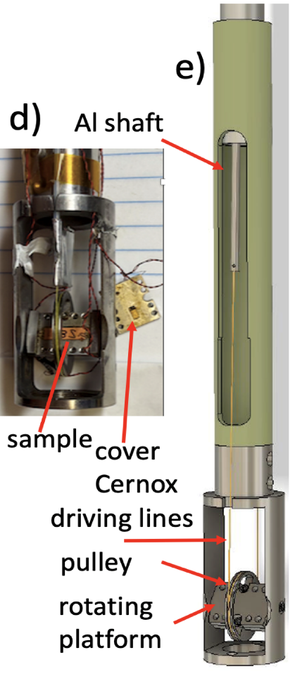
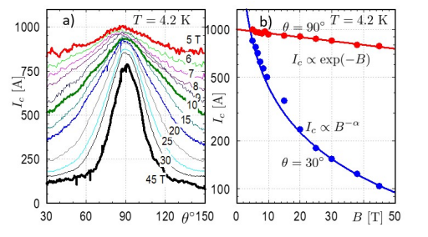



Revolutionizing Superconductor Testing for Next-Gen Magnet Technologies
Jaroszynski, J; Constantinescu, AM; Kolb-Bond, D; Francis, A.; Xu, A.; Ries, R.; Bradford, G.; Bang, B.; Lee, J. and Larbalestier D
National High Magnetic Field Laboratory
Funding Grants: K. M. Amm (NSF DMR-2128556)
REBCO (rare earth–barium–copper–oxide) superconducting tapes are front-runners for high-field magnet applications, including fusion energy systems, advanced research magnets, and high-energy physics experiments. However, conventional transport measurements of their high critical currents are often impractical in the extreme magnetic fields where these materials must operate, creating a bottleneck in their development and qualification.
To address this, MagLab researchers have developed a fast, economical method based on torque magnetometry. When a magnetic field is applied to an anisotropic superconducting tape, it induces a screening current that produces a torque proportional to the tape’s critical current. This enables high-throughput, non-contact characterization across a range of temperatures and field orientations — without the need to apply large currents at cryogenic temperatures.
The method is compatible with both resistive and superconducting magnets and has already been used to evaluate hundreds of tapes, revealing key insights into flux pinning, magneto-thermal stability, and material inhomogeneity. It has attracted strong interest from both academic and industrial partners — including Commonwealth Fusion Systems, Tokamak Energy, the UK Atomic Energy Authority, and several manufacturers — as a powerful tool for accelerating the deployment of next-generation superconducting magnets.
Figures 1 left. Torque magnetometer: a platform with a sample is rotated in magnetic field by servo motor, actuator and driving shaft/lines.. The load cell measures tension of the line, which is proportional to the torque. The torque is proportional to critical current in the sample
Facilities: 45T hybrid magnet and 31 T resistive magnets
Citation: [1] Jaroszynski, J; Constantinescu, AM; Kolb-Bond, D; Francis, A.; Xu, A.; Ries, R.; Bradford, G.; Bang, B.; Lee, J. and Larbalestier, D., Critical Current, Lengthwise Fluctuations, and Flux Jumps in REBCO CC: A Torque Magnetometry Study up to 45 T, https://arxiv.org/abs/2502.02706, (Feb 11 2025)
[2] Jaroszynski, J.; Constantinescu, A. M.; Larbalestier, D. and Miller, G., "Magnetometer For Large Magnetic Moments With Strong Magnetic Anisotropy", US Patent No. 12,181,540 (2024)
UCGP: J. Jaroszynski PI, Fast fatigue and transport current assessment in REBCO coated conductors
Figures 2 above. a) Angular critical current assessed using torque in R&D sample from SuperPower Inc. with 15 % BZO, measured at T = 4.2 K within a magnetic field range of 5 to 45 T. b) Critical current as a function of field for the field in the ab plane and at θ = 60 deg off the ab plane.

Slide 2
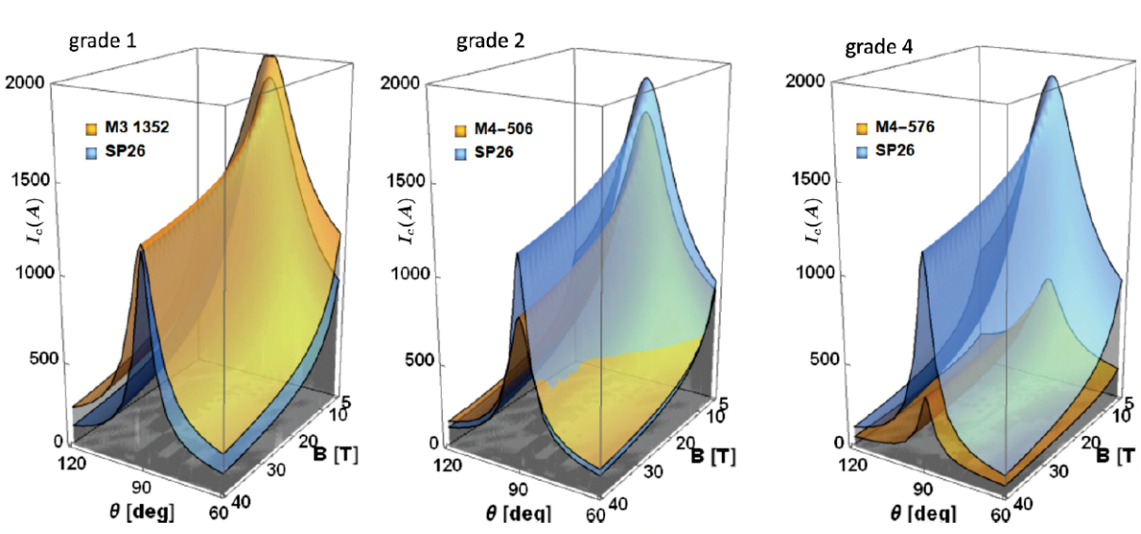
Revolutionizing Superconductor Testing for Next-Gen Magnet Technologies
Jaroszynski, J; Constantinescu, AM; Kolb-Bond, D; Francis, A.; Xu, A.; Ries, R.; Bradford, G.; Bang, B.; Lee, J. and Larbalestier D
National High Magnetic Field Laboratory
Funding Grants: K. M. Amm (NSF DMR-2128556)
What’s the Discovery?
Scientists at the MagLab have invented a faster, easier way to test superconducting tapes — special materials that can carry electricity with zero resistance. These tapes play a big role in future technologies, especially in building powerful magnets for fusion energy and advanced medical devices.
Instead of relying on slow, complex testing methods, the new technique uses a clever trick: once the tape becomes superconducting, it naturally tries to line up with a magnetic field. By measuring this motion (called torque), researchers can quickly find out how much electrical current the tape can carry before superconductivity is destroyed — a key performance metric.
Why Is It Important?
Fusion reactors could provide clean, limitless energy, and superconducting tapes are essential for making the powerful magnets they need. But developing and testing these tapes has been slow and difficult, slowing progress toward this energy breakthrough.
This new method speeds up testing, helping researchers identify the best materials faster — which could help bring fusion energy, better medical imaging, and other high-tech applications closer to reality.
Why Did It Need the MagLab?
Testing how superconducting materials perform under extreme conditions — like very high magnetic fields and super-cold temperatures — isn’t possible in most labs. The MagLab is one of the only places in the world with the powerful magnets and special equipment needed for this kind of research. By combining their one-of-a-kind tools with this new testing method, MagLab scientists are helping accelerate the next generation of energy and technology solutions.
Figure 1. Critical currents vs. magnetic field B ang angle for three graded samples (yellow) compared to standard sample (blue). For 5 < B < 30 T the fitting procedure is an interpolation of torque magnetometry experimental data, while beyond 30 T it is an extrapolation. (.J. Jaroszynski et al., Superconductor Sc. and Tech..35, 095009 (2022))
Facilities: 45T hybrid magnet and 31 T resistive magnets
Citation: [1] Jaroszynski, J; Constantinescu, AM; Kolb-Bond, D; Francis, A.; Xu, A.; Ries, R.; Bradford, G.; Bang, B.; Lee, J. and Larbalestier, D., Critical Current, Lengthwise Fluctuations, and Flux Jumps in REBCO CC: A Torque Magnetometry Study up to 45 T, https://arxiv.org/abs/2502.02706, (Feb 11 2025)
[2] Jaroszynski, J.; Constantinescu, A. M.; Larbalestier, D. and Miller, G., "Magnetometer For Large Magnetic Moments With Strong Magnetic Anisotropy", US Patent No. 12,181,540 (2024)
UCGP: J. Jaroszynski PI, Fast fatigue and transport current assessment in REBCO coated conductors

