Slide 1


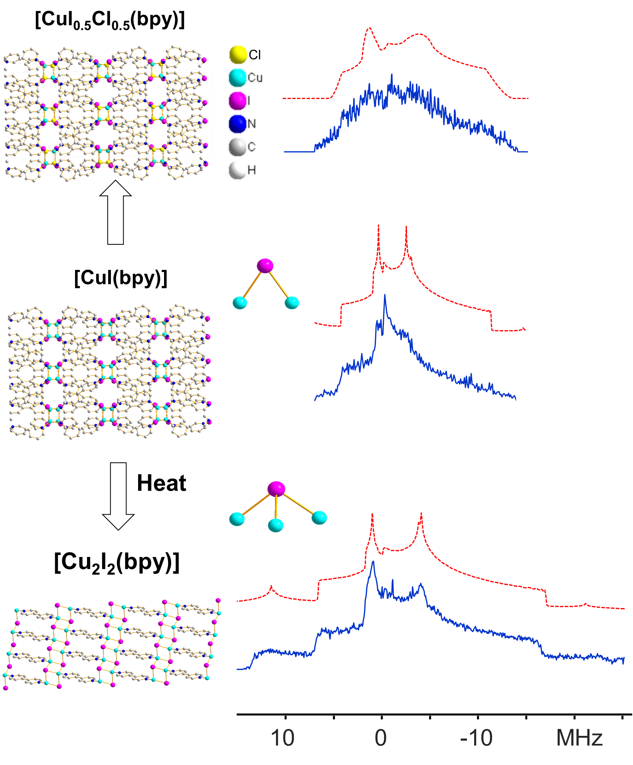
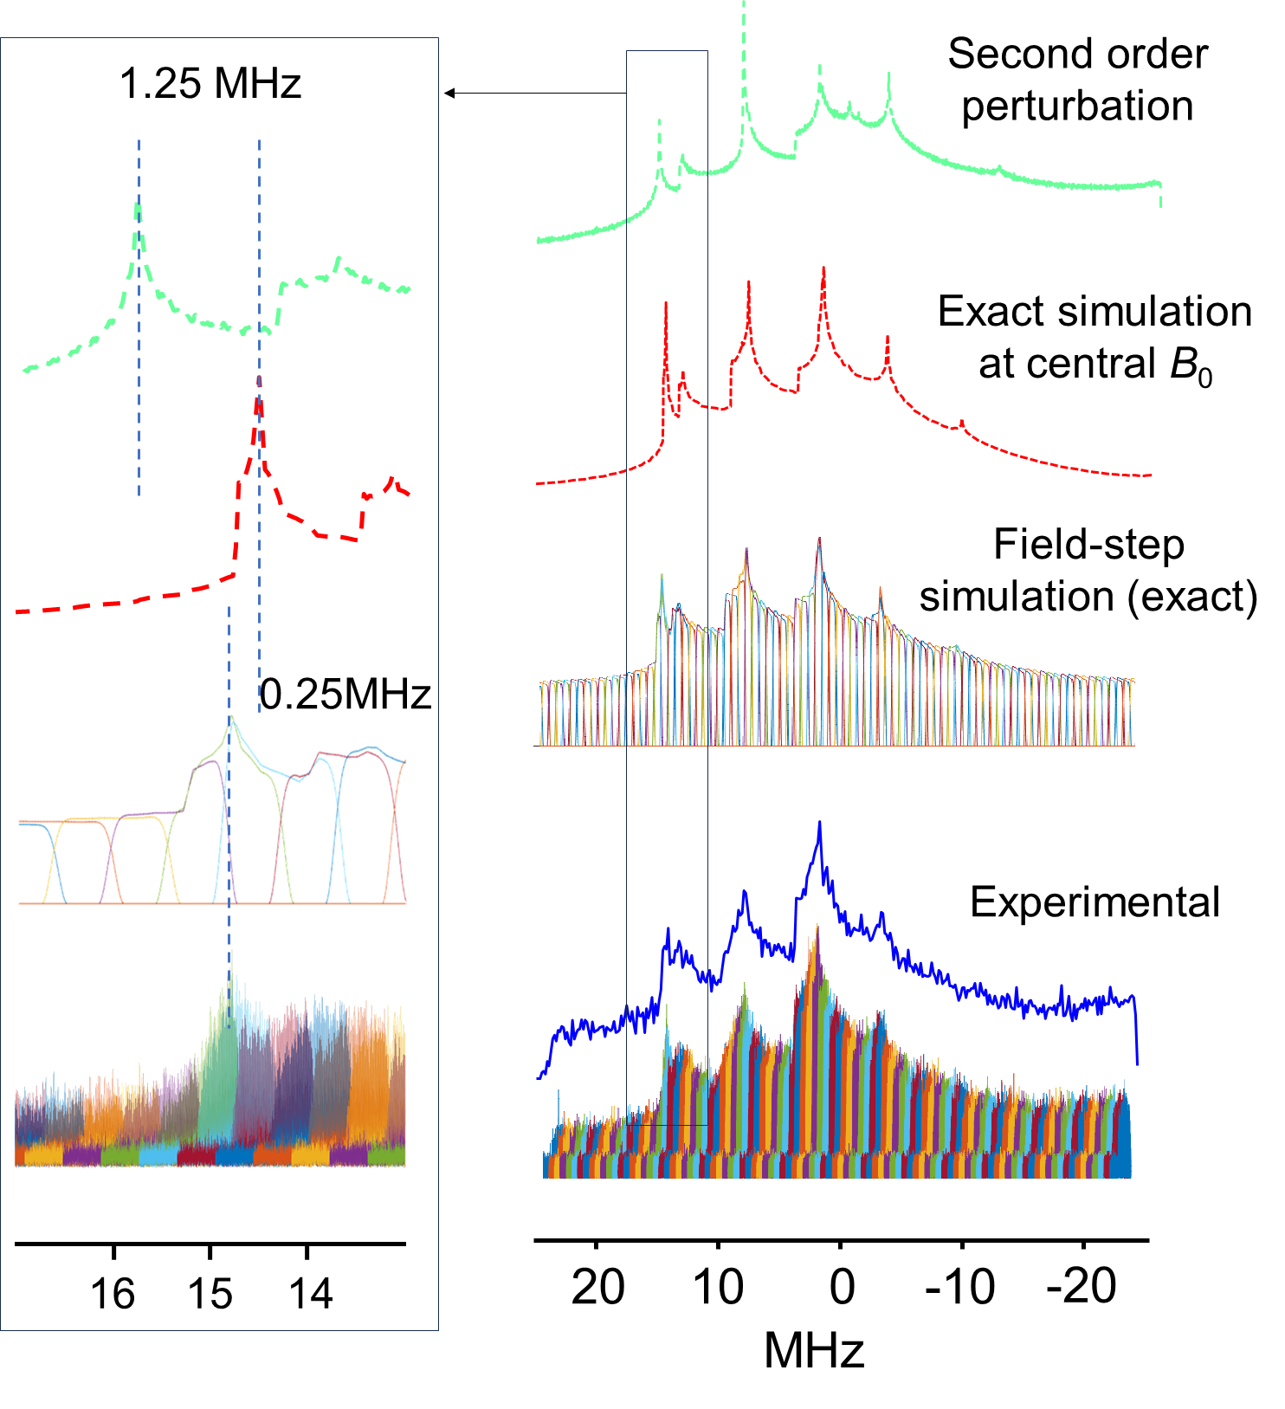



Pushing the Limits of Ultra-Wideline Solid-State NMR: ²⁰⁹Bi and ¹²⁷I Signatures in MOFs
Wanli Zhang¹, Yijue Xu², Amrit Venkatesh², Ivan Hung², Shuting Li¹, Zhehong Gan², Yining Huang^{1,*}
Western University, London, ON, Canada; 2. National High Magnetic Field Laboratory, Tallahassee, FL
Funding Grants: Y. Huang (NSERC of Canada RGPIN-2025-05789), K. M. Amm (NHMFL, NSF/DMR-2128556 and DMR-1644779), R.W. Schurko (NIH P41 GM122698 and NIH RM1-GM148766), M. Bird (NSF/DMR-0603042), W.W. Brey (NSF/DMR-1039938)
Bismuth- and iodine-containing metal-organic frameworks (MOFs) show promise for applications in catalysis, gas adsorption, photoluminescence, and radionuclide capture. Their performance is closely tied to the local environments of Bi³⁺ and I– ions. While ²⁰⁹Bi and ¹²⁷I solid-state NMR (SSNMR) could provide valuable insights, their use for characterizing MOFs remains limited due to major experimental challenges. Despite high natural abundance and favorable receptivity, ²⁰⁹Bi (I = 9/2) and ¹²⁷I (I = 5/2) have exceptionally large quadrupole moments (−51.6 and −71.0 fm²), producing extremely broad SSNMR powder patterns. Higher-order quadrupolar effects and closely spaced satellite transitions further complicate spectral acquisition and analysis.
Using SSNMR at ultra-high magnetic fields on the MagLab’s 36T Series Connected Hybrid (36T-SCH) magnet and field-stepped acquisition strategies, we successfully acquired ultra-wideline (UW) ²⁰⁹Bi and ¹²⁷I SSNMR spectra, overcoming long-standing experimental challenges. These spectra allow for direct probes of the local environments of the Bi and I atoms in MOFs. Despite their extreme breadth, the UW NMR signals are highly sensitive to changes in coordination environments induced by dehydration, guest adsorption, phase transitions, and local disorder.
This work establishes ²⁰⁹Bi and ¹²⁷I UW SSNMR as viable tools for characterizing quadrupolar nuclei with extremely large quadrupole moments. The approach is broadly applicable beyond MOFs and holds significant promise for advancing research fields such as surface science, solar energy conversion, catalysis, and biochemistry, where atomic-scale insights into coordination and bonding environments are essential. The ability to resolve ultra-broad NMR signatures at ultra-high magnetic fields opens new avenues for the rational design of functional materials for targeted applications.
²⁰⁹Bi solid-state NMR
¹²⁷I solid-state NMR
Figure 1. Left: Experimental and simulated ²⁰⁹Bi NMR spectra of MOF IEF-3 using three simulation protocols. The magnified view of the “horn” at ca. 15MHz is shown in the inset. Right: Schematic illustrations of MOFs [CuI(bpy)], [Cu₂I₂(bpy)] and [CuI_{0.5}Cl_{0.5}(bpy)]; experimental (blue) and simulated (red) ¹²⁷I SSNMR spectra of the three MOFs.
Facilities and instrumentation used: 36 T/40 mm Series Connected Hybrid Magnet (35.2 T/1.5 GHz) Citation: Zhang, W.; Xu, Y.; Venkatesh, A.; Hung, I.; Li, S.; Gan, Z.; Huang, Y., Pushing Limits of Ultra-wideline Solid-State NMR Spectroscopy: NMR Signatures of 209Bi and 127I in Metal–Organic Frameworks at Ultra-high Magnetic Fields, Journal of the American Chemical Society, 147 (13), 10823–10828 (2025) doi.org/10.1021/jacs.4c17499

Slide 2
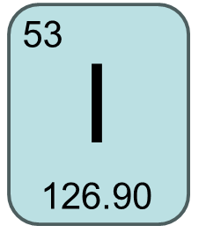
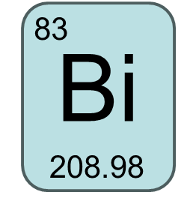
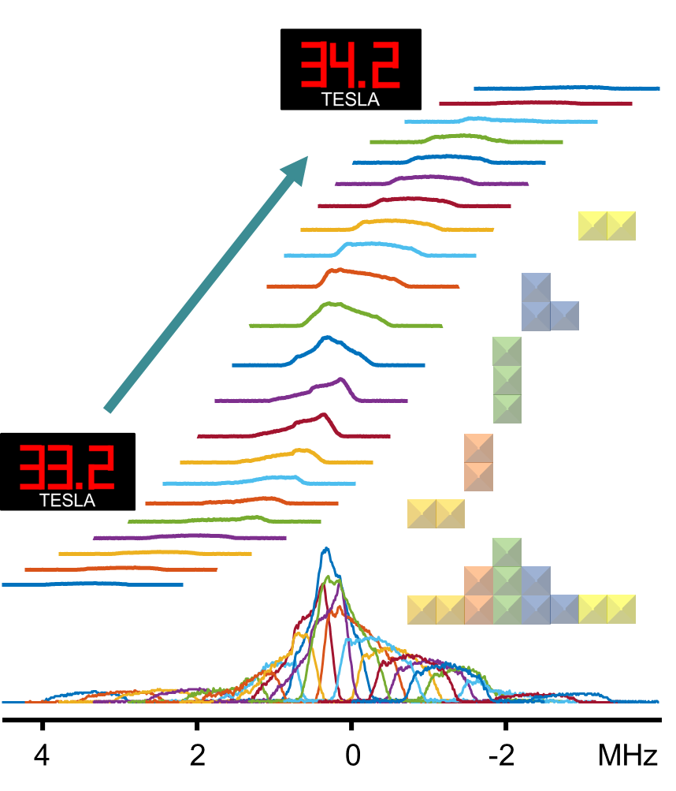
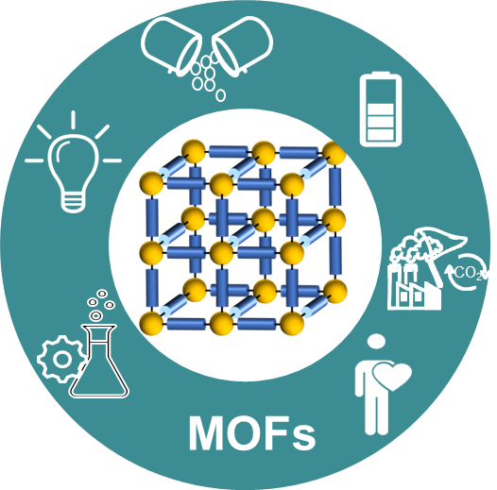
Detecting Atomic Details in Safer, Smarter MOFs
Wanli Zhang¹, Yijue Xu², Amrit Venkatesh², Ivan Hung², Shuting Li¹, Zhehong Gan², Yining Huang^{1,*}
Western University, London, ON, Canada; 2. National High Magnetic Field Laboratory, Tallahassee, FL
Funding Grants: Y. Huang (NSERC of Canada RGPIN-2025-05789), K. M. Amm (NHMFL, NSF/DMR-2128556 and DMR-1644779), R.W. Schurko (NIH P41 GM122698 and NIH RM1-GM148766), M. Bird (NSF/DMR-0603042), W.W. Brey (NSF/DMR-1039938)
What is the finding? Scientists have shown that ultra-wideline solid-state NMR can be used to directly study bismuth (²⁰⁹Bi) and iodine (¹²⁷I) atoms inside metal-organic frameworks (MOFs) — a special type of material with tiny pores that can trap and store gasses, speed up chemical reactions, store energies, or deliver medicines. This breakthrough was made possible by using ultra-high magnetic fields up to 35.2 tesla, enabling high-resolution measurements that were previously out of reach.
Why is this important? Bismuth and iodine are promising building blocks for safer, smarter materials, such as drug delivery systems and light-based technologies. But until now, it’s been incredibly difficult to study them using NMR due to distorted, hard-to-read signals. This study proves that with stronger magnetic fields, it’s possible to capture these signals and uncover details about how the atoms are arranged and how they respond to things like dehydration or molecular interactions. That means better control over MOF properties — from how bright they glow to how safely they can carry medicine.
Why did this research need the MagLab? Only the MagLab has the 36-tesla Series Connected Hybrid magnet and advanced techniques needed to capture clear signals from ²⁰⁹Bi and ¹²⁷Inuclei in such a short time. These ultra-high fields are essential for separating overlapping signals in complex materials and revealing atomic-level details.
Did you use any other national/user shared facilities to complete this work? This work also relied on computing resources from SHARCNET, Compute/Calcul Canada, and the Digital Research Alliance of Canada to support simulations and data analysis.
Drug delivery
Lumine-scence
Battery
CO₂ capture
Catalysis
Sensors
Figure 1. Left: The applications of metal-organic frameworks (MOFs).
Right: ²⁰⁹Bi ultra-wideline solid-state NMR spectra acquired with field-stepped protocol using SCH magnet.
Facilities and instrumentation used: 36 T/40 mm Series Connected Hybrid Magnet (35.2 T/1.5 GHz) Citation: Zhang, W.; Xu, Y.; Venkatesh, A.; Hung, I.; Li, S.; Gan, Z.; Huang, Y., Pushing Limits of Ultra-wideline Solid-State NMR Spectroscopy: NMR Signatures of 209Bi and 127I in Metal–Organic Frameworks at Ultra-high Magnetic Fields, Journal of the American Chemical Society, 147 (13), 10823–10828 (2025) doi.org/10.1021/jacs.4c17499

