Slide 1


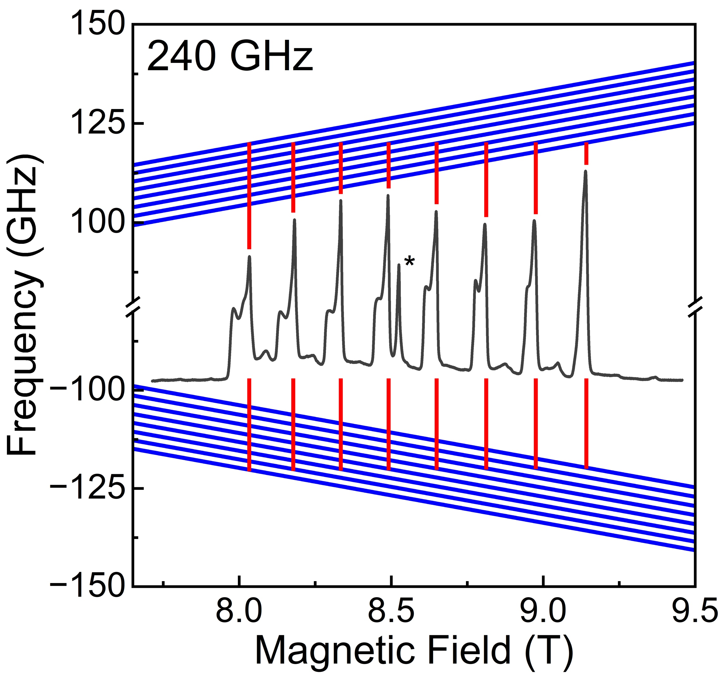
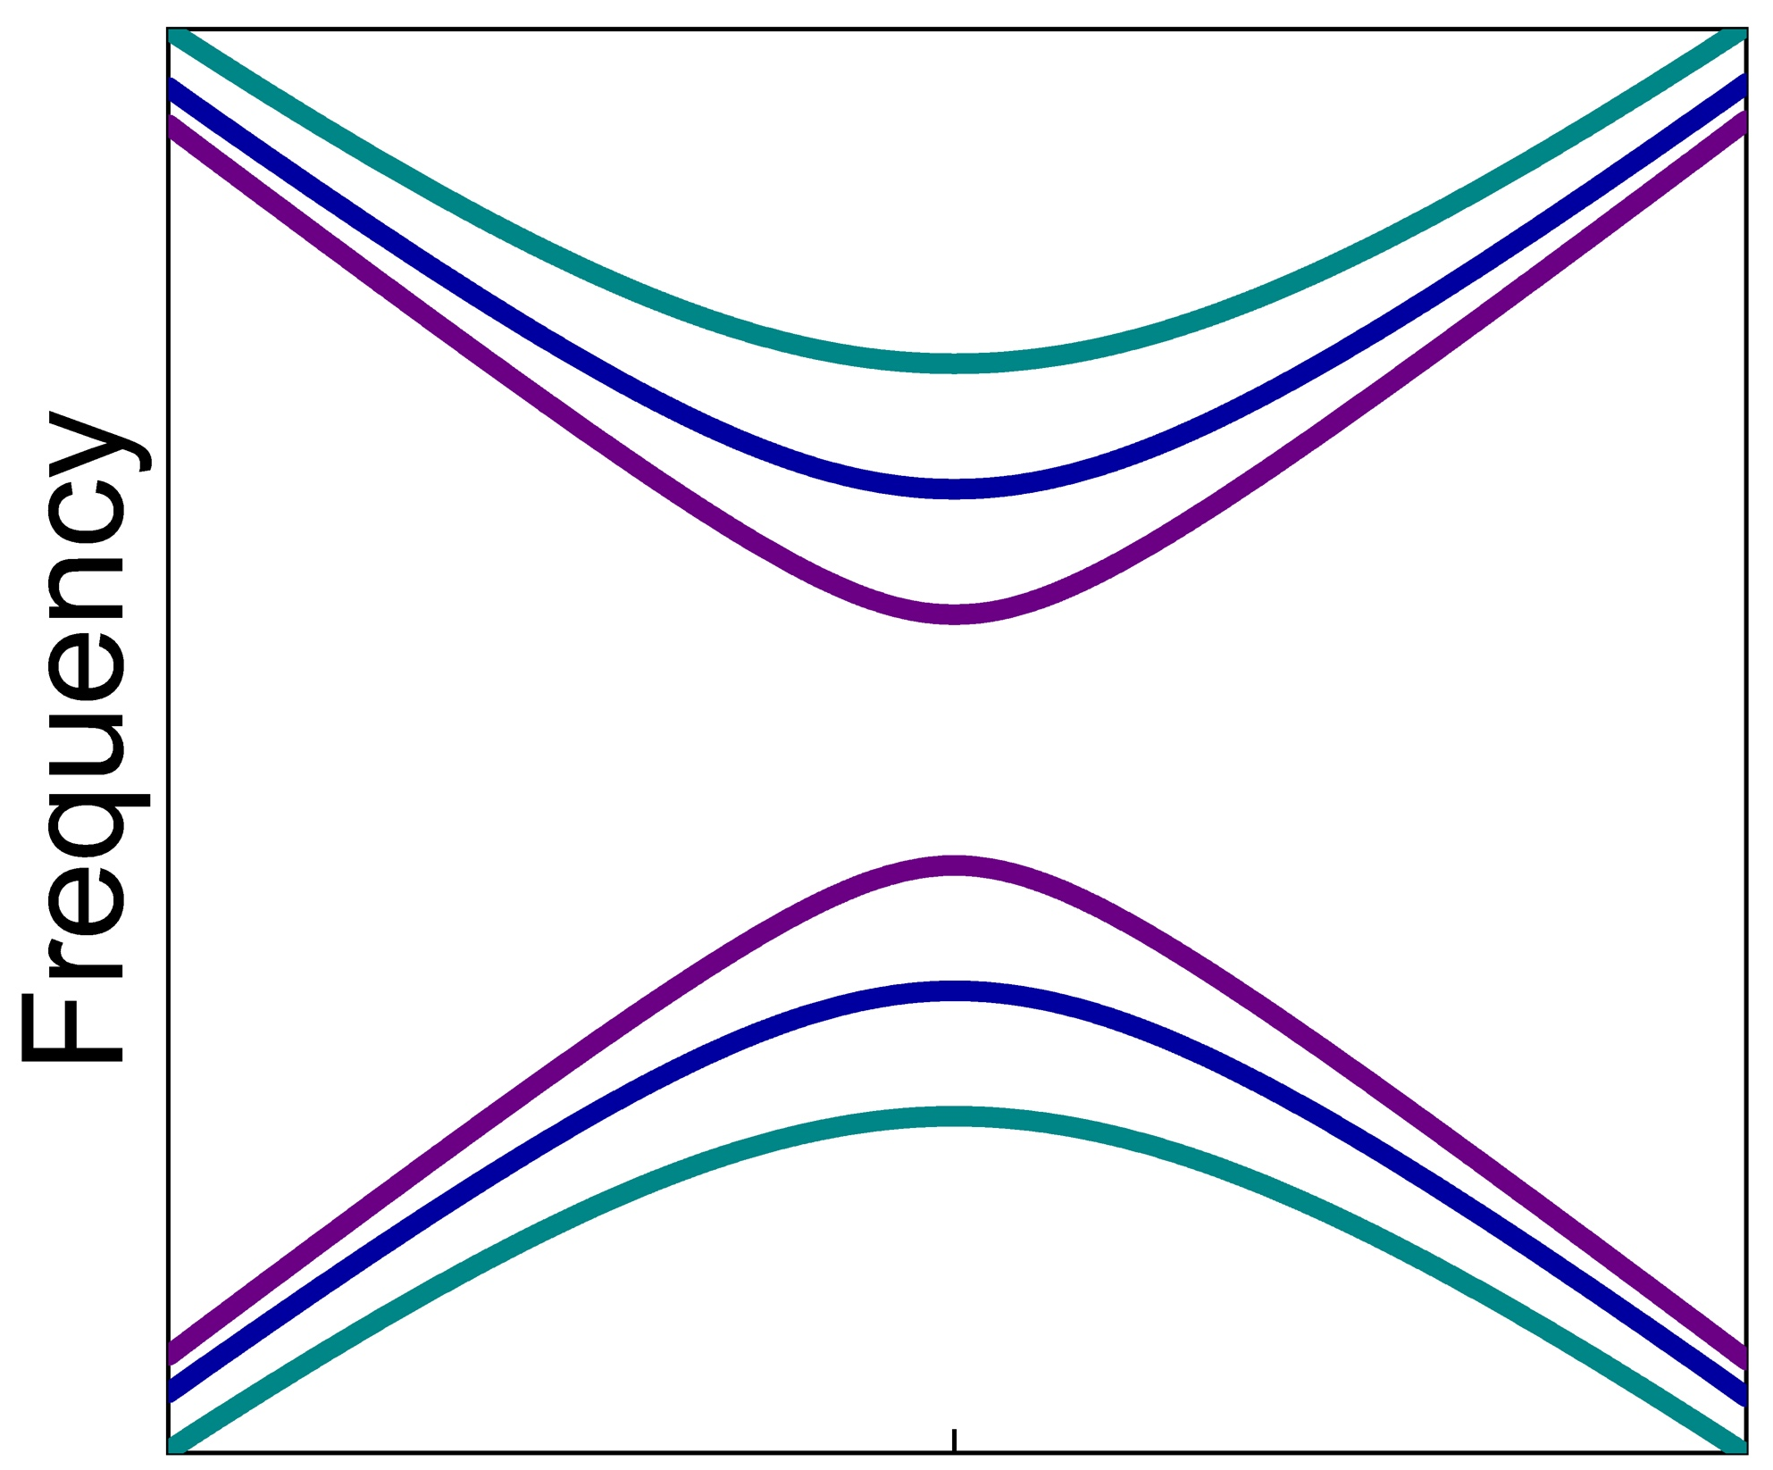
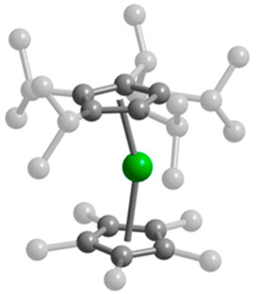




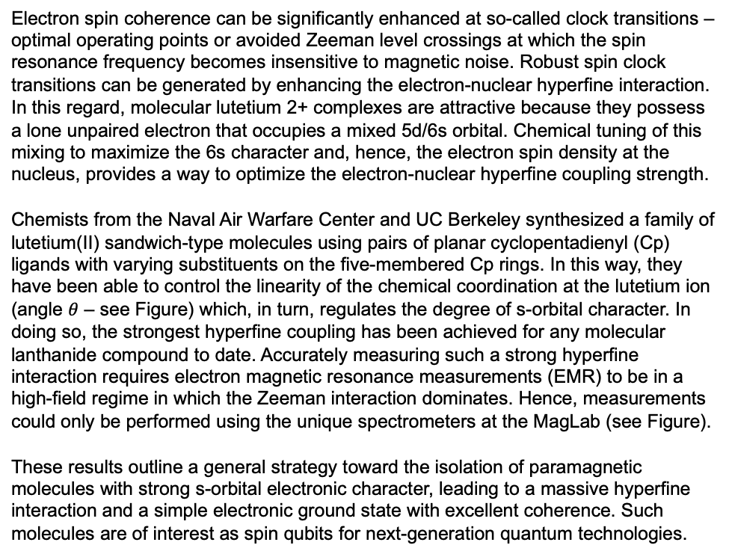
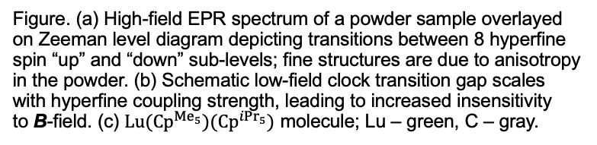
Chemical Control of Clock Frequency in a Series Molecular Lutetium(II) Qubits
D. X. Ngo¹, K. R. McClain², J. Hrubý³, Y. J. Franzke⁴, K. Kundu³, H. Kwon¹, C. A. Gould¹, B. G. Harvey², S. Hill^{3,5}, J. R. Long^{1,6}
1. UC Berkeley, Chemistry; 2. US Navy, China Lake; 3. NHMFL, FSU; 4. Philipps-Universität Marburg; 5. FSU, Physics; 6. Lawrence Berkeley National Lab
Funding Grants: K. M. Amm (NSF DMR-2128556); S. Hill and J. R. Long (DOE DE-AC02-05CH11231); K. R. McClain and B. G. Harvey (Weapons Division ILIR Program)
Electron spin coherence can be significantly enhanced at so-called clock transitions – optimal operating points or avoided Zeeman level crossings at which the spin resonance frequency becomes insensitive to magnetic noise. Robust spin clock transitions can be generated by enhancing the electron-nuclear hyperfine interaction. In this regard, molecular lutetium 2+ complexes are attractive because they possess a lone unpaired electron that occupies a mixed 5d/6s orbital. Chemical tuning of this mixing to maximize the 6s character and, hence, the electron spin density at the nucleus, provides a way to optimize the electron-nuclear hyperfine coupling strength.
Chemists from the Naval Air Warfare Center and UC Berkeley synthesized a family of lutetium(II) sandwich-type molecules using pairs of planar cyclopentadienyl (Cp) ligands with varying substituents on the five-membered Cp rings. In this way, they have been able to control the linearity of the chemical coordination at the lutetium ion (angle $θ$ – see Figure) which, in turn, regulates the degree of s-orbital character. In doing so, the strongest hyperfine coupling has been achieved for any molecular lanthanide compound to date. Accurately measuring such a strong hyperfine interaction requires electron magnetic resonance measurements (EMR) to be in a high-field regime in which the Zeeman interaction dominates. Hence, measurements could only be performed using the unique spectrometers at the MagLab (see Figure).
These results outline a general strategy toward the isolation of paramagnetic molecules with strong s-orbital electronic character, leading to a massive hyperfine interaction and a simple electronic ground state with excellent coherence. Such molecules are of interest as spin qubits for next-generation quantum technologies.
(a)
(b)
Clock transition
B insensitivity
Magnetic field (B)
(c)
240 GHz
*Impurity
Figure. (a) High-field EPR spectrum of a powder sample overlayed on Zeeman level diagram depicting transitions between 8 hyperfine spin “up” and “down” sub-levels; fine structures are due to anisotropy in the powder. (b) Schematic low-field clock transition gap scales with hyperfine coupling strength, leading to increased insensitivity to B-field. (c) $Lu({Cp}^{{Me}_{5}})({Cp}^{{iPr}_{5}})$ molecule; Lu – green, C – gray.
$$θ$$
Facilities and instrumentation used: EMR Facility, 12.5 T Heterodyne Quasi-Optical Spectrometer.
Citation: Ngo, D.X.; McClain, K.R.; Hrubý, J.; Franzke, Y.J.; Kundu, K.; Kwon, H.; Gould, C.A.; Harvey, B.G.; Hill, S.; Long, J.R., Large Hyperfine Coupling Arising from Pseudo-²S Ground States in a Series of Lutetium(II) Metallocene Complexes, Journal of the American Chemical Society, 147 (16), 13799-13807 (2025) doi.org/10.1021/jacs.5c01947

Slide 2
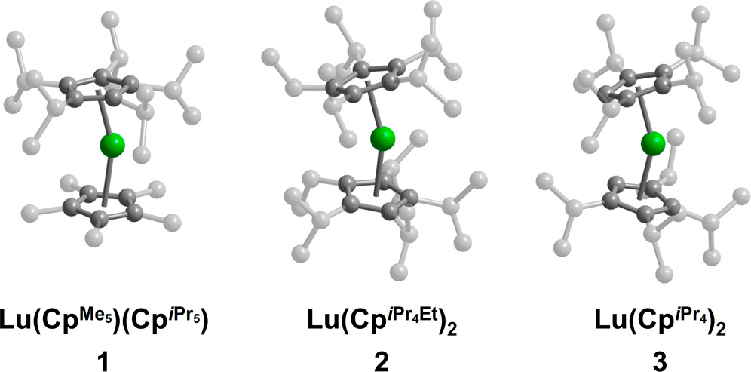
Chemists Unlock Record-Setting Spin Control for Future Quantum Tech
D. X. Ngo¹, K. R. McClain², J. Hrubý³, Y. J. Franzke⁴, K. Kundu³, H. Kwon¹, C. A. Gould¹, B. G. Harvey², S. Hill^{3,5}, J. R. Long^{1,6}
1. UC Berkeley, Chemistry; 2. US Navy, China Lake; 3. NHMFL, FSU; 4. Philipps-Universität Marburg; 5. FSU, Physics; 6. Lawrence Berkeley National Lab
Funding Grants: K. M. Amm (NSF DMR-2128556); S. Hill and J. R. Long (DOE DE-AC02-05CH11231); K. R. McClain and B. G. Harvey (Weapons Division ILIR Program)
What is the finding? Chemists from the Naval Air Warfare Center and UC Berkeley discovered a way to significantly enhance electron spin coherence—an essential trait for quantum computing—by chemically tuning lutetium-based molecules. By adjusting the shape of the molecules, they amplified the electron-nuclear interaction to a record high for lanthanide compounds, creating promising spin qubits for next-gen quantum devices.
Why is it important? Quantum technologies rely on stable, coherent spin states. This work shows how to chemically design molecules with ultra-strong hyperfine coupling, allowing better control over spin states. That means faster, more reliable quantum bits (qubits) for computing, sensing, or communication—potentially revolutionizing multiple industries.
Why did it need the MagLab? Although the goal of this work is to develop molecular spin qubits that operate optimally at low magnetic fields, measuring such intense spin interactions requires extremely strong magnetic fields only available at the National MagLab. These measurements could only be performed using the unique spectrometers available at the MagLab.
These three types of special molecules contain the element lutetium (green). The gray atoms are carbon, and the smallest hydrogen atoms are left out to keep things clear. The differences between the three molecules come from the side groups attached to the five-membered rings - called methyl (Me), ethyl (Et), and isopropyl (iPr). Scientists jokingly call these side groups “shrubbery,” and changing them helps control how long the lutetium’s lone electron stays stable, which is important for quantum technologies.
Facilities and instrumentation used: EMR Facility, 12.5 T Heterodyne Quasi-Optical Spectrometer.
Citation: Ngo, D.X.; McClain, K.R.; Hrubý, J.; Franzke, Y.J.; Kundu, K.; Kwon, H.; Gould, C.A.; Harvey, B.G.; Hill, S.; Long, J.R., Large Hyperfine Coupling Arising from Pseudo-²S Ground States in a Series of Lutetium(II) Metallocene Complexes, Journal of the American Chemical Society, 147 (16), 13799-13807 (2025) doi.org/10.1021/jacs.5c01947

