Slide 1


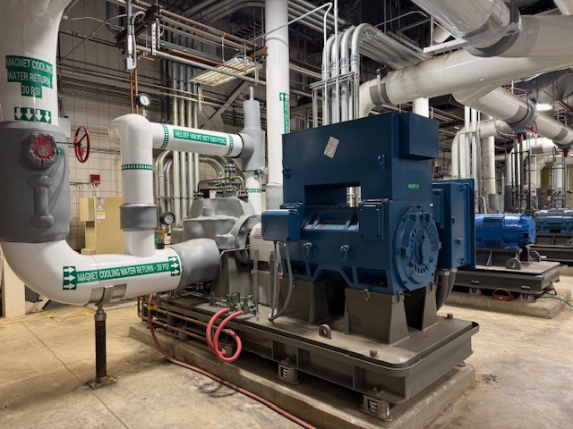



Enhancing Research Resiliency with Magnet Cooling Water System Upgrades
John G. Kynoch, Tra Hunter, Jason Hosey
National High Magnetic Field Laboratory
Funding Grants: K. M. Amm (FSU 227000-520-042549; 227000-110-12853)
What is the improvement? A new 900-horsepower magnet cooling pump was installed in the DC Field Facility.
Why is this important? This upgrade adds a sixth Magnet Cooling Water Pump to the MagLab which provides system redundancy and allows the lab to run water cooled magnet operations even if a failure occurs on any of the other magnet cooling water pumps. The pump also provides the cooling power needed for the future Power Supply upgrade which will allow the operation of two 34 MW magnets at the same time.
Why did this happen at the MagLab? At the MagLab, our job is to manage complex, unique scientific instrumentation for user research programs. When users show up at the lab, the lab needs the instrumentation and infrastructure to provide researchers with reliable access to the world’s highest field magnets
The project was funded by both FSU and the NSF.
This project execution was a collaboration between the MagLab Facilities and the FSU Project Design and Construction departments.

