Slide 1


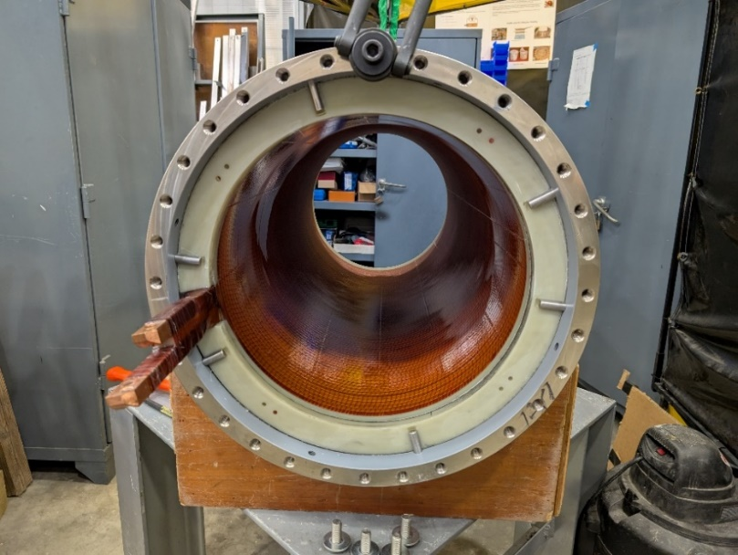
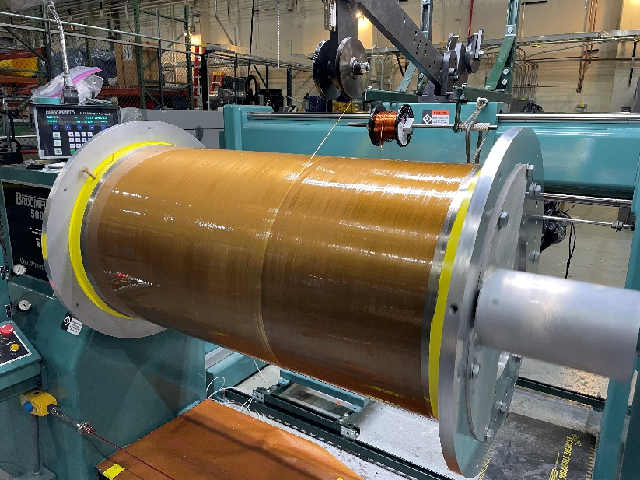



Fabrication of the Coils for the 60 T Controlled Waveform Pulsed Magnet
Iain Dixon¹, Todd Adkins¹, Ke Han¹, Rongmei Niu¹, Doan Nguyen²
National High Magnetic Field Laboratory, FSU; 2. National High Magnetic Field Laboratory, Los Alamos National Laboratory
Funding Grants: K. M. Amm (NSF DMR-2128556)
The 60 T Controlled Waveform (CW) magnet has been one of the MagLab’s flagship instruments, but it has experienced two significant failures over its lifetime. The first occurred in 2000 due to a brittle reinforcement shell, and the second in 2014, likely caused by inclusions or flaws in the conductor of coil 7. After being out of service for more than a decade, the magnet is now being rebuilt and prepared to serve users once again.
Florida State University (FSU) has taken on the responsibility of fabricating the large-scale pulsed coils in-house, which has strengthened the collaboration between the magnet design and operations teams at Los Alamos National Lab (LANL), the materials development team at FSU, and the FSU fabrication team. Of the nine coils that make up the 60 T magnet, three of them, coils 3, 4, and 7 that needed repair have been rebuilt and shipped to LANL.
Several design changes and quality improvements have been implemented in the rebuilt coils. To reduce the risk of shortened fatigue life, non-destructive evaluation using eddy currents was performed over every inch of the wire to detect inclusions or flaws. Damaged sections were either repaired or rejected. Thanks to the diligent efforts of Ke Han and the FSU materials team in strengthening the pulsed conductor supply chain, the conductor for coil 7 was changed from Al60 to CuCrZr, which offers improved strength and quality. An added benefit of CuCrZr is the availability of long continuous lengths, which eliminates the need for interlayer joints—a time-consuming process that introduces additional risks during coil production. The coils also feature an improved high-strength resin insulation system, which has already been successfully demonstrated in several large superconducting coils. Additionally, the reinforcement modulus has been increased by overwrapping the Nitronic shell with Zyon.
The final step in the process is to complete the magnet assembly and install it in its test cell. Full operations will resume once the refurbished generator is installed.
Figure left: View down the bore of coil 7 after epoxy impregnation at FSU. The epoxy impregnation is one of the many detailed procedural steps that includes conductor fabrication, quality control inspections, winding, joint and termination fabrication, outer shell fabrication, epoxy impregnation, Zylon reinforcement application and break out of the coil from the epoxy monolith after impregnation,
Figure right: Winding Zylon fiber with epoxy over the external shell at LANL is a process that further strengthens the pulsed coil against the huge magnetic forces that are generated in fractions of a second within the pulsed magnets. Zylon was implemented by the MagLab and is now one of the state-of-the-art reinforcement methods employed in the MagLab pulsed magnets.
Facilities and instrumentation used: NHMFL Magnet Science & Technology Department, Large Coil Fabrication Facility.
Citation: Nguyen, D.N.; Vo, T.; Michel, J.; Dixon, I.R.; Adkins, T.; Han, K., Redesign of the Coils for the 60T Controlled-Waveform Magnet at NHMFL, IEEE Transactions on Applied Superconductivity, 32 (6), 4300504 (2022) doi.org/10.1109/TASC.2022.3151836

Slide 2
60 Tesla Magnet Rebuilt Stronger Than Ever for Breakthrough Science
Iain Dixon¹, Todd Adkins¹, Ke Han¹, Rongmei Niu¹, Doan Nguyen²
National High Magnetic Field Laboratory, FSU; 2. National High Magnetic Field Laboratory, Los Alamos National Laboratory
Funding Grants: K. M. Amm (NSF DMR-2128556)
What is the finding? After a decade out of service, the MagLab’s powerful 60 Tesla Controlled Waveform (CW) magnet has been rebuilt with major upgrades in performance, reliability, and safety. Three key coils were reconstructed using improved materials, quality control, and insulation techniques.
Why is it important? This magnet allows researchers to study materials under extreme magnetic conditions not possible anywhere else. Designed to provide a unique combination of field and long pulse duration – up to 2 seconds – with a quasi-static field of 60 T and a 100 ms flat-top, this magnet’s pulse shape (or waveform) can be adjusted to suit the needs of different experiments. Controlling a pulsed waveform up to 60 T cannot be done anywhere else in the world and this rebuild ensures long-term access to one of the world’s strongest and most versatile magnets, advancing fields from quantum science to energy innovation.
Why did it need the MagLab? Only the MagLab has the technical expertise, facilities, and collaborative engineering infrastructure—across Florida State University and Los Alamos National Lab—to rebuild and operate such an advanced, custom high-field instrument. MagLab engineers and technicians contribute state-of-the-art quality controls and detailed winding and fabrication procedures that will maximize the fatigue life of the coils. MS&T and ASC materials development teams develop and provide the latest high-strength, high-conductivity conductor to produce the coils and the Los Alamos National Lab team designs pulsed fields, winds smaller bore coils and integrates the pulsed magnets into their unique facilities with a suite of sophisticated and robust power supply hardware. The combination of these capabilities allows production and access to the world’s highest pulsed magnetic fields for users.
Figure left: View down the bore of coil 7 after epoxy impregnation at FSU. The epoxy impregnation is one of the many detailed procedural steps that includes conductor fabrication, quality control inspections, winding, joint and termination fabrication, outer shell fabrication, epoxy impregnation, Zylon reinforcement application and break out of the coil from the epoxy monolith after impregnation,
Figure right: Winding Zylon fiber with epoxy over the external shell at LANL is a process that further strengthens the pulsed coil against the huge magnetic forces that are generated in fractions of a second within the pulsed magnets. Zylon was implemented by the MagLab and is now one of the state-of-the-art reinforcement methods employed in the MagLab pulsed magnets.
Facilities and instrumentation used: NHMFL Magnet Science & Technology Department, Large Coil Fabrication Facility.
Citation: Nguyen, D.N.; Vo, T.; Michel, J.; Dixon, I.R.; Adkins, T.; Han, K., Redesign of the Coils for the 60T Controlled-Waveform Magnet at NHMFL, IEEE Transactions on Applied Superconductivity, 32 (6), 4300504 (2022) doi.org/10.1109/TASC.2022.3151836

