Slide 1


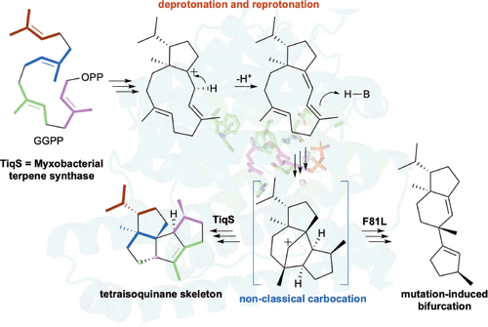
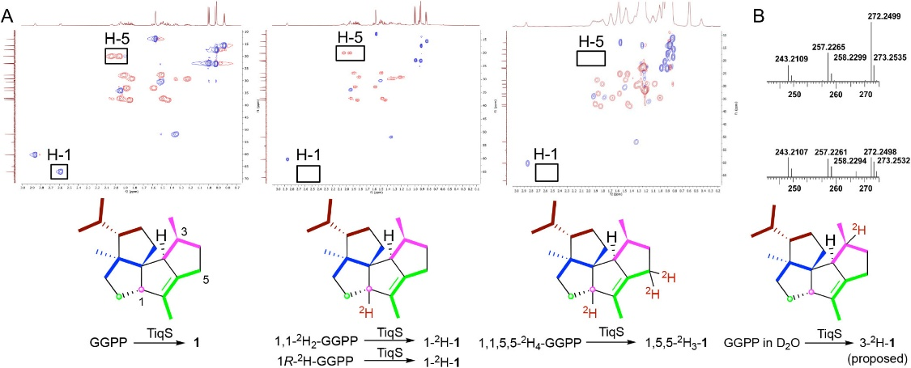



Uncovering Novel Carbocation Dynamics in Terpene Biosynthesis
Wei, X.¹; DeSnoo, W.²; Li, Z.¹; Ning, W.¹; Kong, W-Y².; Nafie, J.³; Tantillo, D.J.²; Rudolf, J.D.¹
1. University of Florida; 2. University of California-Davis; 3. BioTools, Inc.
Funding Grants: J. D. Rudolf (NIH R35 GM142574, the University of Florida); D. J. Tantillo (NIH R35 GM153469, NSF ACCESS program)
Terpenes represent one of the largest and most diverse classes of natural products with critical biological functions and applications across medicine and agriculture. The complexity of these molecules arises from enzyme-catalyzed cyclization reactions that manage highly reactive carbocation intermediates. However, the precise mechanisms by which these enzymes control such reactive species to yield specific products remains poorly understood, particularly for rare and complex terpene skeletons.
This team of chemists and biochemists has conducted the first mechanistic study of tetraisoquinene biosynthesis by TiqS, a diterpene synthase from the myxobacterium Melittangium boletus. By combining minor metabolite isolation, deuterium labeling, site-directed mutagenesis, and quantum chemical calculations, the researchers uncovered unusual deprotonation pathways and nonstatistical dynamic effects that direct the formation of the unique 5/5/5/5-fused ring system. Their work also demonstrates how the enzyme prevents the formation of secondary carbocations during the complex rearrangement of the carbon skeleton.
This work offers fundamental insights into nature’s strategies for terpene cyclization and provides a framework for understanding related transformations in other systems. The findings could facilitate engineering terpene synthases for novel bioactive compounds, especially since the tetraisoquinane scaffold represents a previously unexplored structure with promising biological activities.
Figure 1 (left): TiqS-catalyzed biosynthesis of tetraisoquinane from GGPP. The myxobacterial terpene synthase transforms GGPP through a series of cyclizations, deprotonation-reprotonation events, and a non-classical carbocation intermediate. The complex reaction pathway showcases how enzymes guide carbocation chemistry to form specific products and can be redirected through strategic mutations to produce alternative scaffolds.
Facilities and instrumentation used: AMRIS Facility, University of Florida, 600 MHz NMR spectrometer with a cryogenic probe
Citation: Wei, X.; DeSnoo, W.; Li, Z.; Ning, W.; Kong, W.; Nafie, J.; Tantillo, D.J.; Rudolf, J.D., Avoidance of Secondary Carbocations, Unusual Deprotonation, and Nonstatistical Dynamic Effects in the Cyclization Mechanism of Tetraisoquinane, Journal of the American Chemical Society, 147 (19), 16293-16300 (2025) doi.org/10.1021/jacs.5c01828
Figure 2 (above): Deuterium-labeled GGPP supports isoprene units and C-1 rearrangement. (A) Incubation of TiqS with unlabeled GGPP, 1,1-²H₂-GGPP, 1R-²H-GGPP, and 1,1,5,5-²H₄-GGPP gave 1, 1-²H-1, 1-²H-1, and 1,5,5-²H₃-1, respectively, with zoomed-in ¹H-¹³C HSQC spectra shown above each structure. (B) Incubation of TiqS with unlabeled GGPP in D₂O increased the molecular weight of 1 by one mass unit, supporting the proposed mechanism.

Slide 2
Nature's Chemical Architects: How Bacteria Build Complex Molecules
Wei, X.¹; DeSnoo, W.²; Li, Z.¹; Ning, W.¹; Kong, W-Y².; Nafie, J.³; Tantillo, D.J.²; Rudolf, J.D.¹
1. University of Florida; 2. University of California-Davis; 3. BioTools, Inc.
Funding Grants: J. D. Rudolf (NIH R35 GM142574, the University of Florida); D. J. Tantillo (NIH R35 GM153469, NSF ACCESS program)
What is the finding? Scientists at University of Florida and University of California-Davis have uncovered how certain bacteria create complex molecules called terpenes through an unusual chemical process that involves short-lived, highly reactive intermediates. This process allows bacteria to construct intricate molecular structures with remarkable precision, despite working with unstable chemical components.
Why is this important? Terpenes represent one of nature's most diverse chemical families with applications in medicine, agriculture, and materials science. Understanding how bacteria naturally synthesize these compounds could ultimately enable scientists to engineer biological systems that produce terpenes more efficiently, potentially leading to new pharmaceuticals and environmentally-friendly agricultural products like crop protectants, and bioactive compounds.
Why did this research need the MagLab? The MagLab’s world-leading high-field NMR allowed scientists to detect and map the enzyme’s products and intermediates, making it possible to unravel these hidden chemical steps. This study was achieved with a 600 MHz spectrometer at the MagLab equipped with a cryoprobe that enabled sensitive detection and resolution of key signals in 1D and 2D experiments.
Facilities and instrumentation used: AMRIS Facility, University of Florida, 600 MHz NMR spectrometer with a cryogenic probe
Citation: Wei, X.; DeSnoo, W.; Li, Z.; Ning, W.; Kong, W.; Nafie, J.; Tantillo, D.J.; Rudolf, J.D., Avoidance of Secondary Carbocations, Unusual Deprotonation, and Nonstatistical Dynamic Effects in the Cyclization Mechanism of Tetraisoquinane, Journal of the American Chemical Society, 147 (19), 16293-16300 (2025) doi.org/10.1021/jacs.5c01828
How TiqS builds a rare molecule: This enzyme from bacteria transforms GGPP into a unique four-ring terpene by carefully guiding a complex series of chemical steps: The myxobacterial terpene synthase transforms GGPP through a series of cyclizations, deprotonation-reprotonation events, and a non-classical carbocation intermediate. The complex reaction pathway showcases how enzymes guide carbocation chemistry to form specific products and can be redirected through strategic mutations to produce alternative scaffolds.

