Slide 1
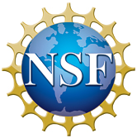

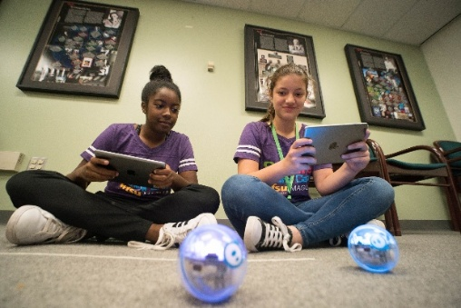
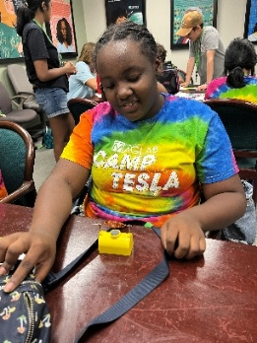
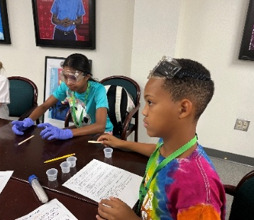
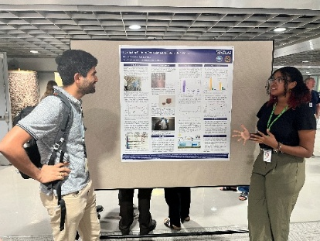
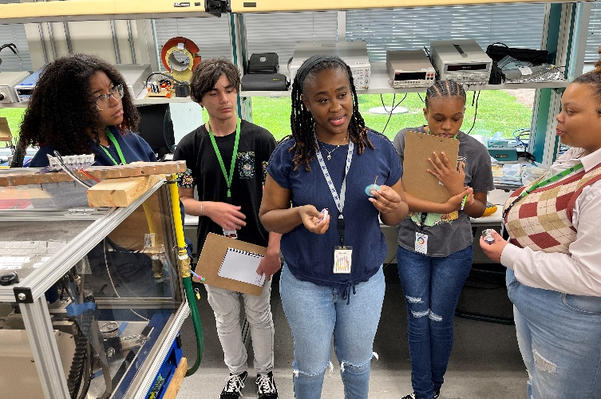



MagLab STEM Experiences Have Lasting Influence
Hughes, R., Villa, C.R.
Center for Integrating Research and Learning (CIRL) at the National High Magnetic Field Laboratory
Funding Grants: K. M. Amm (NSF DMR-2128556)
Facility used: National High Magnetic Field Laboratory, Tallahassee, FL
What is the finding? The Center for Integrating Research and Learning (CIRL) at the MagLab provides immersive, weeklong (or longer) STEM experiences for middle and high school students, including summer camps and internships. Since 2006, more than 1,000 students have participated. Alumni surveys in 2022 and 2024 show consistent, powerful outcomes: over 95% of respondents reported that these programs had a lasting influence on their interest in STEM fields.
Why is this important? Middle and high school are development stages where students lose interest in STEM. The siloed nature and rote memorization of some science classrooms makes STEM fields seem boring. Informal STEM education programs like those at the MagLab help students connect to real-world science, hands-on problem-solving, and authentic role models, helping keep young people engaged in the science and technology workforce pipeline.
Why did this research need the MagLab? The MagLab is an interdisciplinary space with many types of STEM professionals, including technical staff, undergraduate and graduate students, research faculty, and world-renowned experts. These scientists are engaged in the lab’s middle and high school programs, creating an ecosystem where students can participate in engaging activities and receive meaningful mentorship.
Alumni testimonials show how the MagLab’s people and resources were pivotal in shaping their academic and career trajectories, underscoring the lab’s role in building future STEM leaders:
A current PhD student explained: “My experiences at the MagLab helped me to see myself as a real scientist at an early age, and this positive self-image persisted throughout my time in high school despite the lack of other students that looked like me in my STEM classes at the time. I went on to pursue a BS in mathematics and am now completing a PhD in biophysics. The MagLab was instrumental in my decision to pursue science as a career choice.”
A current materials engineer said: “The patient and encouraging mentorship I received from multiple research groups during my high school internship, sparked and fueled my passion for materials science and cutting edge nanotechnology research. As a result of my experience at the MagLab, I gained not only the passion to continue to pursue a career in the material sciences, but also the confidence that I had the ability to do so as a young woman. I continued on to research nanocomposites at the University of Florida for all 4 years of my undergraduate degree, graduated with honors, and am currently working as a materials engineer for a large defense contractor.”

