Slide 1


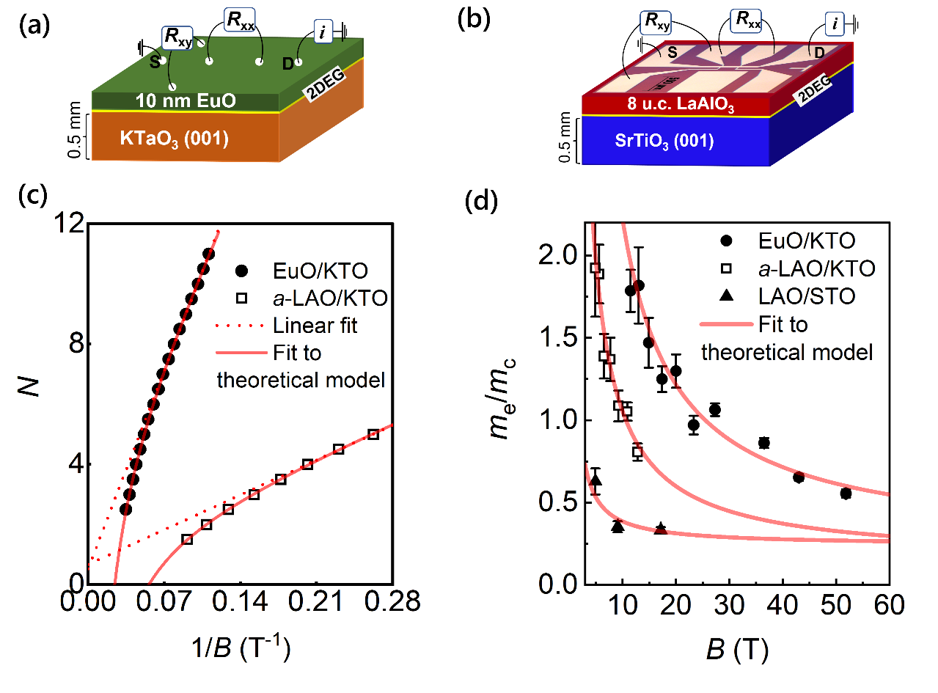



Unconventional quantum oscillations in complex oxide interfaces
K. Rubi¹, D. R. Candido², M. Dumen³, S. Zeng⁴, E. Ammerlaan⁵, F. Bangma⁵, M. Chan¹, M. Goiran⁶, A. Ariando⁴, S. Chakraverty³, W. Escoffier⁶, U. Zeitler⁵, N.Harrison¹
1. National High Magnetic Field laboratory, Los Alamos National laboratory; 2. University of Iowa; 3. Institute of Nano Science and Technology, India; 4. National University of Singapore, Singapore; 5. HFML-EMFL, Radboud University Netherlands; 6. LNCMI-EMFL, Toulouse France.
Funding Grants: G.S. Boebinger (NSF DMR-1644779); Neil Harrison (DoE “Science of 100 Tesla”)
The interface between two insulating oxides (e.g., SrTiO₃ and LaAlO₃) becomes conducting. These interfaces also host superconductivity, magnetism, and spin-orbit interaction—making them promising for next-generation spintronics and quantum computing. However, to harness their potential in technology, a deep understanding of the electronic bands responsible for conduction is essential.
In this study, we explore the electronic states of oxide interfaces through quantum oscillations in three different interfaces: LaAlO₃/SrTiO₃, EuO/KTaO₃, and LaAlO₃/KTaO₃. To accurately resolve quantum oscillations, we conducted resistivity measurements in high magnetic fields up to 60 T.
Contrary to the conventional theory of Landau quantization, the observed quantum oscillations are not periodic in inverse magnetic field (1/B). Instead, both the oscillations frequency and cyclotron mass increase progressively with magnetic field for all three studied interfaces. We attribute these universal and intriguing findings to the nontrivial electronic bands, for which the energy-momentum dispersion incorporates both linear and parabolic relations.
The observed unconventional quantum oscillations, with a frequency that varies quadratically with magnetic field, established a new paradigm for two-dimensional electron systems in complex oxides. Our experimental findings and versatile theoretical model also hold promise for comprehending similar observations in other materials with strong spin-orbit coupling, including Dirac and Weyl semimetals.
Figure: Schematics of two heterostructures (a) EuO/KTaO₃ (EuO/KTO) and (b) LaAlO₃/SrTiO₃ (LAO/STO). (c) Noxideson-linear Landau plots constructed from quantum oscillations and (d) cyclotron mass enhancement with field, fitted with the theoretical model which suggest the existence of non-trivial electronic states in both SrTiO₃- and KTaO₃-based interfaces.
Facilities and instrumentation used: 65 T short-pulse magnet at pulsed field facility.
Citation: Rubi, K.; Candido, D.R.; Dumen, M.; Zeng, S.; Ammerlaan, A.; Bangma, F.; Chan,
M.K.; Goiran, M.; Ariando, A.; Chakraverty, S.; Escoffier, W.; Zeitler, U.; Harrison, N.,
Unconventional quantum oscillations and evidence of nonparabolic electronic states in quasi-two-dimensional electron system at complex oxide interfaces, Physical Review Research, 6, 043231 (2024) doi.org/10.1103/PhysRevResearch.6.043231

Slide 2
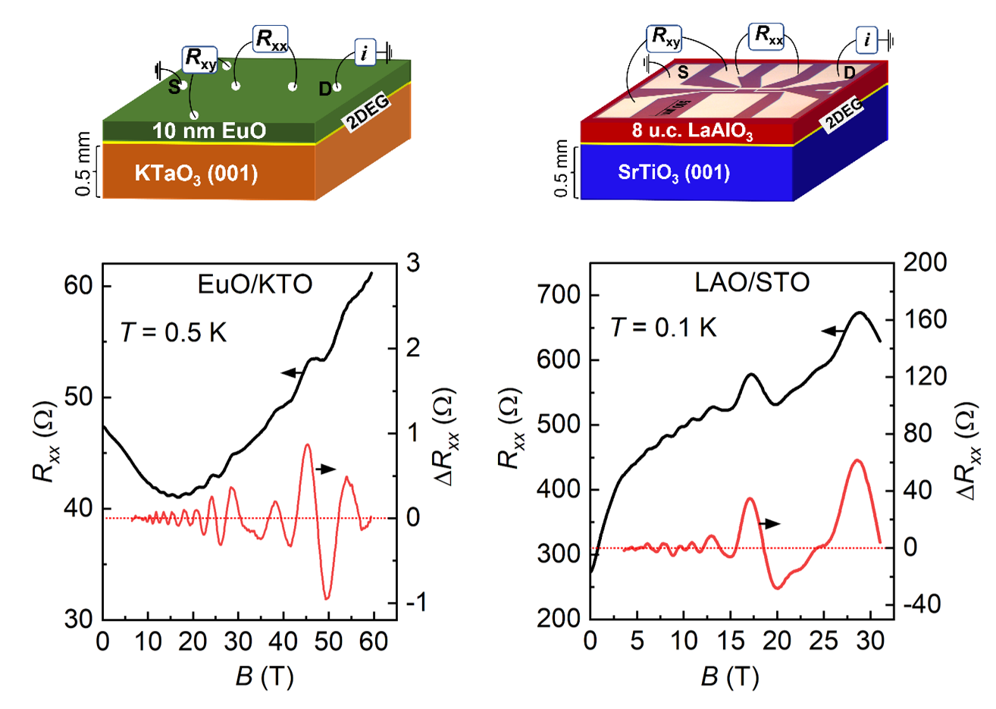
Unconventional quantum oscillations in complex oxide interfaces
K. Rubi¹, D. R. Candido², M. Dumen³, S. Zeng⁴, E. Ammerlaan⁵, F. Bangma⁵, M. Chan¹, M. Goiran⁶, A. Ariando⁴, S. Chakraverty³, W. Escoffier⁶, U. Zeitler⁵, N.Harrison¹
1. National High Magnetic Field laboratory, Los Alamos National laboratory; 2. University of Iowa; 3. Institute of Nano Science and Technology, India; 4. National University of Singapore, Singapore; 5. HFML-EMFL, Radboud University Netherlands; 6. LNCMI-EMFL, Toulouse France.
Funding Grants: G.S. Boebinger (NSF DMR-1644779); Neil Harrison (DoE “Science of 100 Tesla”)
What is the finding? Researchers discovered unusual electronic behavior at the interfaces of special oxides, where electrons move in surprising patterns that break long-standing theories of quantum physics. According to conventional theory, these oscillations should be periodic in the inverse magnetic field. However, in complex oxide interfaces such as LaAlO₃/SrTiO₃ and LaAlO₃/KTaO₃, the oscillation frequency increases progressively with increasing magnetic field strength, indicating the presence of nontrivial electronic states.
Why is this important?
Despite being made from insulating materials, certain oxide interfaces can conduct electricity and even show superconductivity and magnetism—features useful for future memory and quantum technologies. To understand why and how this works, researchers studied the behavior of electrons at three different oxide interfaces using high magnetic fields. They observed unconventional quantum oscillations, showing that electrons follow unique energy pathways that mix two different types of motion. Our experimental findings and versatile theoretical model also hold promise for comprehending similar observations in other materials with strong spin-orbit coupling, including Dirac and Weyl semimetals.
Why did this research need the MagLab? Because electrons do not move very quickly in these oxide interfaces (moderate electron mobility), extremely high magnetic fields—up to 60 T—were essential to resolve the quantum oscillations and see the quantum behavior. Higher magnetic fields are needed to observe a sufficient number of oscillations (typically 8–10) to reliably identify these materials’ unconventional nature.
Figure: Schematics of two heterostructures EuO/KTaO₃ and LaAlO₃/SrTiO₃. Landau plots constructed from quantum oscillations and cyclotron mass enhancement suggest the existence of non-trivial electronic states in both SrTiO₃- and KTaO₃-based interfaces.
Facilities and instrumentation used: 65 T short-pulse magnet at pulsed field facility.
Citation: Rubi, K.; Candido, D.R.; Dumen, M.; Zeng, S.; Ammerlaan, A.; Bangma, F.; Chan, M.K.; Goiran, M.; Ariando, A.; Chakraverty, S.; Escoffier, W.; Zeitler, U.; Harrison, N., Unconventional quantum oscillations and evidence of nonparabolic electronic states in quasi-two-dimensional electron system at complex oxide interfaces, Physical Review Research, 6, 043231 (2024) doi.org/10.1103/PhysRevResearch.6.043231

