Slide 1


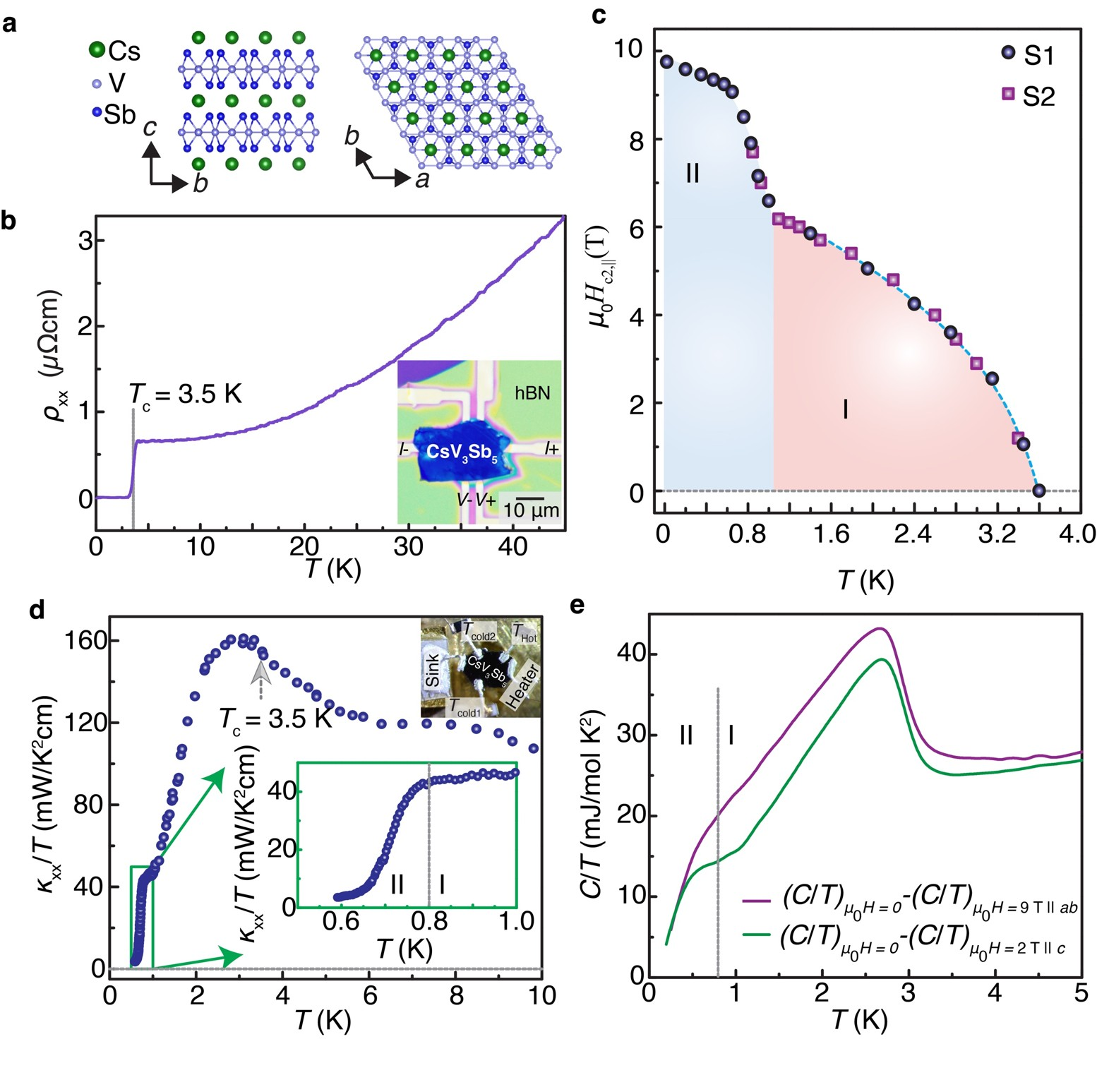



A Tale of Two Uncoupled Superconducting Gaps
Md Shafayat Hossain^{1*}, Qi Zhang²*, Eun Sang Choi³*, Danilo Ratkovski³*, Bernhard Lüscher⁴*, Yongkai Li⁵*, Yu-Xiao Jiang², Maksim Litskevich², Zi-Jia Cheng², Jia-Xin Yin², Tyler A. Cochran², Brian Casas³, Byunghoon Kim², Xian Yang², Jinjin Liu⁵, Yugui Yao⁵, Alimamy Bangura³, Zhiwei Wang⁵, Mark H. Fischer⁴, Titus Neupert⁴, Luis Balicas³, M. Zahid Hasan²
¹University of California, Los Angeles, USA ²Princeton University, Princeton, USA. ³National High Magnetic Field Laboratory, ⁴University of Zurich, ⁵Beijing Institute of Technology
Funding Grants: K. M. Amm (NSF DMR-2128556); M.Z.H. (Gordon and Betty Moore Foundation; GBMF9461 and DOE/BES DE-FG-02-05ER46200); L.B. (DOE-BES through award DE-SC0002613)
Since its discovery in 1911, superconductivity has revealed unexpected quantum phenomena, especially when pairing symmetry is difficult to predict in systems with multiple electronic degrees of freedom and competing orders, as in cuprates and iron-based superconductors. Kagome superconductors AV₃Sb₅ (A = K, Rb, Cs), with their unique band features—van Hove singularities near the Fermi level, flat bands, geometric frustration, and charge order that breaks both time-reversal and lattice symmetries—can serve as a fertile platform for unconventional superconductivity. Yet, no definitive evidence for unique superconducting states had been established.
In CsV₃Sb₅, we discovered a very exotic superconducting quantum phenomenon that has not been reported for other material platforms – namely two decoupled superconducting gaps (states) leading to two distinct superconducting regimes as a function of the temperature that show distinct characteristics without any phase transition between them.
Thermodynamic, electrical, and thermal transport measurements reveal residual quasiparticle weight in the higher-temperature regime (0.8–3.5 K), indicating ungapped Fermi-surface regions or nodal pairing, which vanish as a second gap emerges below 0.8 K. At lower temperatures, in-plane upper critical fields are enhanced, and thermal conductivity shows reoriented anisotropy, consistent with an asymmetric or nodal low-temperature gap. Although two anomalies appear in the heat capacity, angular anisotropy measurements show preserved symmetry, ruling out a phase transition. Instead, our results demonstrate band-selective superconductivity with unusually weak inter-band coupling, unlike MgB₂ or iron pnictides.
This work establishes CsV₃Sb₅ as the first known superconductor with two decoupled superconducting gaps and no transition between them. The finding opens new directions for understanding pairing symmetry in kagome systems and multiband superconductivity more broadly.
Fig a, Lattice structure. b, Superconducting transition, c, d, e, Electrical transport, heat transport, and heat capacity evidence of two distinct superconducting regimes in CsV₃Sb₅, respectively.
Facilities and instrumentation used: SCM1 and SCM2
Citation: Hossain, MD.S.; Zhang, Q.; Choi, E.S.; Ratkovski, D.R.; Lüscher, B.; Li, Y.; Jiang, Y.X.; Litskevich, M.; Cheng, Z.J.; Yin, J.X.; Cochran, T.A.; Casas, B.W.; Kim, B.; Yang, X.; Liu, J.; Yao, Y.; Bangura, A.; Wang, Z.; Fischer, M.H.; Neupert, T.; Balicas, L.; Hasan, M.Z., Unconventional gapping behaviour in a kagome superconductor, Nature Physics (2025) doi.org/10.1038/s41567-024-02770-z

Slide 2
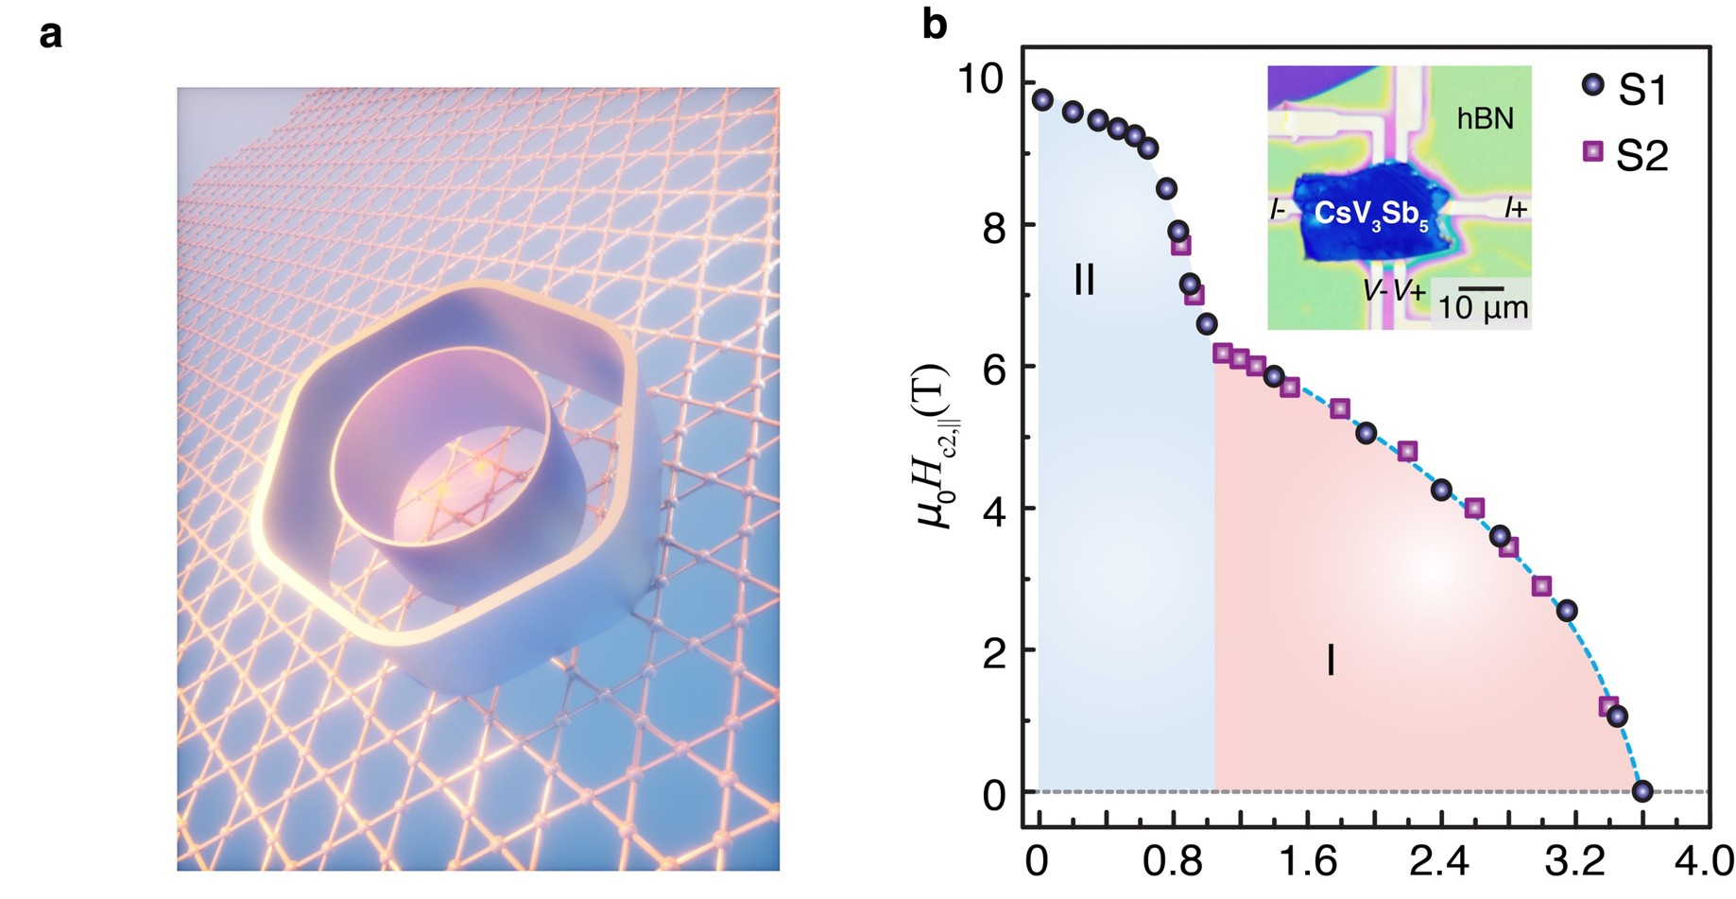
A Tale of Two Uncoupled Superconducting Gaps
Md Shafayat Hossain^{1*}, Qi Zhang²*, Eun Sang Choi³*, Danilo Ratkovski³*, Bernhard Lüscher⁴*, Yongkai Li⁵*, Yu-Xiao Jiang², Maksim Litskevich², Zi-Jia Cheng², Jia-Xin Yin², Tyler A. Cochran², Brian Casas³, Byunghoon Kim², Xian Yang², Jinjin Liu⁵, Yugui Yao⁵, Alimamy Bangura³, Zhiwei Wang⁵, Mark H. Fischer⁴, Titus Neupert⁴, Luis Balicas³, M. Zahid Hasan²
¹University of California, Los Angeles, USA ²Princeton University, Princeton, USA. ³National High Magnetic Field Laboratory, ⁴University of Zurich, ⁵Beijing Institute of Technology
Funding Grants: K. M. Amm (NSF DMR-2128556); M.Z.H. (Gordon and Betty Moore Foundation; GBMF9461 and DOE/BES DE-FG-02-05ER46200); L.B. (DOE-BES through award DE-SC0002613)
What is the finding? Scientists discovered that a kagome superconductor CsV₃Sb₅ hosts two different superconducting states at the same time—something never seen before.
Why is this important? Superconductivity is the ability of a material to conduct electricity with zero resistance. Kagome materials—named after a Japanese basket-weaving pattern of interlaced triangles and hexagons—have a distinctive atomic arrangement that gives rise to unusual electronic behavior and makes them promising candidates for unconventional superconductivity.
Cesium vanadium antimonide (CsV₃Sb₅) is the first material found with two coexisting superconducting gaps, overturning long-standing theories about superconductivity. Understanding this unusual behavior could inspire new technologies for energy-efficient electronics, quantum devices, and future computing platforms.
Why did this research need the MagLab? The MagLab’s unique combination of very high magnetic fields and advanced low-temperature techniques made it possible to reveal this phenomenon.
Facilities and instrumentation used: SCM1 and SCM2
Citation: Hossain, MD.S.; Zhang, Q.; Choi, E.S.; Ratkovski, D.R.; Lüscher, B.; Li, Y.; Jiang, Y.X.; Litskevich, M.; Cheng, Z.J.; Yin, J.X.; Cochran, T.A.; Casas, B.W.; Kim, B.; Yang, X.; Liu, J.; Yao, Y.; Bangura, A.; Wang, Z.; Fischer, M.H.; Neupert, T.; Balicas, L.; Hasan, M.Z., Unconventional gapping behaviour in a kagome superconductor, Nature Physics (2025) doi.org/10.1038/s41567-024-02770-z
Fig: a, artistic rendition of two gap superconductivity from two Fermi surface pockets, on the atomic kagome motif. b, c, d, Electrical transport, heat transport, and heat capacity evidence of two distinct superconducting regimes in CsV₃Sb₅, respectively.

