Slide 1


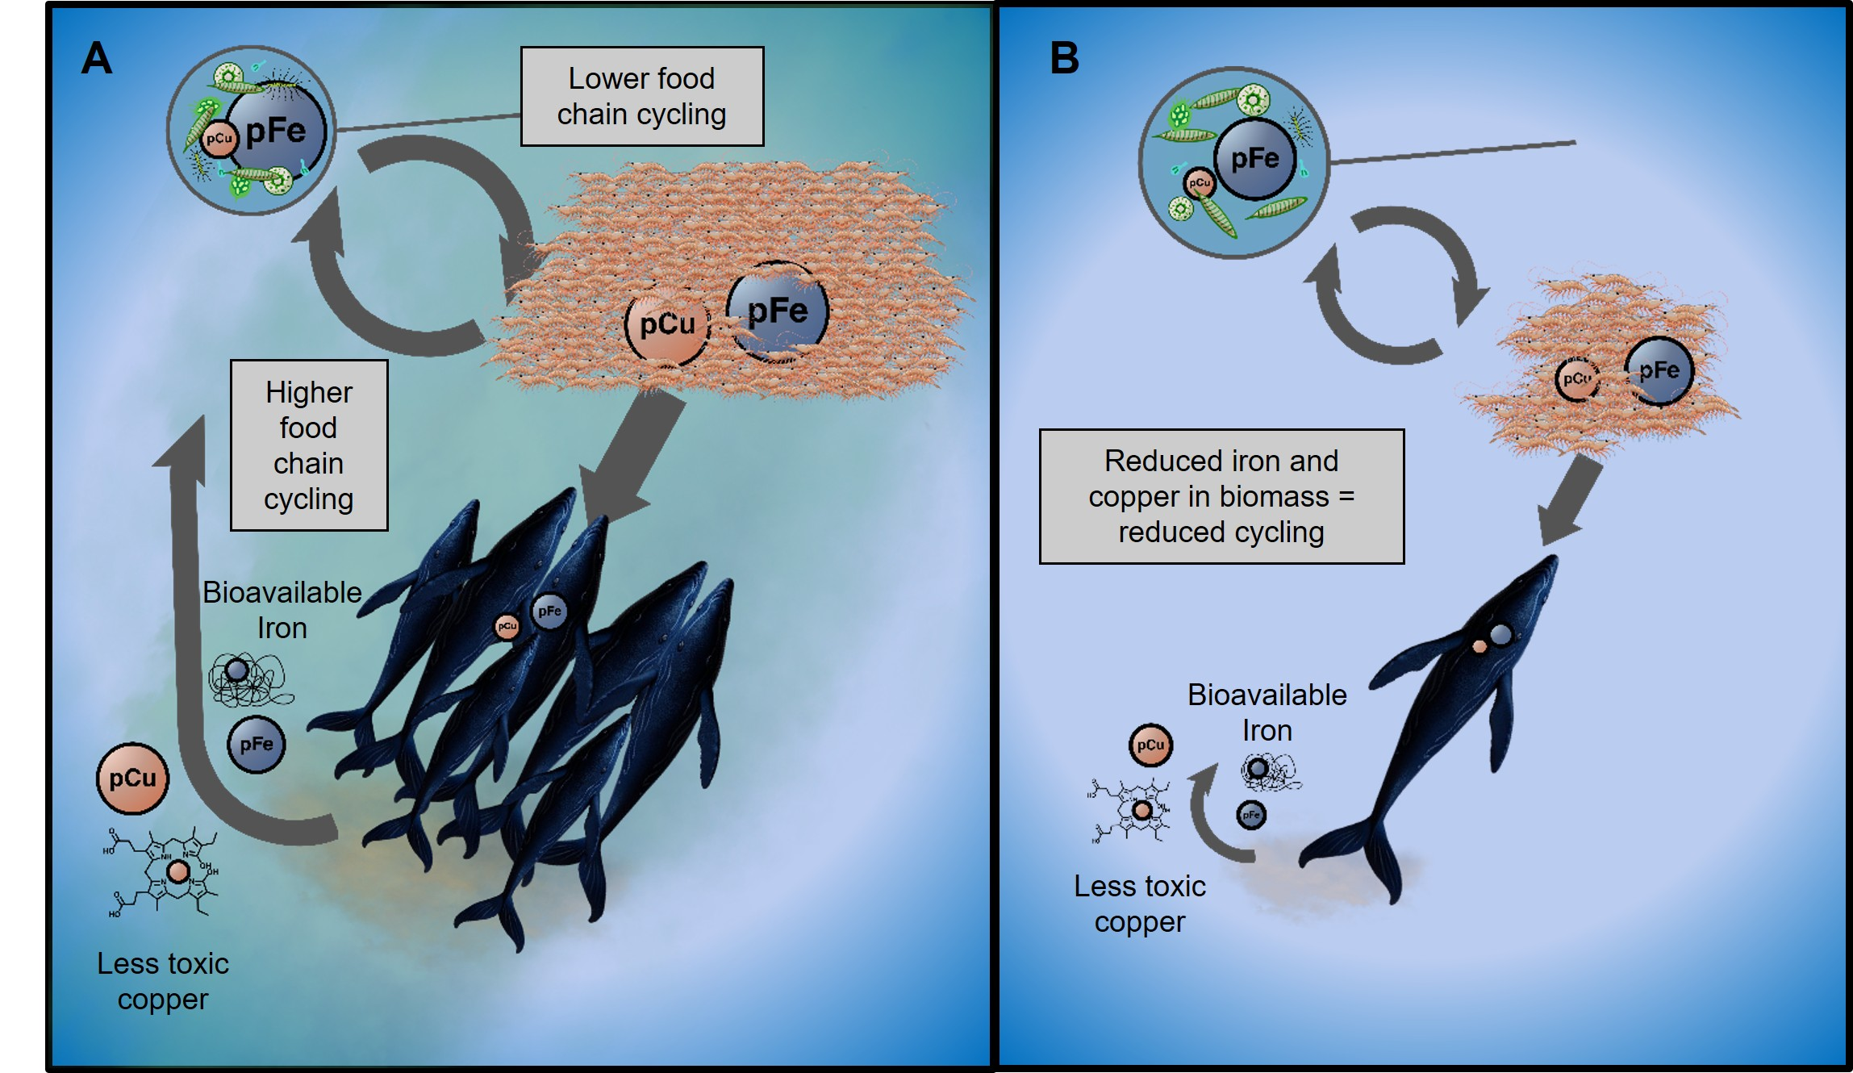



Whales Recycle Bioavailable Iron and Copper to Marine Phytoplankton
P. J. Monreal¹, M. S. Savoca², L. Babcock-Adams³, L. E. Moore¹, A. Ruacho¹, D. Hull¹, L. J. Pallin⁴, R. C. Nichols⁴, J. Calambokidis⁵, J. A. Resing^{1,6}, A. S. Friedlaender⁴, J. Goldbogen², R. M. Bundy¹
University of Washington; 2. Stanford University; 3. National High Magnetic Field Laboratory; 4. University of California Santa Cruz; 5. Cascadia Research Collective; 6. Pacific Marine Environmental Laboratory
Funding Grants: K. M. Amm (NSF DMR-1644779); J. Calambokidis (ANT-1643877); Palmer LTER (ANT-1440435, ANT-2026045)
Whales are nutrient recyclers in our oceans. By eating krill and releasing metal-rich fecal plumes at the surface, baleen whales may have played a major role in sustaining phytoplankton growth in the iron-limited Southern Ocean. However, many questions remained about how accessible this metal is to phytoplankton, which depends on the organic molecules bound to the metal.
To investigate these metal-organic complexes, biologists collected rare fecal samples from whales, and chemists analyzed the metal and organic content. Electrochemical techniques revealed the iron was loosely bound to organic compounds, making it readily available. By contrast, copper (toxic at high levels) was found to be tightly bound. The MagLab 21 T Fourier Transform Ion Cyclotron Resonance mass spectrometer was used to identify the copper-binding compounds, many of which were novel and appear to be produced within the whale gut. These ligands play an important role in reducing the toxicity of copper.
The findings reveal that whales recycle iron in a form that boosts phytoplankton growth while simultaneously detoxifying copper, underscoring their role as ecosystem engineers. Thus, the loss of 1.5 million whales from industrial whaling may have disrupted ecosystem dynamics in unprecedented ways. The identification of copper-binding ligands enabled by the MagLab also highlights how animal microbiomes can shape ocean chemistry, with implications for microbial communities throughout the global ocean.
An illustration of the interactions between whales, krill, and phytoplankton in the Southern Ocean under (A) pre-whaling and (B) post-whaling conditions.
Facilities and instrumentation used: 21 T FT-ICR MS in the ICR Facility
Citation: Monreal, P.J.; Savoca, M.S.; Babcock-Adams, L.C.; Moore, L.E.; Ruacho, A.; Hull, D.; Pallin, L.J.; Nichols, R.C.; Calambokidis, J.; Resing, J.A.; Friedlaender, A.S.; Goldbogen, J.; Bundy, R.M., Organic Ligands in Whale Excrement Support Iron Availability and Reduce Copper Toxicity to the Surface Ocean, Communication Earth & Environment, 6, 20 (2025) doi.org/10.1038/s43247-024-01965-9 - Data Set 1, Data Set 2

Slide 2
Whale Waste Improves Ocean Ecosystems
P. J. Monreal¹, M. S. Savoca², L. Babcock-Adams³, L. E. Moore¹, A. Ruacho¹, D. Hull¹, L. J. Pallin⁴, R. C. Nichols⁴, J. Calambokidis⁵, J. A. Resing^{1,6}, A. S. Friedlaender⁴, J. Goldbogen², R. M. Bundy¹
University of Washington; 2. Stanford University; 3. National High Magnetic Field Laboratory; 4. University of California Santa Cruz; 5. Cascadia Research Collective; 6. Pacific Marine Environmental Laboratory
Funding Grants: K. M. Amm (NSF DMR-1644779); J. Calambokidis (ANT-1643877); Palmer LTER (ANT-1440435, ANT-2026045)
What is the finding? When whales poop, they release iron and copper into the ocean. Phytoplankton, the plants of the sea, need iron to grow and they are able to use the iron from whale poop. However, copper is toxic when there is too much available, but it is released by whales in a form that is less toxic.
Why is this important? Phytoplankton are the foundation of the oceanic food web and are responsible for almost half of the oxygen in the atmosphere. Access to nutrients (like iron) and protection from toxic elements (like copper) have large impacts on their ability to grow and photosynthesize (take in carbon dioxide from the atmosphere and release oxygen), which has implications for the climate. The loss of millions of whales to industrial whaling may disrupt this cycle, changing how these elements move through the ocean.
Why did this research need the MagLab? The MagLab is home to the 21 tesla Fourier Transform Ion Cyclotron Resonance (FT-ICR) mass spectrometer, the world’s most powerful mass spectrometer, which can see molecules at a level of detail no other mass spectrometer can. This instrument was required for this work because seawater is a very complex mixture, containing tens of thousands of different chemicals that need to be resolved from one another and identified. With the mass accuracy achievable at 21 tesla, we can determine which elements (like copper and iron) and how many are in each molecule just by weighing them.
An illustration of the interactions between whales, krill, and phytoplankton in the Southern Ocean under (A) pre-whaling and (B) post-whaling conditions.
Facilities and instrumentation used: 21 T FT-ICR MS in the ICR Facility
Citation:
Facilities and instrumentation used: 21 T FT-ICR MS in the ICR Facility
Citation: Monreal, P.J.; Savoca, M.S.; Babcock-Adams, L.C.; Moore, L.E.; Ruacho, A.; Hull, D.; Pallin, L.J.; Nichols, R.C.; Calambokidis, J.; Resing, J.A.; Friedlaender, A.S.; Goldbogen, J.; Bundy, R.M., Organic Ligands in Whale Excrement Support Iron Availability and Reduce Copper Toxicity to the Surface Ocean, Communication Earth & Environment, 6, 20 (2025) doi.org/10.1038/s43247-024-01965-9 - Data Set 1, Data Set 2

