Slide 1


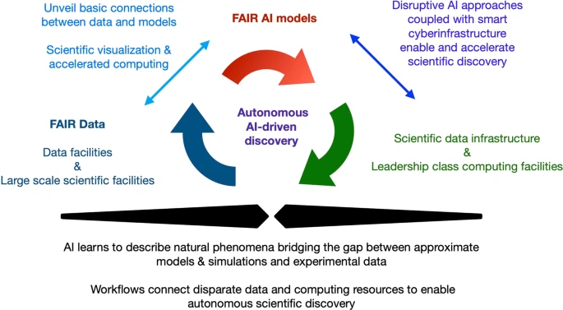



FOXDEN: Advancing AI-Ready Data Exchange Through CHESS–MagLab Collaboration
David S. Butcher, Lissa C. Anderson
Ion Cyclotron Resonance Facility, National High Magnetic Field Laboratory, Tallahassee FL
Funding Grants: K. M. Amm (NSF DMR-2128556)
Over the past decade, the concept of FAIR data—Findable, Accessible, Interoperable, and Reusable for both humans and machines—has become a cornerstone of modern scientific research. FAIR principles are essential for ensuring reproducibility, integrity, and rigor across disciplines. With the rapid rise of artificial intelligence (AI) tools in research, the machine-actionable aspect of FAIR data has gained new urgency: data that is FAIR is also AI-ready, enabling responsible deployment of AI agents to accelerate discovery. AI-ready data is foundational to emerging innovations such as self-driving laboratories, which can conduct fully automated experiments with minimal human intervention (1).
Despite its importance, achieving FAIR data remains a challenge in fields where detailed metadata collection is not standard practice. To address this, the National High Magnetic Field Laboratory (MagLab) is collaborating with researchers at the Cornell High Energy Synchrotron Source (CHESS) to implement new cyberinfrastructure solutions. CHESS has developed the FAIR Open-Science Extensible Data Exchange Network (FOXDEN) (2) — a suite of services for managing data and metadata, visualizing results, and publishing to external repositories.
The MagLab is building custom applications on FOXDEN to automate the generation of rich metadata using emerging standards such as Science-on-schema.org (3) and Croissant (4). These tools enhance dataset discoverability and support AI and machine learning workflows. By integrating these innovations, the MagLab is making FAIR and AI-ready data more accessible to its user community — empowering researchers to harness advanced computational methods and contribute to a more connected, intelligent research ecosystem.
Vision for the integration of FAIR & AI-ready datasets with FAIR AI models and modern computing environments to enable autonomous AI-driven discovery. This approach will also catalyze the development of next-generation AI methods, and the creation of a rigorous approach that identifies foundational connections between data, models and high-performance computing (5).
Citations: (1) Canty, R. B. et al. Science Acceleration and Accessibility with Self-Driving Labs. Nat Commun 2025, 16 (1), 3856. https://doi.org/10.1038/s41467-025-59231-1. (2) CHESS Computing: FOXDEN. https://github.com/CHESSComputing/FOXDEN
(3) Science-on-Schema.Org v1.3.2, 2024. https://doi.org/10.5281/ZENODO.7884538.
(4) Akhtar, M. et al. Croissant: A Metadata Format for ML-Ready Datasets. https://doi.org/10.1145/3650203.3663326.
(5) Ravi, N. et al. FAIR principles for AI models with a practical application for accelerated high energy diffraction microscopy. Sci Data 2022, 9, 657. https://doi.org/10.1038/s41597-022-01712-9

Slide 2
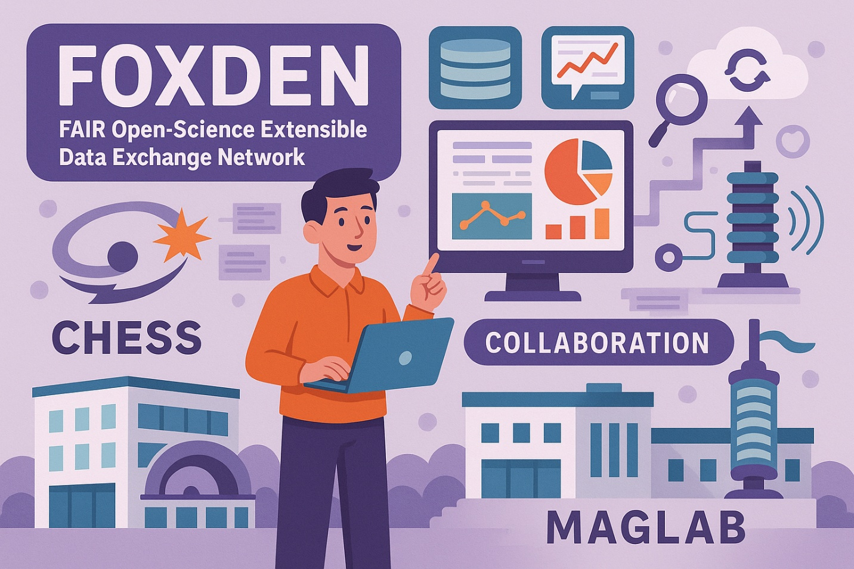
FOXDEN: Advancing AI-Ready Data Exchange Through CHESS–MagLab Collaboration
David S. Butcher, Lissa C. Anderson
Ion Cyclotron Resonance Facility, National High Magnetic Field Laboratory, Tallahassee FL
Funding Grants: K. M. Amm (NSF DMR-2128556)
What is the development?
The MagLab is partnering with researchers at the Cornell High Energy Synchrotron Source (CHESS) to implement FOXDEN (1) — their FAIR Open-Science Extensible Data Exchange Network. This software helps manage, discover, and track data and metadata that are Findable, Accessible, Interoperable, and Reusable (FAIR). By using emerging metadata standards like Science-on-schema.org (2) and Croissant (3), the system improves data discoverability and makes it easier to apply artificial intelligence (AI) techniques.
Why is this important?
Making data FAIR through detailed metadata — information that describes the data, such as experimental parameters — is key to ensuring scientific results are reproducible. It also makes data AI-ready, meaning it can be understood and used by computer algorithms and AI agents. This enables automation of tasks like experimental design and data analysis, helping scientists work faster and more efficiently.
How does the MagLab benefit from working with CHESS?
CHESS has already developed a robust suite of services that support advanced data and metadata management, visualization, analysis, and publishing to external repositories. By building on these tools, the MagLab can offer similar capabilities to its users without starting from scratch. This collaboration between facilities with different specialties — high-energy radiation at CHESS and high magnetic fields at the MagLab — highlights the power of cross-disciplinary and inter-institutional partnerships in advancing scientific research.
Figure created with the assistance of AI-based image generation (OpenAI DALL·E)
Citations: (1) CHESS Computing: FOXDEN. https://github.com/CHESSComputing/FOXDEN
(2) Canty, R. B. et al. Science Acceleration and Accessibility with Self-Driving Labs. Nat Commun 2025, 16 (1), 3856. https://doi.org/10.1038/s41467-025-59231-1. (3) Science-on-Schema.Org v1.3.2, 2024. https://doi.org/10.5281/ZENODO.7884538.
(4) Akhtar, M. et al. Croissant: A Metadata Format for ML-Ready Datasets. https://doi.org/10.1145/3650203.3663326.

