Slide 1


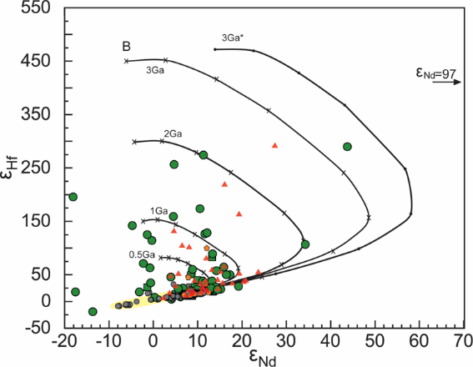
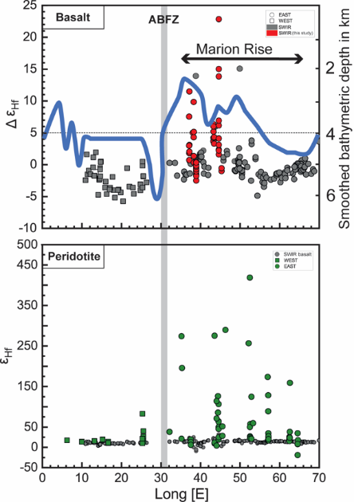



Anciently melt-depleted mantle resurface again at mid-ocean ridges
Salters, V.J.M.¹, Woelki, D.^{1,2},Stracke, A.², White, G.A.¹, Genske, F.³,
NHMFL/FSU; 2. Now at: Univ. Freiburg, Germany; 3. University of Münster, Germany;
Funding Grants: K. M. Amm (NSF DMR-2128556); Salters(NSF- OCE-1657826, OCE-2126496); Stracke and Genske(DFG 03G0273E)
The convecting Earth mantle transports mantle peridotite toward the surface, where it melts under mid-ocean ridges (MOR) and forms oceanic crust. This accounts for ca. 75% of today's volcanic activity. The return mass transport is at subduction zones where melt-depleted mantle, oceanic crust and sediment sinks into the mantle. Abyssal peridotites recovered from MOR are residual from the oceanic crust extraction, but their Hf isotopic compositions are vastly different from the basalts and require ancient melt depletion at MOR followed by the long-term (up to 3-4Ga) residence in the mantle (see Fig. 1). These depleted peridotites ascent now under a MOR again, and re-melt and contribute to the chemically and isotopically heterogeneous basalts at mid-ocean ridges (MORB, Fig 2). Since degree of depletion of peridotite and their density are correlated, the depletion affects crustal thickness and ridge depth as is observed at the Marion Rise on the Southwest Indian Ridge (Fig 2). At this Rise peridotites with extreme Hf-isotopic composition surface, indicating the abundant presence of anciently depleted material and supports that the Rise is formed by depleted low density peridotite.
Ultra-depleted peridotites have been documented at multiple localities, indicating their ubiquity in the sub-ridge mantle. Hence, melts from such ultra depleted peridotite influences mid-ocean ridge basalt compositions and variably mel- depleted sub-ridge peridotites should be considered when evaluating ridge depth variations. The large spectrum of Hf isotope ratios in abyssal peridotites, ranging to εHf > 450, confirms that the predicted variation of melt-depleted peridotites (Figure 1) characterizes peridotites in the sub-ridge mantle.
Figure 1: Green, red and orange symbols are peridotites from the Southwest Indian, Gakkel and Doldrums Ridge showing much higher ε_{Hf}, compared to MOR basalts (grey symbols and yellow field). Model evolution curves for depleted peridotite for different ages are shown in black.
Today, the Earth's mantle is a chemically and lithologically heterogeneous assemblage of peridotites and recycled oceanic and continental crust. During partial melting, the different components of the heterogeneous mantle supply a different fraction of each element to the total budget of the generated basalts. This fraction differs for elements with different geochemical behavior and depends on intrinsic factors such as the abundance and composition of the different mantle components. The shallow ridge depth of the Marion Rise Ultra-depleted peridotite less dense and thus are more buoyant and can cause the shallow ridge depth instead of high degrees of melting related to higher temperatures
Figure 2: Geographic variation in ε_{Hf} for both basalts and peridotites over the Marion Rise show that the peridotites contribute a signification fraction of melt to the oceanic crust.
Facilities and instrumentation used: Geochemistry program, MC-ICP-MS and HR-ICP-MS. Citation: Woelki, D.; Salters, V.J.M.; Stracke, A.; Genske, F.; White, G.A.; Brunelli, D., Abundant Ancient Melt-Depleted Peridotite Beneath the Marion Rise, Southwest Indian Ocean, Effects on Basalt Composition and Dynamic Topography, Geochemistry, Geophysics, Geosystems, 26 (9), e2025GC012418 (2025) doi.org/10.1029/2025GC012418 and Stracke, A.; Salters, V.J.M., The Role of Peridotite for Oceanic Volcanism, Geochemistry, Geophysics, Geosystems, 26 (8), e2025GC012463 (2025) doi.org/10.1029/2025GC012463

Slide 2
Ancient Earth Mantle Resurfaces at Mid-Ocean Ridges
Salters, V.J.M.¹, Woelki, D.^{1,2},Stracke, A.², White, G.A.¹, Genske, F.³,
NHMFL/FSU; 2. Now at: Univ. Freiburg, Germany; 3. University of Münster, Germany;
Funding Grants: K. M. Amm (NSF DMR-2128556); Salters(NSF- OCE-1657826, OCE-2126496); Stracke and Genske(DFG 03G0273E)
What is the finding? Scientists discovered that some rocks rising beneath mid-ocean ridges — called peridotites — are actually ancient remnants of Earth’s mantle that formed billions of years ago. These rocks were once melted and depleted deep inside the planet before sinking and later reemerging at mid-ocean ridges, where new ocean crust forms today. Their unusual chemical fingerprints, especially in hafnium (Hf) isotopes, show that ancient materials still play an active role in shaping Earth’s surface.
Why is this important? This discovery changes how scientists understand the Earth’s recycling system — the process that builds new ocean crust and drives plate tectonics. The chemistry of mantle rocks at mid-ocean ridges illustrate that these rocks experienced melting near the ocean floor billions of years ago, were returned into the deep mantle and are now resurfacing again. Essentially, ancient mantle materials continue to influence volcanic activity and ocean floor formation today. These differences also help explain why the ocean crust varies in thickness and depth from place to place.
Why did this research need the MagLab? To detect these subtle isotopic differences, researchers needed the MagLab’s world-class high-field mass spectrometry capabilities, which allow for ultra-precise measurements of trace elements in rare rock samples.
Figure 1: Green, red and orange symbols are peridotites from the Southwest Indian, Gakkel and Doldrums Ridge showing much higher ε_{Hf}, compared to MOR basalts (grey symbols and yellow field). Model evolution curves for depleted peridotite for different ages are shown in black.
Today, the Earth's mantle is a chemically and lithologically heterogeneous assemblage of peridotites and recycled oceanic and continental crust. During partial melting, the different components of the heterogeneous mantle supply a different fraction of each element to the total budget of the generated basalts. This mantle architecture changes our understanding of the relation between basalts and residual peridotite.
Figure 2: Geographic variation in ε_{Hf} for both basalts and peridotites over the Marion Rise show that the peridotites contribute a signification fraction of melt to the oceanic crust
Facilities and instrumentation used: Geochemistry program, MC-ICP-MS and HR-ICP-MS. Citation: Woelki, D.; Salters, V.J.M.; Stracke, A.; Genske, F.; White, G.A.; Brunelli, D., Abundant Ancient Melt-Depleted Peridotite Beneath the Marion Rise, Southwest Indian Ocean, Effects on Basalt Composition and Dynamic Topography, Geochemistry, Geophysics, Geosystems, 26 (9), e2025GC012418 (2025) doi.org/10.1029/2025GC012418 and Stracke, A.; Salters, V.J.M., The Role of Peridotite for Oceanic Volcanism, Geochemistry, Geophysics, Geosystems, 26 (8), e2025GC012463 (2025) doi.org/10.1029/2025GC012463

