Slide 1


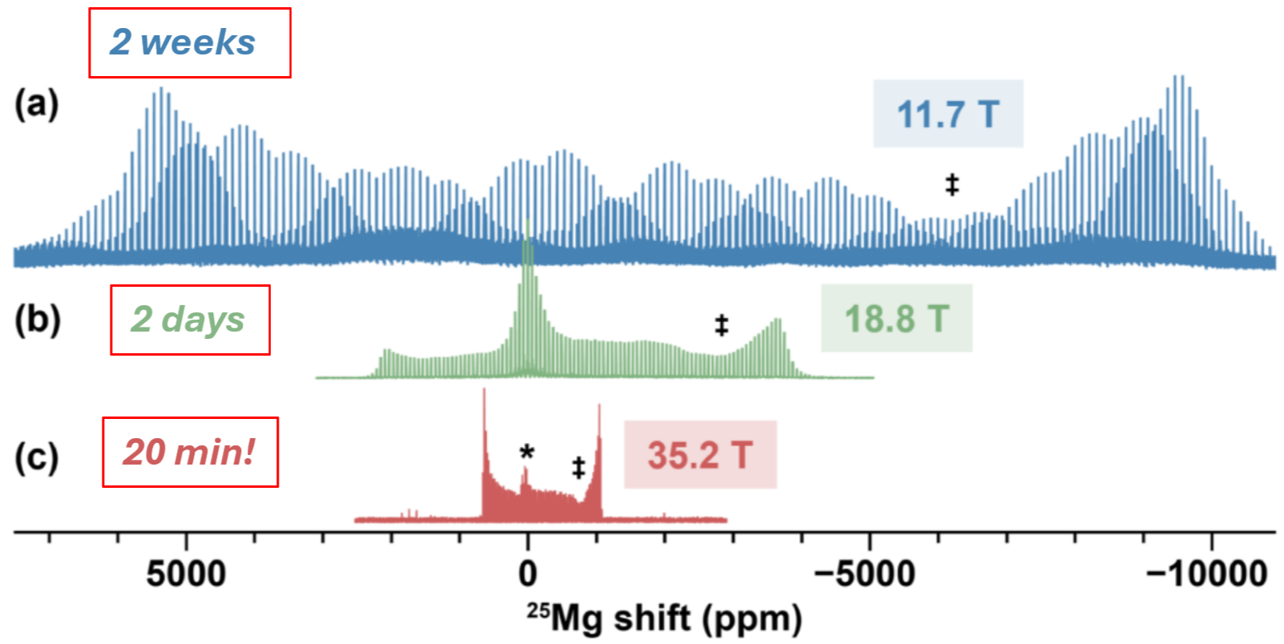



Probing Mg-ion Transport in Antiperovskites via Ultrahigh Field ²⁵Mg NMR
David M. Halat¹˒²˒³, Haoyu Liu⁴, Kwangnam Kim⁵˒⁶, Grant C. B. Alexander⁷, Xiaoling Wang⁸˒⁹, Amrit Venkatesh⁸, Adam R. Altenhof¹⁰, Harris E. Mason¹¹, Saul H. Lapidus¹², Jeong Seop Yoon¹³, Ivan Hung⁸, Zhehong Gan⁸, Jordi Cabana⁷˒¹⁴, Donald J. Siegel¹³, Jeffrey A. Reimer²˒³, Baris Key⁴
1. Colorado School of Mines; 2. University of California Berkeley; 3. Lawrence Berkeley National Laboratory; 4. Argonne National Laboratory; 5. University of Michigan; 6. Lawrence Livermore National Laboratory; 7. University of Illinois at Chicago; 8. National High Magnetic Field Laboratory, Florida State University; 9. California State University East Bay; 10. Los Alamos National Laboratory (MPA-Q); 11. Los Alamos National Laboratory (Chemistry Division); 12. Advanced Photon Source, Argonne National Laboratory; 13. University of Texas at Austin; 14. Argonne National Laboratory (Materials Science Division)
Funding grants: D.M.H., J.C., D.J.S., J.A.R., B.K. (DOE BES JCESR, DE-AC02-06CH11357); X.W., A.V., I.H., Z.G. (NSF DMR-2128556, NSF DMR-1039938, NSF DMR-0603042, NIH BTRR 1P41 GM122698); K.K. (DOE DE-AC52-07NA27344); X.W. (DOE DE-SC0025712); D.M.H. (Pines Magnetic Resonance Center Fellowship); J.C., D.J.S., J.A.R., B.K. (DOE Office of Science, Argonne National Laboratory, DE-AC02-06CH11357); D.J.S., J.A.R., B.K. (DOE, Los Alamos National Laboratory, 89233218CNA000001).
Magnesium-ion batteries promise safer, higher-capacity energy storage than lithium-ion systems, but development has been hindered by the absence of solid electrolytes capable of fast Mg-ion conduction. Antiperovskite materials such as Mg₃AsN and Mg₃SbN have been proposed as candidates, yet their ion transport properties have not been experimentally verified.
To address this challenge, we performed natural-abundance ²⁵Mg solid-state NMR at 35.2 T using the MagLab’s 36 T Series-Connected Hybrid (36T SCH) magnet, the highest-field NMR instrument in the world. The ultrahigh field dramatically reduces pattern broadening arising from the second-order quadrupolar interaction, enabling acquisition of complete, ultra-wideline ²⁵Mg spectra in just 20 minutes. At conventional fields (e.g., 11.7 T), the same measurements require “piecewise” acquisition over nearly two weeks. This gain in efficiency made variable-temperature experiments practical, allowing us to quantify Mg-ion hopping rates and activation energies directly. The 36T SCH therefore enables ²⁵Mg NMR experiments that would otherwise be impractical, reducing weeks of effort to less than an hour!
These studies reveal the largest quadrupolar coupling constants reported for magnesium to date (up to 22 MHz) and provide direct evidence of fast, low-barrier Mg-ion motion in antiperovskites. By confirming the predicted ion transport mechanisms, this work advances the atomic-scale understanding of these materials and supports the rational design of new solid electrolytes for next-generation, beyond-lithium battery technologies.
Figure: Variable-field ²⁵Mg static QCPMG spectra of Mg₃AsN acquired at (a) 11.7 T, (b) 18.8 T, and (c) 35.2 T (using the 36T SCH). Acquisition times were approximately 2 weeks, 2 days, and 20 min, respectively. *Mg₃As₂ impurity. ‡Depletion of signal due to overlap of central transition (CT) and satellite transition (ST) patterns.
Facilities and instrumentation used: Solid-State NMR Facility: 36 T/40 mm Series Connected Hybrid Magnet (35.2 T/1.5 GHz) and 18.8 T/63 mm/800 MHz solid-state NMR spectrometer (800#1)
Citation: Halat, D.M.; Liu, H.; Kim, K.; Alexander, G.C.; Wang, X.; Venkatesh, A.; Altenhof, A.R.; Mason, H.E.; Lapidus, S.H.; Yoon, J.; Hung, I.; Gan, Z.; Cabana, J.; Siegel, D.J.; Reimer, J.A.; Key, B., Mg-Ion Conduction in Antiperovskite Solid Electrolytes Revealed by 25Mg Ultrahigh Field NMR and First-Principles Calculations, Journal of the American Chemical Society, 147 (31), 27949–27961 (2025) doi.org/10.1021/jacs.5c07442

Slide 2
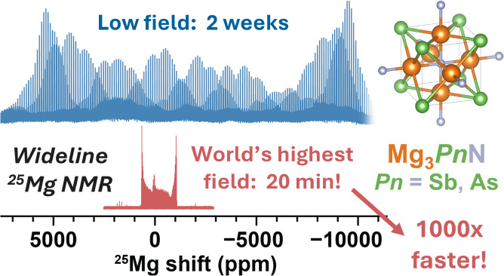
Observing Magnesium-ion Motion in Antiperovskite Materials
David M. Halat¹˒²˒³, Haoyu Liu⁴, Kwangnam Kim⁵˒⁶, Grant C. B. Alexander⁷, Xiaoling Wang⁸˒⁹, Amrit Venkatesh⁸, Adam R. Altenhof¹⁰, Harris E. Mason¹¹, Saul H. Lapidus¹², Jeong Seop Yoon¹³, Ivan Hung⁸, Zhehong Gan⁸, Jordi Cabana⁷˒¹⁴, Donald J. Siegel¹³, Jeffrey A. Reimer²˒³, Baris Key⁴
1. Colorado School of Mines; 2. University of California Berkeley; 3. Lawrence Berkeley National Laboratory; 4. Argonne National Laboratory; 5. University of Michigan; 6. Lawrence Livermore National Laboratory; 7. University of Illinois at Chicago; 8. National High Magnetic Field Laboratory, Florida State University; 9. California State University East Bay; 10. Los Alamos National Laboratory (MPA-Q); 11. Los Alamos National Laboratory (Chemistry Division); 12. Advanced Photon Source, Argonne National Laboratory; 13. University of Texas at Austin; 14. Argonne National Laboratory (Materials Science Division)
Funding grants: D.M.H., J.C., D.J.S., J.A.R., B.K. (DOE BES JCESR, DE-AC02-06CH11357); X.W., A.V., I.H., Z.G. (NSF DMR-2128556, NSF DMR-1039938, NSF DMR-0603042, NIH BTRR 1P41 GM122698); K.K. (DOE DE-AC52-07NA27344); X.W. (DOE DE-SC0025712); D.M.H. (Pines Magnetic Resonance Center Fellowship); J.C., D.J.S., J.A.R., B.K. (DOE Office of Science, Argonne National Laboratory, DE-AC02-06CH11357); D.J.S., J.A.R., B.K. (DOE, Los Alamos National Laboratory, 89233218CNA000001).
What is the finding? Scientists used the world’s strongest NMR magnet to study how magnesium ions (²⁵Mg) move inside special materials called antiperovskites. The ultra-high magnetic field allowed researchers to perform variable-temperature solid state nuclear magnetic resonance (SSNMR) to measure magnesium’s motion in detail for the first time, finding low-energy pathways.
Why is this important? Magnesium-ion batteries could store more energy and avoid the safety risks of lithium-ion systems, but progress has been limited because magnesium carries a double positive charge (Mg²⁺) and has difficultly moving through solid materials. Researchers have struggled to identify and validate solid electrolytes that allow fast magnesium transport This research confirms that antiperovskites allow magnesium ions to move easily — a major step toward designing faster, more efficient materials for next-generation batteries critical for energy security and independence.
Why did this research need the MagLab? The MagLab’s 36T Series-Connected Hybrid magnet enabled ²⁵Mg solid-state NMR experiments that would be nearly impossible at conventional fields. At 11.7 T, a spectrum must be acquired in small pieces over ~2 weeks. At 35.2 T, the entire spectrum can be captured in only 20 minutes: a time savings of nearly 1000-fold. This unique capability made it feasible to conduct the variable-temperature measurements that revealed magnesium-ion motion in antiperovskites.
Figure: At lower magnetic fields, ²⁵Mg solid-state NMR spectra required nearly two weeks of spectrometer time (blue). At the world’s strongest magnetic field for NMR at the MagLab (field strength of 35.2 T), the same data were collected in only 20 minutes (red), more than 1000 times faster. This ultrahigh-field capability made it possible to directly observe magnesium-ion motion in antiperovskite materials.
Facilities and instrumentation used: Solid-State NMR Facility: 36 T/40 mm Series Connected Hybrid Magnet (35.2 T/1.5 GHz) and 18.8 T/63 mm/800 MHz solid-state NMR spectrometer (800#1)
Citation: Halat, D.M.; Liu, H.; Kim, K.; Alexander, G.C.; Wang, X.; Venkatesh, A.; Altenhof, A.R.; Mason, H.E.; Lapidus, S.H.; Yoon, J.; Hung, I.; Gan, Z.; Cabana, J.; Siegel, D.J.; Reimer, J.A.; Key, B., Mg-Ion Conduction in Antiperovskite Solid Electrolytes Revealed by 25Mg Ultrahigh Field NMR and First-Principles Calculations, Journal of the American Chemical Society, 147 (31), 27949–27961 (2025) doi.org/10.1021/jacs.5c07442

