Slide 1


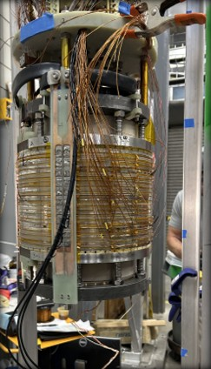
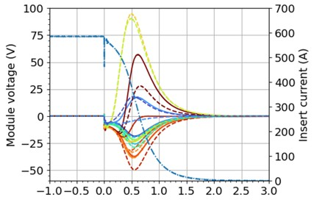
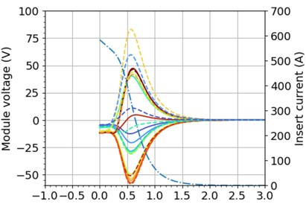



Demonstration of Technology Suitable for an All-Superconducting 40 T Magnet through Testing of a Large-Scale REBCO Coil
Iain Dixon¹, Shannon Griffin¹, Kwangmin Kim¹, John Rogers¹, Dharmendra Shukla¹, Yu Suetomi¹, Hongyu Bai¹,
National High Magnetic Field Laboratory, Florida State University
Funding Grants: K. M. Amm (NSF DMR-2128556, NSF DMR-2131790)
A solenoid test coil fabricated with REBCO high temperature superconductor was designed with features and stresses representative of the proposed 40 T all-superconducting magnet. This coil with a 260 mm inner diameter, has a relatively high stored energy of 0.2 MJ and contains 3.7 km (2.3 miles) of superconducting tape. Testing of the coils was performed in a background field to see if it could attain its designed maximum operational current, if it could be protected from quench, and if the internal joints could withstand the high operational strains.
The coil was tested in the MagLab’s DC Field Facility using the outer super-conducting coils of the 45 T Hybrid magnet to provide a magnetic environment of 11.4 T in a 4.2 K cold bore of 353 mm diameter. The REBCO coil reached its target current of 645 A which created a ΔB = 5 T, for a total central field of 16.4 T. This is the first coil of its kind to reach 70% of its short-sample critical current, a vital requirement for compact high-field coils. The coil was also subjected to seven forced quenches to find weak points in its design. Finally, field control experiments were performed to qualify techniques to improve field stability.
The REBCO coil will now be disassembled and inspected to search for internal damage. This information will be used for design improvements. The measured voltages developed during quench and measured strains during operation will be evaluated and numerical models adjusted where necessary to further refine our predictive capabilities for the final 40 T all-superconducting system.
322 mm
Time (s)
Measured voltages (top) during quench – when magnetic stored energy rapidly converts to heat in the coil – showed excellent agreement with simulations (bottom). Agreement is essential for designing the quench protection system for the final 40 T magnet.
Large-Scale REBCO Coil
Facilities and instrumentation used: DC Field Facility 45 T Hybrid.
Citation: Bai, H.; Bird, M.D.; Cooley, L.; Dixon, I.R.; Kim, K.L.; Larbalestier, D.C.; Marshall, W.S.; Trociewitz, U.P.; Weijers, H.W.; Abraimov, D.V.; Boebinger, G.S., The 40 T Superconducting Magnet Project at the National High Magnetic Field Laboratory, IEEE Transactions on Applied Superconductivity, 30 (4), 1-5 (2020) doi.org/10.1109/TASC.2020.2969642

Slide 2
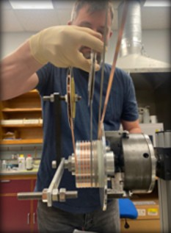
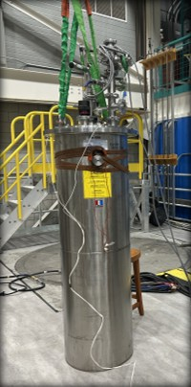
Successful Test of Key Superconducting Coil for Future 40-Tesla Magnet
Iain Dixon¹, Shannon Griffin¹, Kwangmin Kim¹, John Rogers¹, Dharmendra Shukla¹, Yu Suetomi¹, Hongyu Bai¹,
National High Magnetic Field Laboratory, Florida State University
Funding Grants: K. M. Amm (NSF DMR-2128556, NSF DMR-2131790)
What is the finding? MagLab researchers successfully tested a REBCO high-temperature superconducting coil designed to mimic a future 40 T all-superconducting magnet. The coil reached its full design current of 645 A, generating 5 T on its own for a total field of 16.4 T; achieved 70% of its short-sample critical current—a first for a coil of this type; withstood seven forced quenches and maintained structural integrity; and demonstrated new field-control techniques to stabilize the magnetic environment.
Why is this important? This test demonstrates that REBCO coils can meet the extreme performance, stability, and protection requirements needed for next-generation high-field magnets like the world’s first 40 T all-superconducting magnet, which will offer unprecedented research capabilities. This work also improves future predictive models for coil behavior and provides key data for design changes before final magnet construction.
Why did this research need the MagLab? Only the MagLab provides the field strength, stability, and experimental environment needed to validate technology for a 40-tesla superconducting magnet. The MagLab’s unique facilities acted as a “magnet test bed” providing extreme environments that used the outer super-conducting coils of the 45 T Hybrid magnet to provide a magnetic environment of 11.4 T in a -452 °F (4.2 K) cold bore of 353 mm diameter.
REBCO Length | 3.7 km
Inner Diameter | 260 mm
Outer Diameter | 322 mm
Coil Length | 194 mm
Inductance | 1.0 H
Energy | 213 kJ
ΔB (in 11.4 T) | 5 T
322 mm
Large-scale coil (left), being wound (center) and in the dewar prior to insertion into the 45 T outsert (right)
Facilities and instrumentation used: DC Field Facility 45 T Hybrid.
Citation: Bai, H.; Bird, M.D.; Cooley, L.; Dixon, I.R.; Kim, K.L.; Larbalestier, D.C.; Marshall, W.S.; Trociewitz, U.P.; Weijers, H.W.; Abraimov, D.V.; Boebinger, G.S., The 40 T Superconducting Magnet Project at the National High Magnetic Field Laboratory, IEEE Transactions on Applied Superconductivity, 30 (4), 1-5 (2020) doi.org/10.1109/TASC.2020.2969642

