Slide 1





Neutral Fermions Revealed by High-Field Heat Capacity in a Kondo Insulator
Kuan-Wen Chen¹,; Yuan Zhu¹,; Danilo Ratkovski²; Guoxin Zheng¹; Dechen Zhang¹; Aaron Chan¹; Kaila Jenkins¹; Joanna Blawat³; Tomoya Asaba⁴;
Fumitoshi Iga⁵; Chandra M. Varma⁶; Yuji Matsuda⁴,⁷; John Singleton³; Alimamy F. Bangura²; Lu Li¹,
¹University of Michigan, ²National High Magnetic Field Laboratory, FSU. ³National High Magnetic Field Laboratory, LANL, ⁴Kyoto University,
⁵Ibaraki University, ⁶University of California, Riverside, ⁷Los Alamos National Laboratory
Funding Grants: K. M. Amm (NSF DMR-2128556); (NSF DMR-2317618; DOE DE-SC0020184; DOE BES “Science at 100 T”; Gordon and Betty Moore Foundation
GBMF5305; JSPS KAKENHI 23H00089; JST CREST JPMJCR19T5)
Quantum oscillations—regular variations in material properties with magnetic field—are typically found only in metals, where they serve as a direct fingerprint of the Fermi surface. Their unexpected appearance in electrical insulators raises fundamental questions about the nature of the charge carriers in these systems. The Kondo insulator YbB₁₂ has emerged as a key platform for exploring these exotic, potentially charge-neutral quasiparticles.
Using high-field heat-capacity measurements in continuous fields up to 41.5 tesla at the MagLab’s DC-Field Facility, researchers directly detected large-amplitude quantum oscillations from bulk, charge-neutral excitations. These measurements are complemented by magnetization, torque, and resistivity studies at the Pulsed-Field Facility (PFF), which track how these excitations evolve to even higher fields. Together, the DC and PFF results show that neutral-fermion quantum oscillations persist through the insulator–metal transition near 45–47 T and give way to a different high-field magnetic state above ~65 T, providing a consistent picture across independent techniques.
This combined approach offers strong evidence for a neutral Fermi surface in an insulating state and reveals how it transforms under extreme magnetic fields. The work highlights the power of complementary thermodynamic and magnetic-response measurements across MagLab facilities to uncover unexpected forms of quantum matter.
Figure 1. High-field heat capacity of YbB₁₂ shows a clear double-peak feature near 20 T and well-defined quantum oscillations above 35 T. The left panels display heat capacity versus magnetic field, while the right panel shows the raw C/T data as a function of temperature used to identify these features.
Figure 2. Oscillatory component of the heat capacity at several temperatures, obtained after subtracting a smooth background. The field positions of the peaks shift systematically with temperature, enabling determination of the quantum-oscillation frequency and effective masses. These thermodynamic oscillations are consistent with high-field transport and torque measurements.
Facilities and instrumentation used: DCFF Cell 12 (35 T) and Cell 6 (41.5 T) - high-resolution nanocalorimetry. Magnetization measurements performed at PFF.
Citation: Chen, K.; Zhu, Y.; Ratkovski, D.R.; Zheng, G.; Zhang, D.; Chan, A.; Jenkins, K.; Blawat, J.; Asaba, T.; Iga, F.; Varma, C.M.; Matsuda, Y.; Singleton, J.; Bangura, A.; Li, L., Quantum Oscillations in the Heat Capacity of Kondo Insulator YbB₁₂, Physical Review Letters, 135, 156501 (2025) doi.org/10.1103/ms3x-pjsk. Implementation of the nanocalorimetry capability at the DC-Field Facility was supported by an NHMFL UCGP grant awarded to A.F. Bangura

Slide 2
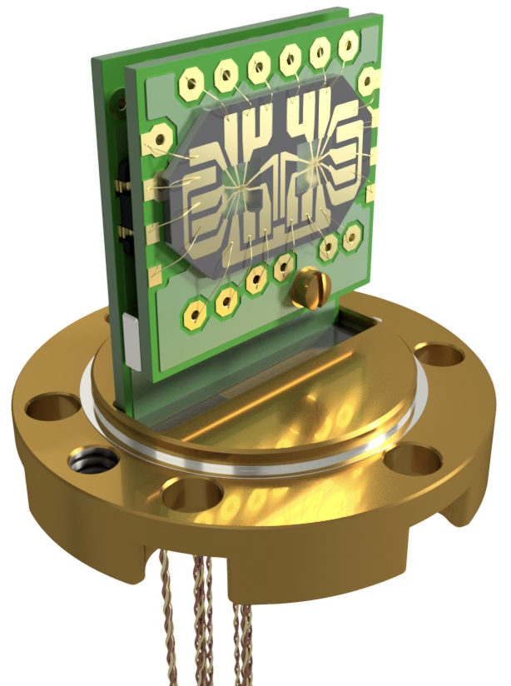
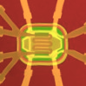
Neutral Particles Behaving Like Metals: MagLab Reveals Hidden Quantum Structure in Electrical Insulator
Kuan-Wen Chen¹,; Yuan Zhu¹,; Danilo Ratkovski²; Guoxin Zheng¹; Dechen Zhang¹; Aaron Chan¹; Kaila Jenkins¹; Joanna Blawat³; Tomoya Asaba⁴;
Fumitoshi Iga⁵; Chandra M. Varma⁶; Yuji Matsuda⁴,⁷; John Singleton³; Alimamy F. Bangura²; Lu Li¹,
¹University of Michigan, ²National High Magnetic Field Laboratory, FSU. ³National High Magnetic Field Laboratory, LANL, ⁴Kyoto University,
⁵Ibaraki University, ⁶University of California, Riverside, ⁷Los Alamos National Laboratory
Funding Grants: K. M. Amm (NSF DMR-2128556); (NSF DMR-2317618; DOE DE-SC0020184; DOE BES “Science at 100 T”; Gordon and Betty Moore Foundation
GBMF5305; JSPS KAKENHI 23H00089; JST CREST JPMJCR19T5)
What is the finding? Scientists discovered that an electrical insulator, YbB₁₂, contains hidden particles that respond to magnetic fields even though they carry no electric charge. These “neutral fermions” revealed themselves through tiny ripples in the heat capacity when the material was placed in very strong magnetic fields.
Why is this important? An insulator behaving like a metal is not expected, challenging long-standing ideas about how electrons behave in solids. Understanding these unusual particles may help scientists develop new theories for quantum materials. In the long term, insights from these systems could contribute to new technologies in electronics, sensing, and quantum information.
Why did this research need the MagLab? Detecting these extremely small heat-capacity signals requires both very strong, stable magnetic fields and highly sensitive calorimetry. The MagLab’s DC-Field Facility is the only place where continuous magnetic fields above 35 tesla can be combined with precision nanocalorimetry—making this discovery possible. The MagLab’s unique environments allow scientists to uncover hidden states of matter that cannot be seen anywhere else.
Did you use any other national/user facilities to complete this work?
Additional magnetization measurements were performed at NHMFL’s Pulsed Field Facility at the Los Alamos National Laboratory.
Figure: Vacuum cell containing the custom-built nanocalorimeter (left) and a magnified view of the lithographically patterned sensor (right). The dashed outline marks the ~100-micron wide active area—about the width of a human hair—that detects power changes as small as 10⁻¹⁴ W, comparable to the faint light from a tiny LED indicator across a room and producing a temperature rise of only ~0.1 mK, which the calorimeter can still resolve.
Facilities and instrumentation used: DCFF Cell 12 (35 T) and Cell 6 (41.5 T) - high-resolution nanocalorimetry. Magnetization measurements performed at PFF.
Citation: Chen, K.; Zhu, Y.; Ratkovski, D.R.; Zheng, G.; Zhang, D.; Chan, A.; Jenkins, K.; Blawat, J.; Asaba, T.; Iga, F.; Varma, C.M.; Matsuda, Y.; Singleton, J.; Bangura, A.; Li, L., Quantum Oscillations in the Heat Capacity of Kondo Insulator YbB₁₂, Physical Review Letters, 135, 156501 (2025) doi.org/10.1103/ms3x-pjsk. Implementation of the nanocalorimetry capability at the DC-Field Facility was supported by an NHMFL UCGP grant awarded to A.F. Bangura

