Slide 1




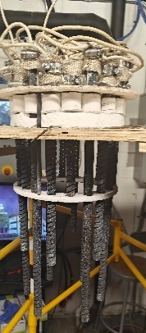
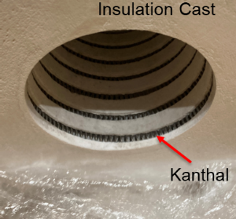
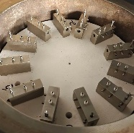
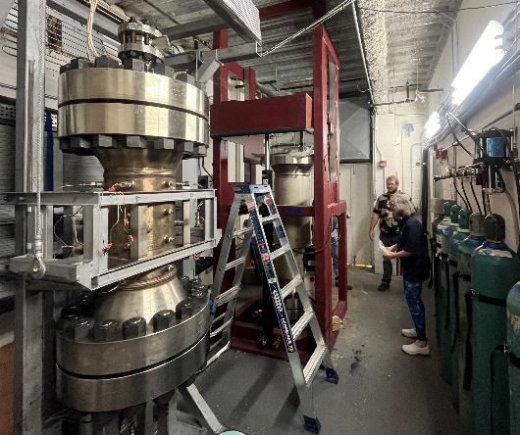
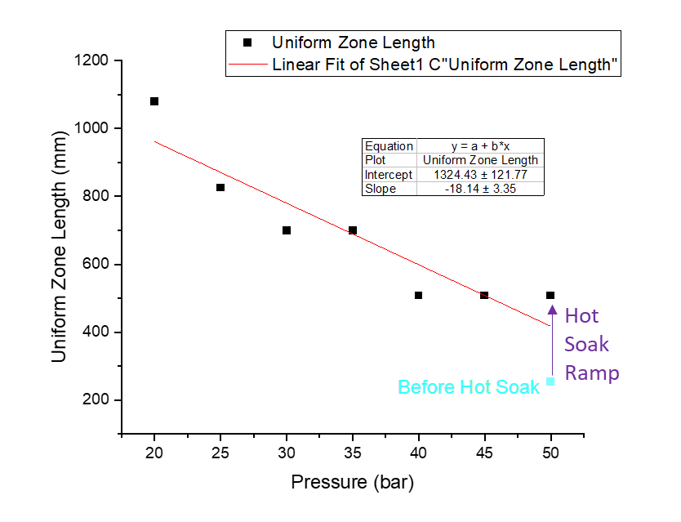



Reliable & Uniform High-Pressure Furnaces for Superconducting Magnets
Daniel S. Davis¹, Ulf P. Trociewitz¹, Youngjae Kim¹, George Miller¹, Cindonia T. Brady¹, Eric Hellstrom¹, David C. Larbalestier¹, Tengming Shen²
ASC-NHMFL-FSU; 2. Lawrence Berkeley National Lab;
Funding Grants: K. M. Amm (NSF DMR-2128556); E. Hellstrom (DOE DE-SC0010421); U.P. Trociewitz (DOE DE-SC0018683, NIH-RO1 1RO1GM154600); D.S. Davis (DOE-ARDAP DE-AC02-05CH11231/AWD00007176); State of Florida; US DOE-MDP
Most high field (> 8T) superconducting magnets are made with a wind-and-react conductor, including low-temperature-superconductor Nb₃Sn and high-temperature-superconductor (HTS) Bi-2212, that must undergo a heat treatment in final form due to strain limitations. Additionally Bi-2212, produced by powder-in-tube technology is reacted under high pressure to achieve dense filaments carrying high currents [1]. HTS Bi-2212 magnet technology is being developed for compact research magnets, accelerator magnets [2], nuclear magnetic resonance (NIH-R01-Trociewitz), and possibly fusion ohmic heating applications.
Scaling up high-pressure furnaces to meet the needs of these applications is critical but challenging due to the tight temperature tolerance (±2°C up to 900°C) and the need to maintain flowing oxygen to maintain 100kPa pO₂ within 5-10MPa Argon. We have recently completed the commissioning of two magnet scale furnaces designing and implementing a more robust heater technology to reduce maintenance down-time. These furnaces enable progress on multiple domestic and international collaborations developing Bi-2212 magnet technology. This is the only facility in the world capable of Over-Pressure Heat-Treatment of Bi-2212 magnets.
A significant advance is the demonstration of a 0.5m long uniform hot-zone in our larger furnace by optimizing the heating schedule. Additionally, a path to increasing this up to 1m at lower pressures that still achieve the benefits of over-pressure has been achieved. This is critical for our high energy physics partners, where sub-scale magnets begin at 1m lengths. This is motivating our continued efforts to partner with industry to produce a commercial large-volume furnace.
Many Terminations
Heater Technology Upgrade
Reduced number of terminations made from Ni
Very complex heaters made with brittle silicon carbide
More furnace heating zones (25cm each) reaching peak temperature as pressure is reduced
“Renegade” Furnace
Φ15 cm x 50-100 cm
Gas
Bottles
2% O₂
98% Ar
“Δ-Tech” Furnace
Φ13 cm x 38 cm
Longer uniform heating-zone (± 2°C) with optimized heating and reduced pressure
Facilities and instrumentation used: Applied Superconductivity Center
over-pressure-heat-treatment furnaces.
Citation: [1] Larbalestier, D., Jiang, J., Trociewitz, U. et al. Isotropic round-wire multifilament cuprate superconductor for generation of magnetic fields above 30 T. Nature Mater 13, 375–381 (2014). https://doi.org/10.1038/nmat3887. [2] Shen, T.; Garcia Fajardo, L. Superconducting Accelerator Magnets Based on High-Temperature Superconducting Bi-2212 Round Wires. Instruments, 4, 17 (2020). https://doi.org/10.3390/instruments4020017.
Upgraded Over-Pressure Furnaces for HTS Bi-2212 Magnets

Slide 2
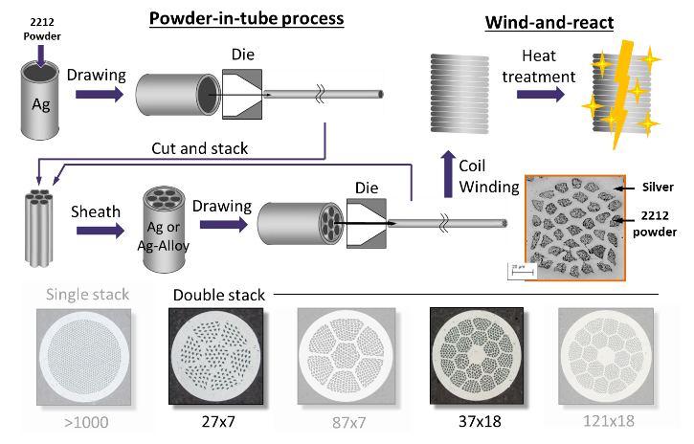
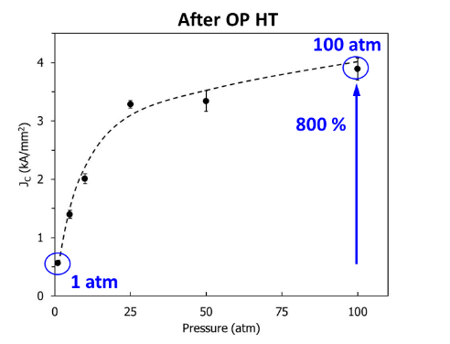
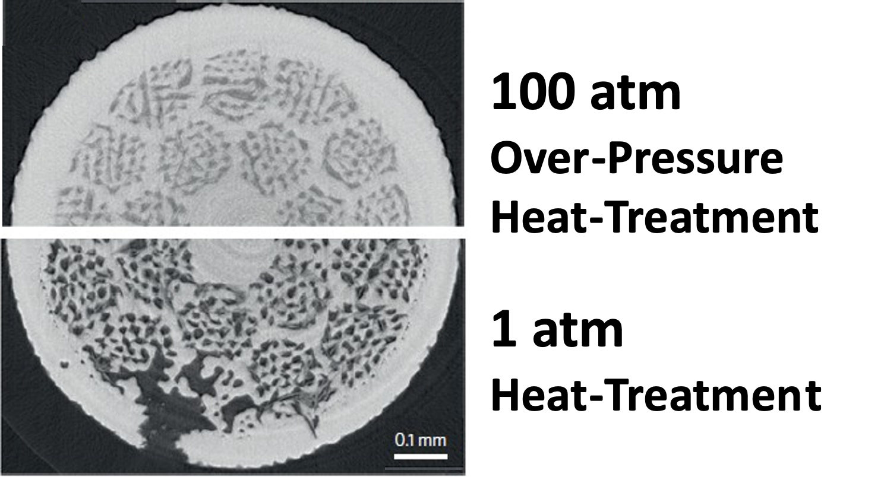
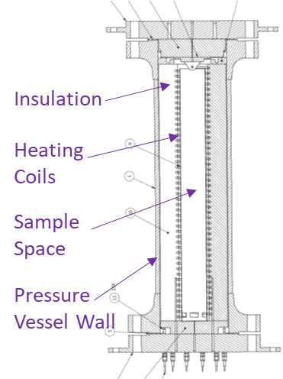
Furnace Upgrade Supercharges Future Magnet Technology
Daniel S. Davis¹, Ulf P. Trociewitz¹, Youngjae Kim¹, George Miller¹, Cindonia T. Brady¹, Eric Hellstrom¹, David C. Larbalestier¹, Tengming Shen²
ASC-NHMFL-FSU; 2. Lawrence Berkeley National Lab;
Funding Grants: K. M. Amm (NSF DMR-2128556); E. Hellstrom (DOE DE-SC0010421); U.P. Trociewitz (DOE DE-SC0018683, NIH-RO1 1RO1GM154600); D.S. Davis (DOE-ARDAP DE-AC02-05CH11231/AWD00007176); State of Florida; US DOE-MDP
What is the finding? Two state-of-the-art furnaces at the MagLab have been upgraded to produce next-generation superconducting magnets. These enhanced furnances can now manufacture magnets up to 15 cm in diameter and 1 meter in length—ideal for advanced applications like particle accelerators, fusion energy, and materials research. Upgrades include stronger heaters, better insulation, more precise temperature control, and a safer hydraulic mechanism for opening and closing - all upgrades that will boost performance and reliability.
Why is this important? Heat-treating superconducting wires under high pressure can increase their performance by as much as 400%, allowing for more compact, powerful magnets. These upgraded furnaces are the only ones in the world capable of performing such treatments on these advanced materials. This breakthrough supports emerging technologies, including compact magnets for research, high-performance accelerators, next-gen MRI systems, and potentially fusion energy devices.
Why did this research need the MagLab? The MagLab is uniquely equipped with the expertise, infrastructure, and collaborative environment needed to advance superconducting magnet technology. Scientists at the Applied Superconductivity Center have a proven track record of transforming new superconducting materials into practical, high-field magnets. This work directly supports the National Science Foundation’s mission to enable cutting-edge science and the Department of Energy’s push for the next generation of particle accelerators.
Pressure prevents bubbles
that block electric current [1]
Increased conductor and magnet performance applying high pressure heat treatment [1]
“Renegade” Furnace
Φ15 cm x 50-100 cm
> 1 m
@ 20 Atm
> 0.5 m
@ 50 Atm
Gas
Bottles
2% O₂
98% Ar
0.25 m
“Δ-Tech” Furnace
Φ13 cm x 38 cm
Slower heating and lower pressure enables longer magnets
Facilities and instrumentation used: Applied Superconductivity Center
over-pressure-heat-treatment furnaces.
Citation: [1] Larbalestier, D., Jiang, J., Trociewitz, U. et al. Isotropic round-wire multifilament cuprate superconductor for generation of magnetic fields above 30 T. Nature Mater 13, 375–381 (2014). https://doi.org/10.1038/nmat3887. [2] Shen, T.; Garcia Fajardo, L. Superconducting Accelerator Magnets Based on High-Temperature Superconducting Bi-2212 Round Wires. Instruments, 4, 17 (2020). https://doi.org/10.3390/instruments4020017.
Upgraded Over-Pressure Furnaces for HTS Bi-2212 Magnets

