Slide 1
FT-ICR Research Opportunities
Ryan Rodgers

Slide 2
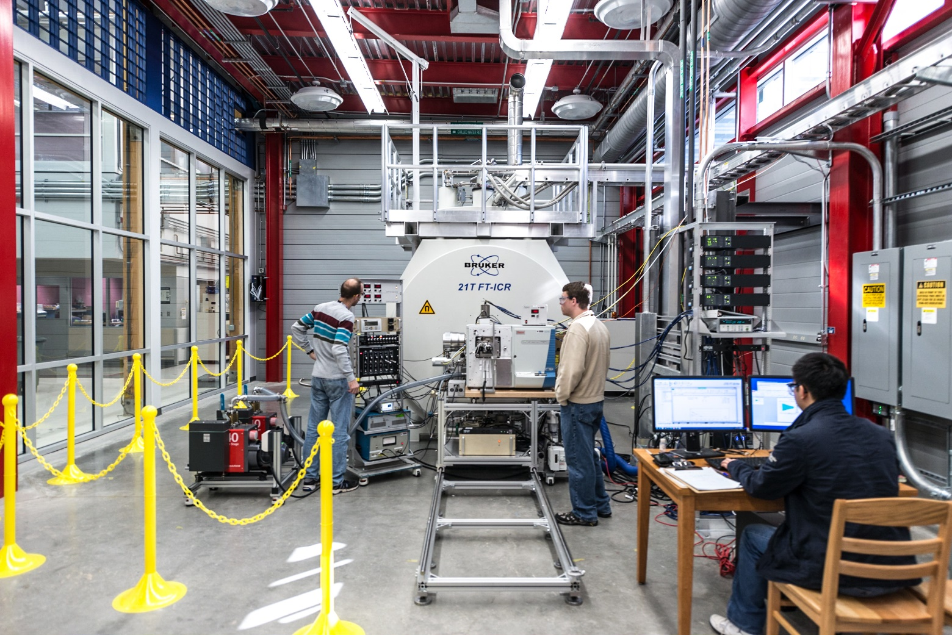
21T FT-ICR MS
21T FT-ICR MS

Slide 3
FT-ICR
Excitation
Detection
fast (~1 ms) scan
all m/z simultaneously
+
+
+
+
+
+
+
+
+
B₀
+
+
+
C
+
+
R
+
+
+
+
q B
ω
= 2πf =
kinetic energy
distance
slit width
m
Ion Cyclotron Resonance

Slide 4
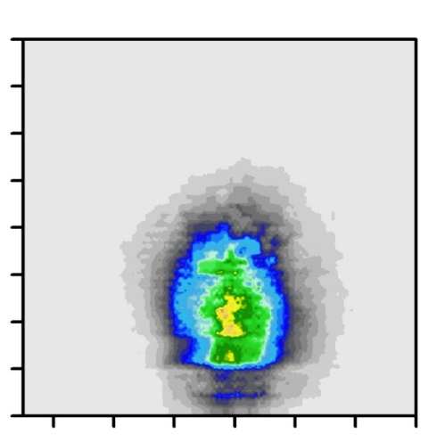
Accurate mass = elemental formula
Data Processing / Visualization
m/z 704.53510
50 - 200 ppb
[C₅₀H₇₂S₁ + H]⁺
S₁ Class
40
400
500
600
700
800
1. Carbon Number
30
2. Aromaticity (Rings + Double Bonds)
20
DBE
H
N
DBE = C
–
+
+
1
10
2
2
McLafferty & Turecek Int. Mass Spectra, 1993
0
20
40
60
80
[Z = -2(DBE) + n + 2]
Carbon Number
Relative Abundance (% total)

Slide 5
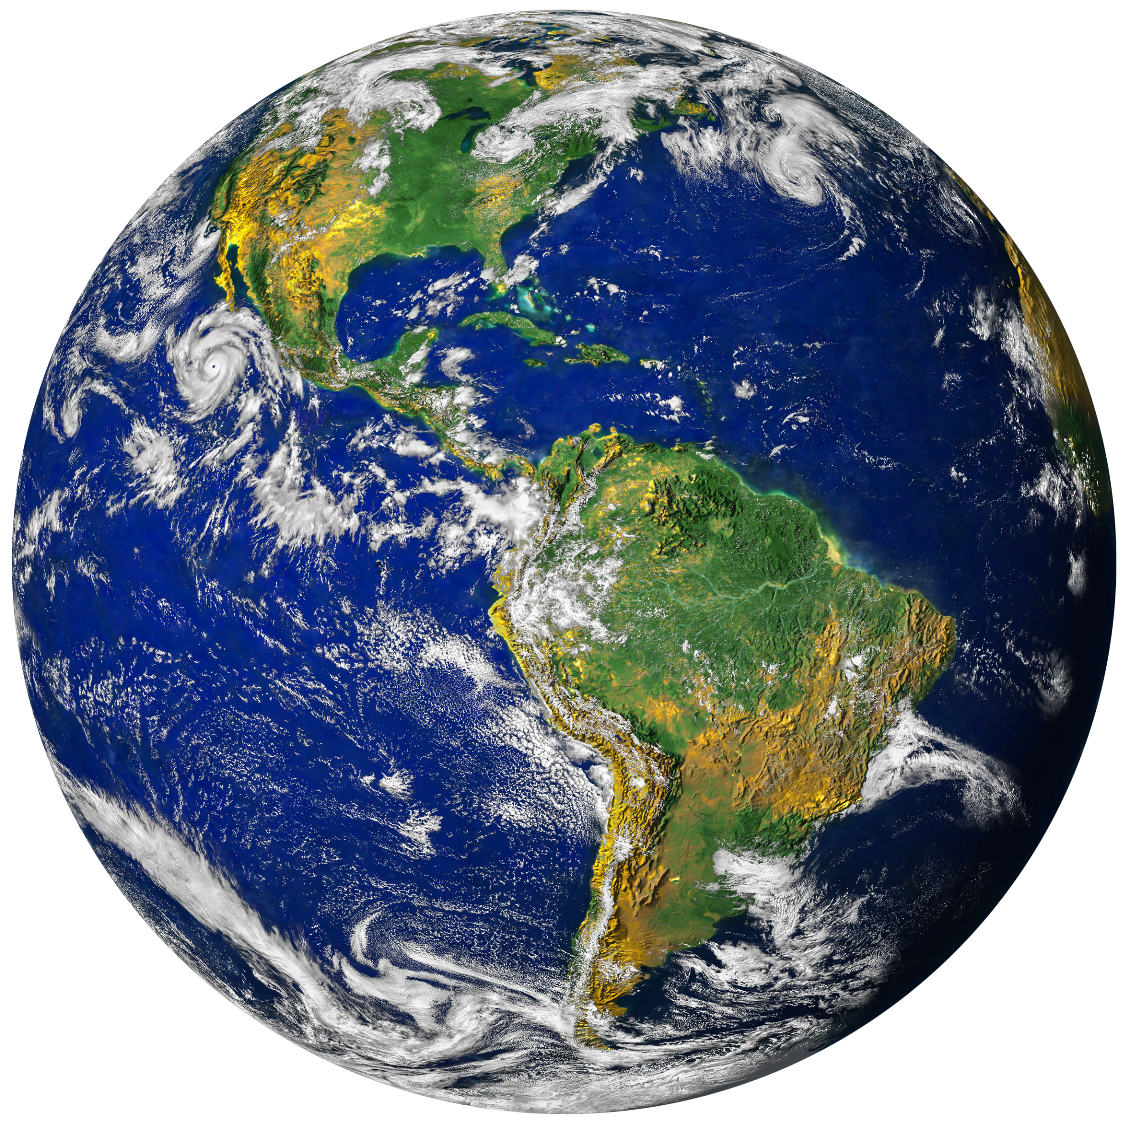
Built Environment
Warming Arctic
Wildfires
Biofuels
Marine Plastics
Oil Spills
Extraterrestrial
PFAS

Slide 6
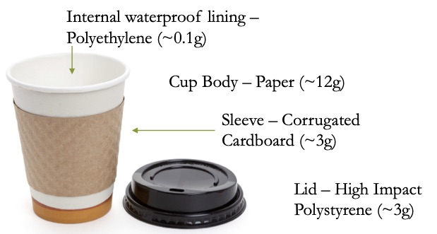
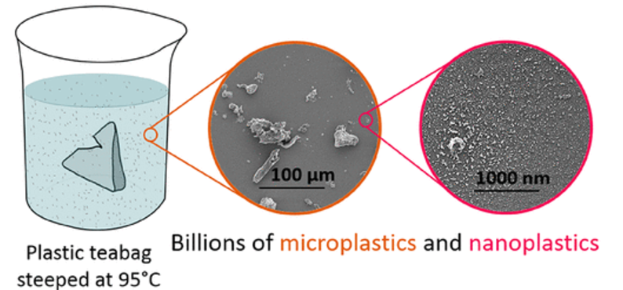
What Might Be Leaking Out of Your Teabag or Coffee Cup?
Disposable Coffee Cups
Plastic Tea Bags

Slide 7
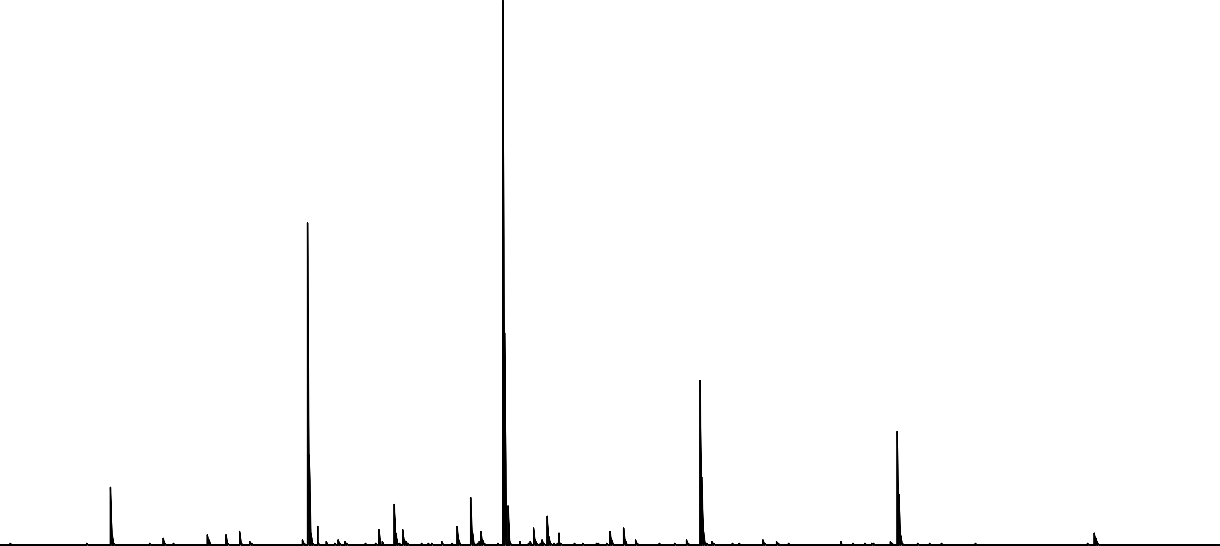
Positive ESI of Tea Bags
588.4095406
475.3254766
701.4936046
814.5776686
362.2414126
927.6612851
300
400
500
600
700
800
900
1,000
m/z

Slide 8
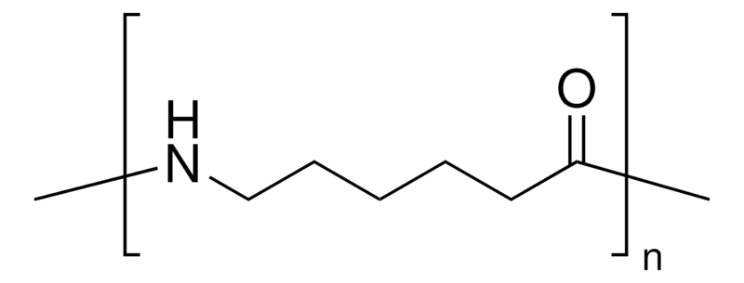
Positive ESI of Tea Bags
588.4095406
Nylon 6
475.3254766
113.0840640
C₆H₁₁N₁O₁
701.4936046
814.5776686
362.2414126
927.6617325
300
400
500
600
700
800
900
1,000
m/z

Slide 9

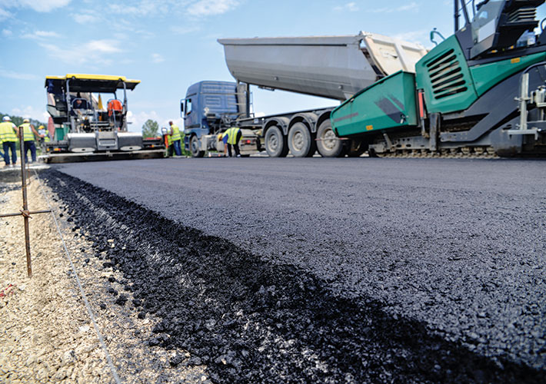
What Might Be Leaking Off Your Roof?
Asphalt / Bitumen Derived Products (Roof shingles)

Slide 10
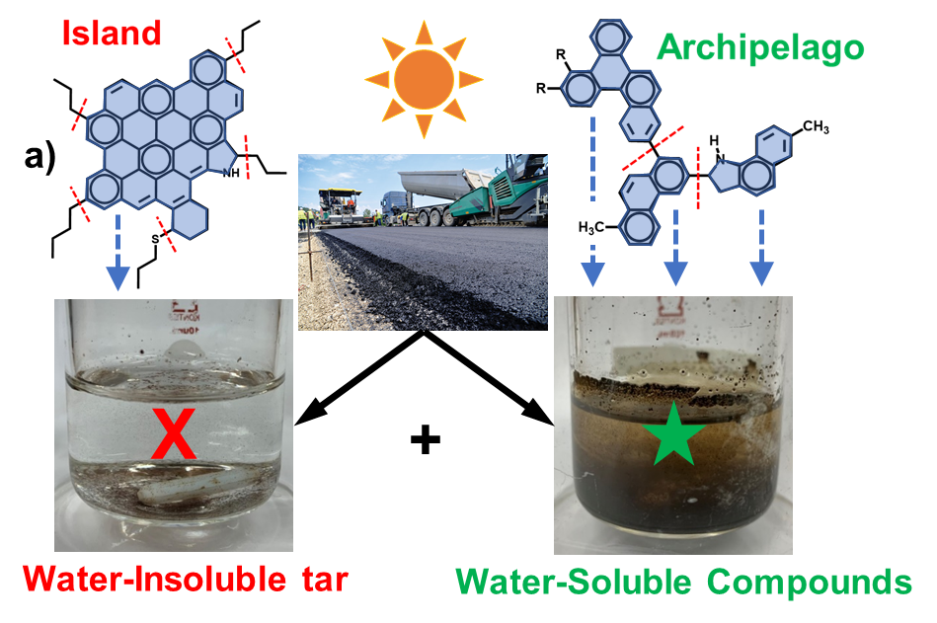
Emerging Environmental Contaminants
Emerging Contaminants from the Built Environment:
Structural Dependence
Structure correlates to weathering behavior.
Notes:
300 million tons per year. The analysis of the water revealed…

Slide 11

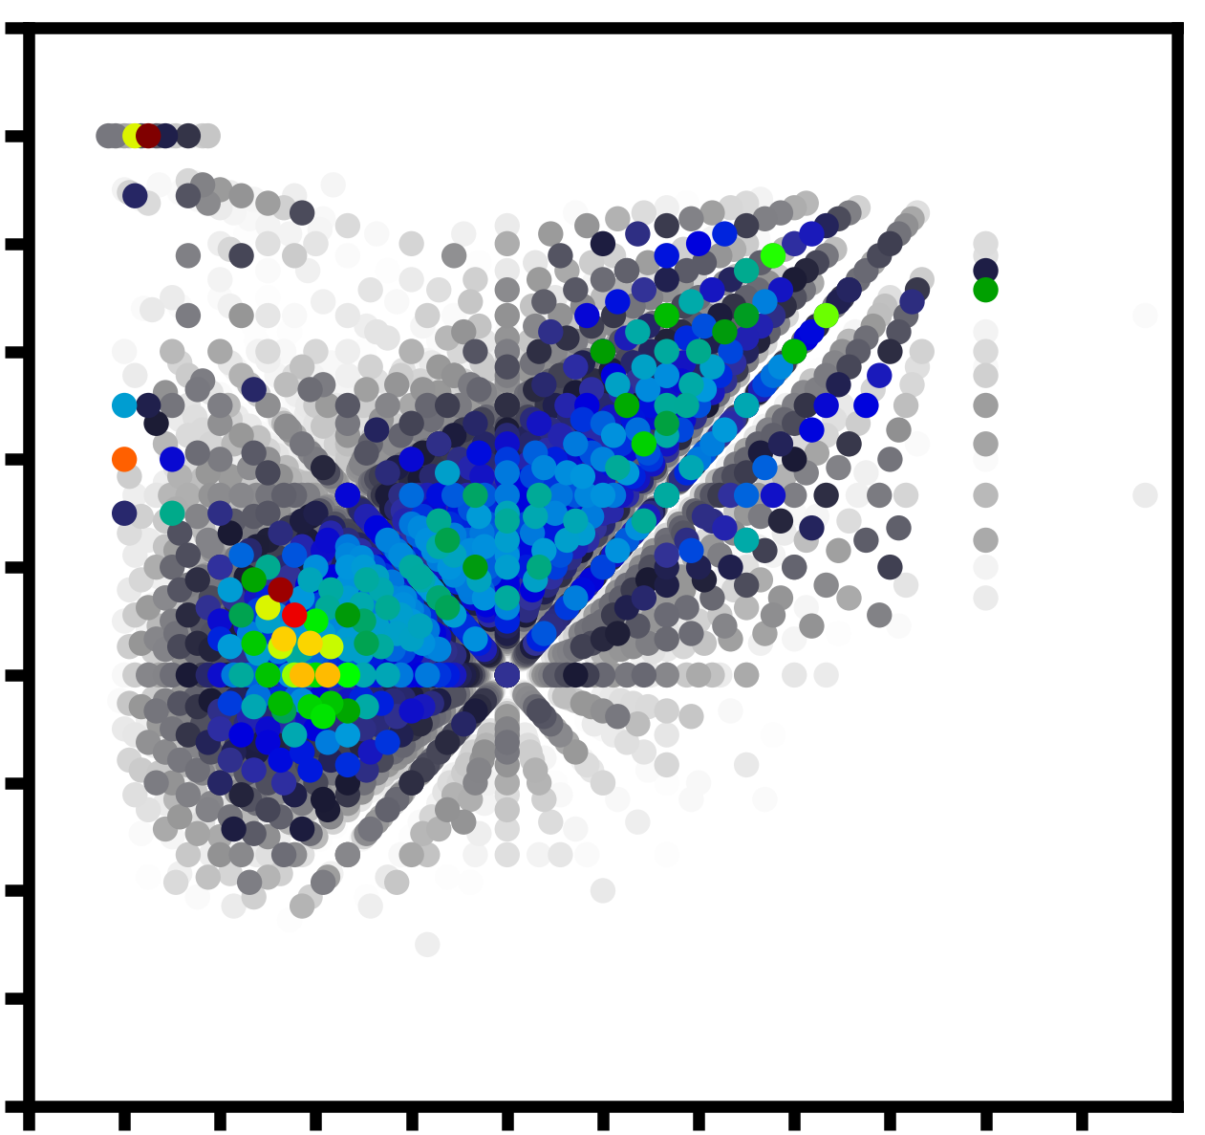
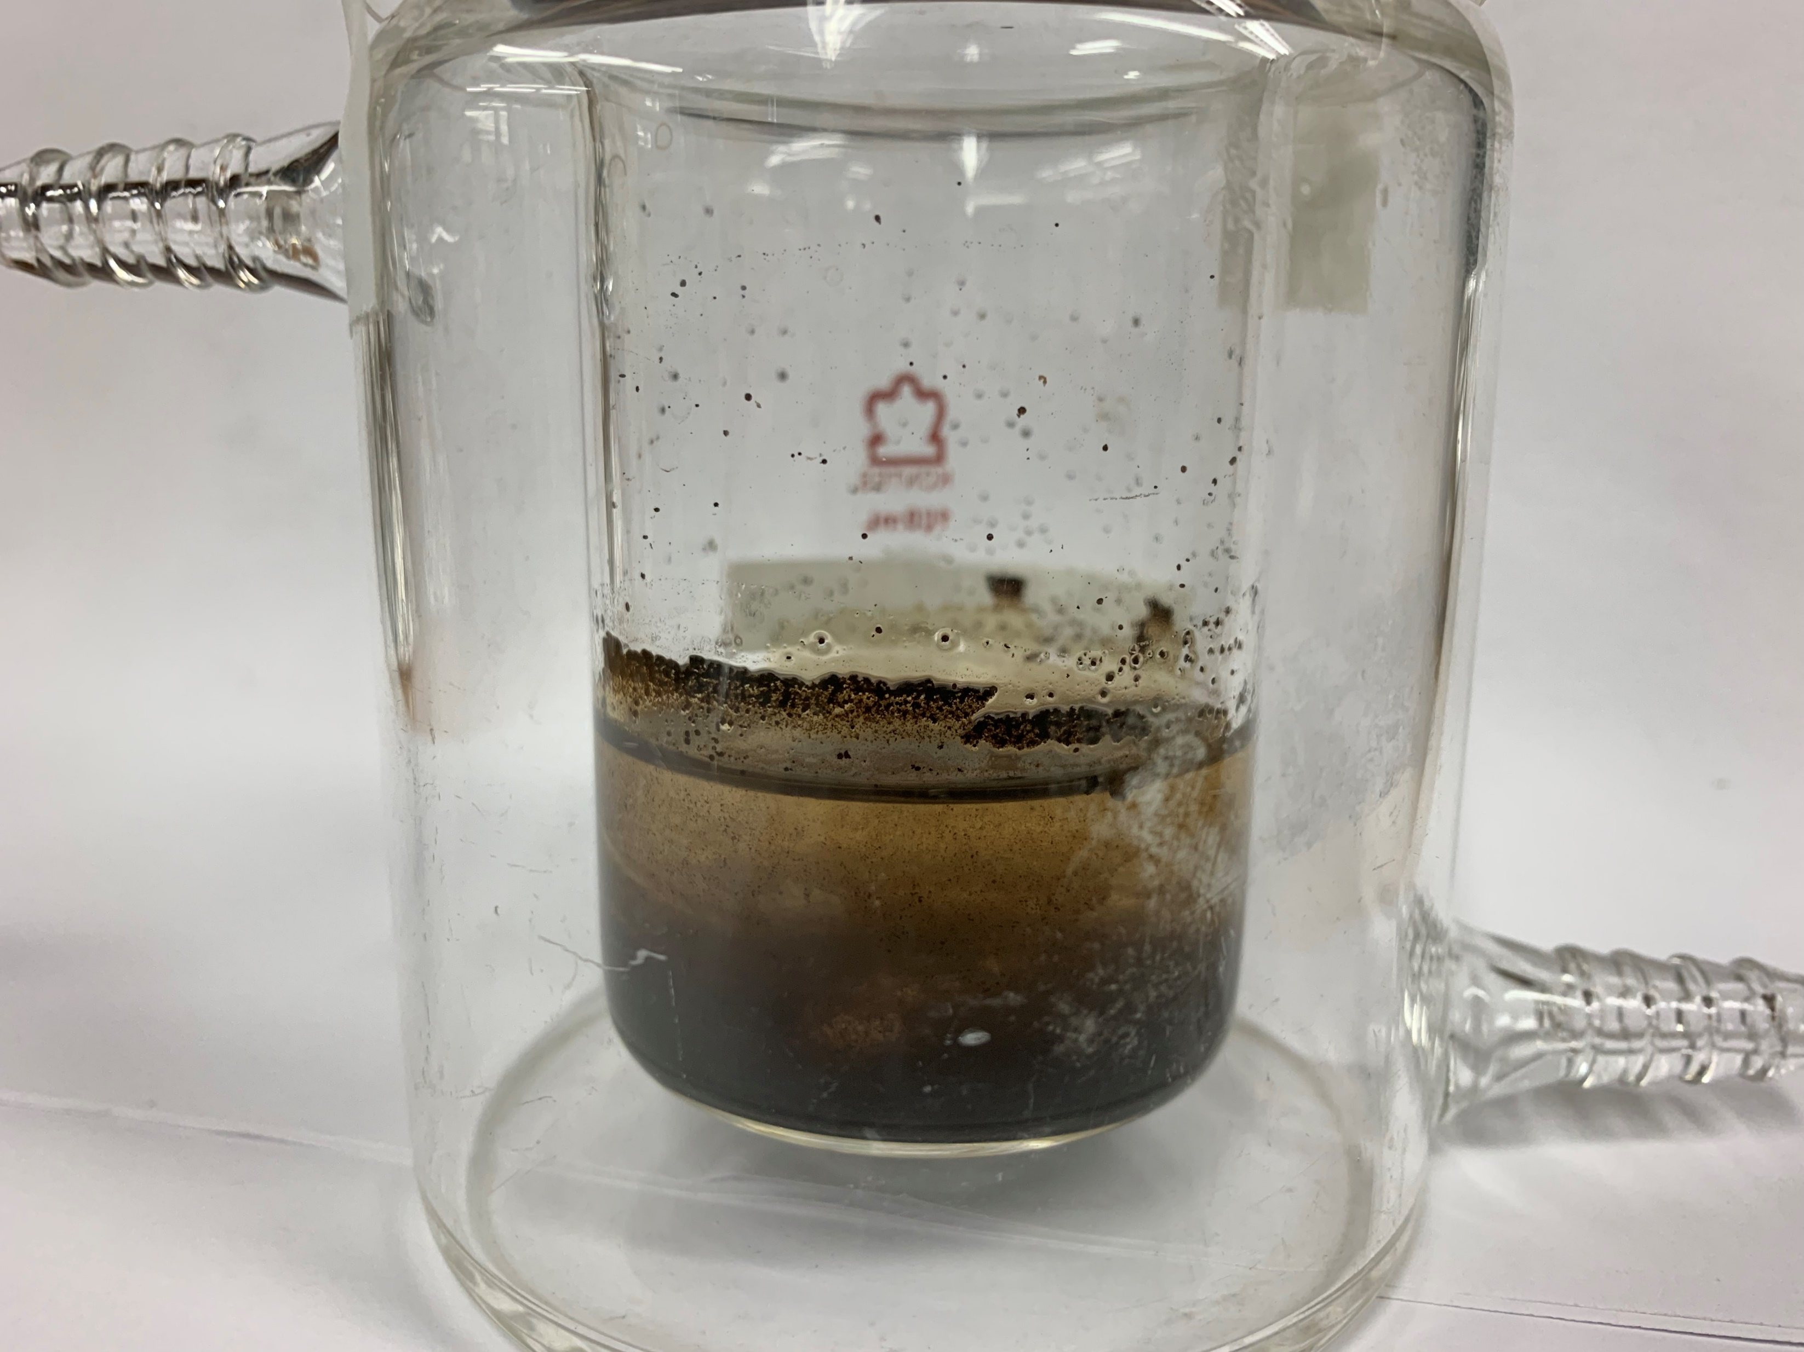
What Might Be Leaking Off Our Roads?
Each dot is a unique molecular formula!
2.2
Road Asphalt
1.8
1.4
H/C
1.0
0.6
0.2
0.0
0.2
0.4
0.6
0.8
1.0
1.2
O/C
Notes:
300 million tons per year. The analysis of the water revealed…

Slide 12
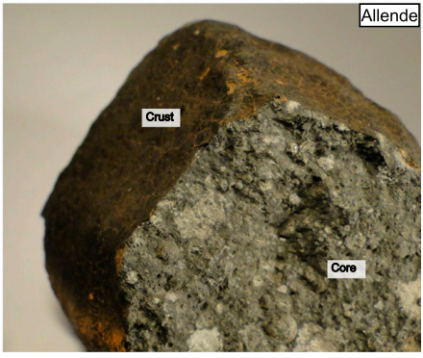
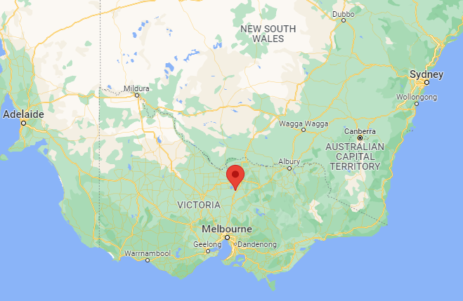
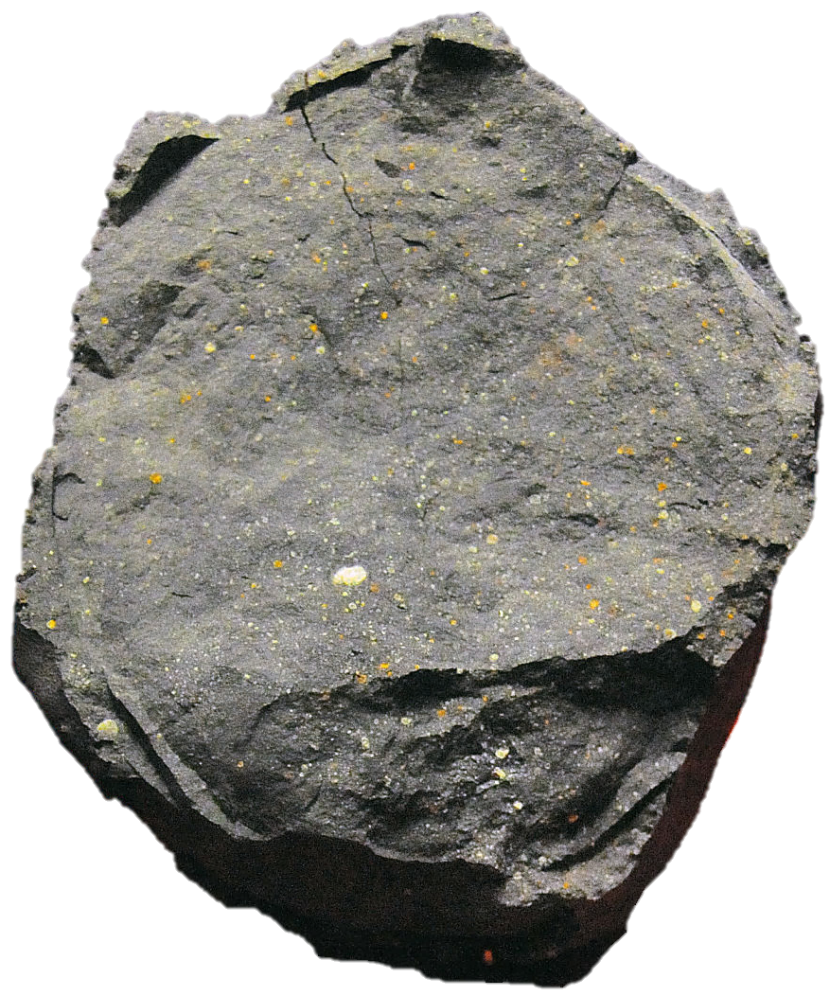
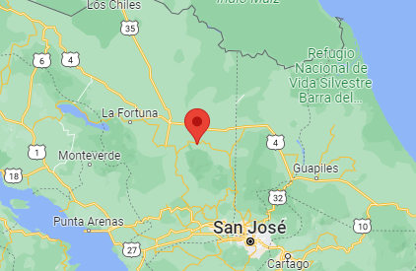
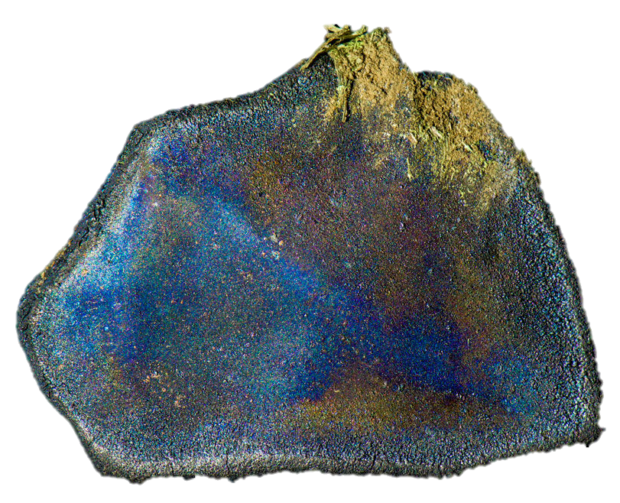
What is the Composition of Space Organics?
Murchison, Victoria
Sept 28, 1969
Crust
Core
Aguas Zarcas
April 23, 2019

Slide 13
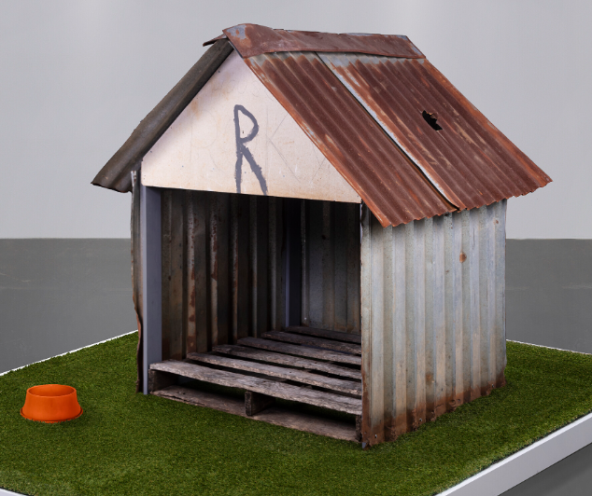
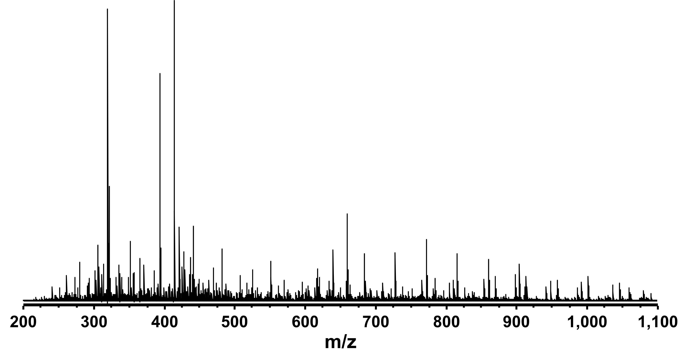
Isotopic Fine Structure
351.23802
C₁₉H₃₅O₄²⁴Mg₁
²⁴Mg | 78.99%
²⁵Mg | 10.00%
²⁶Mg | 11.01%
(+) ESI 21 T FT-ICR MS

Slide 14
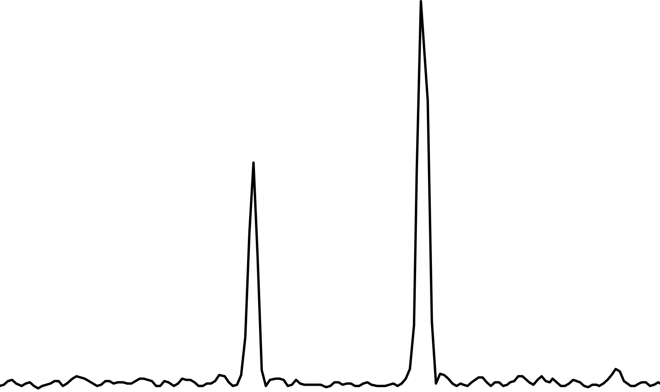
Isotopic Fine Structure
351.23802
C₁₉H₃₅O₄²⁴Mg₁
1.00080 Da
352.23882
C₁₉H₃₅O₄²⁵Mg₁
Theoretical (IsoPro)
²⁴Mg | 78.99%
²⁵Mg | 10.00%
²⁶Mg | 11.01%
¹³C₁
Measured
²⁵Mg₁
(+) ESI 21 T FT-ICR MS

Slide 15
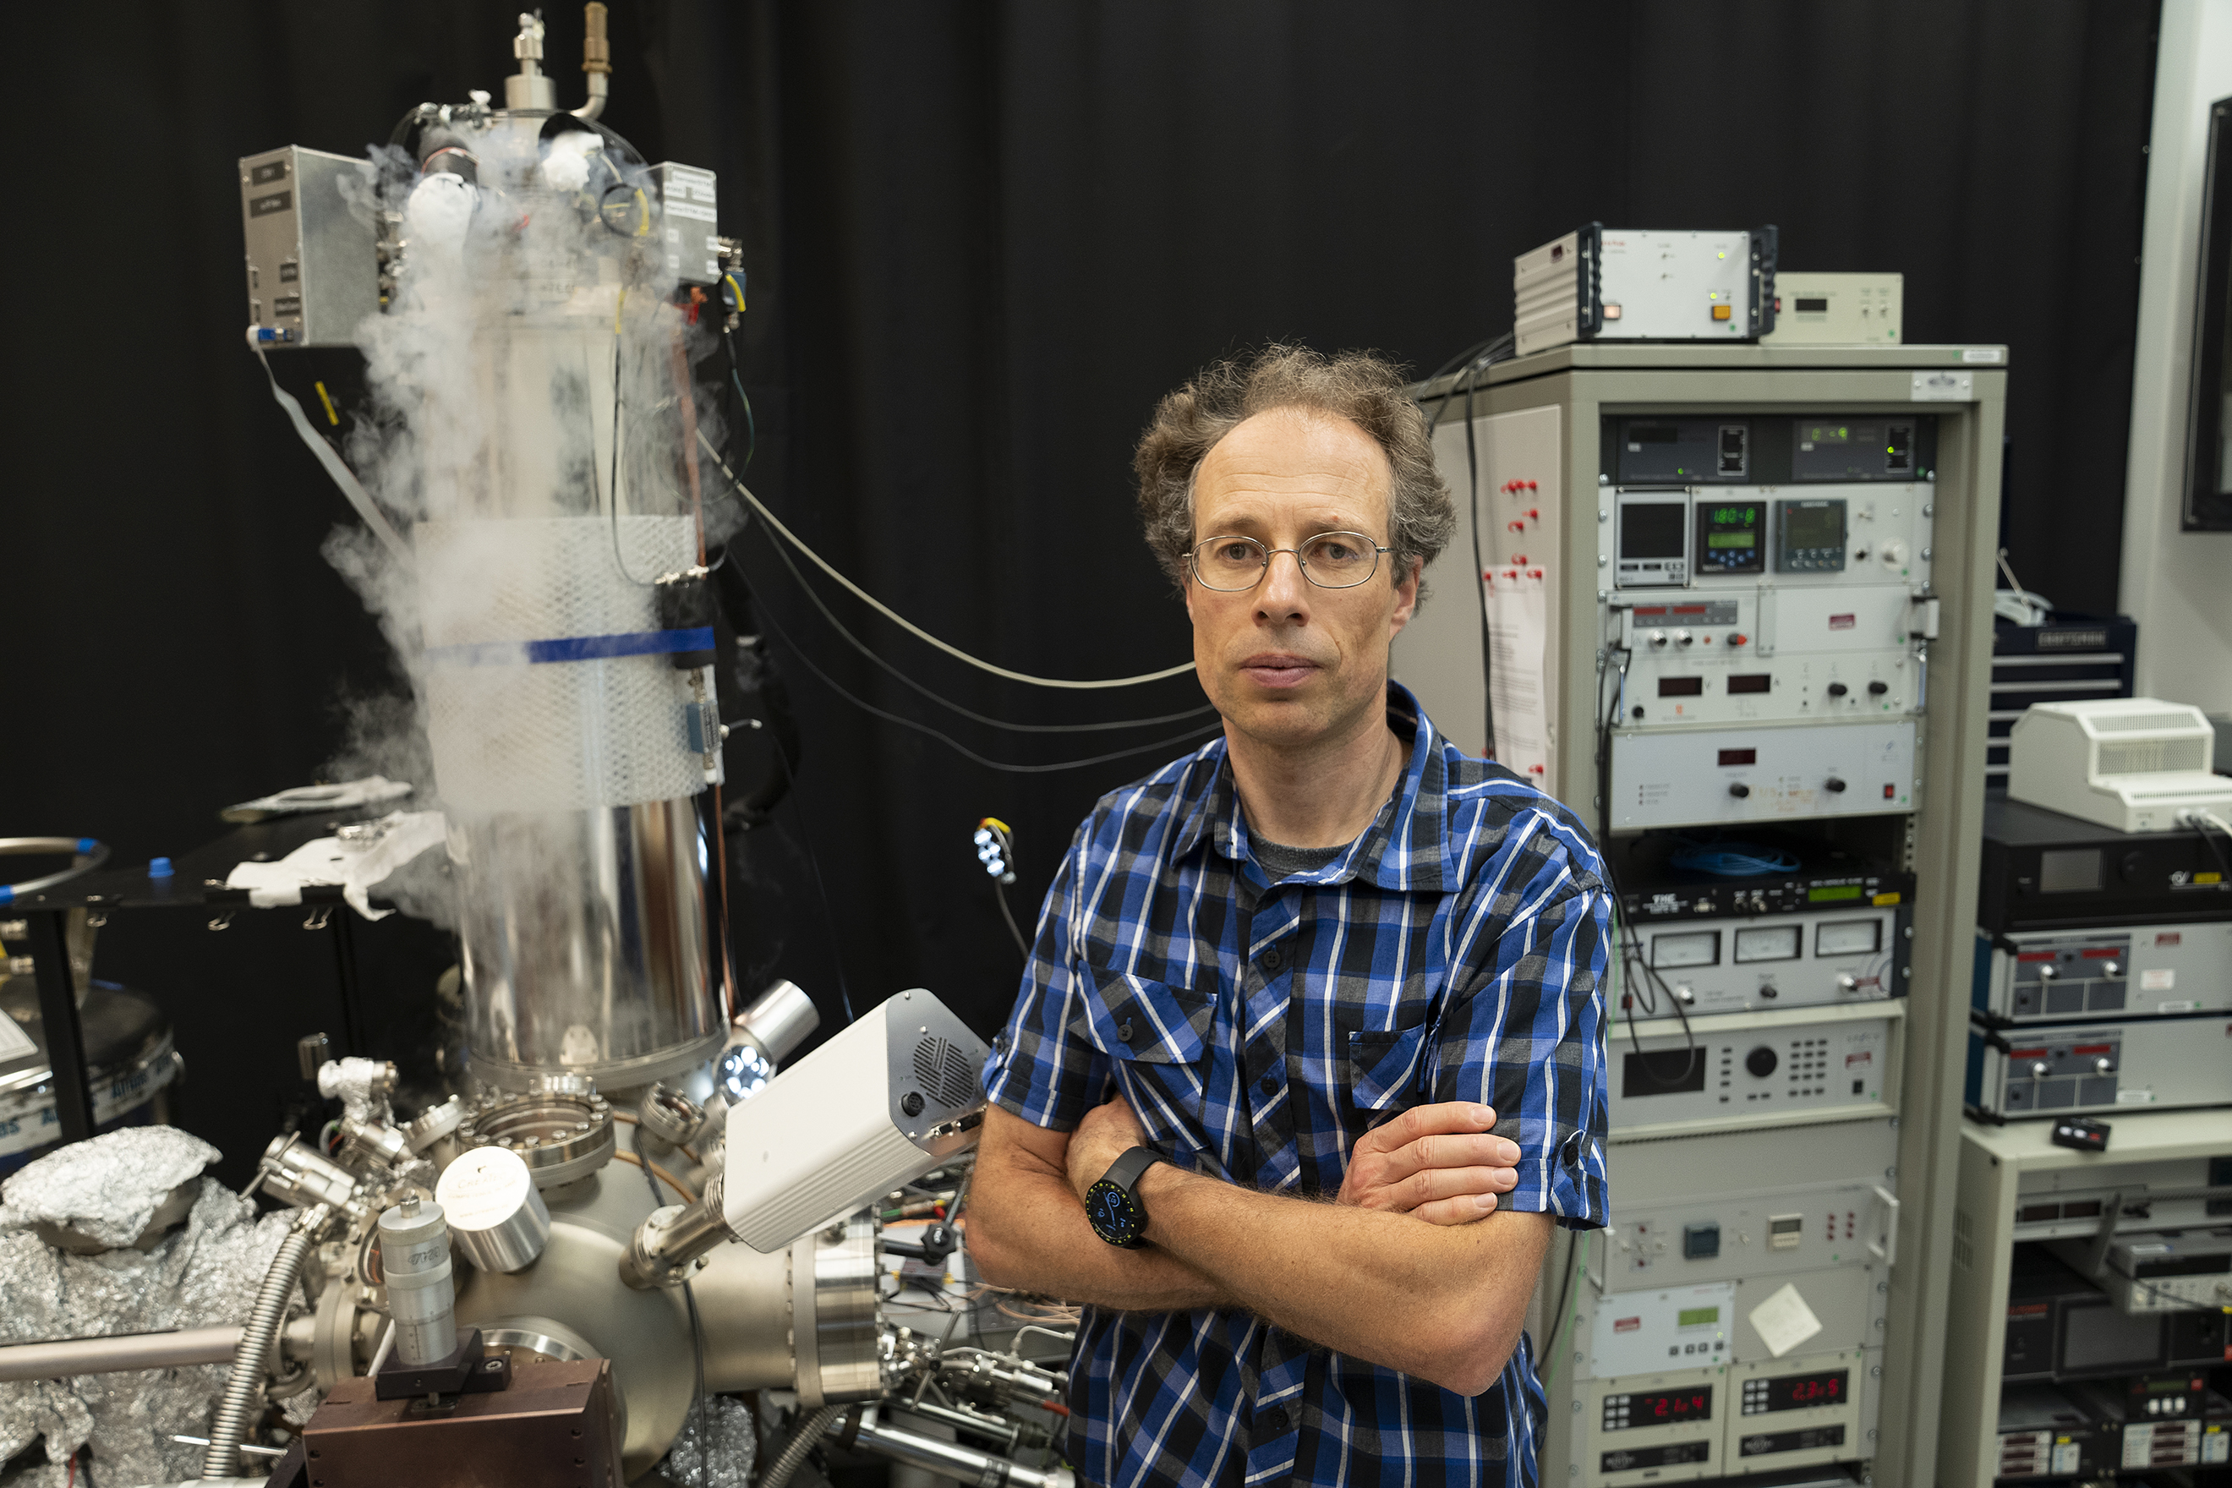
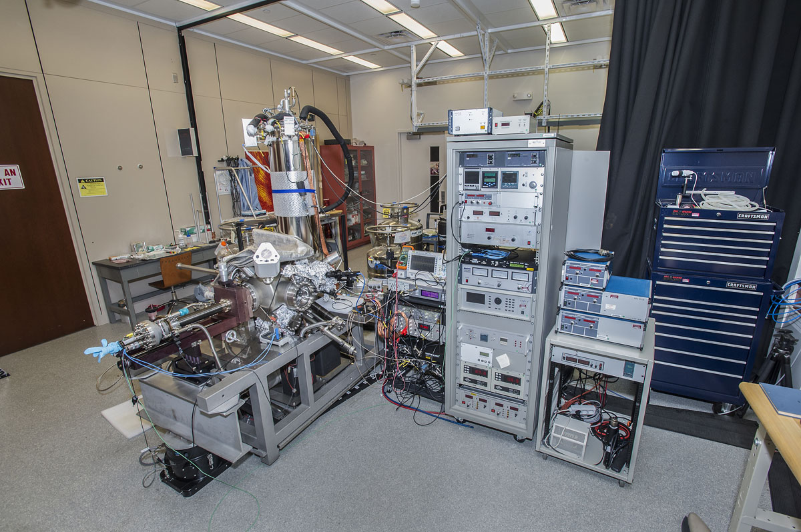
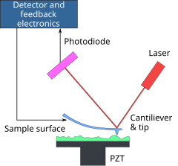
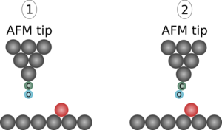

Molecular Structure
Custom-built UHV No-contact Atomic Force Microscopy
Percy Zahl
Typical AFM
NC-AFM

Slide 16


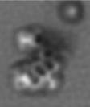
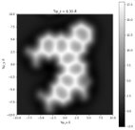
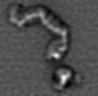

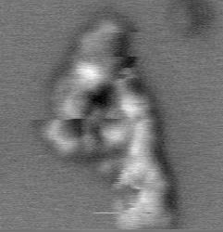

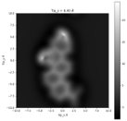
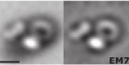



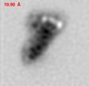
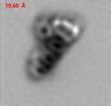
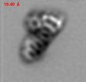
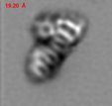
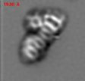
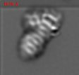
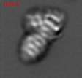
High-resolution Atomic Force Microscopy
High H/C
Low H/C
C₁₉H₃₈O₂N_{y}
C₂₀H₃₈O₃N_{y}
C₃₁H₂₄O_{x}N_{y}
R-(CH₂)_{n}-R
C₁₅H₃₂O₂N_{y}
Z-maps
Decreasing Distance
Unstable
20.80 Å
18.70 Å

Slide 17
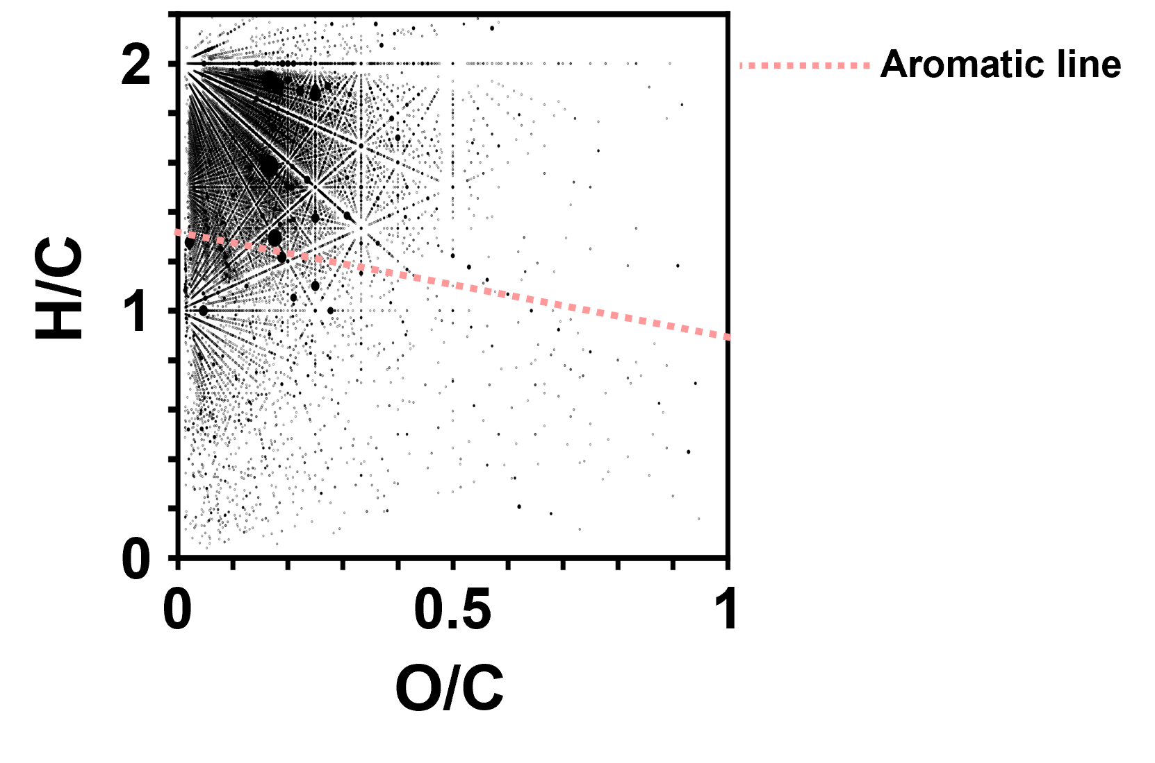
Adding Structure to Molecular Formulas

Slide 18
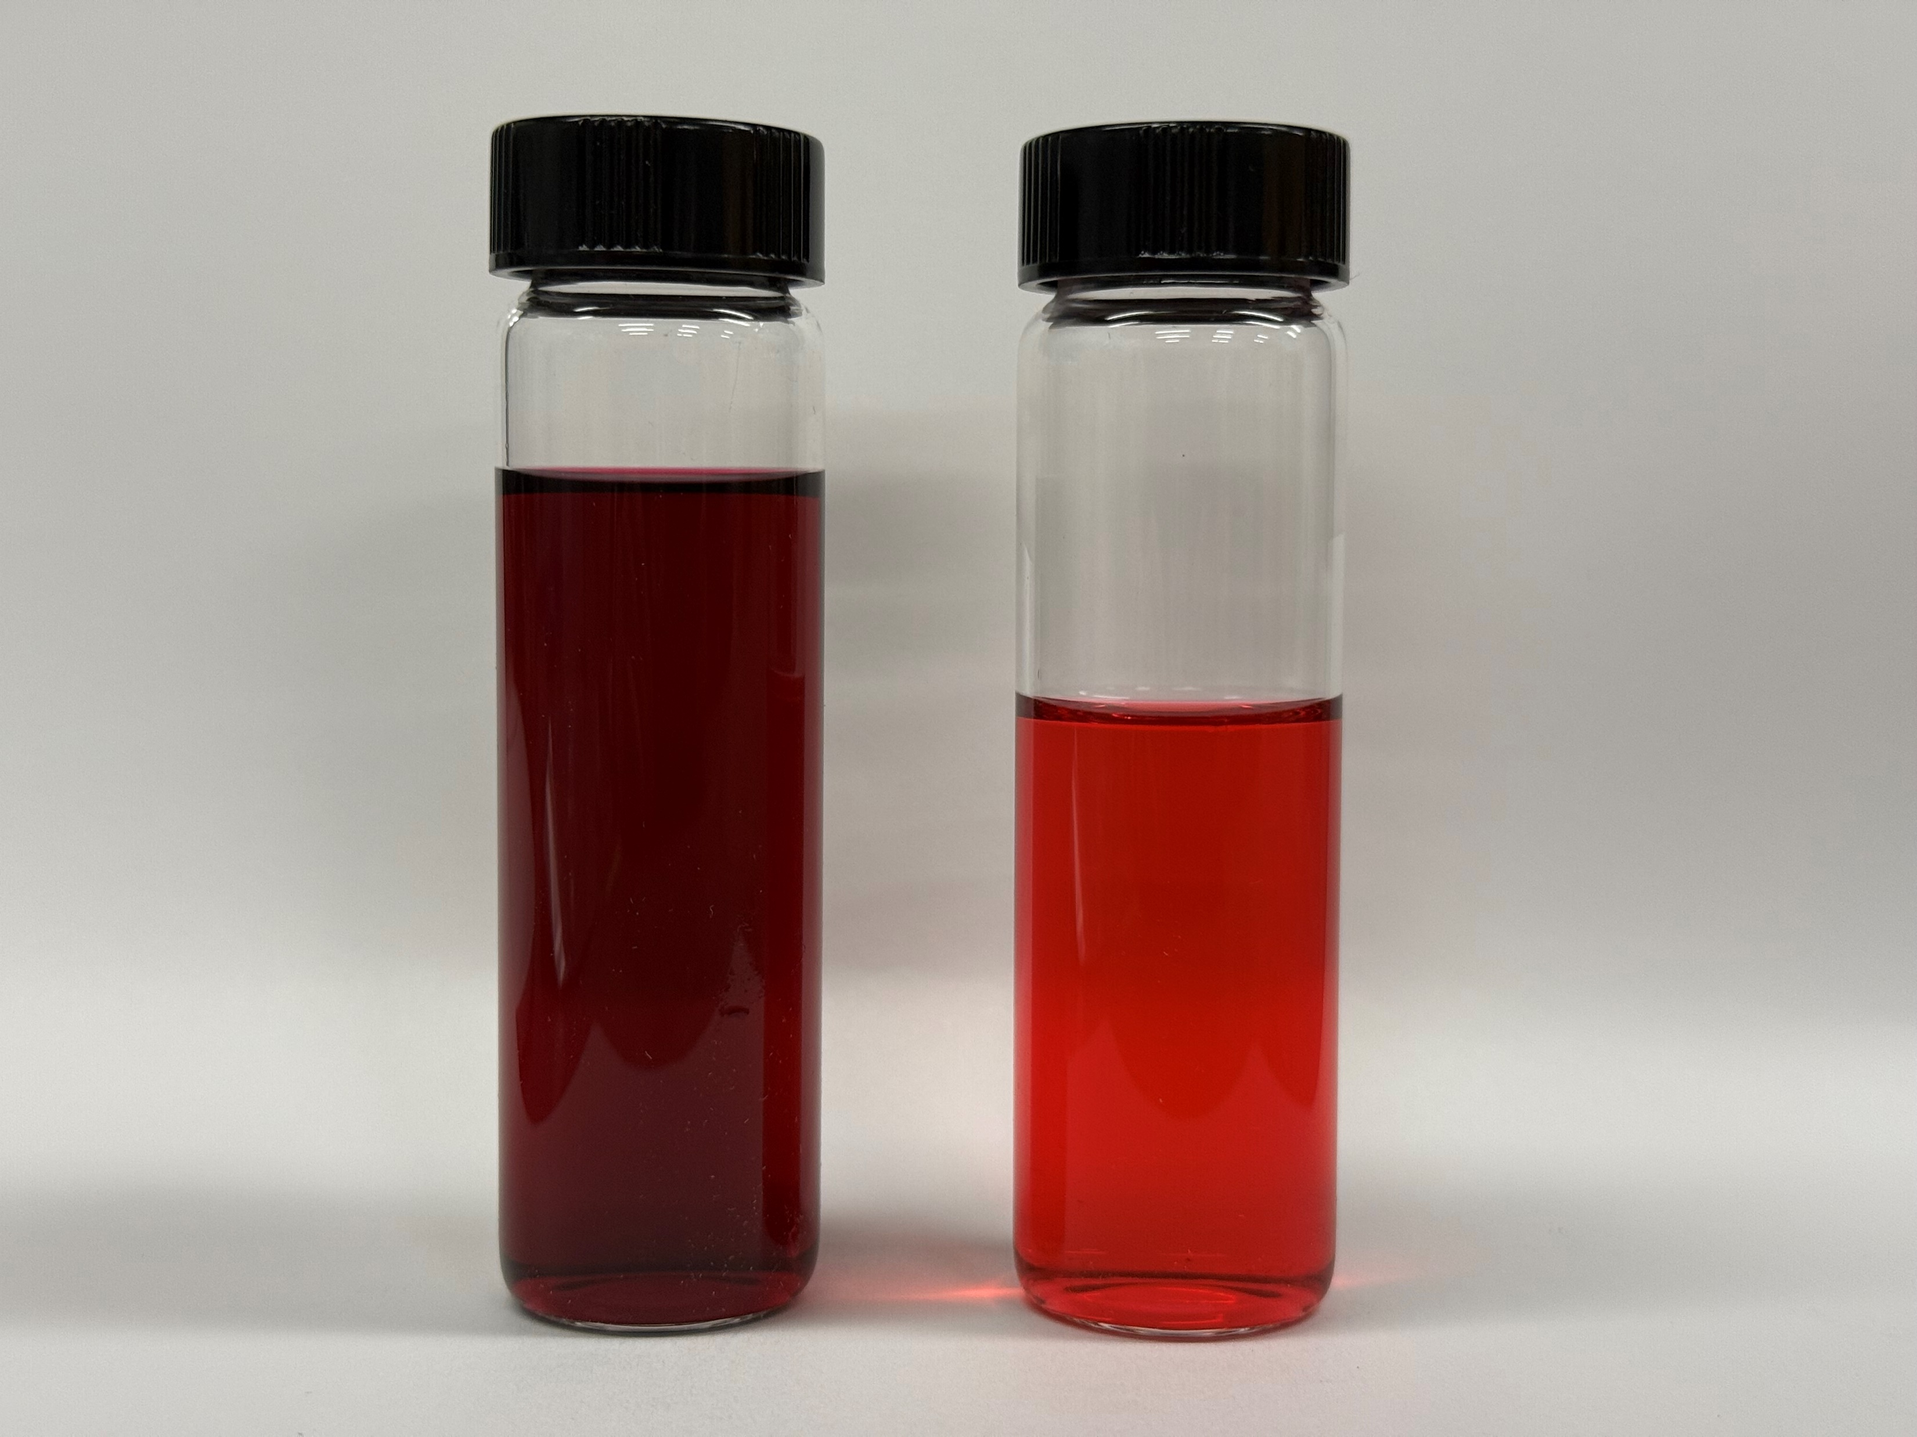
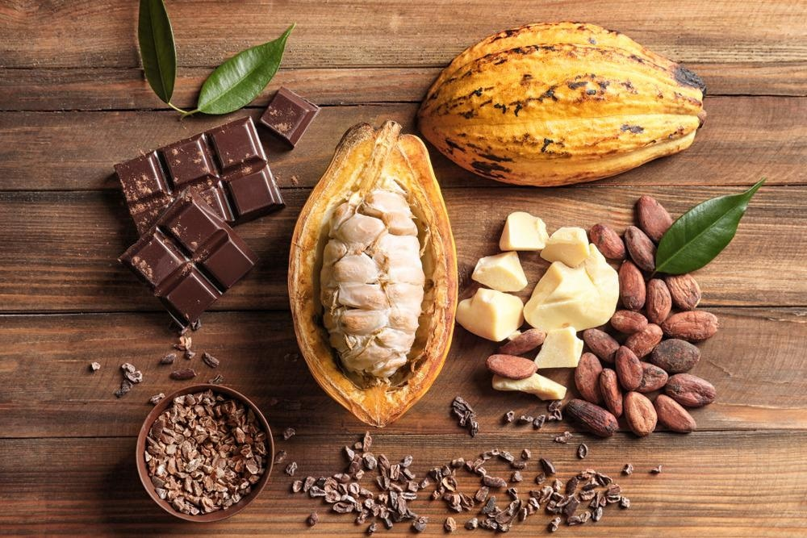

Antioxidants in Superfoods
Ultrasound Assisted Solvent Extraction of Antioxidants
Cacao or Chocolate
Raspberries

Slide 19
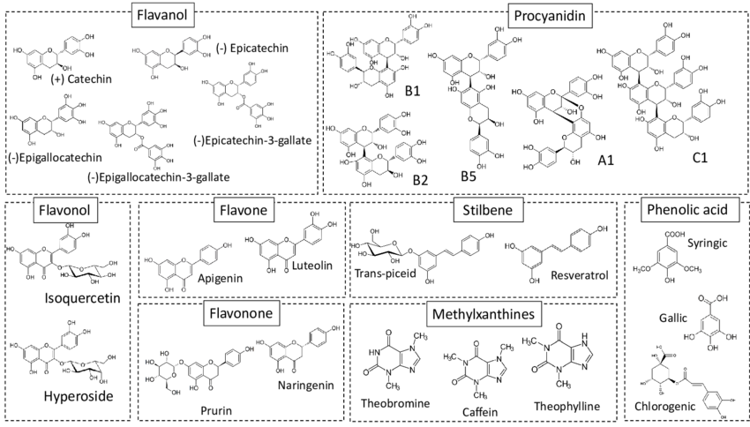
Antioxidants in Superfoods
Cacao or Chocolate
Raspberries

Slide 20

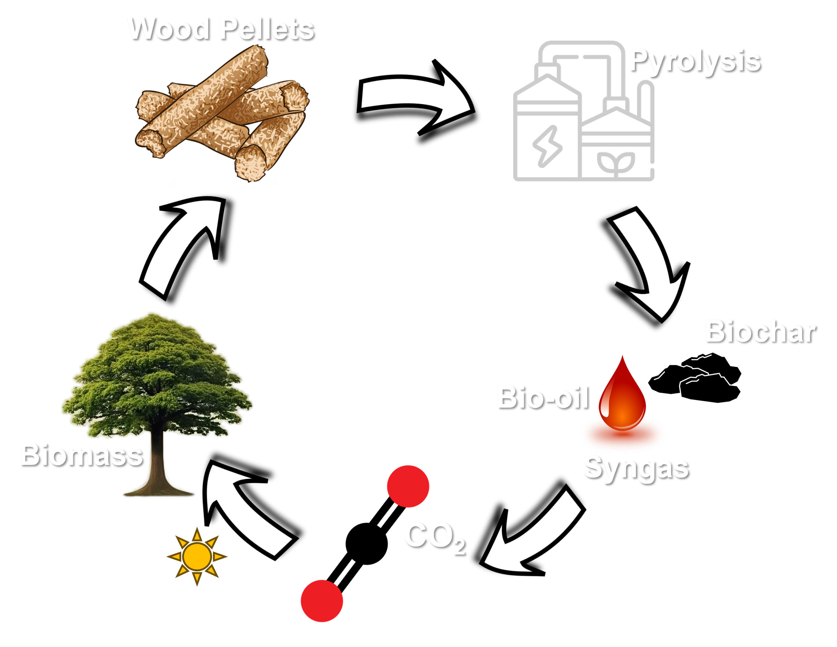
Marine Transportation Heavily Relies on Fossil Fuels
3/4 of fuel used in marine transportation is heavy fuel oil – HFO (~3.5 wt% S)
~2.5 Billion Barrels in 2019
13%
2.6%
Bio-oils from wood pyrolysis are inherently low in sulfur
NREL: Marine Fuels Research, https://www.nrel.gov/transportation/marine-fuels
Nature Communications volume 12, Article number: 1698 (2021)

Slide 21
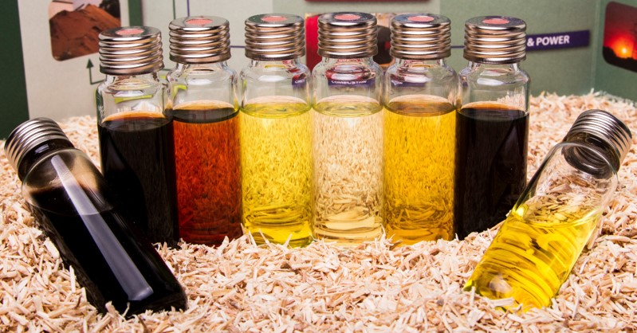
Biofuels: Push for SAF

Slide 22
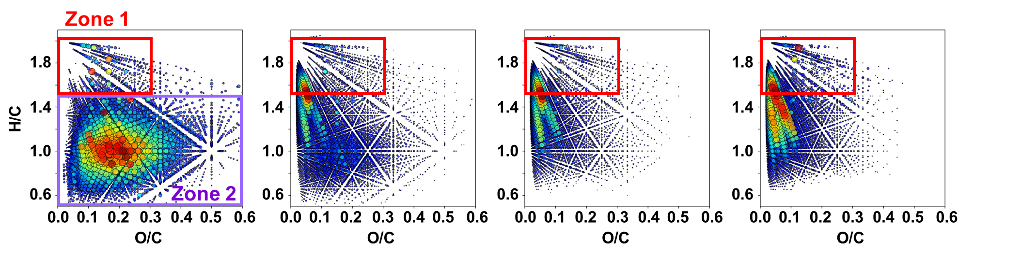
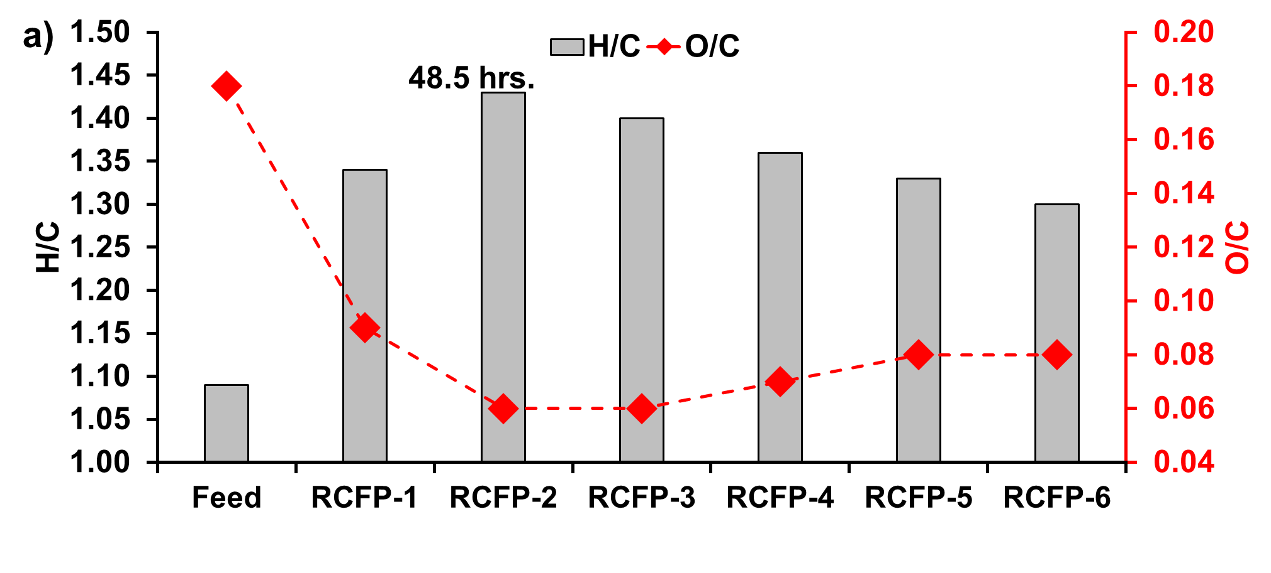
Molecular Changes as a Function of Process Run Time
Feed
RCFP-1
RCFP-2
RCFP-3
Catalyst Deactivation Begins

Slide 23




Fate and Impacts of Plastic in the Ocean
Collin Ward & Anna Walsh
Marine Chemistry & Geochemistry
Woods Hole Oceanographic Institution
OCE-1828581
OCE-1841092

Slide 24
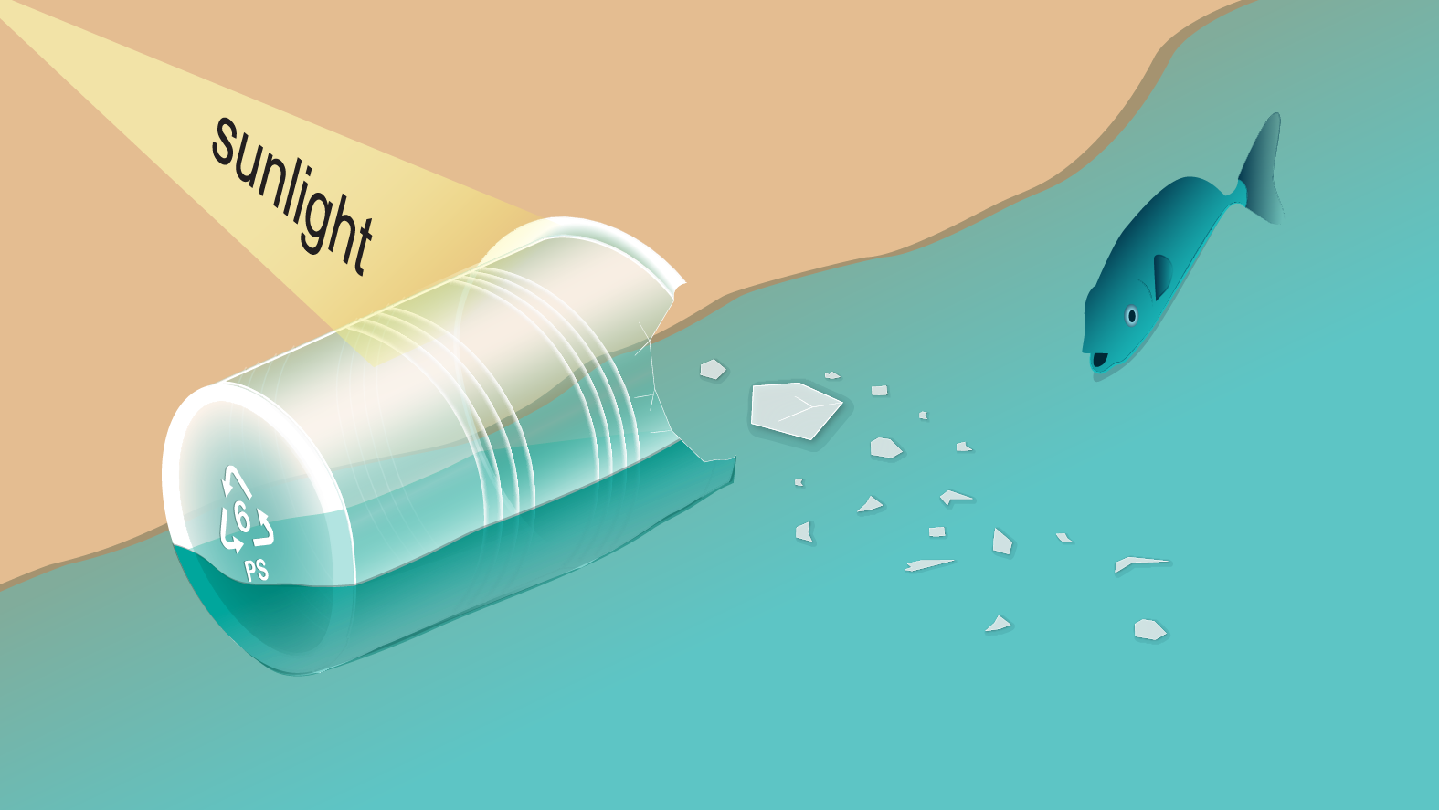
Chemical Characterization of Marine Plastic Partial Photochemical Oxidation by FT-ICR MS at 21 Tesla
Old View: Sunlight = Macro → Micro
“Plastic fragments will have similar structural properties as larger items of the same polymer.”
Chemical Characterization of Marine Plastic Partial Photochemical Oxidation by FT-ICR MS at 21 Tesla
GESAMP 2019

Slide 25
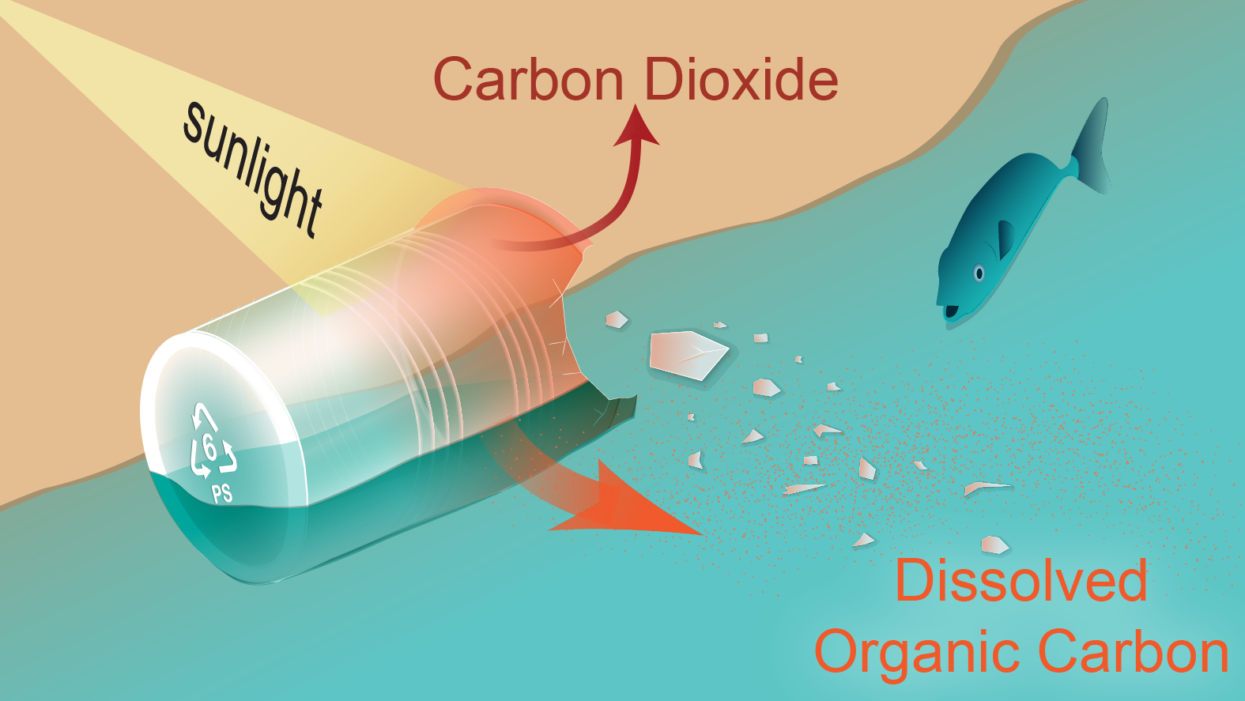
Chemical Characterization of Marine Plastic Partial Photochemical Oxidation by FT-ICR MS at 21 Tesla
Chemical Characterization of Marine Plastic Partial Photochemical Oxidation by FT-ICR MS at 21 Tesla
New View: Sunlight = Physical & Chemical Fragmentation
Ward et al., 2019, ES&T Letters

Slide 26
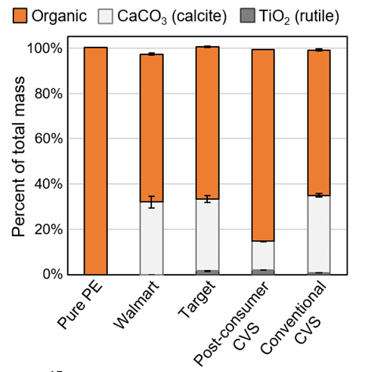
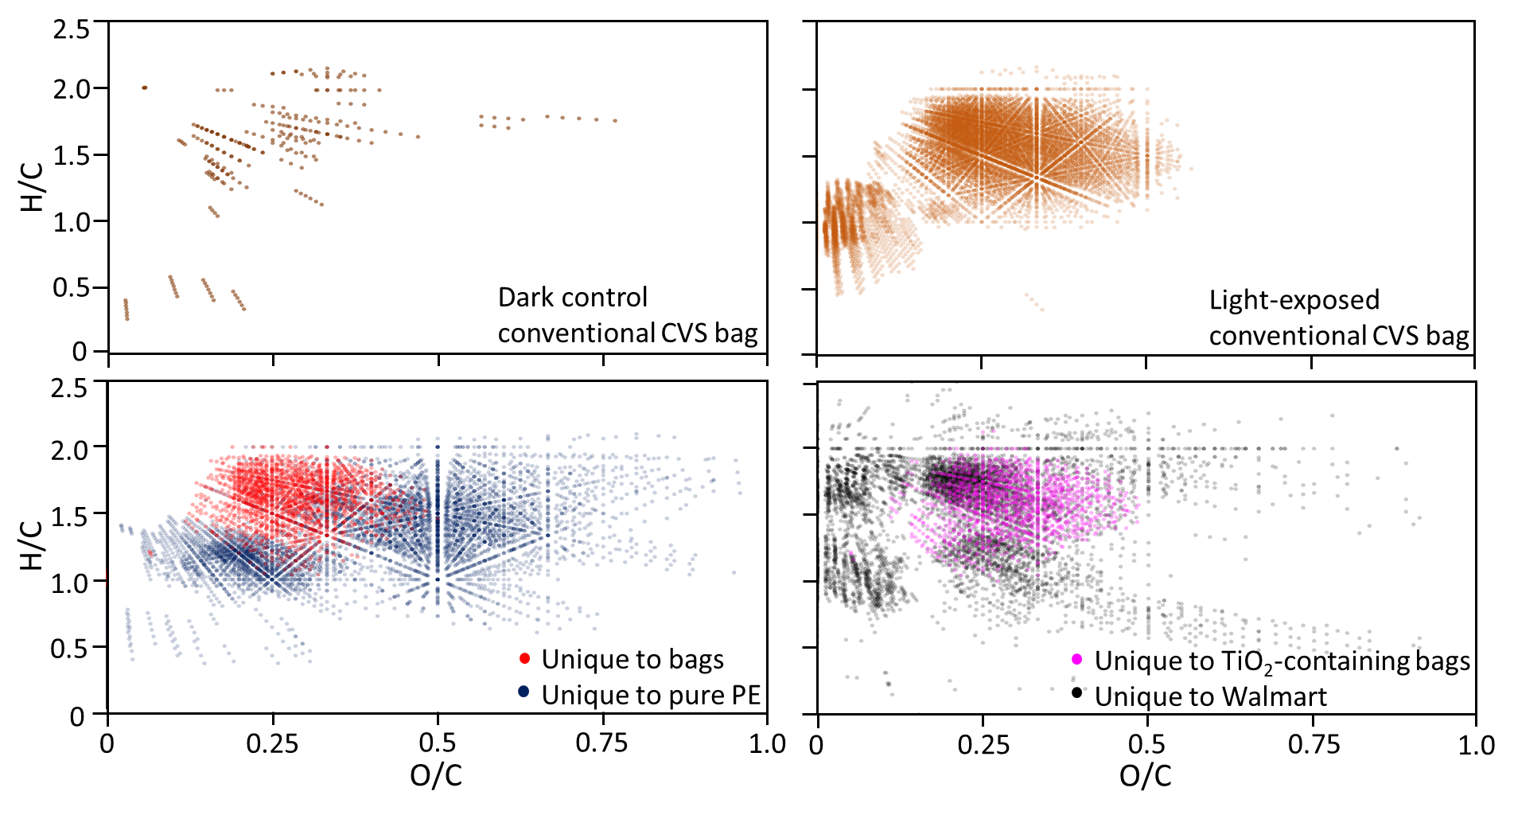
Plastic Formulation Governs the Composition of Water-Soluble Photo-products
Light-exposed: >13,000 unique peaks assigned vs. dark control
Notes:
Even more interesting is how the formulations of the plastic influenced the composition of the DOC generated by sunlight.
Using XRD and ICP-MS, we found that on average about 1/3 of the consumer plastics was inorganic additives, specifically calcium carbonate and titanium dioxide.
Tio2 is actually a photo-catalyst, leading us to the hypothesis that these inorganic additives controlled the composition of the DOC generated photochemically. We confirmed this hypothesis experimentally. In this VK diagram, I’m showing you red formulas produced by sunlight and detected only in the consumer grade materials vs. Blue formulas produced by sunlight and detected only in the pure PE.
The differences are striking.
Only 28% of photoproduced formulas from the pure PE were detected in the consumer PE treatments, telling us that plastic formulation is a key control of plastic photo-reactivity.
NEXT SLIDE Please

Slide 27
Plastic Formulation Governs the Composition of Water-Soluble Photo-products
Pure PE vs. Bag
Vendor Specific Photo-Products

Slide 28






Thank You!
rodgers@magnet.fsu.edu

